Slide 1

Monthly Matter - October 2026

Slide 2

Last month, we asked you to think about your rights and create a charter.

Slide 3
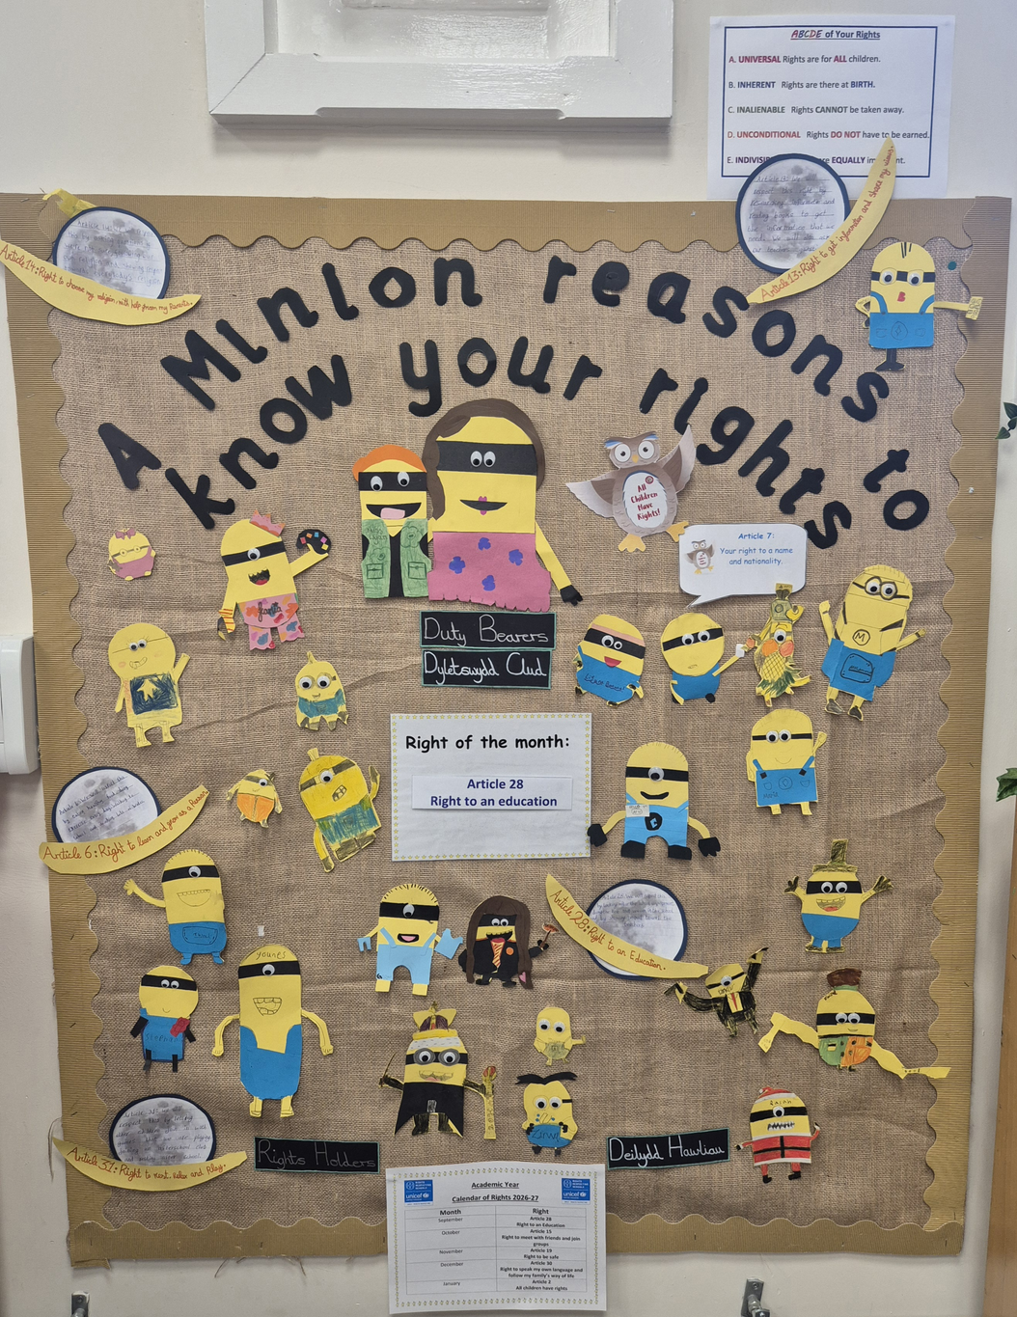
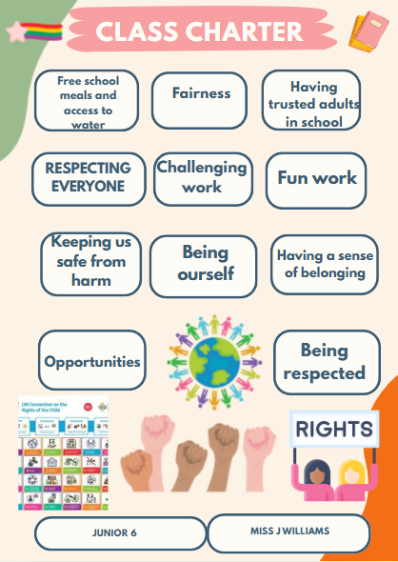
A big diolch to everyone who took part, here are some charters that were sent to us.
Stacey Primary School
Ysgol Heulfan

Slide 4

November’s Monthly Matter is about public transport
This topic links to many of your rights including:
  Article 28 - your right to an education
  Article 15 – your right to meet with friends and to join groups
  Article 31 – your right to play, relax and rest

Slide 5
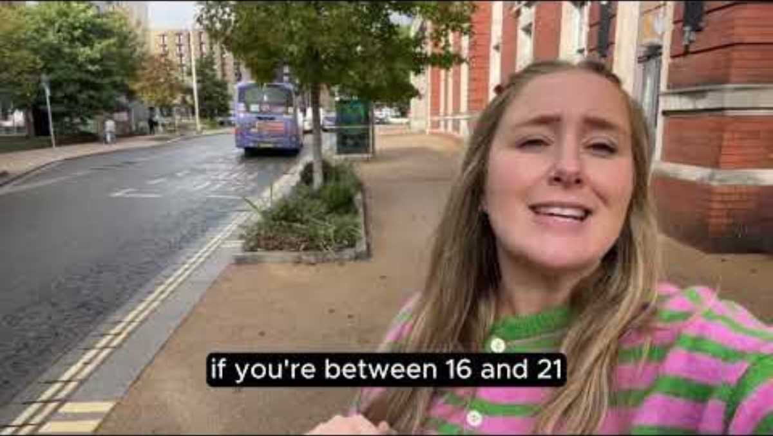
Notes:
https://youtu.be/L7B8Tf5Q-rc

Slide 6

Time to talk!
  How often do you use public transport like buses and trains?
  How reliable do you find public transport in your area?
  Had you heard about the low fare bus tickets before today?
(£1 for a single journey/£3 day ticket)

Slide 7
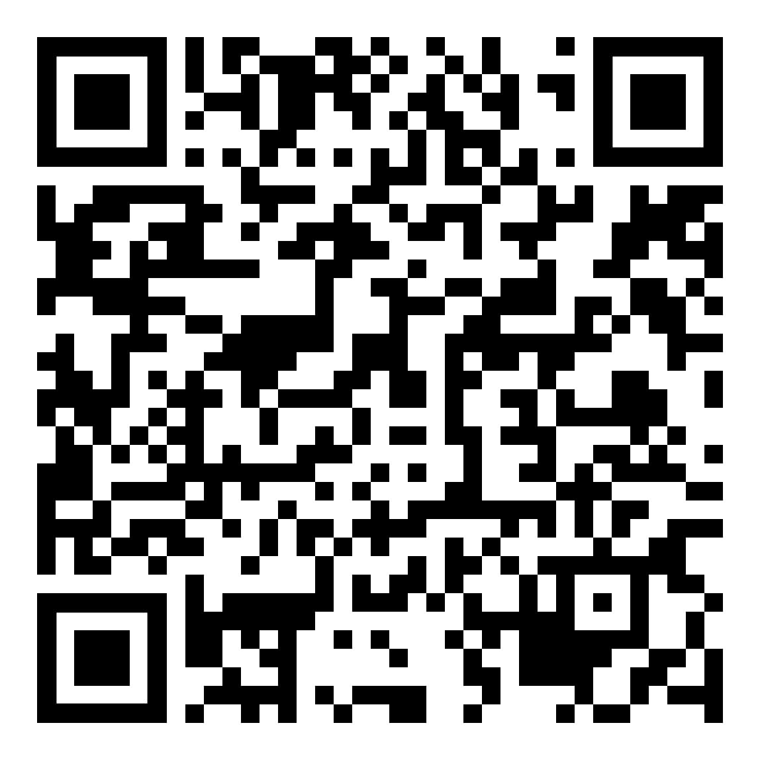
Share!
Share your ideas with us by using the QR code or survey link
(Each young person can do this individually or a teacher can do it on behalf of the class)
Notes:
Survey:

Slide 8
If you are worried about anything after today's session you should speak to a trusted adult.
You could also contact our Advice team:
0808 801 1000
advice@childcomwales.org.uk
www.childcomwales.org.uk

Slide 9
Diolch!
Our next Monthly Matter will be available on
Monday, November 2nd

