Slide 1

Monthly Matter - September 2026

Slide 2

Last month, we asked you what you thought about monthly matters.

Slide 3
Many said the like learning about their rights every month.
A big diolch for all your responses last month! We found out that...
Lots of you feel listened to and valued by taking part in Monthly Matter.
Some said they would like there to be more activities in Monthly Matter.
Lots said they would like a monthly matter on litter, the environment & recycling.
You enjoy the survey and some even wanted more questions!

Slide 4
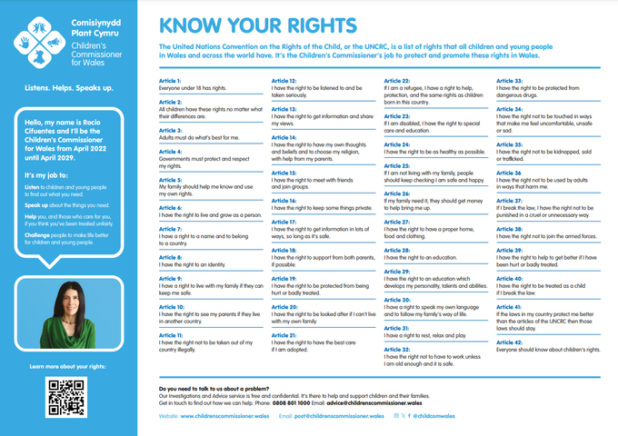

So after listening to your feedback, Monthly Matter will be changing a little. Instead of running a survey every time, we will now give you an activity to do every other month.
This month you will have a chance to think about and discuss all your rights!

Slide 5
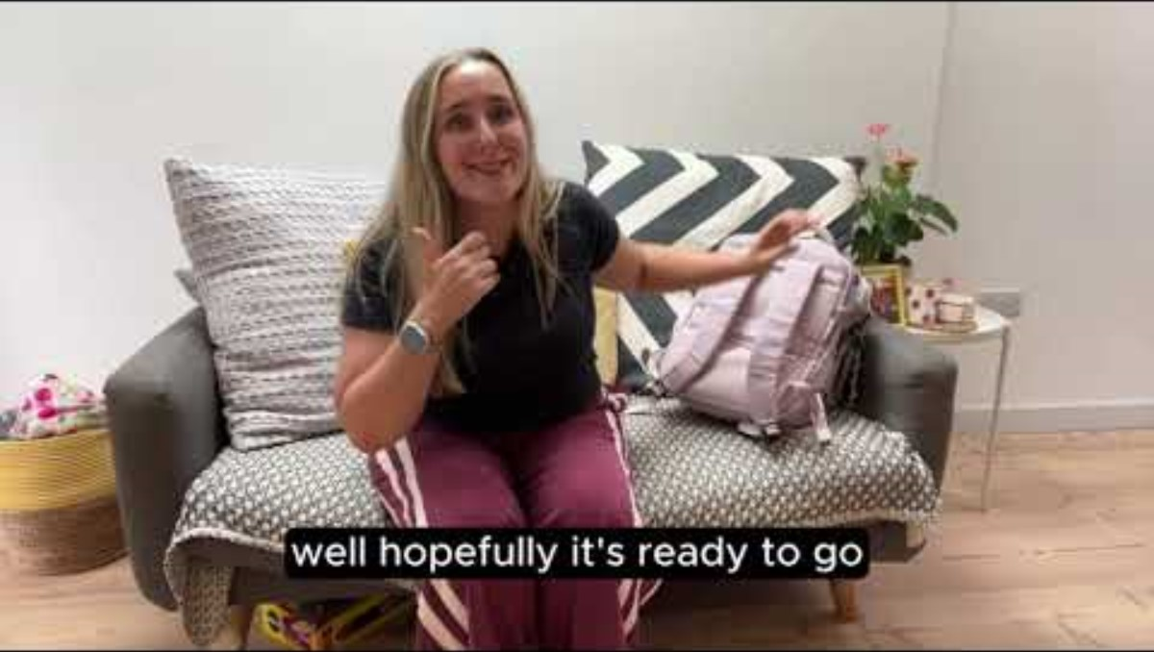
Notes:
Link to video: https://youtu.be/dWT2Kk7FI3s

Slide 6

Time to talk!
  What rights are most important to you?
  What would help everyone feel happy, healthy and safe?
  What would you like to see reflected in your school, group or setting?

Slide 7

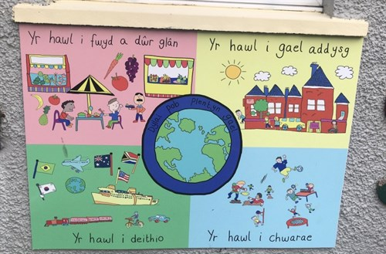
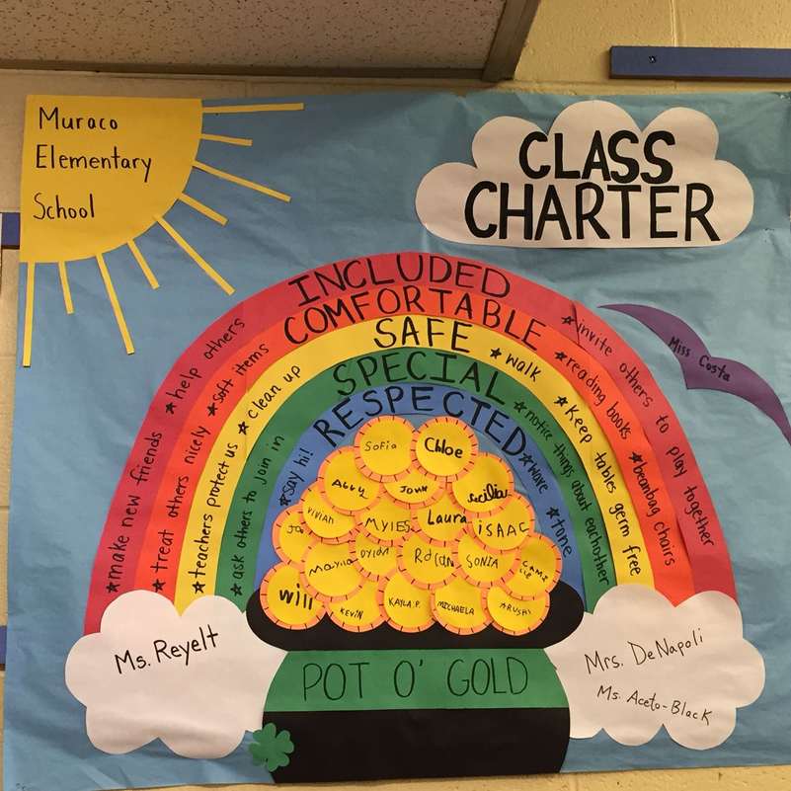
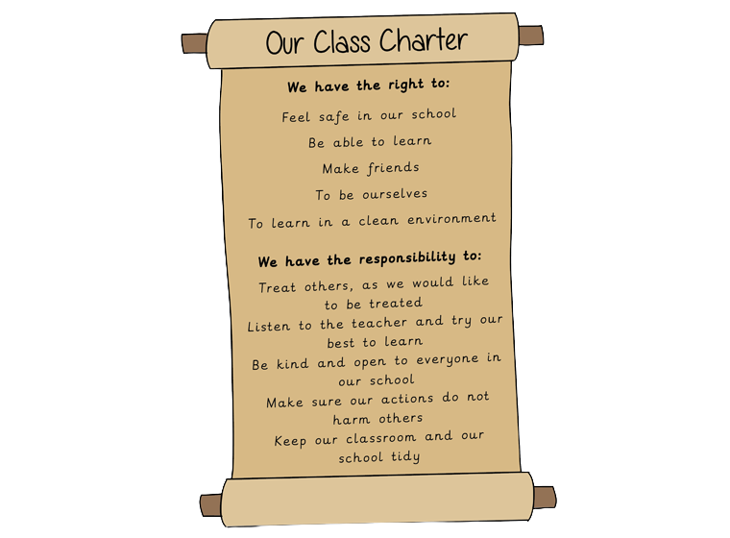
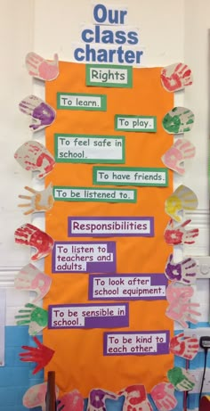
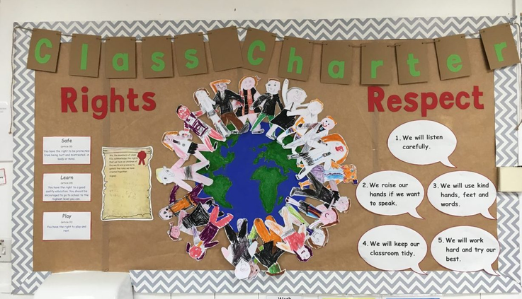

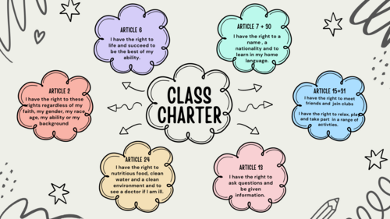

Inspiration

Slide 8
Share!
post@childcomwales.org.uk
@childcomwales
Don’t forget we’d love to see what you get up to this month - you can share pictures of your charters with us by emailing or tagging us online!

Slide 9
If you are worried about anything after today's session you should speak to a trusted adult.
You could also contact our Advice team:
0808 801 1000
advice@childcomwales.org.uk
www.childcomwales.org.uk

Slide 10
Diolch!
Our next Monthly Matter will be available on
Monday, October 5th

