Slide 1

Monthly Matter – June and July 2026

Slide 2

Last month, we asked you about Cultural activities.

Slide 3
Here's what you told us:
Most of you took part in cultural activities at school.
Lots of you said "cost" and "transport" stopped you from taking part in cultural activities.
Some of you said parents sometimes stop you going to cultural activities.
Lots of you thought that sporting activities were the most expensive.

Slide 4

June and July's Monthly Matter is all about your views on Monthly Matters

Slide 5
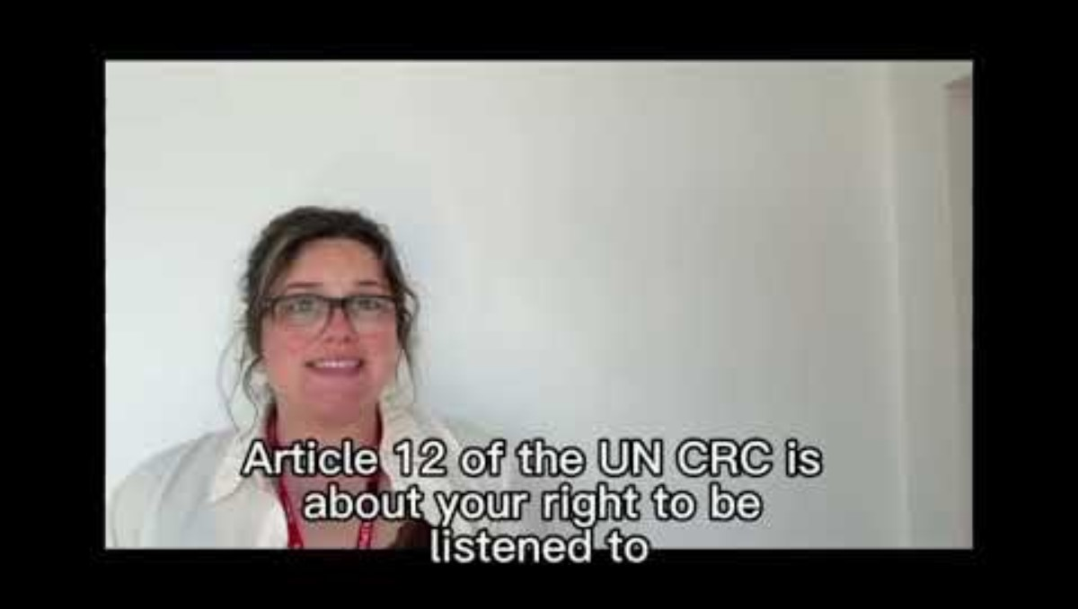
Notes:
Link to the video: https://youtu.be/idYm7SQP2zU

Slide 6
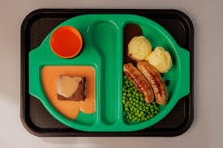




​
Your views on school dinners were shared on Newsround! It started a discussion across Wales. ​
We’ve asked a lot about online safety. We’ve used your views and shared them with decision makers.
​
We’ve asked you about the Senedd. We shared your views with the Electoral and Senedd Commission – it's going to help them raise awareness of their work.​
You told us lots about school toilets and anti-bullying. We shared your views with Welsh Government. ​
We shared all your views on transport with Transport for Wales.​
​

Slide 7

Discuss in pairs or as a group:
What do you like about Monthly Matters?
How could Monthly Matters be improved?
Are there any topics we haven't covered yet?
Notes:
There are supporting materials on our web page for children with additional learning needs

Slide 8

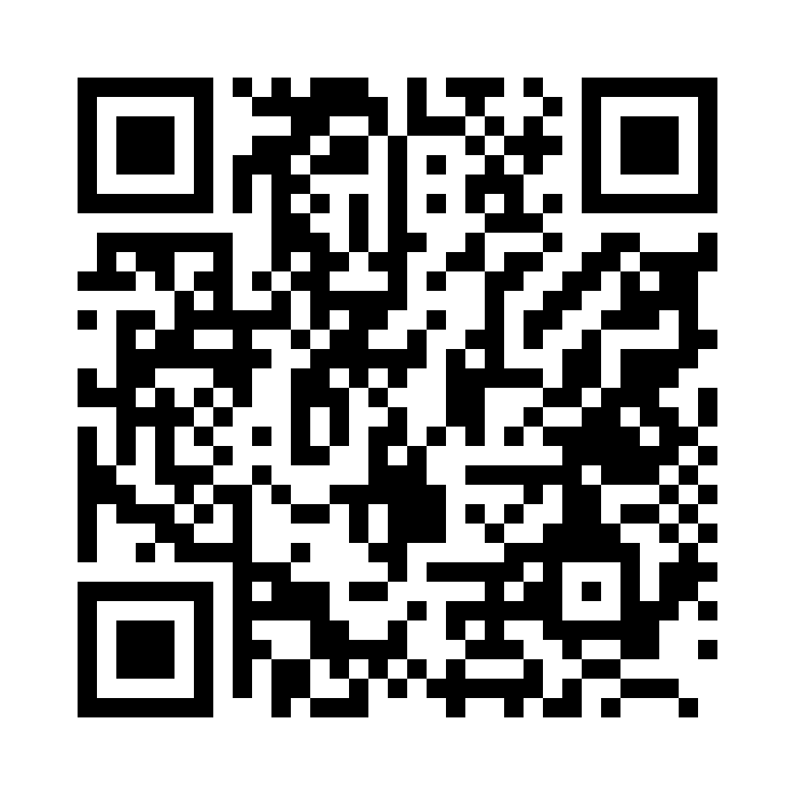
Share your ideas with us by using the QR code or survey link​
(Each young person can do this individually or a teacher can do it on behalf of the class)​
Notes:
Link to the children and young people's survey: https://online1.snapsurveys.com/u9ggbl
We've also made a survey for teachers/youth workers, we would appreciate your feedback on Monthly Matters.
Link to the teachers/youth workers survey: https://online1.snapsurveys.com/xub1wt

Slide 9

If you are worried about anything after today's session you should speak to a safe adult.
You could also contact our Advice team:​
0808 801 1000​
advice@childcomwales.org.uk​
www.childcomwales.org.uk

Slide 10

Diolch!​
Thanks!
Our next Monthly Matter will be available on our website in September. ​

