Slide 1

Monthly Matter – May 2026

Slide 2

Last month, we asked what you know about Members of the Senedd.

Slide 3
In primary schools 38% of you who took part knew about the Senedd election.
In Secondary schools 58% of you who took part knew about the Senedd election.
Most of you knew about the Senedd election from your family.
Some of you said that you had seen leaflets at home or that people had knocked your door to talk about the election.
Only some of you had met your Member of the Senedd. Lots of you said you'd met them on a school trip at the Senedd. A few of you had met them at youth council or committee meetings.
Most of you said that you would prefer to meet your Member of Senedd at school.

Slide 4

Article 8 – I have the right to an identity
Article 31 – I have the right to relax and play
May's Monthly Matter is all about cultural activities

Slide 5
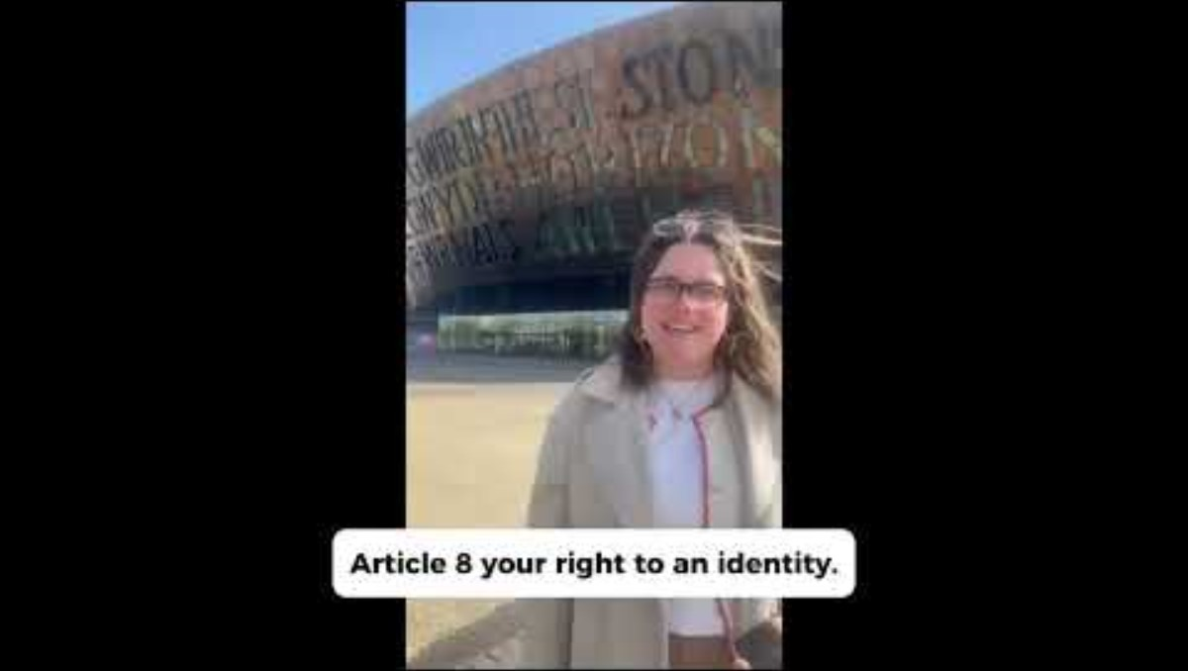
Notes:
Link to the video: https://youtu.be/1SUWloY1mmc

Slide 6

Discuss in pairs or as a group:
Have you ever taken part in a cultural activity?
Do you have access to these in school or your community?
What stops you from taking part in cultural activities?
Notes:
There are supporting materials on our web page for children with additional learning needs

Slide 7

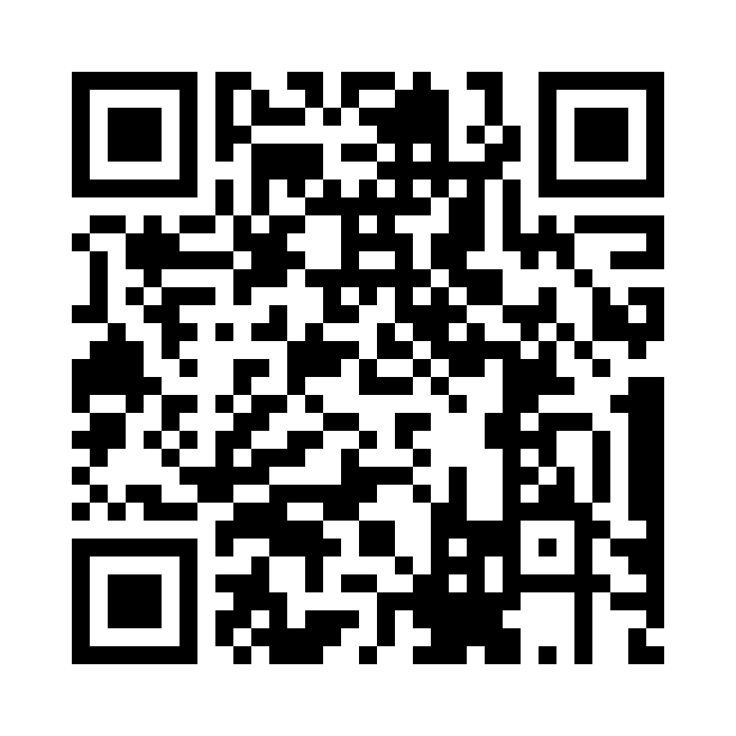
Share your ideas with us by using the QR code or survey link
(Each young person can do this individually or a teacher can do it on behalf of the class)
Notes:
Survey link - https://online1.snapsurveys.com/tfev3w

Slide 8

If you are worried about anything after today's session you should speak to a trusted adult.
You could also contact our Advice team:
0808 801 1000
advice@childcomwales.org.uk
www.childcomwales.org.uk
Notes:
You could also contact & speak to:
Childline – 0800 1111
Meic – 080880 23456

Slide 9

Diolch!
Thanks!
Our next Monthly Matter will be available on our website on Monday 1st June.

