Slide 1

Monthly Matter – April 2026

Slide 2

Last month, we asked what you thought about potentially banning social media for children under 16 years old.

Slide 3




Thanks to everyone who took part, we had over 1700 of you tell us your opinion!
58% of you think banning social media for under‑16s isn’t a good idea
At the same time, 70% of you think a ban might reduce cyberbullying
85% of you think it would be harder to stay in touch with friends if social media platforms were banned for children under 16​
👉 So there are a lot of benefits and downsides - and that's why we value your opinions!

Slide 4

Article 13: I have the right to get information and share my views.
April’s Monthly Matter is about your understanding of Members of the Senedd.

Slide 5
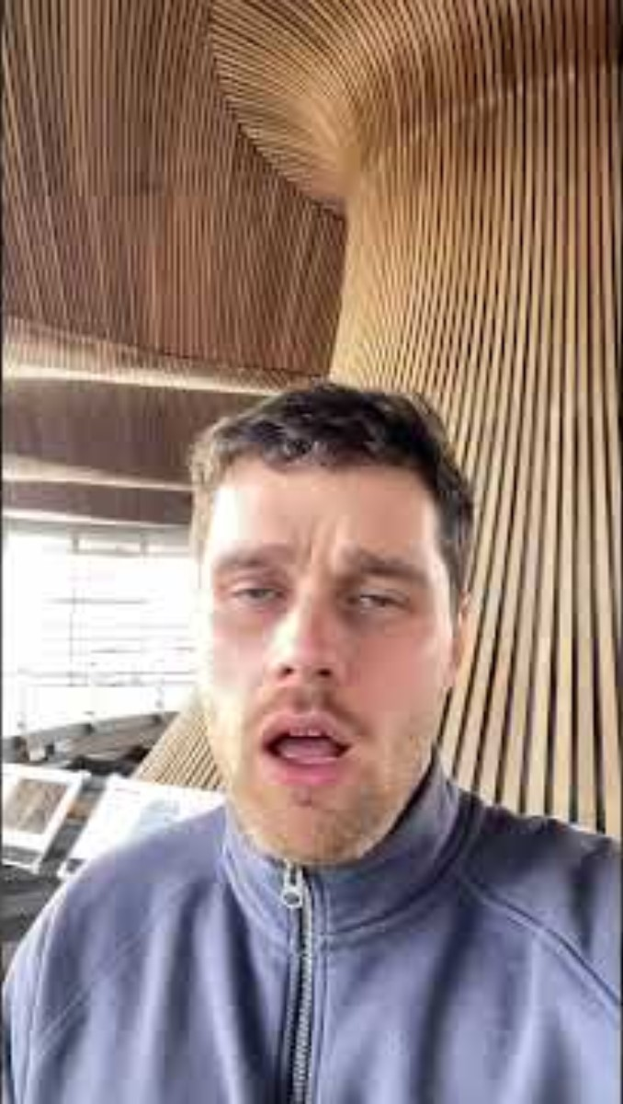
Notes:
Link to the video: https://youtube.com/shorts/clEqrLq5xKM

Slide 6

Discuss in pairs or as a group:
Before today - did you know about the election in Wales in May? How did you know about it?
Do you know what a Member of the Senedd is?
Have you ever met a Member of the Senedd? Where?
What would be the best way for your new Member of the Senedd to listen to your views?
Notes:
There are supporting materials on our web page for children with additional learning needs

Slide 7

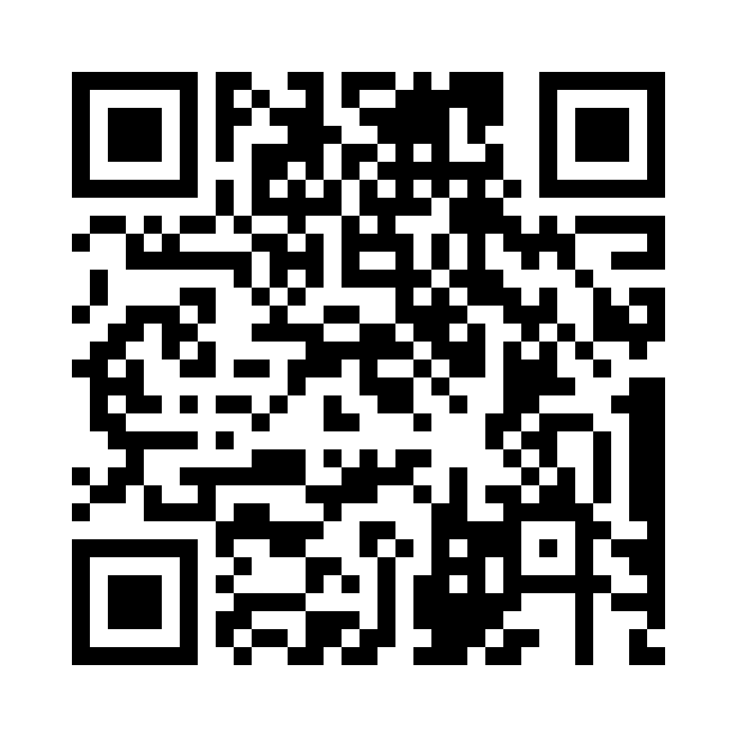
Share your ideas with us by using the QR code or survey link
(Each young person can do this individually or a teacher can do it on behalf of the class)
Notes:
Survey link - https://online1.snapsurveys.com/ruwhly

Slide 8

If you are worried about anything after today's session you should speak to a trusted adult.
You could also contact our Advice team:
0808 801 1000
advice@childcomwales.org.uk
www.childcomwales.org.uk
Notes:
You could also contact & speak to:
Childline – 0800 1111
Meic – 080880 23456

Slide 9

Diolch!
Thanks!
Our next Monthly Matter will be available on our website on
Tuesday, May 5th

