Slide 1

Monthly Matter – March 2026

Slide 2

Last month, we asked you about play during the winter months.

Slide 3



Thanks to everyone who told us about play during the winter months, this is what we found out:
Lots of you don’t play outside as much in the winter months because it’s too dark, wet and rainy
Most of you get to places by having a lift from an adult in the car and lots of you said by walking or biking with a friend
Lots told us that it would be easier to hang out with friends in the winter months if there were more shelters in outdoor parks and better streetlights

Slide 4

Article 15: I have the right to meet with friends and join groups.
Article 19: I have the right to be protected from being hurt or badly treated.
March’s Monthly Matter is all about children’s use of social media platforms.

Slide 5
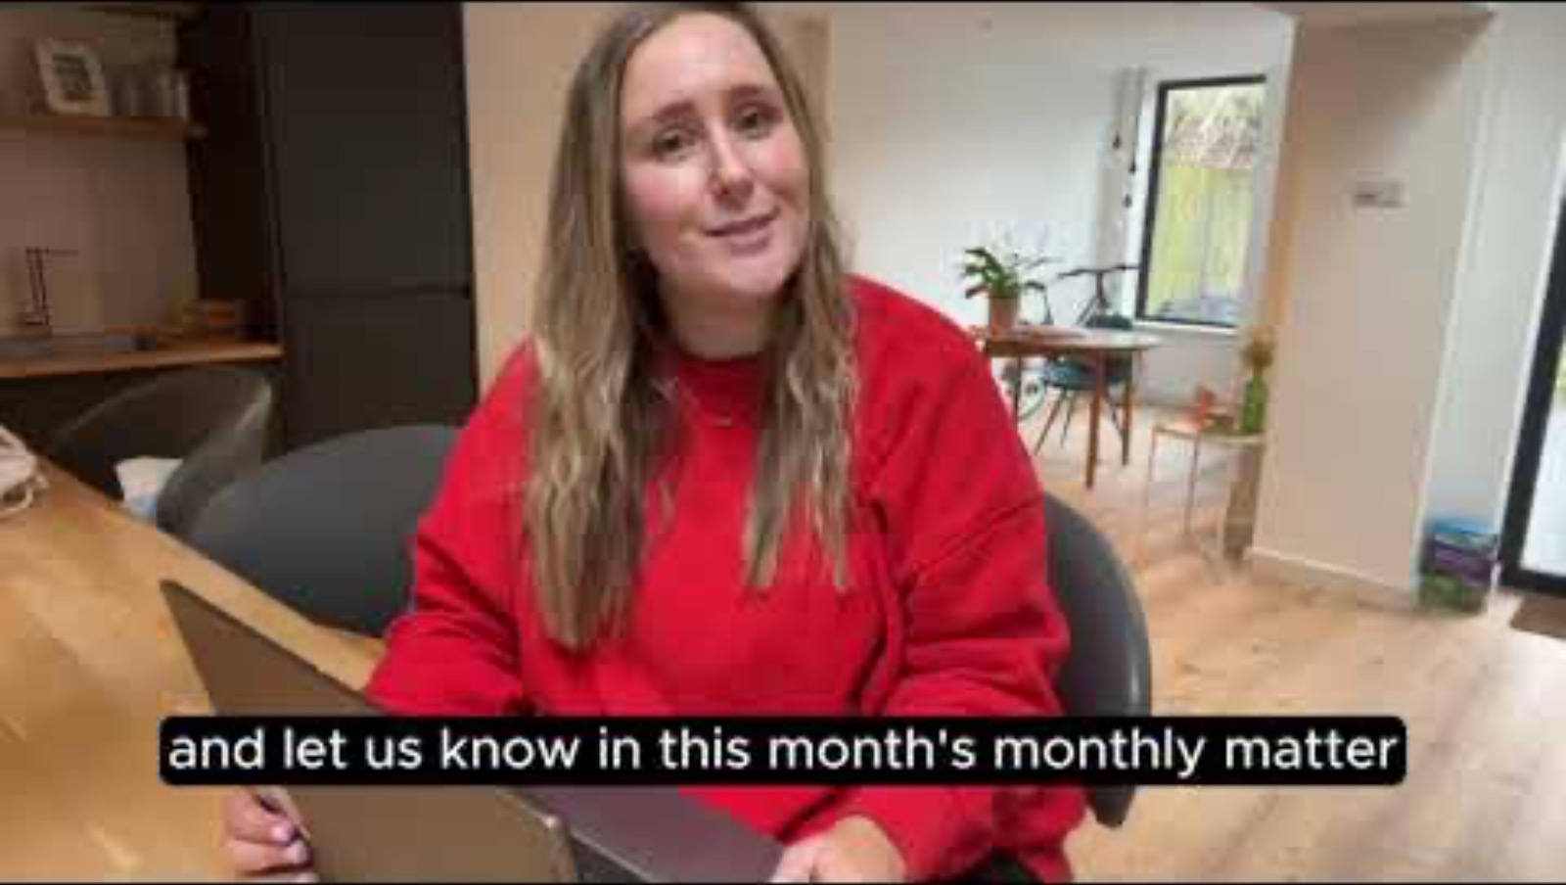
Notes:
Link to the video: https://youtu.be/nC2kZmgDX3Y

Slide 6

1) Discuss in pairs or as a group:
Do you use any social media?
Have you ever felt unsafe or unhappy online?
Do you think it is a good idea to ban social media platforms for children under 16 years old? Why?
Notes:
There are supporting materials on our web page for children with additional learning needs

Slide 7

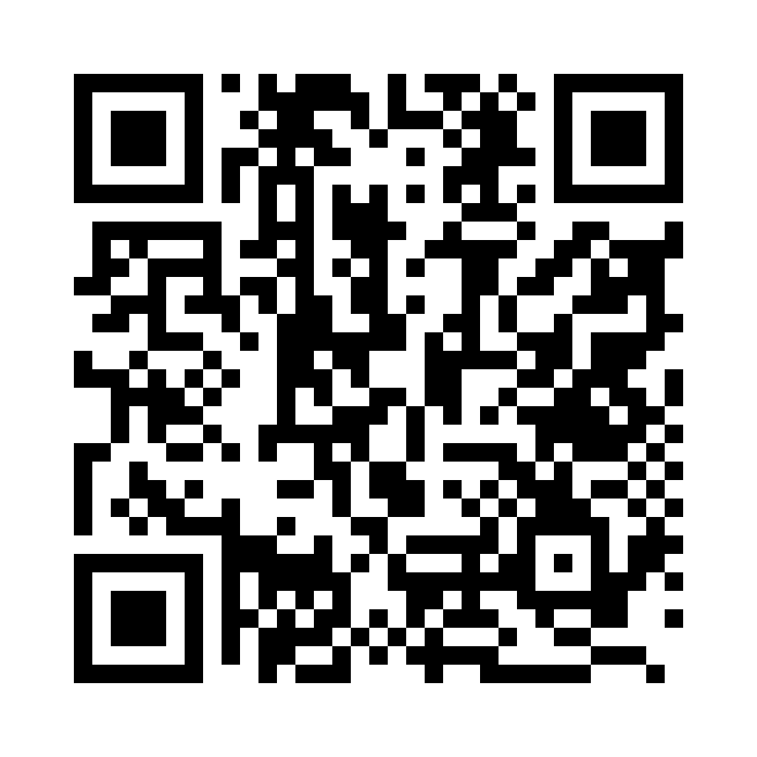
Share your ideas with us by using the QR code or survey link
(Each young person can do this individually or a teacher can do it on behalf of the class)
Notes:
Survey link - https://online1.snapsurveys.com/cf6w7u

Slide 8

If you are worried about anything after today's session you should speak to a trusted adult.
You could also contact our Advice team:
0808 801 1000
advice@childcomwales.org.uk
www.childcomwales.org.uk
Notes:
You could also contact & speak to:
Childline – 0800 1111
Meic – 080880 23456

Slide 9

Diolch!
Thanks!
Our next Monthly Matter will be available on our website on
Tuesday, April 7th

