Slide 1

Monthly Matter – February 2026

Slide 2

Last month, we asked you to complete a survey all about your rights and how you learn about them.

Slide 3

Over 3500 of you took part!
You should have your reports.
If you haven’t, please contact:
Jordan.Doherty@childcomwales.org.uk

Slide 4

Article 15: I have the right to meet with friends and join groups.
Article 31: I have a right to rest, relax and play.
February’s Monthly Matter is all about playing during the winter months (November to March).

Slide 5
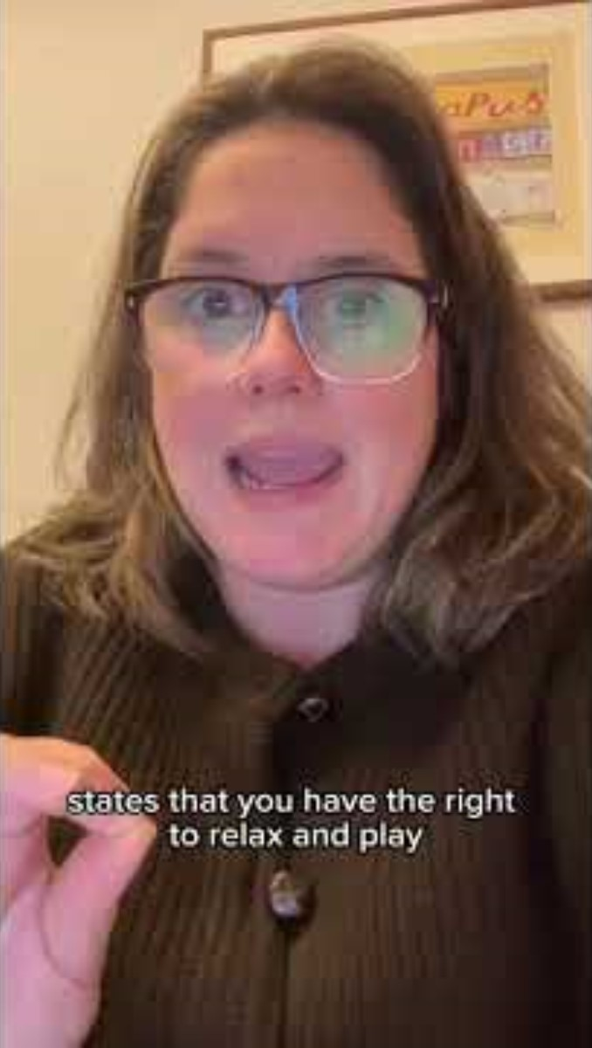
Notes:
Link to the video: https://youtube.com/shorts/SZ8tNiTjUHY

Slide 6

1) Discuss in pairs or as a group:
- Do you go out to play or hang out with friends in the winter?
- Do you feel like you have enough time?
- What could make it easier for you to play or hang out in the winter?
Notes:
There are supporting materials on our web page for children with additional learning needs

Slide 7

If you are worried about anything after today's session you should speak to a trusted adult.
You could also contact our Advice team:
0808 801 1000
advice@childcomwales.org.uk
www.childcomwales.org.uk
Notes:
You could also contact & speak to:
Childline – 0800 1111
Meic – 080880 23456

Slide 8

Diolch!
Thanks!
Our next Monthly Matter will be available on our website on
Monday, March 2nd

