Slide 1

Monthly Matter – January 2026

Slide 2

Last month, we asked you about how your school supports you to celebrate your identity.
Here’s what we found out:

Slide 3



Identity:
Lots of you told us about the ways your school supports your Welsh identity
Lots of you told us about the ways your schools celebrates and helps you learn about different religions
Lots of you thought having visitors to school was the best way to learn about other cultures

Slide 4

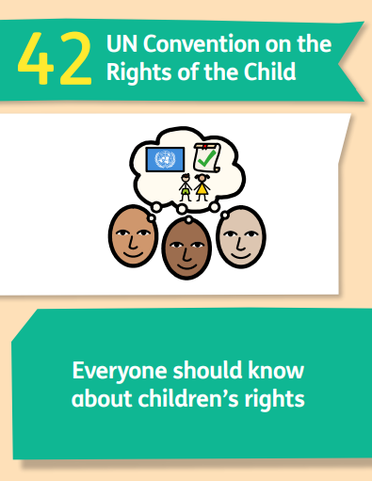
Article 2: All children have these rights no matter what their differences are
Article 42: Everyone should know about children’s rights
January’s Monthly Matter is all about rights and how you learn about them
Notes:
NOTE – you will need to sign up for the survey ahead of sharing with pupils.
You will get a unique code for your school/ setting and can share that with as many children or staff as you like.

Slide 5
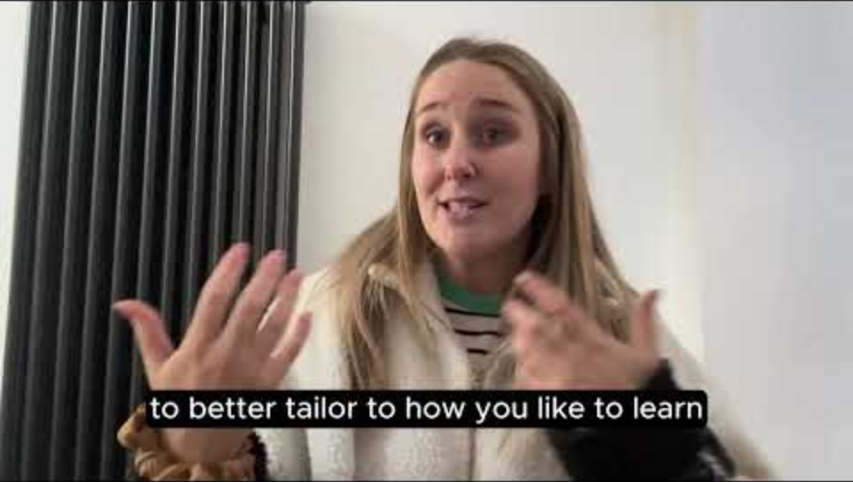
Notes:
Link to the video: https://youtu.be/e6n9Cjd7by8

Slide 6

This month it’s a little bit different!
You will have a code from your teacher or youth worker.
You will use that code to fill in a survey.
Your answers will help you school / youth club plan their rights work.
Notes:
There are supporting materials on our web page for children with additional learning needs

Slide 7

If you are worried about anything after today's session you should speak to a trusted adult.
You could also contact our Advice team:
0808 801 1000
advice@childcomwales.org.uk
www.childcomwales.org.uk
Notes:
You could also contact & speak to:
Childline – 0800 1111
Meic – 080880 23456

Slide 8

Diolch!
Thanks!
Our next Monthly Matter will be available on our website on
Monday 2nd February

