Slide 1

Monthly Matter – December 2025

Slide 2

Last month, we asked you about public transport in your area and if you knew about the new low-fare bus ticket.
Here’s what we found out:

Slide 3



Public transport: 1152 of you took part
41% of you think you’ll get the bus more because of the £1 fares offer
Only 29% of you had heard about the offer before doing this survey – so we’re really happy we could help you to know about it!
Thanks to the schools who showed us how they were promoting the offer in their school community as a result of our Monthly Matter, including this from Ysgol Heulfran in Wrexham!

Slide 4

Article 14: I have the right to have my own thoughts and beliefs and to choose my religion.
Article 30: I have a right to follow my family’s way of life.
December’s Monthly Matter is all about religious/cultural celebrations

Slide 5
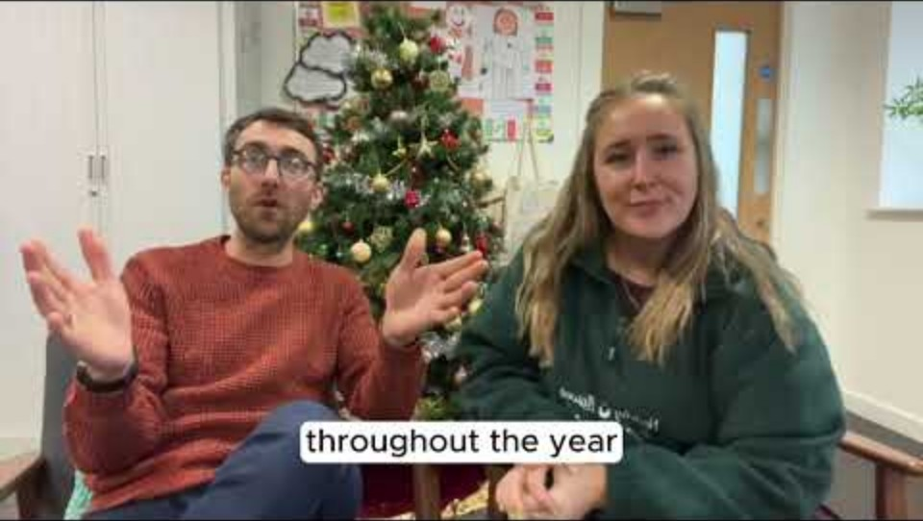
Notes:
Link to the video: https://youtu.be/Yg0GZNNyGLg

Slide 6

1) Discuss in pairs or as a group:
What have you done in school/youth group that helps you celebrate your identity?
What has worked well/what could be better?
How would you like to learn about different religious and cultural celebrations?
Notes:
There are supporting materials on our web page for children with additional learning needs

Slide 7

Add your ideas to our padlet!
✅ This month, instead of a survey, we’ve made a padlet where you can add the things that have worked well in your school or club.
💡 We hope it will help schools with ideas for the new year!
👇 Please add your thoughts, and if you have photos you’re able to share, please include them!
📷 This is a public link so any children in the photos will need to have photo consent.
Diolch!

Slide 8

If you are worried about anything after today's session you should speak to a trusted adult.
You could also contact our Advice team:
0808 801 1000
advice@childcomwales.org.uk
www.childcomwales.org.uk
Notes:
You could also contact & speak to:
Childline – 0800 1111
Meic – 080880 23456

Slide 9
👇 Ideas on what you could do next….
How about you map out religious/cultural celebrations that happen during the school year?
Think about how you and your friends would like to learn about these and how you could celebrate in an authentic way.

Slide 10

Diolch!
Thanks!
Our next Monthly Matter will be available on our website on
Monday, January 5th

