Slide 1

Monthly Matter – October 2025

Slide 2

Last month, we asked you about school uniform.
Here’s what we found out:

Slide 3




53% of you think uniform is important, but only 41% of you think your uniform is comfortable
23% of you said your families find it difficult to pay for uniform and other school essentials
58% of you had been told off for something uniform-related, like not having the correct uniform item, wearing jewellery, or not wearing specific shoes
We'll be sharing your views with the Welsh Government – they tell schools what should be in their school uniform policies

Slide 4
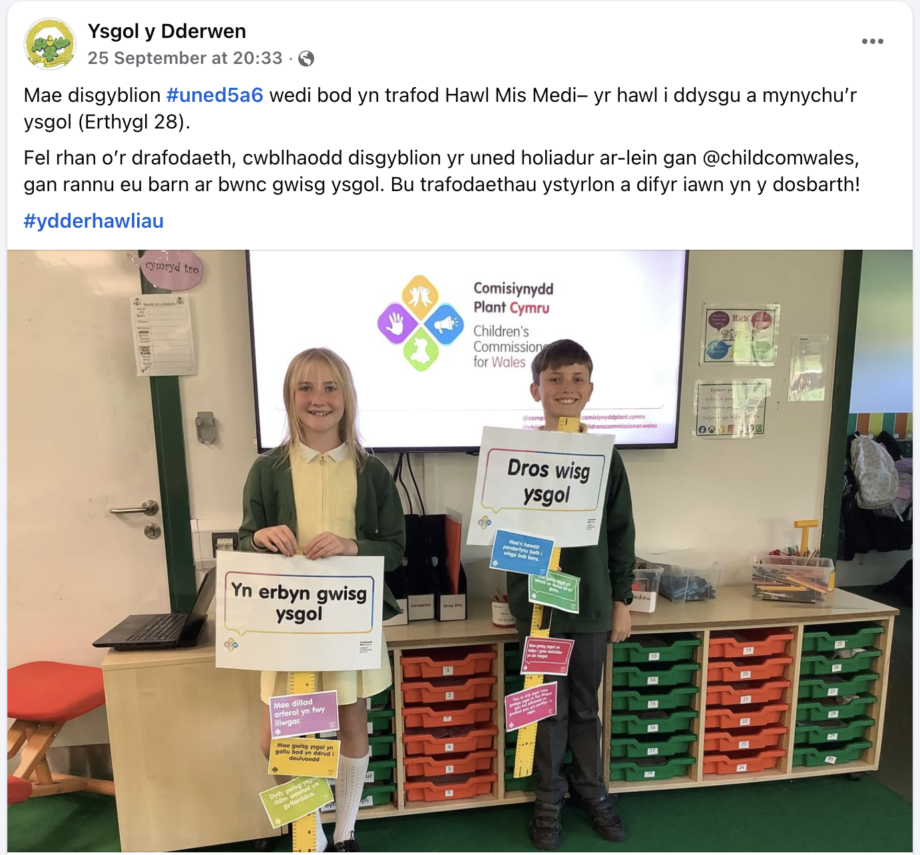
We enjoyed seeing how some school use monthly matters in their class!
Make sure you tag us on social media -@childcomwales on Facebook and Instagram

Slide 5
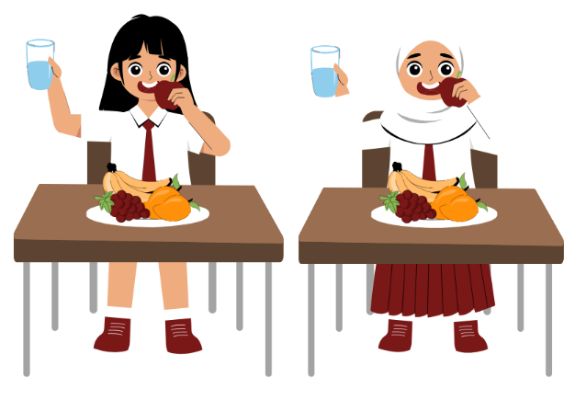
October’s Monthly Matter is all about school dinners, specifically the cost of them. Remember: Article 26: If my family need it, they shoukd get money to help bring me up Article 27: the right to a proper home, food and clothing

Slide 6
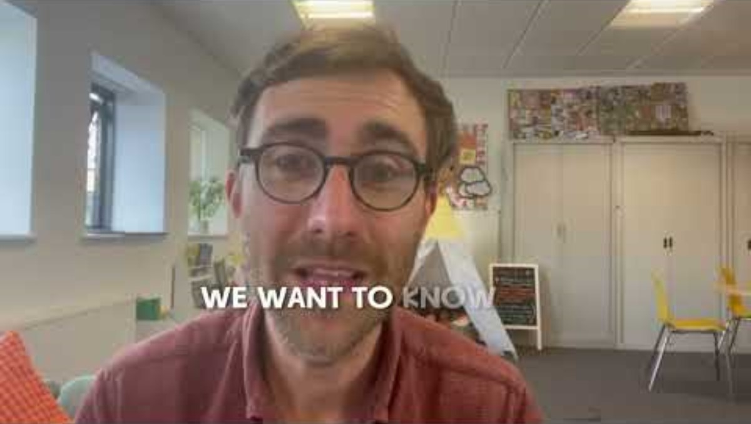
Notes:
Link to the video: https://youtu.be/z203VnI4I-8

Slide 7

1) Discuss in pairs or as a group:
Are food prices visible/clear in the canteen?
How much money do you think you would need every day to eat well in school?
Notes:
There are supporting materials on our web page for children with additional learning needs

Slide 8

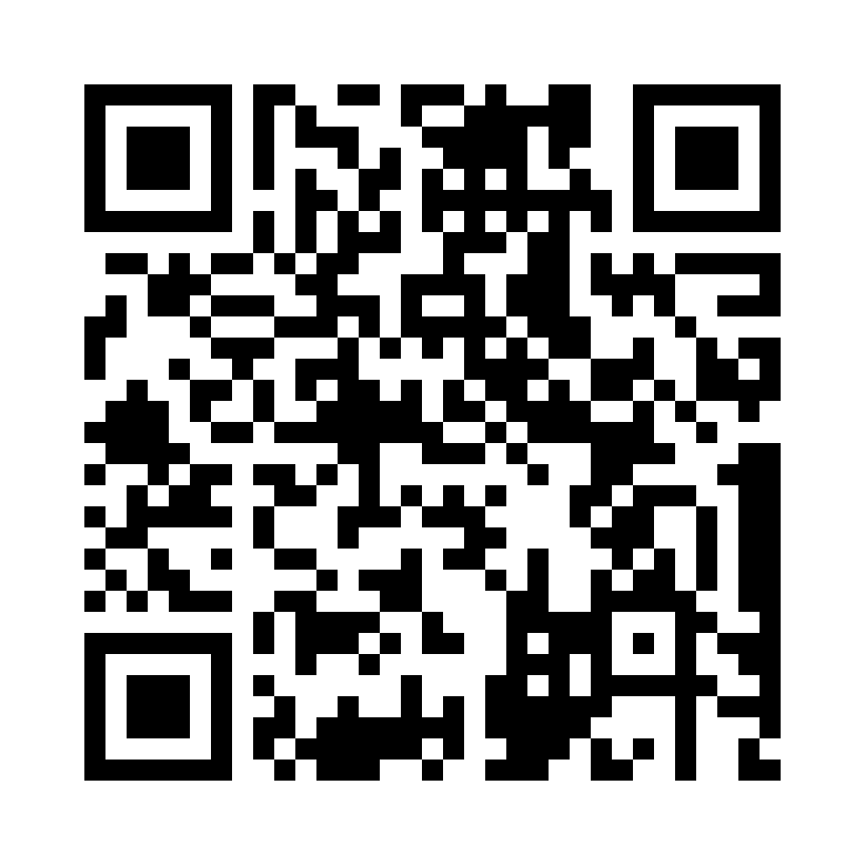
Share your ideas with us by using the QR code or survey link
(Each young person can do this individually or a teacher can do it on behalf of the class)
Notes:
Survey link - https://online1.snapsurveys.com/o7xsds

Slide 9

If you are worried about anything after today's session you should speak to a trusted adult.
You could also contact our Advice team:
0808 801 1000
advice@childcomwales.org.uk
www.childcomwales.org.uk
Notes:
You could also contact & speak to:
Childline – 0800 1111
Meic – 080880 23456

Slide 10
👇 If you want to continue this discussion….
🔗 Take a look at the follow-up activity on the website. It's about your school's calendar of costs – the things that cost money for families throughout the year and changes that could be made to help
Notes:
Check-with-Ceri-KS3-KS4-Sept-2019.pdf

Slide 11

Diolch! Thanks!
Our next Monthly Matter will be available on our website on
Monday 3rd November

