Slide 1

Monthly Matter – November 2025

Slide 2

Last month, we asked you about price of school dinners & if you think schools should source vegetables for your dinner locally?
Here’s what we found out:

Slide 3




School Food (secondary schools)
Most of you think you need between £4-£6 every day to eat well in school
Lots of you think prices of food items could be a lot clearer in the school canteen
23% of you said you don’t have enough money to eat what you want every day in school
The Children’s Commissioner is asking the Welsh Government to make all school food free for young people in secondary schools

Slide 4


Vegetables (primary schools)
Your favourite vegetable was….CARROTS
This was followed by Cucumber, Potatoes and Sweetcorn
We’ll be sharing your answers with Food Sense Wales, who are trying to get more locally grown vegetables on your school dinner plates

Slide 5

Novembers’s Monthly Matter is all about public transport . This topic links to many of your rights including: Article 28 - your right to an education Article 15 – your right to meet with friends and to join groups Article 31 – your right to play, relax and rest

Slide 6
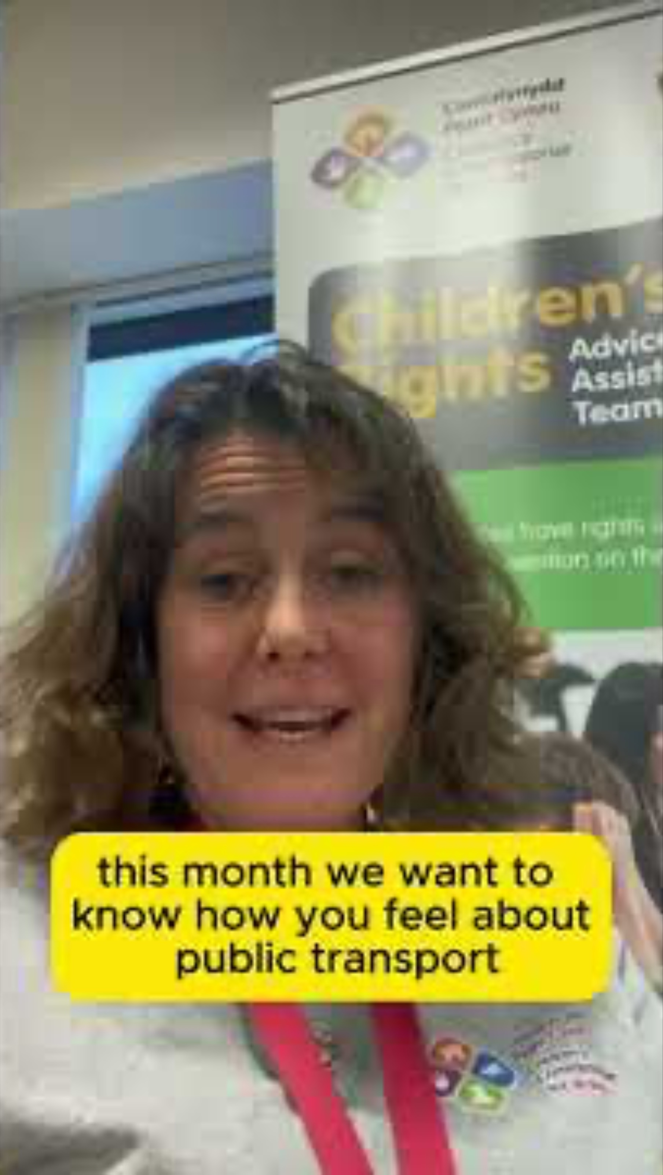
Notes:
Link to the video: https://youtube.com/shorts/5sx3_nYQXuM?feature=share

Slide 7

1) Discuss in pairs or as a group:
How often do you use public transport like buses and trains?
Had you heard about the new low fare bus tickets before today? (£1 for a single journey/£3 day ticket)
Is there anything about the buses and trains in your area that you want to share with us?
Extra question: Do you have any ideas about how you could share information about the new low bus fares with other pupils in your school, and parents?
Notes:
There are supporting materials on our web page for children with additional learning needs

Slide 8

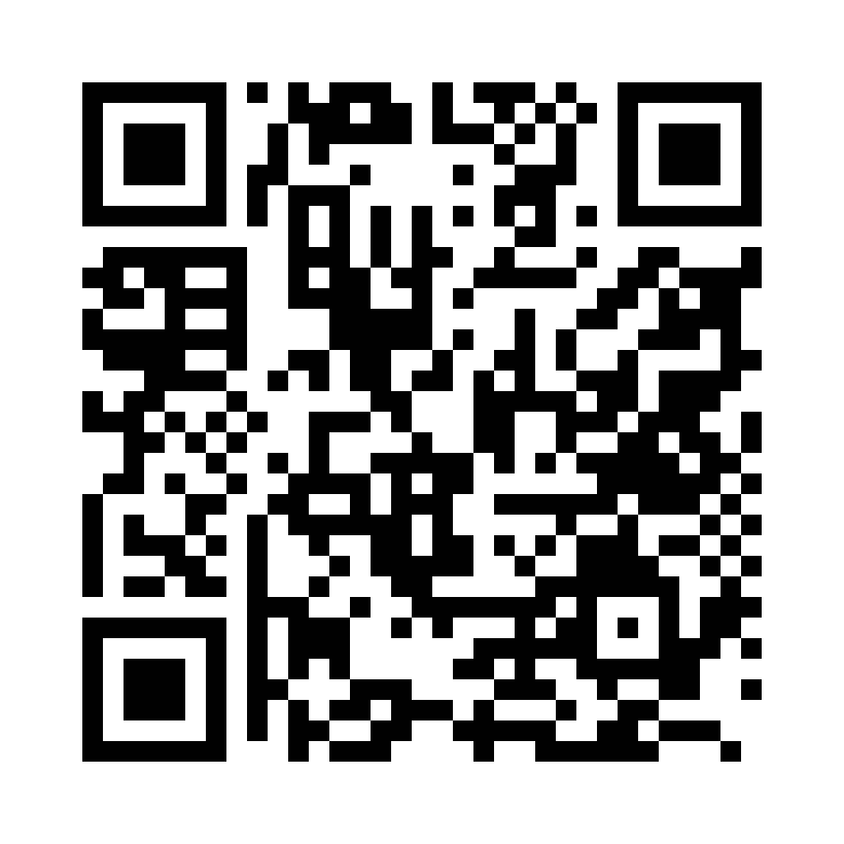
Share your ideas with us by using the QR code or survey link
(Each young person can do this individually or a teacher can do it on behalf of the class)
Notes:
Survey link - https://online1.snapsurveys.com/ohnuv2

Slide 9

If you are worried about anything after today's session you should speak to a trusted adult.
You could also contact our Advice team:
0808 801 1000
advice@childcomwales.org.uk
www.childcomwales.org.uk
Notes:
You could also contact & speak to:
Childline – 0800 1111
Meic – 080880 23456

Slide 10
👇 Ideas on what you could do next….
🤔 Think of the ways you could let other young people in your school (and their families) know about the low bus fares offer
🚂 It’s not just about buses either. You can also travel for free on a Transport for Wales train if you’re with an adult – we’ve put a flyer on the next slide that you could share

Slide 11
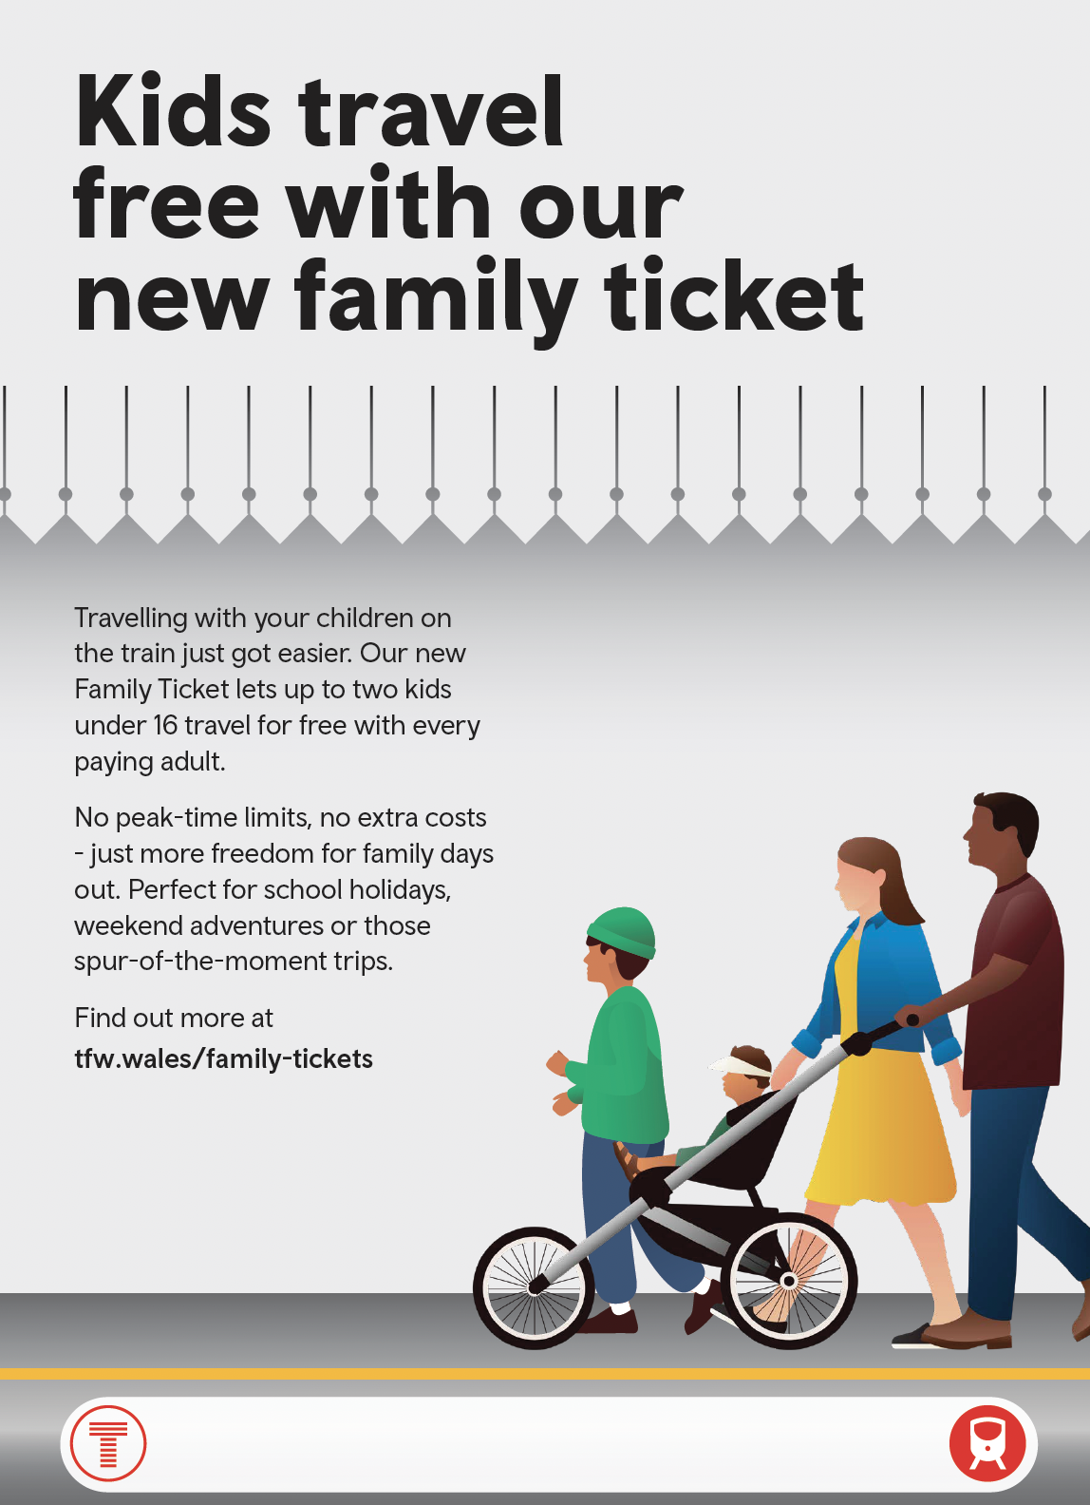
Notes:
Link to the video:

Slide 12

Diolch! Thanks!
Our next Monthly Matter will be available on our website on
Monday, December 1st

