Slide 1

Monthly Matter – October 2025

Slide 2

Last month, we asked you about school uniform.
Here’s what we found out:

Slide 3



Over 1,000 of you shared your views with us!
Here’s what you told us about uniform:
Safety – lots of you said it helps on school trips (to make it easy for teachers to spot you if you get lost)
Represents the school – shows the logo and makes you feel part of a team
Equality – everyone looks the same and it helps stop bullying
But…
Some of you said it’s uncomfortable (itchy, too hot/cold), it can be really expensive, and it doesn’t allow you to express yourself.
We will be sharing your views with the Welsh Government!

Slide 4
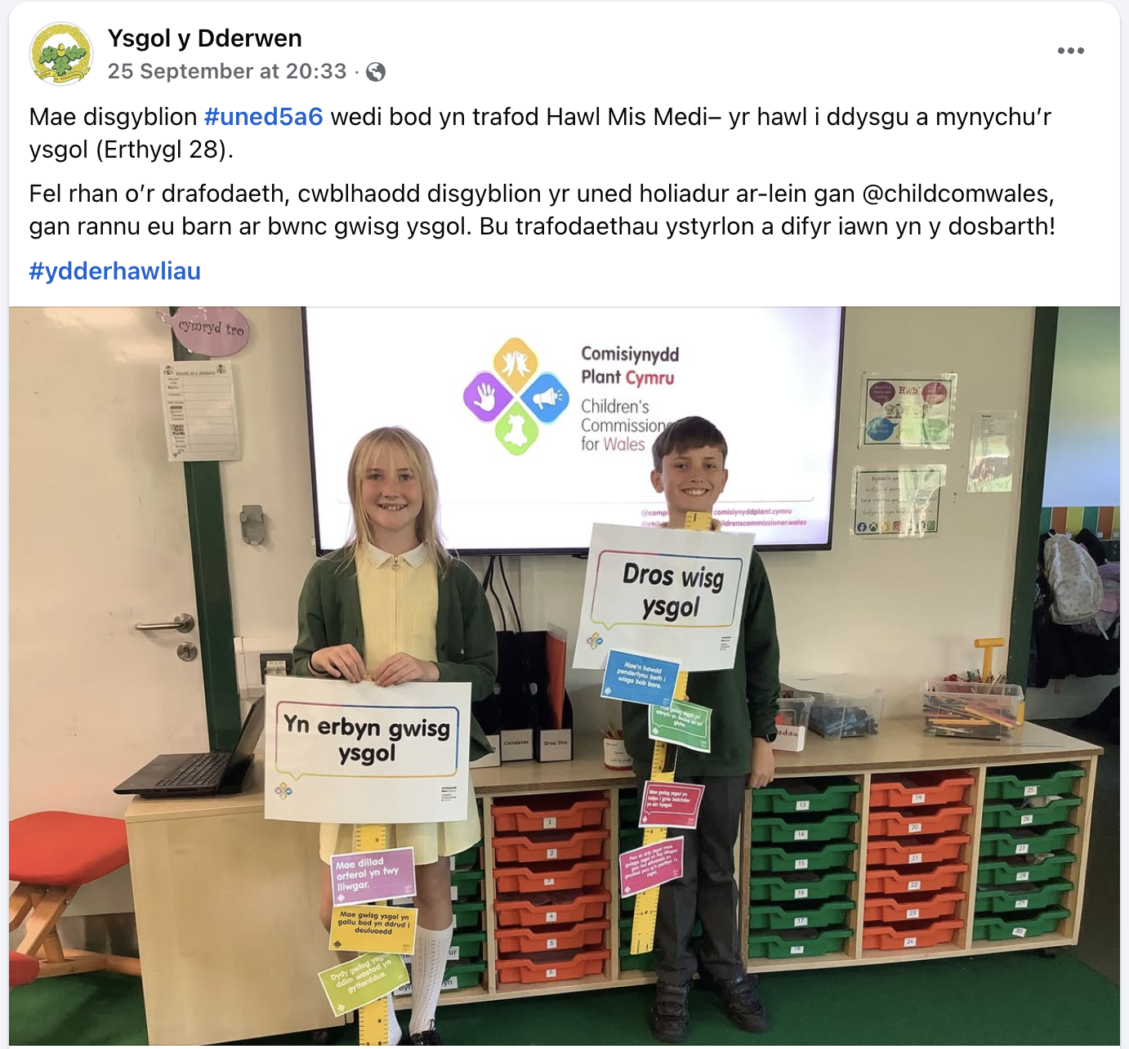
We enjoyed seeing how some schools use monthly matters in their class! Thanks for this Ysgol y Dderwen – it looks like you had a brilliant debate.
Make sure you tag us on social media
@childcomwales on Facebook and Instagram

Slide 5
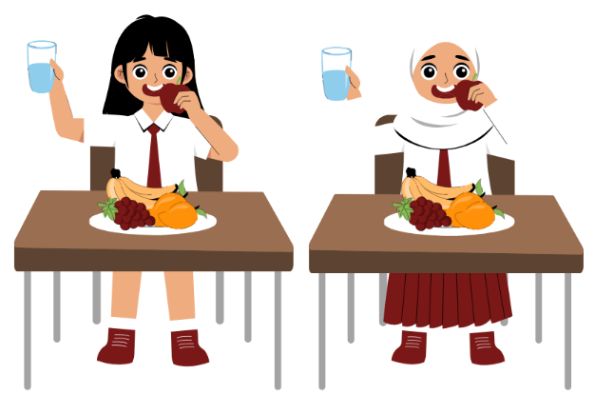
October’s Monthly Matter is about where our vegetables grow, and whether we should have more locally grown vegetables in schools!
Remember:
Article 27: The right to a proper home, food and clothing

Slide 6
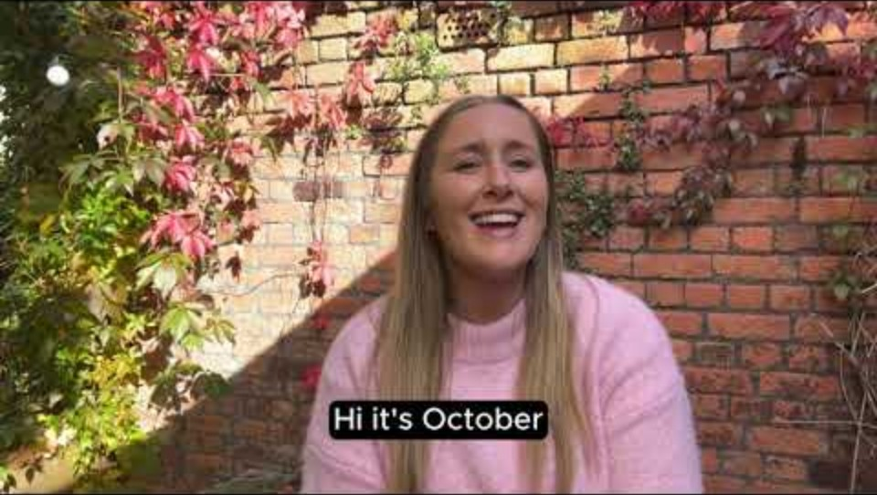
Notes:
Link to the video: https://youtu.be/MLWf5jHkMNw

Slide 7

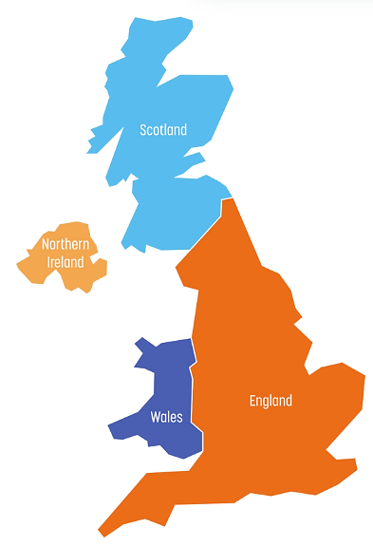

The world
United Kingdom
Notes:
Link to the video:

Slide 8

Leeks
Cennin
True or false? Leeks grow in Wales/UK

Slide 9
Leeks
Cennin
True! Leeks grow in Wales/UK

Slide 10

Bananas
True or false? Bananas grow in Wales/UK

Slide 11
Bananas
False! Bananas grow in other parts of the world

Slide 12

Mangoes
True or false? Mangoes grow in Wales/UK

Slide 13
Mangoes
False! Mangoes grow in other parts of the world

Slide 14

Strawberries
Mefus
True or false? Strawberries grow in Wales/UK

Slide 15
Strawberries
Mefus
True! Strawberries grow in Wales/UK
Strawberries grow in Wales during May, June, July, August and September.

Slide 16

Potatoes
Tatws
True or false? Potatoes grow in Wales/UK

Slide 17
Potatoes
Tatws
True! Potatoes grow in Wales/UK
We grow our own potatoes in the UK for most of the year.

Slide 18

Broccoli
True or false?
Broccoli grows in Wales/UK

Slide 19
Broccoli
True! Broccoli grows in Wales/UK
We grow broccoli in the UK for most of the year.

Slide 20

1) Discuss in pairs or as a group:
Should we only use fruit and veg that can be grown in the UK in school?
What would be good about doing this?
Can you think of any negatives?
What’s your favourite vegetable, and how do you like to eat it?
Here’s a useful link showing the fruit and veg that grows in the UK throughout the year
Notes:
Some ideas of pros and cons:
Pros:
good for the planet because your food has less distance to travel and isn’t taking precious resources, like water, from other countries
good for the local economy and Welsh producers because we will be spending money on vegetables that stays in Wales
good for the future of food in Wales because if there is more demand for Welsh Vegetables, Wales will grow more veg, and then won’t rely so much on other countries.
Cons: If we only eat seasonal and locally grown food in school there might be times of the year where you can’t eat your favourite fruit or vegetable in school
There are supporting materials on our web page for children with additional learning needs

Slide 21

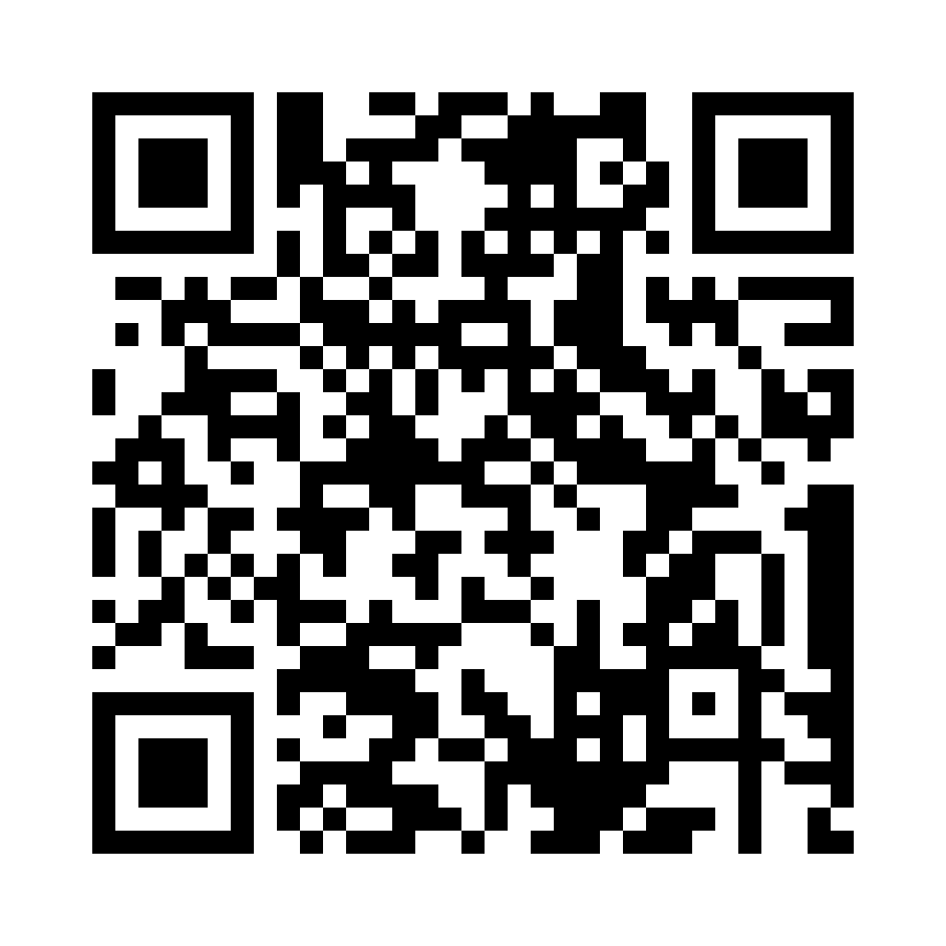
Share your ideas with us by using the QR code or survey link
(Each young person can do this individually or a teacher can do it on behalf of the class)
Notes:
Survey link -https://online1.snapsurveys.com/ktyb5s

Slide 22
Follow-up activity
If you want to explore this issue more, why not give this a go?
Come up with a school meal (main course and dessert) for any month of the year, that uses vegetables and fruit that grow in the UK that month.
This website shows you the fruit and veg that grows in the UK every month
A recipe website like this might help you find meals based on your ingredients
You can write or draw your meals – and send them to us! You can take pictures of them and send on email, to our social media (@childcomwales), or by post!

Slide 23

If you are worried about anything after today's session you should speak to a trusted adult.
You could also contact our Advice team:
0808 801 1000
advice@childcomwales.org.uk
www.childcomwales.org.uk
Notes:
You could also contact & speak to:
Childline – 0800 1111
Meic – 080880 23456

Slide 24

Diolch!
Thanks!
Our next Monthly Matter will be available on our website on
Monday 3rd November

