Slide 1
WELCOME TO
WELCOME TO
WELCOME TO
WELCOME TO
WELCOME TO
WELCOME TO YOUR VOTE
2026 Senedd Election How to Vote

Slide 2
Learning objectives
By the end of this lesson, you will:
Understand how to register and cast your vote at a Senedd election
Notes:
Introduce learning objective for the session.

Slide 3

Starter
10 minutes
There is a Senedd election taking place in 2026.
What do you already know about the 2026 Senedd election?
Do you think it's important to vote in the Senedd election? Why or why not?
Think, pair, share!
Notes:
Encourage learners to share anything they already know about the 2026 Senedd election.
Support quick discussion on whether it is important to vote in the election or not, why or why not?
The share key information about the election on next slide.

Slide 4

2026 Senedd election
What’s going to happen?
The Senedd election will take place on Thursday 7 May 2026
You can vote if you're aged 16 and over on polling day and live in Wales
To cast your vote, you must register to vote by midnight on 20 April 2026
Why does it matter?
The Senedd makes decisions about things that affect you and your community
This election is your chance to have a real say and make young people’s voices count
Election day:
7 May 2026
Notes:
The 2026 Senedd election:
The election will take place on 7 May 2026
You need to be 16, living in Wales and registered to vote to vote in this election
You can vote in person, by post or by proxy (when someone votes on your behalf)
You get one vote, and will be given one ballot paper
You will be voting for the political party or independent candidate you want to represent you in the Senedd
For each local area, called a constituency, 6 Members of the Senedd will be elected
Why it matters:
The Senedd makes decisions about your education, health, transport, housing, and the environment.
Your voice matters. This election is your chance to have a real say in shaping Wales’ future, show that young people’s votes count, influence decisions that affect you and your community every single day
If young people don’t vote, decisions will still be made - but without your voice.

Slide 5
Register to Vote
Notes:
Explain that you must be registered to vote to take part in an election.

Slide 6
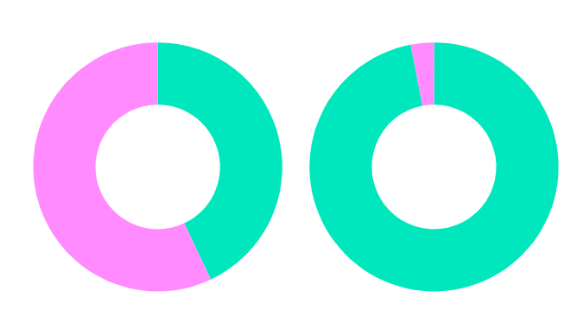

Who's registered?
What percentage of 16-17 year olds in Wales are registered to vote?
In 2024, 43% of 16-17-year-olds in Wales were registered to vote, compared to 97% of voters over 65
Registered
16-17
+65
Not registered
Notes:
If you've already delivered the assembly, briefly recap this info and check if students can remember that only 43% of 16-17 year olds were registered to vote in 2024.
If this is new information to the group, ask learners what % of 16-17 year olds they think are registered before revealing the answer. You could also ask about 60% of the group to raise their hand or stand up to demonstrate that this % of 16-17 year olds in Wales are not registered to vote to have their voice heard. Highlight that 16-17-year-olds in Wales are much less likely to be registered to vote than older voters and explain it’s important you know how to register to vote, so you can have your say.

Slide 7
Why is it important to register to vote?
5 minutes
Instructions:
Discuss why you think it's important to register to vote
Write a list of reasons why people should register to vote for the 2026 Senedd election
Notes:
Support students to have a discussion in pairs/groups and then write a list of reasons why registering to vote is important.
Ideas:
to make sure I can have my say
to influence decisions that will affect me
to have my say on x issue (what issues do you care about?)
registering to vote can improve your credit rating
politicians might create their manifestos to appeal to those they think will vote for them

Slide 8
60 seconds to share your idea
Notes:
You can adapt this slide depending on how/if you want students to share their ideas.
Our lesson on designing a voter registration campaign can be found here - https://www.electoralcommission.org.uk/media/12653

Slide 9
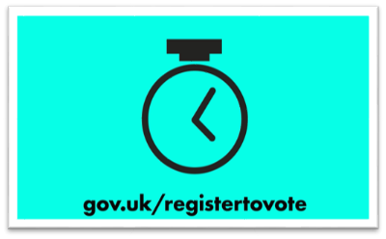
Register to vote
Things to know
You can register to vote in a Senedd election when you’re 14
You don’t need to register before every election
You’ll be asked for your National Insurance number (but you can still register if you don’t have one)
It only takes five minutes
Things to do
Register online at gov.uk/registertovote
Notes:
Share key information about registering to vote and answer any questions.
You don’t need to register before every election - you only need to register if:
you’ve never registered to vote before
you’ve moved house recently
you’ve changed your name
Talk to your local elections team at your council if you need help
More information on registering to vote can be found on the Electoral Commission website - https://www.electoralcommission.org.uk/voting-and-elections/register-vote

Slide 10
How to vote
Notes:
Explain that it’s important to know how to vote in Senedd elections.

Slide 11
How to vote – quiz
15 minutes
Instructions:
Watch the video about how to vote in a Senedd election
Answer the quiz questions on the slide to test your knowledge
Notes:
Introduce the activity.

Slide 12

Watch this video about how to vote in Senedd elections
Notes:
Show the video about how to vote in Senedd elections.
https://youtu.be/5rPOXt-ZfsY

Slide 13
Quiz
Quiz
Quiz
Quiz
Quiz
Notes:
Tell learners you’ll be testing what they learnt from the video.
Give instructions on how you’d like the group to share their answers to the quiz questions.

Slide 14
Quiz
What is the name of the voting system used to elect Members of the Senedd?
A closed proportional list system
Notes:
Extra info:
This voting system affects how candidates are elected and sets out the rules for how your vote is counted.

Slide 15
Quiz
Fill in the gap.
In Senedd elections, you vote for a ___________ or ___________.
In Senedd elections, you vote for a political party or independent candidate
Notes:
Extra info:
The ballot paper will still show the list of candidates for each political party, but remember, you are voting for a political party or an independent candidate, rather than specific candidates on a party’s list.

Slide 16
Quiz
How many ballot papers will you be given when voting in a Senedd election?
You will have one vote and will be given one ballot paper
Notes:
Extra info:
Make sure you read the instructions on your ballot paper and ask the staff at the polling station if you need help.

Slide 17
Quiz
True or False? The voting system for Senedd elections is a form of proportional representation.
True!
The number of seats each party or independent candidate wins in the Senedd will reflect the percentage of votes they receive in each constituency
Notes:
Extra info:
Proportional representation means the number of candidates elected for each political party roughly matches the number of votes received

Slide 18
Quiz
How many Members of the Senedd will be elected to represent your constituency?
6 Members of the Senedd will be elected to represent your constituency
Notes:
Extra info:
your constituency is the local area where you live
There are 16 constituencies in Wales that each elect 6 Members of the Senedd

Slide 19
Voting in person
Notes:
Explain that we'll now look at what to expect on polling day when voting in person.

Slide 20
Voting in person – timeline activity
10 minutes
Instructions:
Read the key steps to voting in person on the next slide
Put the steps in the correct (chronological) order to create a timeline for voting in person
Notes:
Introduce the activity.

Slide 21
Voting in person – timeline activity
To cast your vote, put a cross [X] in the box next to your choice of political party or independent candidate.
Fold your completed ballot paper and put it in the ballot box.
Take your ballot paper to a polling booth, so that you can cast your vote in secret.
Receive a poll card saying where your polling station is. You can also check online.
At the polling station, you will be given one ballot paper. Ask staff if you need any help.
Register to vote
Notes:
Ask learners to discuss the key steps to voting in person and to correctly order them to create a timeline for voting in person.

Slide 22
Voting in person – timeline activity
3
1
2
At the polling station, you will be given one ballot paper. Ask staff if you need any help.
Register to vote
Receive a poll card saying where your polling station is. You can also check online.
4
5
Take your ballot paper to a polling booth, so that you can cast your vote in secret.
To cast your vote, put an 'X' in the box next to your choice of political party or independent candidate.
6
Fold your completed ballot paper and put it in the ballot box.
Notes:
Show the correctly ordered steps and talk through how to vote in person.

Slide 23
What else do I need to know?
Things to know
You can choose how to vote
  In person - at a polling station
  By post - send your vote in the post
  By proxy - someone else votes for you
Things to do
Decide how you’ll vote
If you're voting in person, find your polling station
Put the date in your phone or school planner
Election day:
7 May 2026
Notes:
Share additional information on how to get ready to vote in a Senedd election.
You’re more likely to vote if you’ve planned how, when and where to do it.
We've just looked at voting in person, remind learners they can also choose to vote by post or by proxy.
To vote by post you need to apply for a postal vote by Tuesday 21 April 2026. You can only apply to vote by proxy in certain circumstances. More information can be found on the Electoral Commission website - https://www.electoralcommission.org.uk/voting-and-elections/ways-vote
You can also find your polling station on the Electoral Commission website - https://www.electoralcommission.org.uk/i-am-a/voter/your-election-information

Slide 24
2026 Senedd election
What’s going to happen?
The Senedd election will take place on Thursday 7 May 2026
You can vote if you're aged 16 and over and live in Wales
To cast your vote, you must register to vote by midnight on 20 April 2026
The votes will be counted after polling stations close
Once all the votes have been counted your new Members of the Senedd will be announced!
Why does it matter?
The Senedd makes decisions about things that affect you and your community
This election is your chance to have a real say and make young people’s voices count
Election day:
7 May 2026
Notes:
Option to show the slide with key info about the election again and answer any final questions.

Slide 25
Remember, you need to register to be able to vote!
Notes:
Wrap up the session by reminding students they need to register to be able to vote.

