Slide 1

My First Vote
Your Voice, Your Wales
Notes:
Welcome to a session on ‘Your First Vote’. During the session today we will be sharing information with you on the Senedd and about how to vote in the Senedd Election.

Slide 2
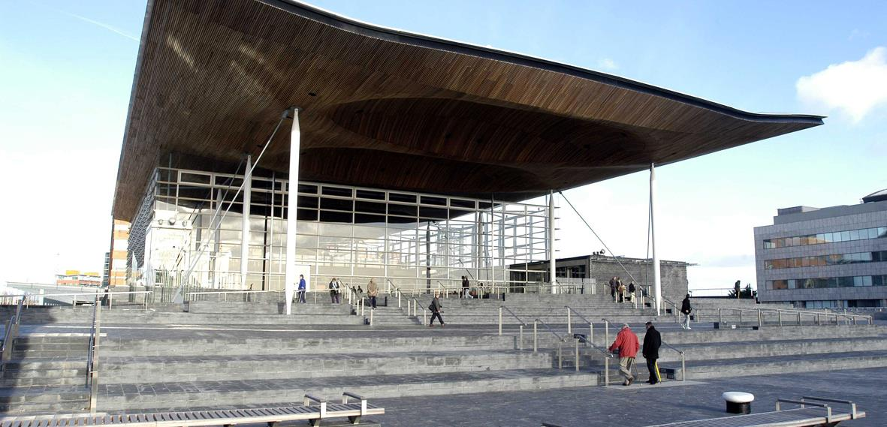
Notes:
Does anyone know what the name of this Building is? – the Senedd
The Senedd is in Cardiff Bay.
What does the word Senedd mean? – Senedd is the Welsh word for ‘Parliament’, which means somewhere for a group of people to come together to discuss and make decisions. The Senedd in Wales has a role in discussing and making decisions on things that affect our everyday lives here in Wales.
But how did we get to this point? How does the Senedd exist?

Slide 3

Notes:
We’re going to watch this short video which shows you how the Senedd came to exist here in Wales and what its role is.
(After watching the video) We now know that the Senedd, as it is today, has full law making powers here in Wales. It’s able to discuss, make decisions and turn those decisions into laws.

Slide 4
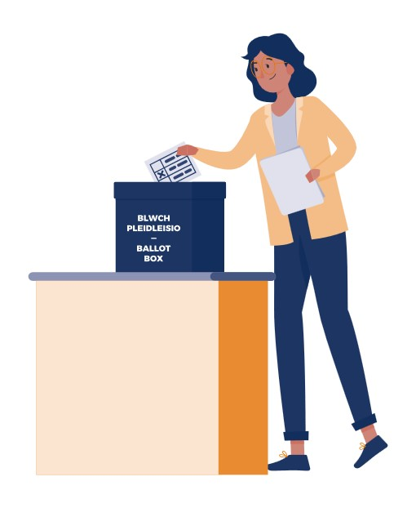
Senedd Election 2026
The next Senedd Election will be on 7 May 2026.
If you’re 16 by the 7 May – you will be eligible to vote in this election.
What will we be voting for in this election?
Notes:
The next Senedd Election will take place on 7 May 2026.
If you’re 16 by 7 May, you will be able to vote in this election.
But, what will you be voting for in this election?

Slide 5

Why do we vote?
Notes:
We’re now going to look at ‘Why we vote?'

Slide 6

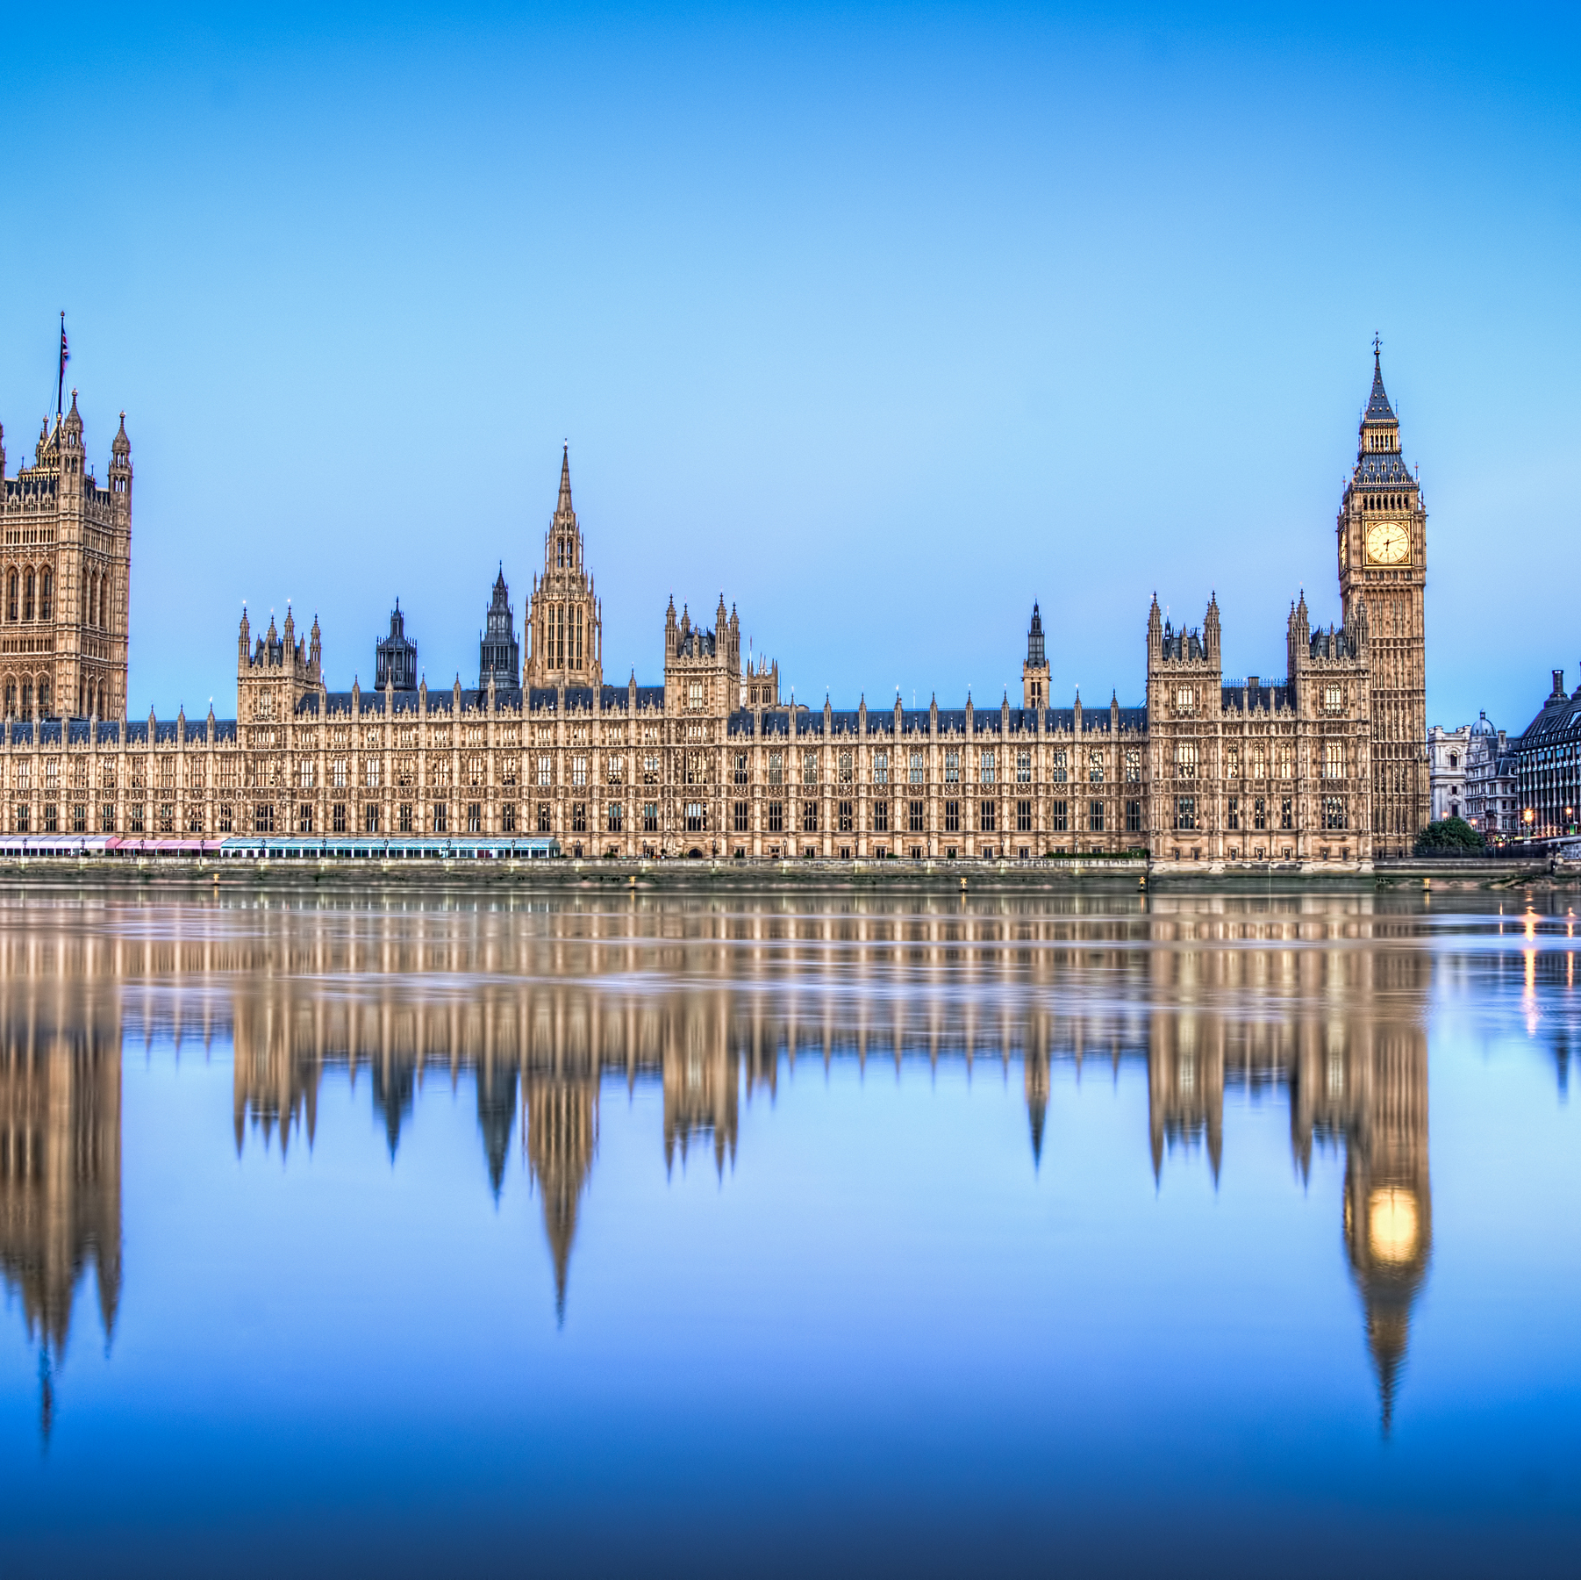

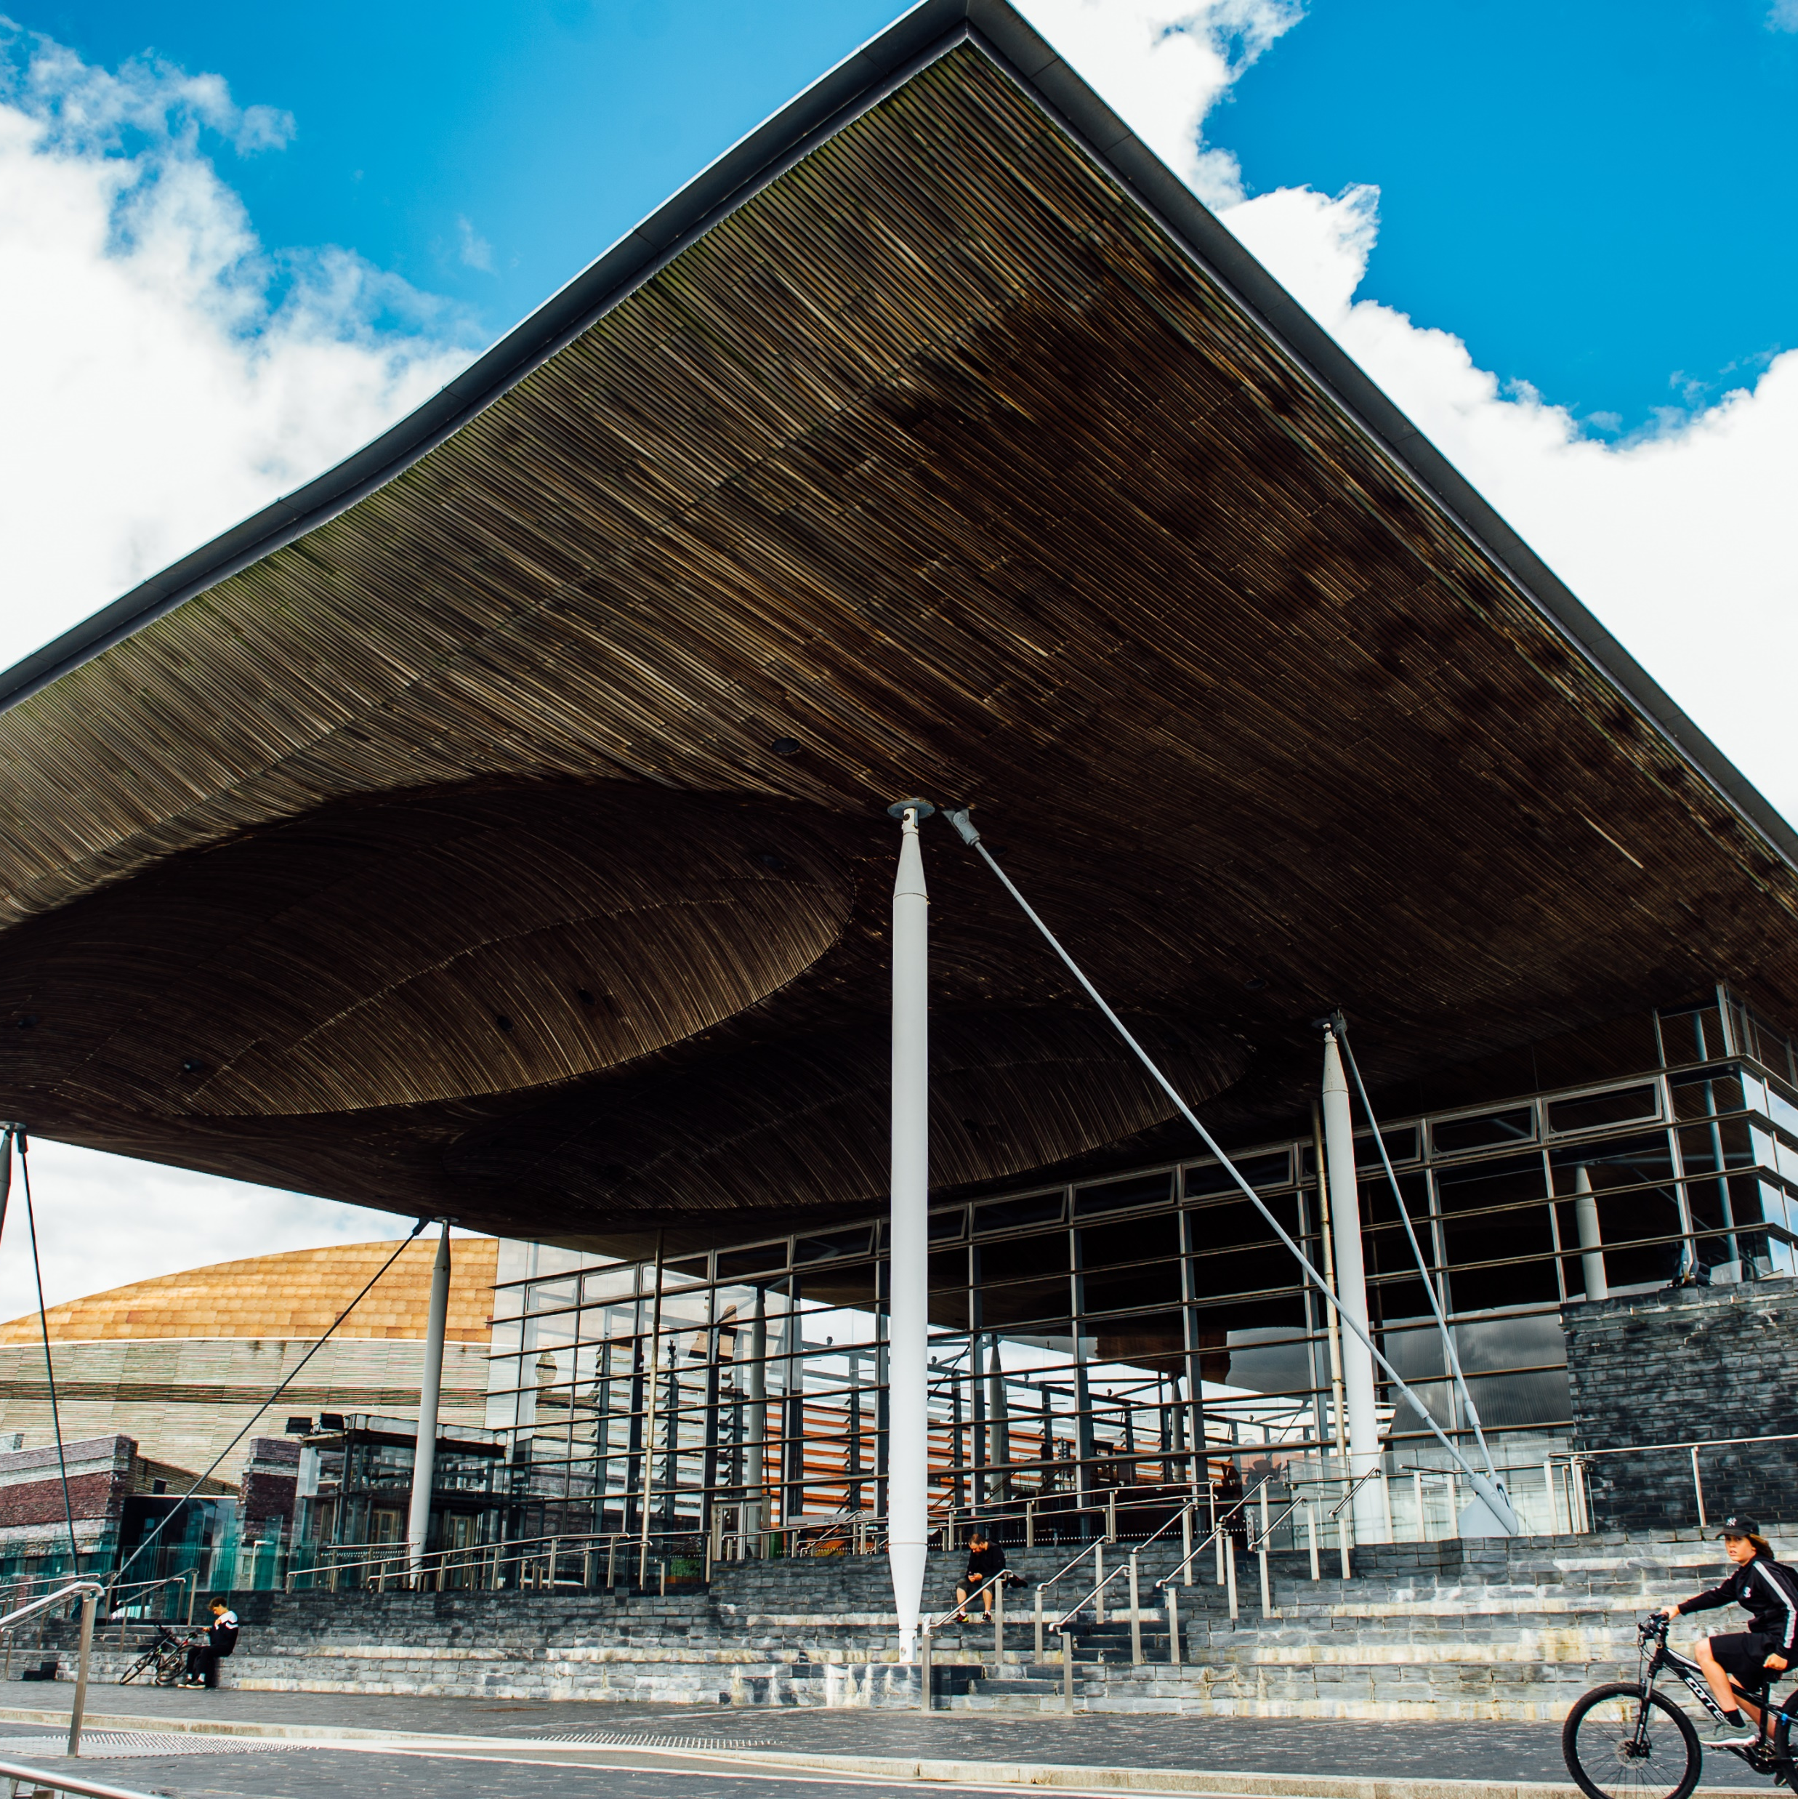
What is the Senedd responsible for and what will you be voting for?
UK Parliament
Welsh Parliament
Notes:
The Senedd is a democratically elected body, which means that we elect people to be Members of the Senedd to represent us in our areas and to speak on our behalf and for our rights.
The problem is – people are confused between the Senedd here in Wales and the UK Parliament in London.
This can affect people's confidence when going out to vote because they are not sure what exactly they are voting for.
So, here's a short task for you....

Slide 7












The Welsh
Language
Benefits
Sports
Tourism
Health
Food
Immigration
Environment
Education
Media
Housing
Crime and Policing
Notes:
Powers game
What Members of the Senedd discuss has to be related to the Powers of the Senedd.
Which of the Powers in the slide do you think Members of the Senedd are allowed to debate and discuss? The others are Powers that the UK have, these have been held back and the Senedd are not able to debate and discuss them.

Slide 8






Benefits
The Internet
Media
Nuclear Energy
Defence
Crime and Policing
Outer space
Import and Export
Air transport
Immigration
Notes:
These are the powers of the UK Parliament, and they are called reserved powers.

Slide 9




The Welsh
Language
Agriculture
Sports
Tourism
Health
Food
Fire and Rescue
Services
Environment
Education
Highways and transport
Housing
Culture
Notes:
Here are all the powers decided in The Senedd – as you can see it’s an important place that makes a lot of decisions on aspects of our lives. These are all called devolved powers as they’re decided in the Senedd.

Slide 10

The Senedd is responsible for many topics that affect our day-to-day lives.
Health
Food
Education
Fire and Rescue
Services
Sports
Environment
Agriculture
Housing
Notes:
The Senedd, as we can see, is responsible for many topics that affect our day-to-day lives.
When voting in the Senedd Election, we are voting for the best people to be meeting in the Senedd and making these decisions on our behalf.

Slide 11

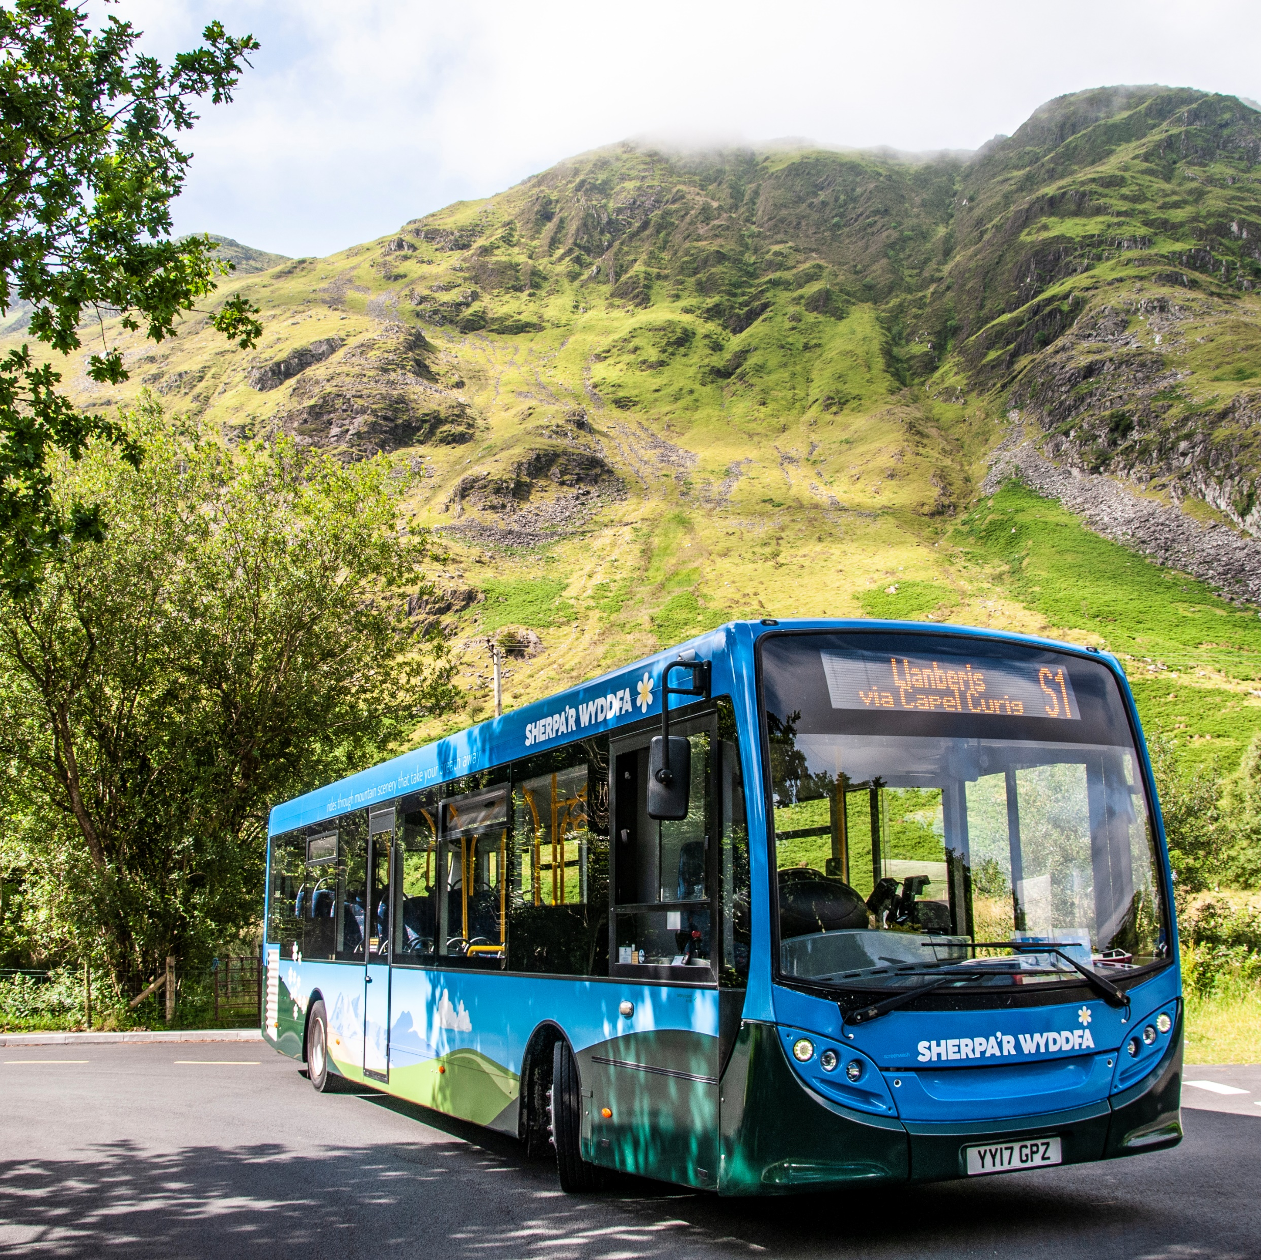
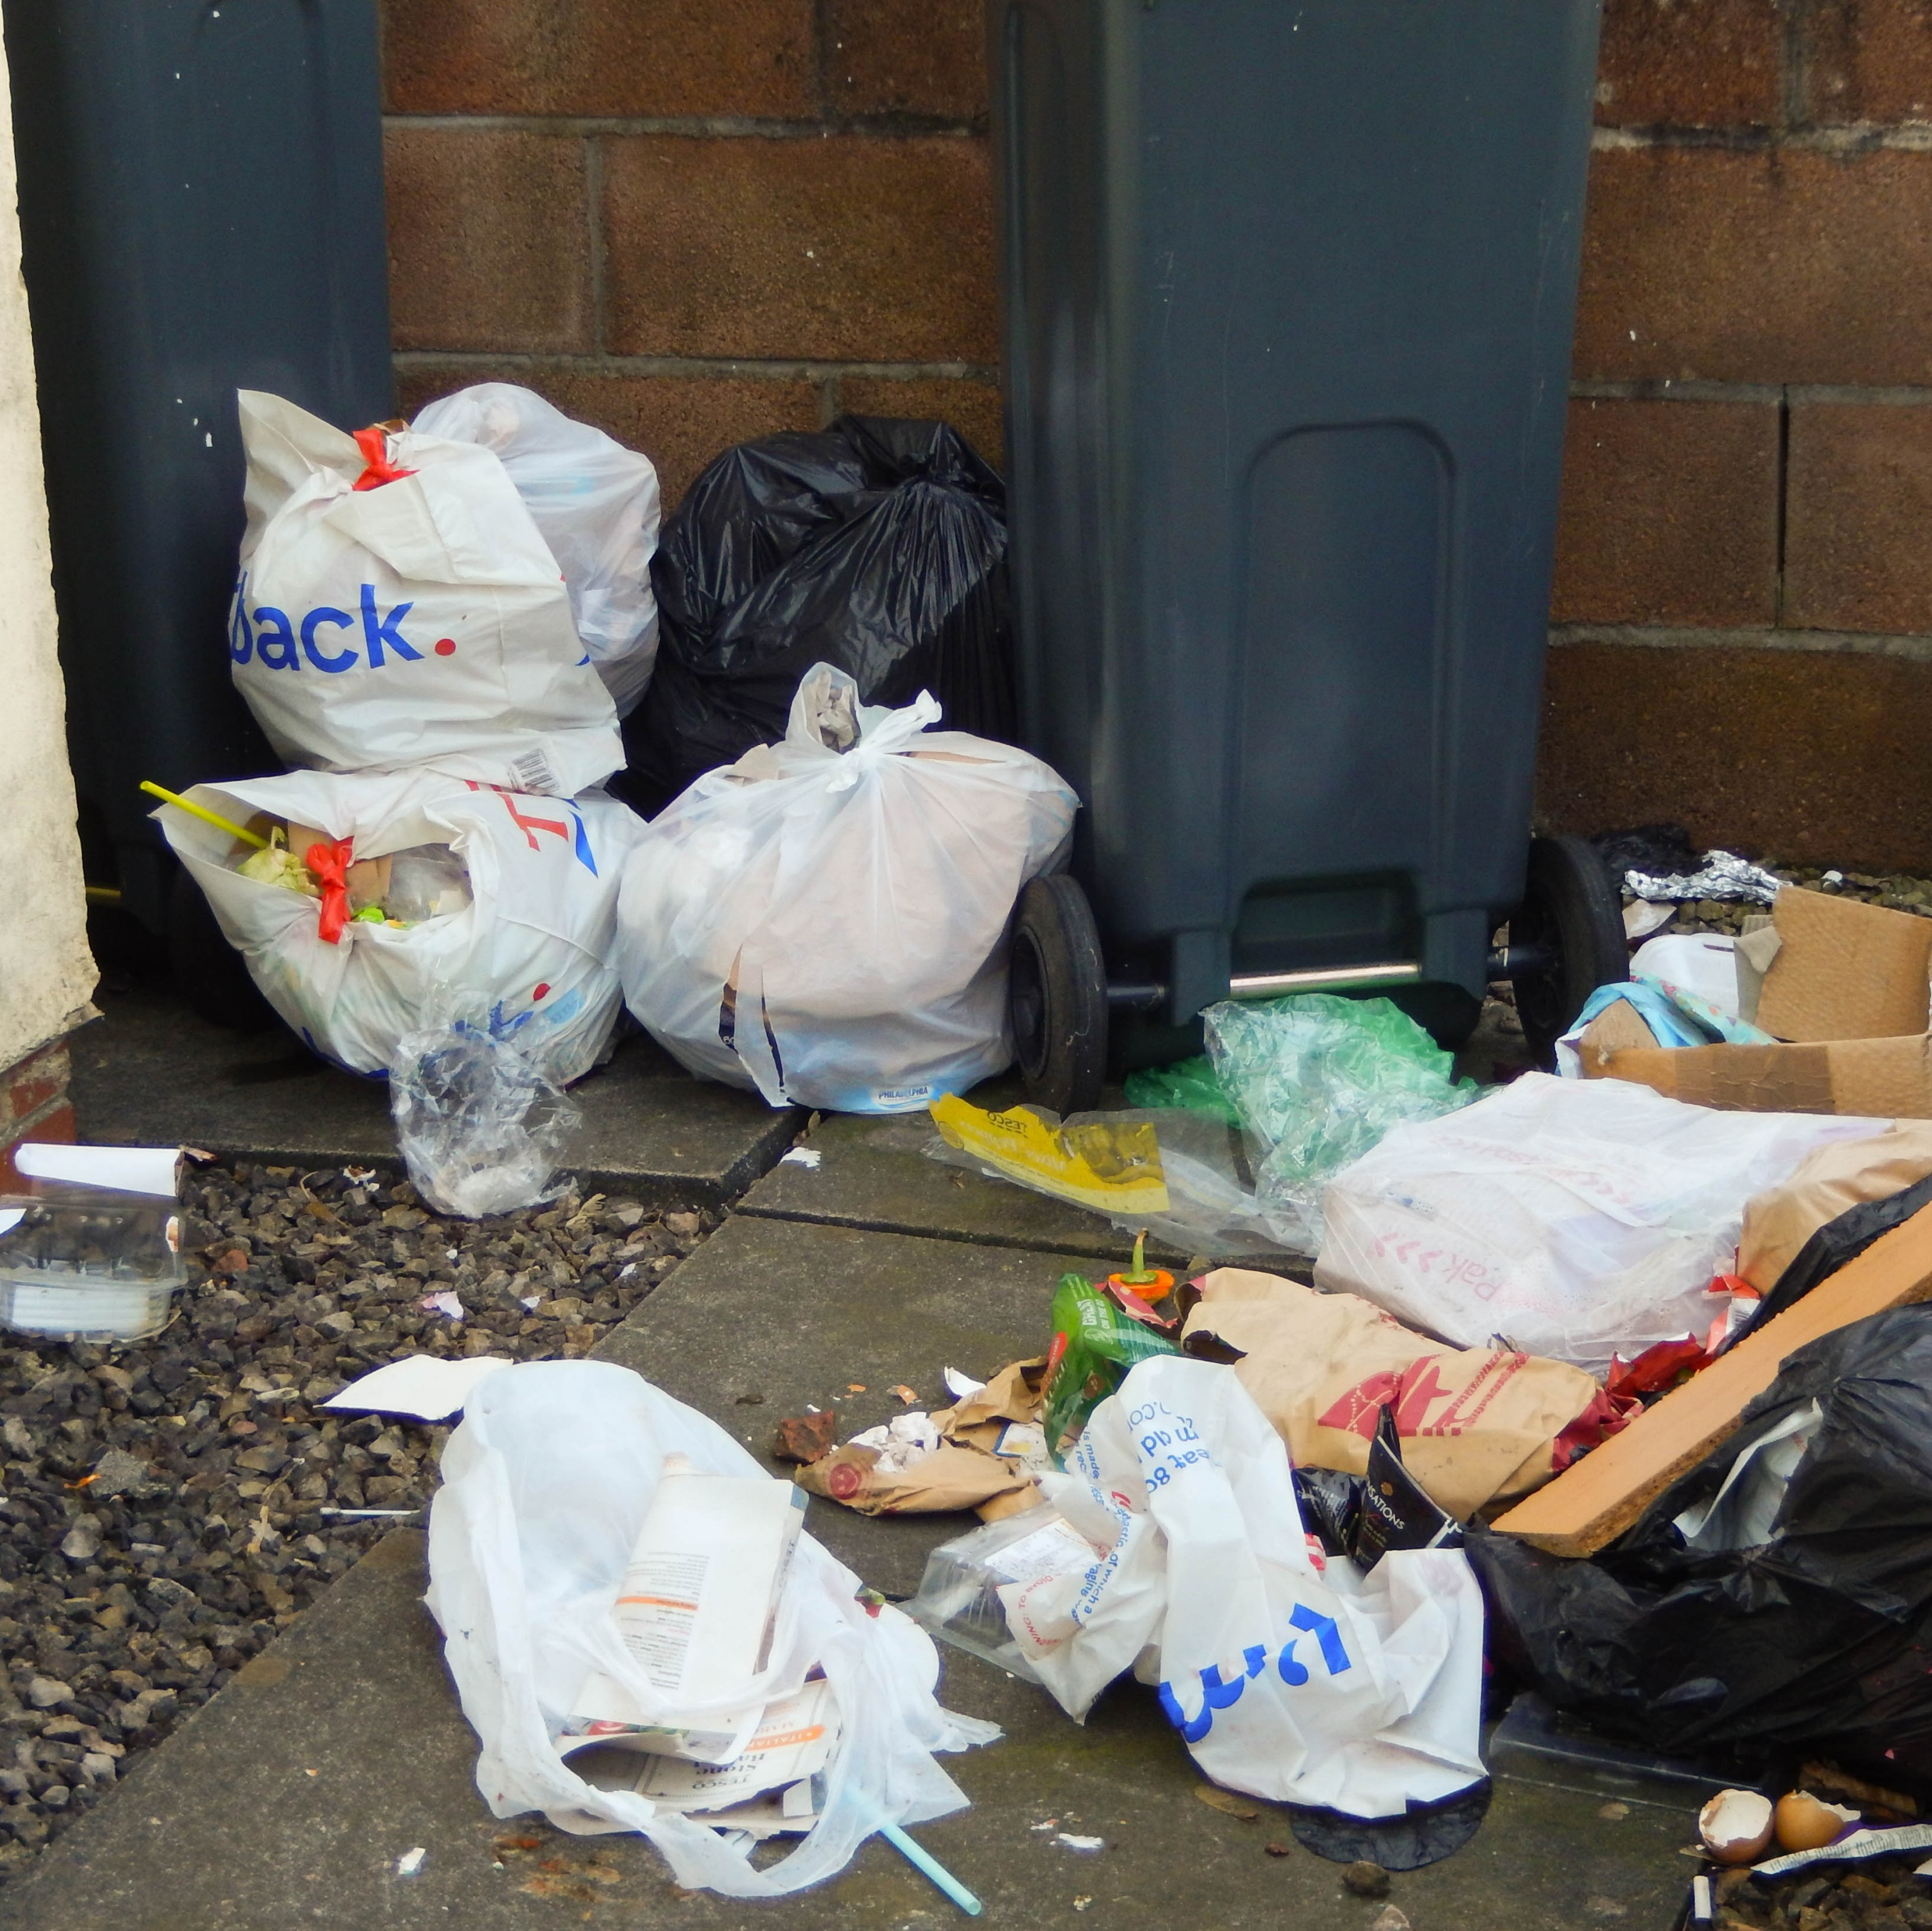
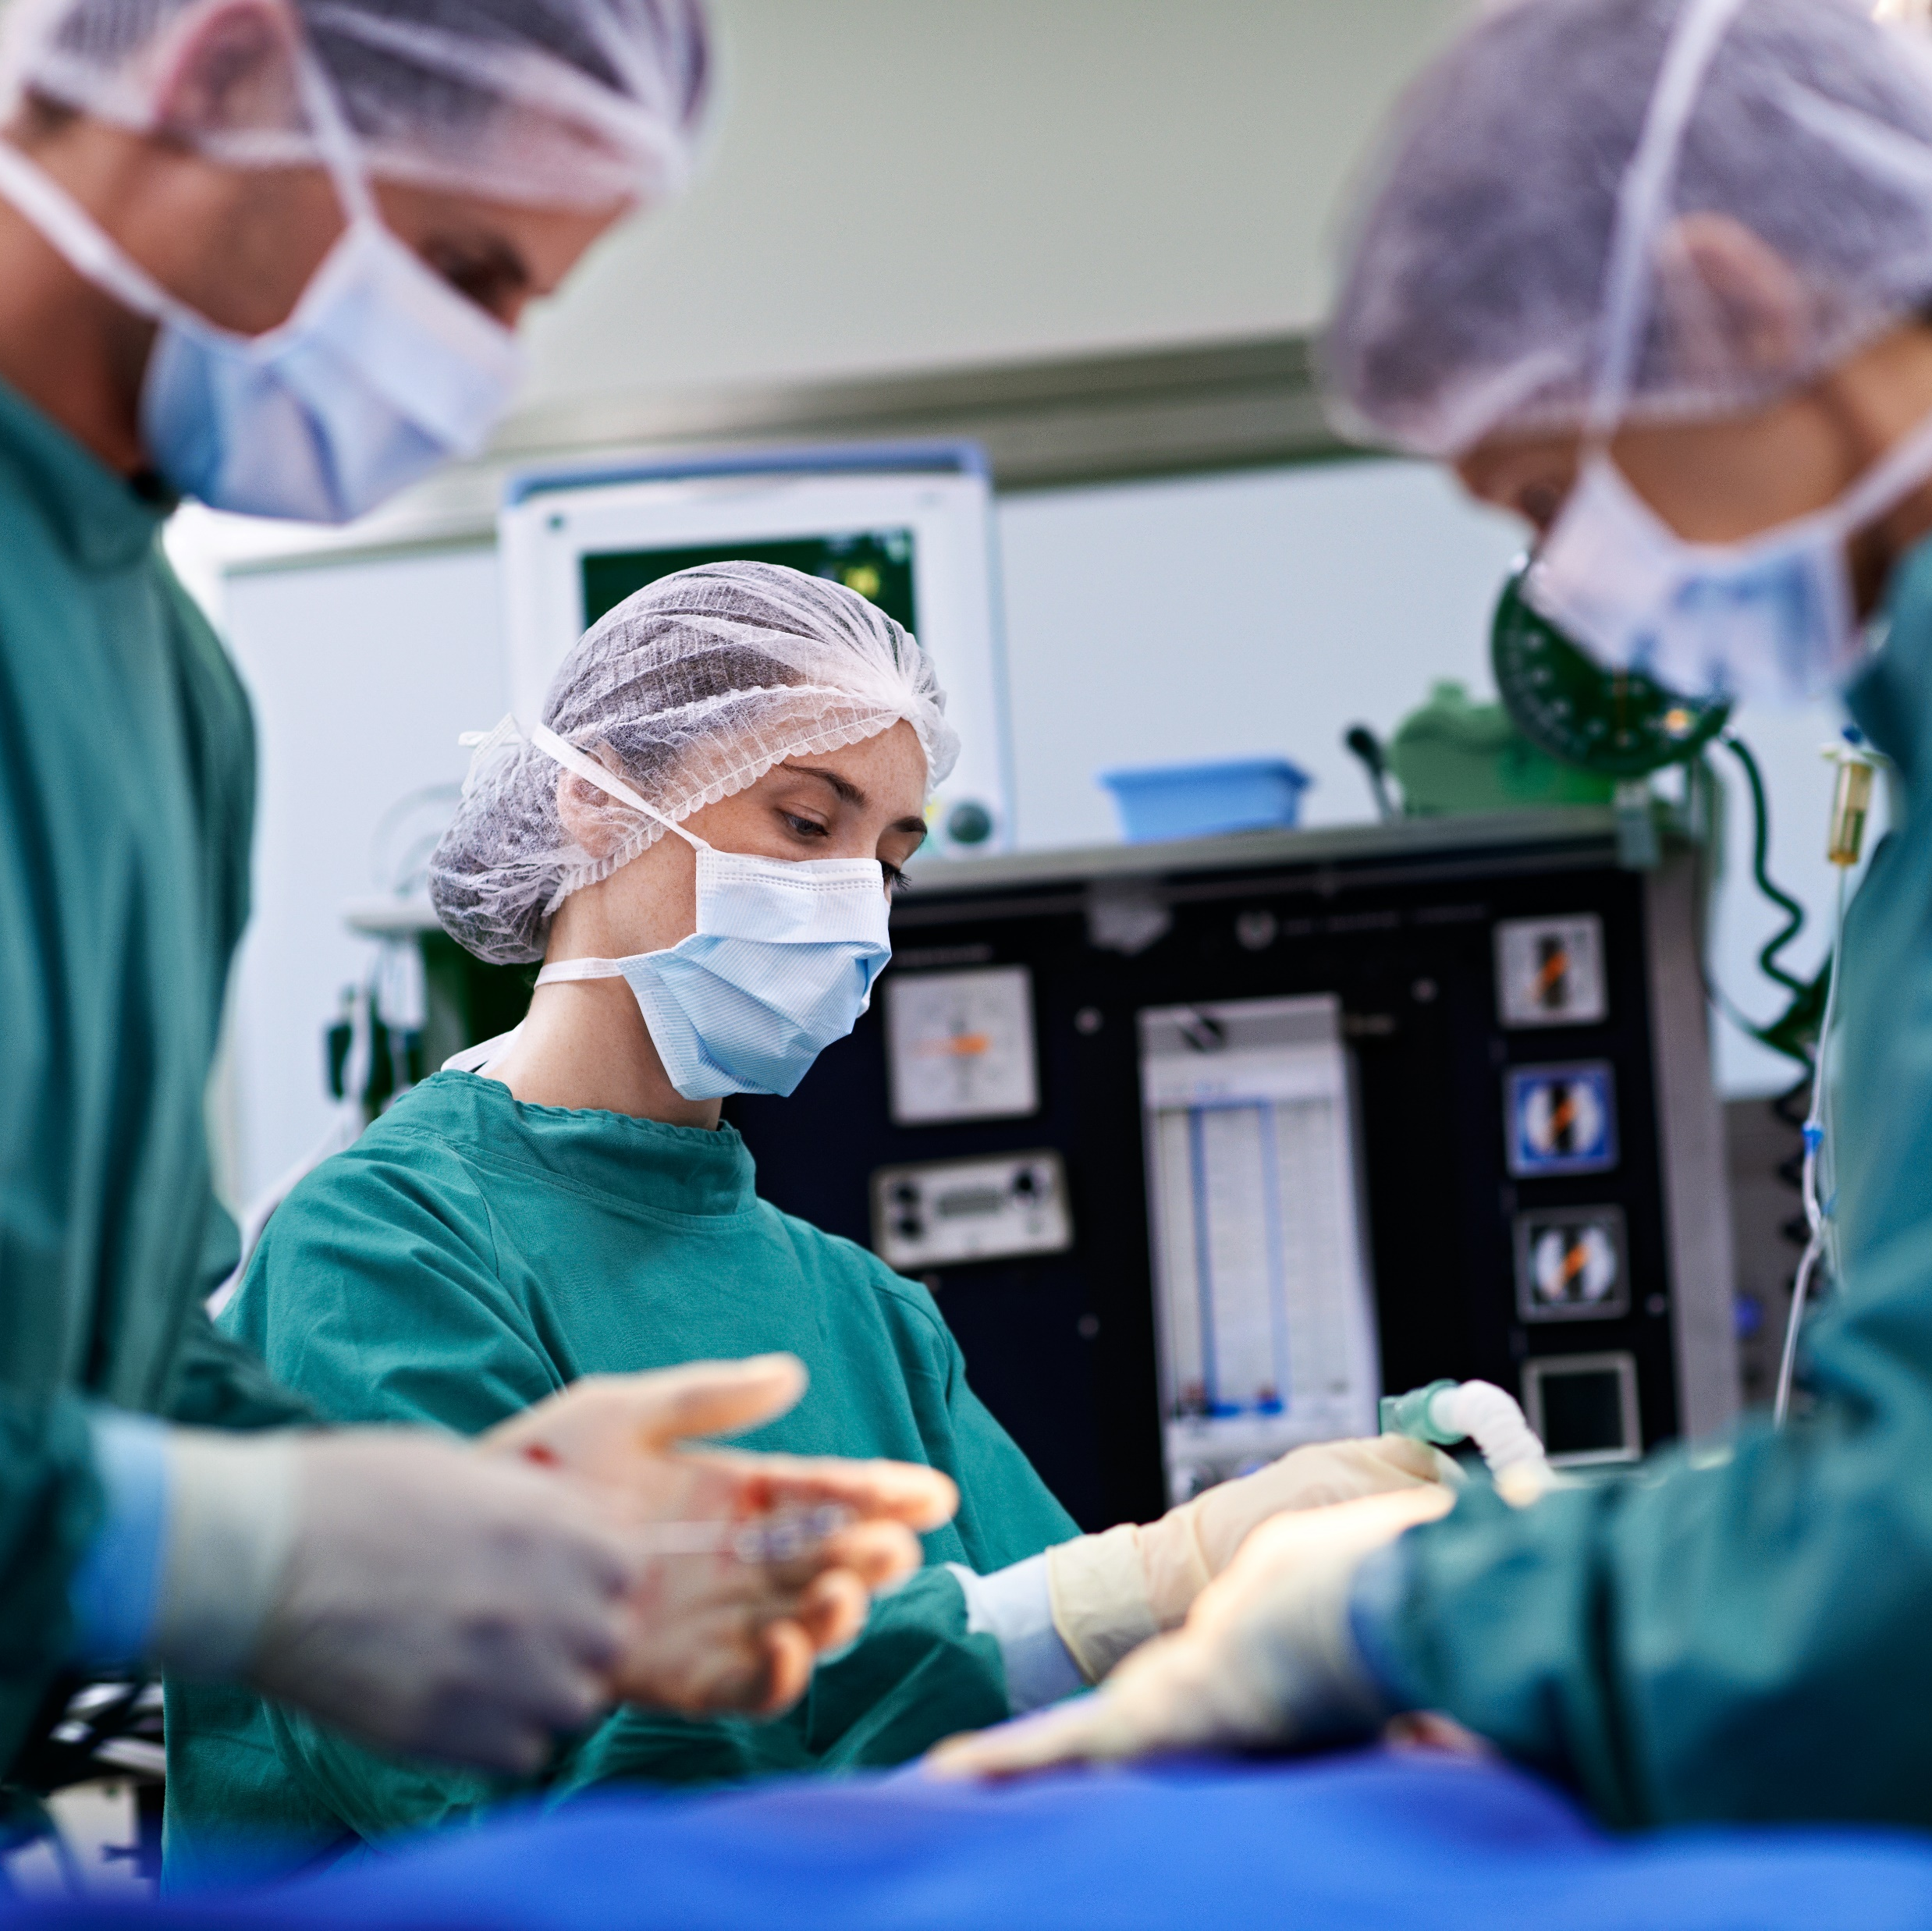


Deddfau’r Senedd Senedd Laws
Smoking ban
Free bus passes for those over 60 years old
£1 bus passes for young people 16-21 years old
5p plastic bags
Presumed consent for organ donation
Free prescriptions
20 mph
Notes:
What has the Senedd already done that has an affect on our everyday lives? Here are some of the things the Senedd has passed laws in here in Wales.
Going back to the question I asked at the beginning: why do we vote? We vote for the best people to represent us and legislate for Wales. Will you use your vote?

Slide 12

Is it important to vote?
Discuss!
Notes:
Is it important to vote? I want you to turn to the person next to you, in front of you or behind you and discuss this question. Is it important to vote? And why?

Slide 13
Is it important to vote?
Suffragettes
Make a protest
Discuss!
Be an active Citizen
Use your voice
Notes:
There are lots of reasons why it’s important to vote – it’s your opportunity to use your Voice and vote for the representatives you feel will make the best decisions for Wales. It’s a way to be an active citizen and be a part of making decisions for the Country.

Slide 14

What’s happening in this scene?
Elections and representation are an important part of politics and democracy - it’s important we have a way of choosing our leaders, and the way our country is led.
Notes:
What’s happening in this scene? What do you think the people in the queue are thinking and feeling?
Elections and representation are an important part of politics and democracy - it’s important we have a way of choosing our leaders, and the way our country is led.

Slide 15
Who are we voting for?
Notes:
Who are we voting for? We know what the Senedd is, what it does and that we have an election. But who are the people that meet in the Senedd.
We have an election to elect Members of the Senedd. Currently there are 60 Members of the Senedd, but the Senedd is changing.

Slide 16
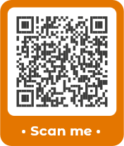
Your Senedd is Changing
What you need to know
Notes:
With the election on 7 May 2026 there will be some changes to the Senedd. If you want to find out more about this, you can scan the QR code or go to the senedd.wales website.

Slide 17
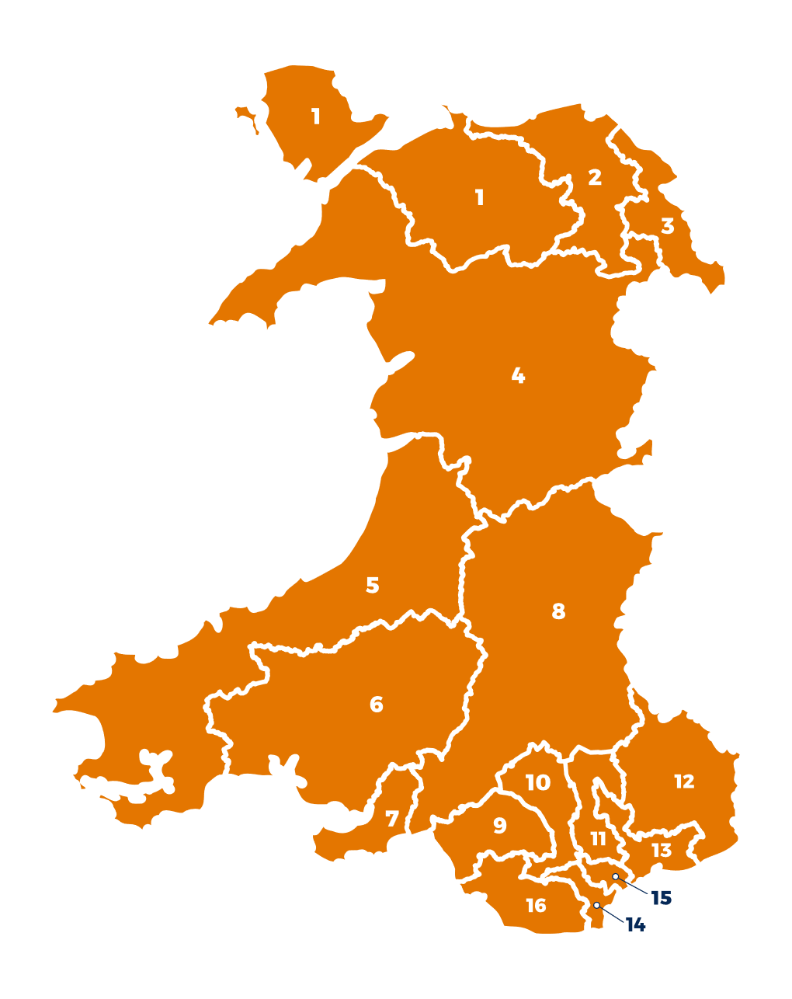
Members of the Senedd
Members of the Senedd are elected to represent us and our communities.
96 Members of the Senedd
16 Constituencies
6 Members of the Senedd in each Constituency
Notes:
These are the changes to the next election (go through them).
Some other changes include more regular election, so they will be every 4 years instead of every 5 years and candidates standing in election needing to live in Wales.

Slide 18




Political Parties
At the moment, there are five political parties in the Senedd.
Notes:
Members of the Senedd are members of political parties. Currently there are 5 parties in the Senedd. Depending on how the people of Wales vote, there could be additional parties in the Senedd following the election and there could also be independent members who aren’t a member of a party, they stand on their own.
Why have political parties? Yes – they all have different beliefs on how to run Wales as a country. They put their beliefs or promises in something called a manifesto.

Slide 19

Manifesto
A list of promises
Outlines what the party stands for and how they plan to effect change.
Each party will announce their manifesto in the lead up to the election.

Slide 20

Who do I vote for?
Party manifestos will help you to decide who to vote for in the Senedd election.
You should vote for the party whose manifesto you agree with the most.
Vote for the policies that will make life better for you here in Wales.

Slide 21
How to find out who’s standing?
Elections in your area | Electoral Commission
Notes:
It is also possible to find out who’s standing in your area by searching it on google and there is a post code hunter for candidates on the Electoral Commission’s website

Slide 22

How can you use your voice?
Notes:
The Senedd is a democratically elected body, which means that we elect people to be Members of the Senedd to represent us in our areas and to speak for us and for our rights.
Y broblem yw – mae pobl yn drysu rhwng y Senedd yma yng Nghymru a Senedd y DU yn Llundain.
Gall hyn effeithio ar hyder pobl wrth fynd allan i bleidleisio am nad ydynt yn siŵr am beth yn union y maen nhw’n pleidleisio.
Felly, mae yna dasg fer i chi....

Slide 23




Use your voice
There are lots of ways you can use your voice:
Election
Email
Meeting
Petition
Notes:
Show how young people can use their voice and contact their members. It doesn’t matter if you voted for them or not, you can contact any of them to ask for help with an issue.

Slide 24
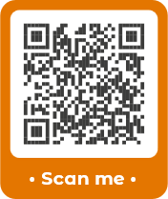
Contact your Members of the Senedd
Scan the QR code or visit senedd.wales/members
Notes:
Show how young people can use their voice and contact their members.

Slide 25

Petitions
Young people can begin petitions to be sent to the Senedd
Live petitions:
https://deisebau.senedd.cymru
https://petitions.senedd.wales
Notes:
Young people can start petitions to the Senedd. The Committee needs 50 signatures for a petition to be debated and 5,000 for the whole Parliament to debate it.
Llwyddodd Ysgol y Wern i gasglu dros fil o lofnodion i’w deiseb yn gofyn am wahardd gwellt plastig mewn ysgolion. Bydd Llywodraeth Cymru yn cyflwyno deddf i wahardd eitemau plastic untro yng Nghymru – dylai hon ddod i rym yn 2021 - https://busnes.senedd.cymru/mgIssueHistoryHome.aspx?IId=22259
Ysgol Caer Drewyn (pictured) sent a petition to Parliament to reinstate the Corwen Dental Unit. They managed to collect 157 signatures, which meant that the Petitions Committee could discuss the petition. The Committee contacted those responsible for the dental unit and it was agreed to restore the unit - https://busnes.senedd.cymru/mgIssueHistoryHome.aspx?IId=18654
Whizz Kidz sent a petition to Parliament asking for better access to public transport https://deisebau.senedd.cymru/deisebau/1046
Sam Faulkner and Joanne Griffiths, pupils at Ysgol y Preseli in Pembrokeshire, and Ysgol Cardigan in Ceredigion (bottom right), collected over 1,300 signatures and created their own website to highlight the petition. There was even more coverage from the local press, BBC Wales and ITV Wales. Rail services were increased and a new station was built.
Holly Rosalie Homer (goldfish photo) – Holly submitted a petition to Parliament to ban goldfish from being given away at a fair. She collected over 2000 signatures. The impact of Covid-19 has delayed the Animal Welfare (Licensing of Animal Exhibitions) Regulations 2020 and the Welsh Animal Health and Welfare Framework Group will discuss the awarding of animals as prizes in the future- https://busnes.senedd.cymru/mgIssueHistoryHome.aspx?IId=27032

Slide 26


Will you vote in the 7 May 2026 Senedd Election?
Yes
No
Notes:
Will you vote next year? Why is it important to vote?

Slide 27

Any questions?

