Slide 1

Monthly Matter – September 2025

Slide 2

Last month, we asked you about how much time you spend on screens and devices.
Here’s what we found out:

Slide 3
⏰ 30% of you said you spend less than 2 hours a day on a device. But 20% of you spent 7 hours or more
✅ 53% of you had rules about screen time at home
📲 30% of you thought the Government needed to stop young people from spending too much time online; but 42% of you disagreed

Slide 4
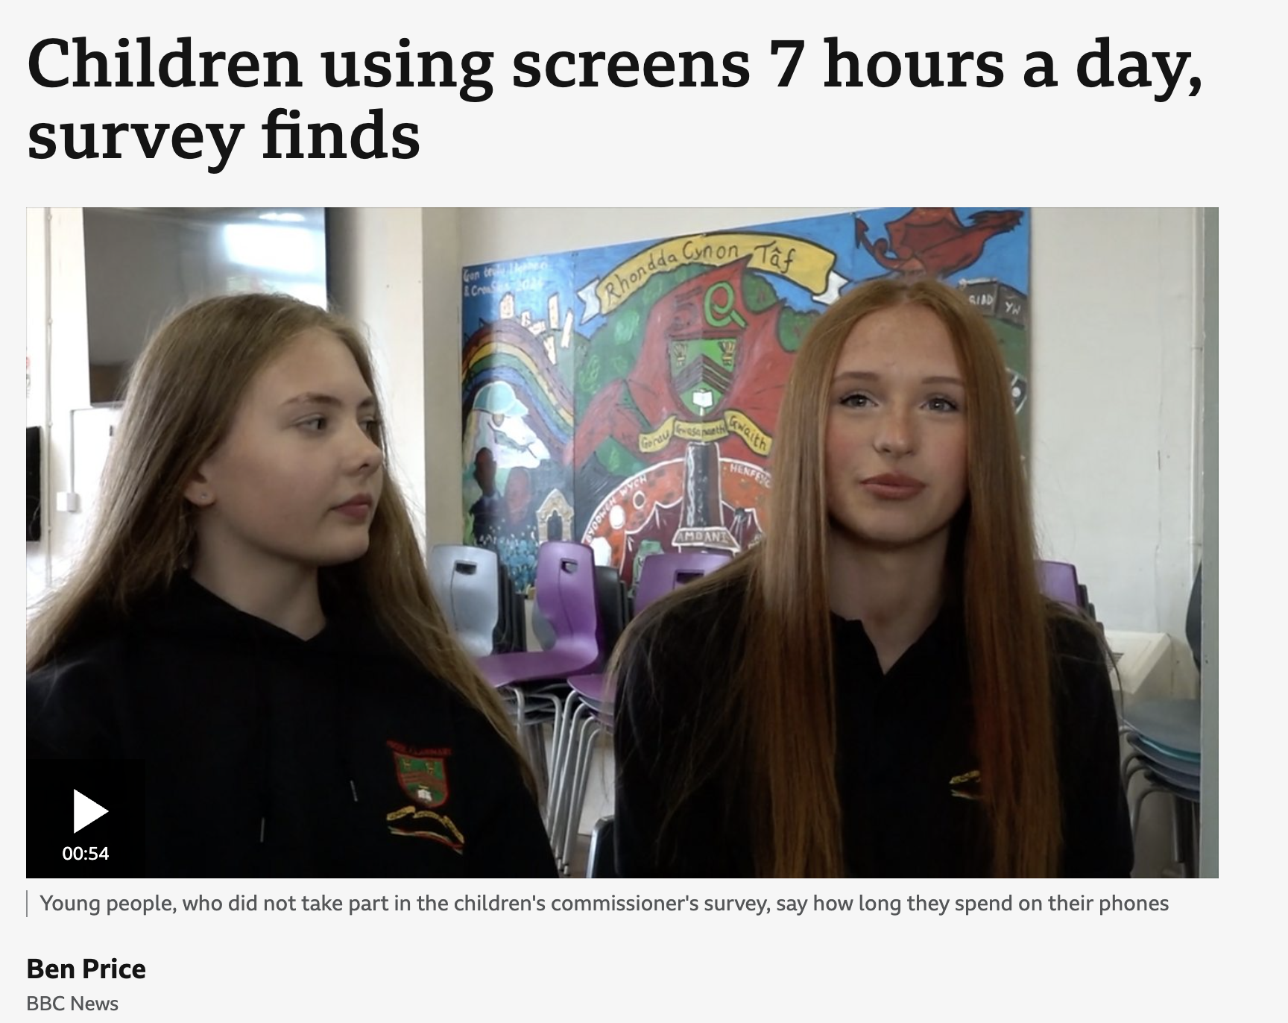
We shared your responses as part of a BBC Wales news piece ➡️

Slide 5

September’s Monthly Matter is all about school uniform.
Remember: Article 12 – Right to proper food, clothing and housing

Slide 6
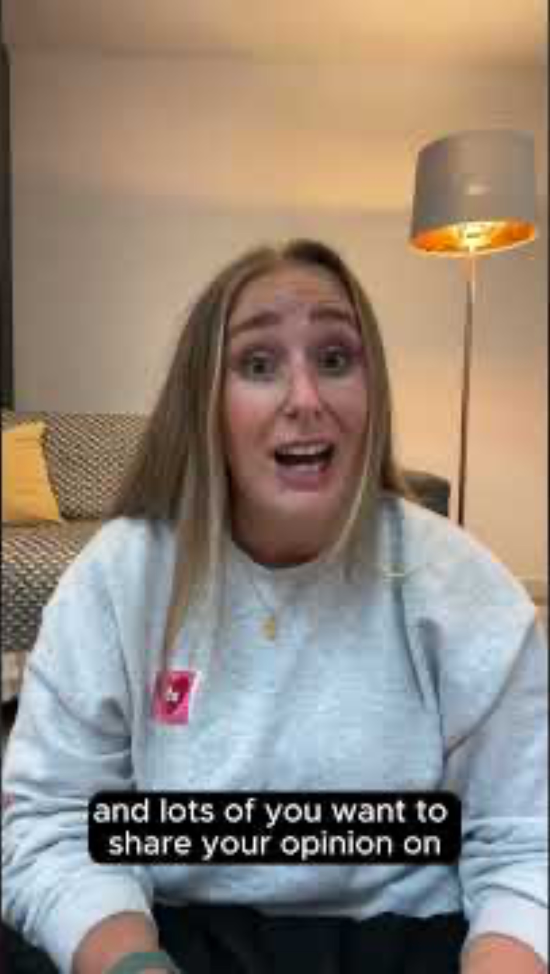
Notes:
Link to the video: https://youtube.com/shorts/Sqt8KenIluI

Slide 7

1) Discuss in pairs or as a group:
Is school uniform important?
Is your uniform comfortable
What about the cost of school uniform, is this something you know about?
Notes:
There are supporting materials on our web page for children with additional learning needs

Slide 8

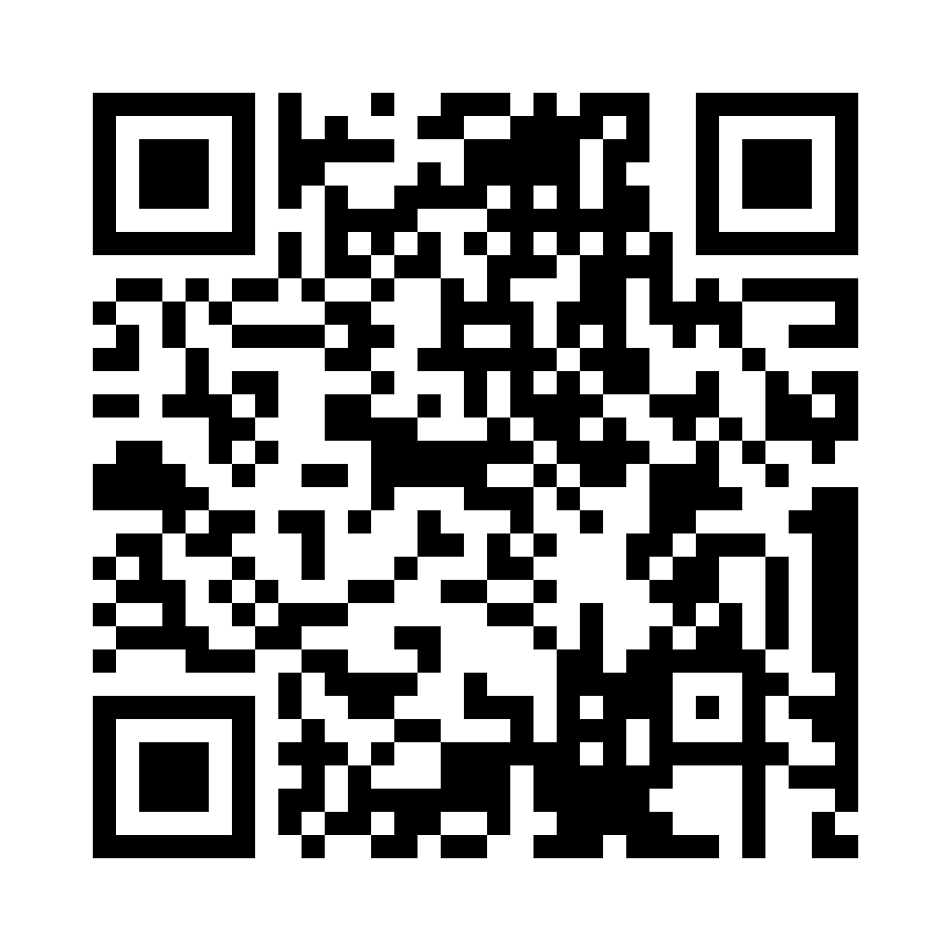
Share your ideas with us by using the QR code or survey link
(Each young person can do this individually or a teacher can do it on behalf of the class)
Notes:
Survey link - https://online1.snapsurveys.com/eoqtha

Slide 9

If you are worried about anything after today's session you should speak to a trusted adult.
You could also contact our Advice team:
0808 801 1000
advice@childcomwales.org.uk
www.childcomwales.org.uk
Notes:
You could also contact & speak to:
Childline – 0800 1111
Meic – 080880 23456

Slide 10
👇 If you want to continue this discussion….
🔗 Take a look at the follow-up activity on the website. It’s all about how clothes are made and how we can make uniform more environmentally friendly 🌍

Slide 11

Diolch!
Thanks!
Our next Monthly Matter will be available on our website on
Monday, October 6th

