Slide 1







Hawliau plant a Chomisynydd
plant Cymru
Children’s Rights & the children’s commissioner for wales

Slide 2




Heddi...
Today we will...
Hawliau Plant
Comisiynydd Plant Cymru
Cwestiynau
Children’s Commissioner for Wales
Children’s Rights
Questions
Notes:
This powerpoint covers what children’s rights are, who the commissioner is and what they do. Opportunity for further questions and potential future learning.
Mae'r cyflwyniad Pwerbwynt yma yn cynnwys - beth yw hawliau plant, pwy yw'r comisiynydd a beth maen nhw'n ei wneud. Cyfle i ofyn cwestiynau pellach a dysgu posib i’r dyfodol.

Slide 3
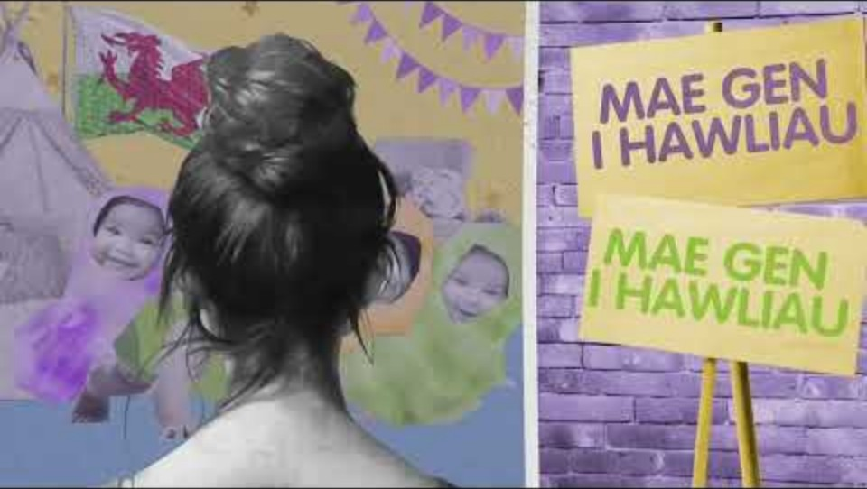
Notes:
https://www.youtube.com/watch?v=4b4OVUbI5hk
Mae’r fidoe yma yn cynnwys ‘3 pennod’ – efallai bo chi ond eisiau gwylio un darn o’r fideo neu gofyn i bawb wylio’r fideo cyn neu ar ol y gwasanaeth.

Slide 4
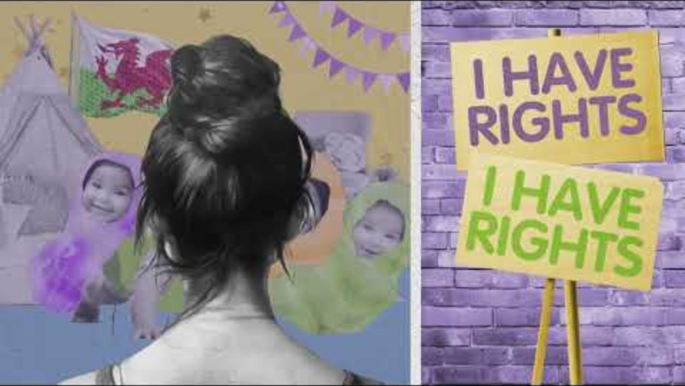
Notes:
https://www.youtube.com/watch?v=CJPZ_31njq4
This video is split into 3 parts – you may only wish to watch one part during the assembly or you might like to ask classes to watch the video before or after the assembly.

Slide 5





Hawliau plant
Children’s rights
Hapus
Iach
Diogel
Happy
Healthy
Safe
Notes:
‘What are children’s rights?’ Pupils should know from the video that they are the things children and young people need to grow up happy, healthy and safe. They may name some of their rights during this part and that’s great! If they don’t prompt them to name things they need to grow up happy, health and safe (their rights!)
‘Beth yw hawliau plant?’ Dylai disgyblion wybod o’r fideo mai nhw yw’r pethau sydd eu hangen ar blant a phobl ifanc i dyfu i fyny’n hapus, yn iach ac yn ddiogel. Efallai wneiff rhai ateb trwy enwi rhai o’u hawliau yn ystod y rhan yma ac mae hynny’n wych! Os nad ydyn nhw’n enwi rhai hawliau gallwch eu hannog i enwi pethau sydd eu hangen arnyn nhw i dyfu i fyny’n hapus, yn iach ac yn ddiogel (eu hawliau nhw!).

Slide 6

Notes:
Here are some visual clues for some of their rights if they need some additional support.
They represent (from left to right, top and then bottom)
Right to be listened to and taken seriously, right to choose own religion, right to privacy, right to be safe, if you are a refugee - you have the same rights as every other child in Wales, right to additional support and special education if needed, rights to appropriate food/safe home & clothing, right to play/rest/relax.
Dyma rai cliwiau gweledol ar gyfer rhai o'u hawliau os oes angen rhywfaint o gefnogaeth ychwanegol arnynt. Maent yn cynrychioli (o'r chwith i'r dde, o’r top ac yna’r gwaelod)
Hawl i gael eich gwrando a'ch cymryd o ddifrif, hawl i ddewis eich crefydd eich hun, hawl i breifatrwydd, hawl i fod yn ddiogel, os ydych chi'n ffoadur mae gennych chi'r un hawliau â phob plentyn arall yng Nghymru, hawl i gefnogaeth ychwanegol ac addysg arbennig os oes angen, hawliau i fwyd/cartref diogel a dillad addas, yr hawl i chwarae/gorffwys/ymlacio.

Slide 7
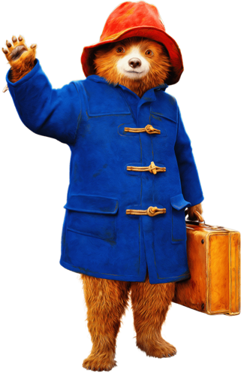

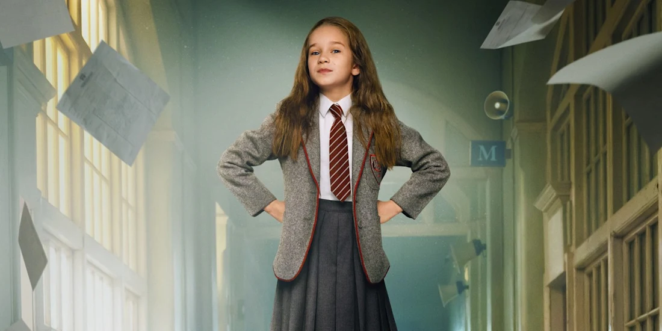
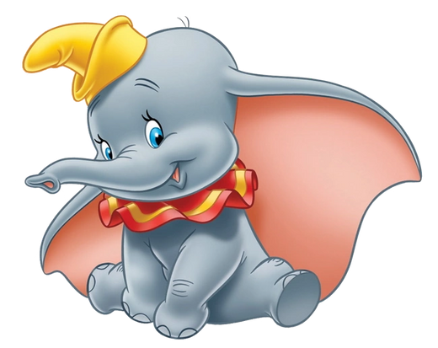

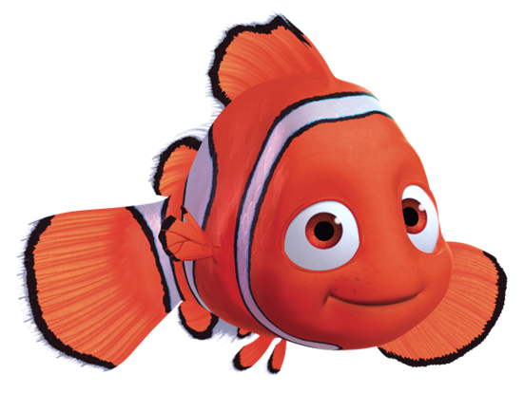
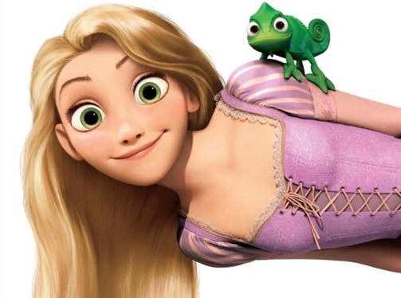
Notes:
Before showing this slide!! Tell the children that on this slide they will see some familiar faces and characters. You want them to think individually if these characters were getting their rights? Were they kept happy, healthy and safe?
Ask pupils to share their thoughts and ideas on which rights are being accessed or denied.
Matilda: Didn’t get accessed education (article 28) or a full education(article 29) was not listened to (article 12) and was not living in a safe/adequate home (article 27) she is happily adopted on the end (article 21)
Dumbo: Was bullied for his ears/appearance (Article 19) and didn’t have many friends (article 15)
Paddington: Is a refugee (article 22) is fostered (20)
Ariel/Little mermaid: Looses her voice and is not listened too by her father (article 12)
Rapunzel: Was kidnapped (article 35) and is not listened too (article 12) and was not safe (article 19)
Harry Potter: Did not live in appropriate room (article 27) was not treated fairly by his aunt and uncle (article 3/20) was often in danger (article 19)
Nemo: Was kidnapped (article 35) has a disability (article 23) His father tried too keep him too safe and didn’t listen to him (article 3 & 12)
Cyn dangos y sleid hon!! Dywedwch wrth y plant y byddant yn gweld rhai wynebau a chymeriadau cyfarwydd ar y sleid yma. Rydych chi eisiau iddyn nhw feddwl yn unigol a oedd y cymeriadau hyn yn cael eu hawliau? A oeddent yn cael eu cadw'n hapus, yn iach ac yn ddiogel?
Gofynnwch i'r disgyblion rannu eu meddyliau a'u syniadau ynghylch pa hawliau sy'n cael i dderbyn neu i wrthod.
Matilda: Ni chafodd addysg (erthygl 28) neu addysg lawn (erthygl 29) ni chafodd wrando arni (erthygl 12) ac nid oedd yn byw mewn cartref diogel/digonol (erthygl 27) mae hi’n cael i'w mabwysiadu yn y diwedd (erthygl 21)
Dumbo: Cafodd ei fwlio am ei glustiau/ymddangosiad (Erthygl 19) ac nid oedd ganddo lawer o ffrindiau (erthygl 15)
Paddington: Yn ffoadur (erthygl 22) yn cael ei maethu (20)
Ariel/Y forforwyn fach: Yn colli ei llais ac nid yw ei thad yn gwrando arni chwaith (erthygl 12)
Rapunzel: Cafodd ei herwgipio (erthygl 35) ac nid yw'n cael ei gwrando chwaith (erthygl 12) ac nid oedd yn ddiogel (erthygl 19)
Harry Potter: Ni oedd ganddo stafell wely priodol (erthygl 27) ni chafodd ei drin yn deg gan ei fodryb a'i ewythr (erthygl 3/20) roedd mewn perygl yn aml (erthygl 19)
Nemo: Cafodd ei herwgipio (erthygl 35) mae ganddo anabledd (erthygl 23) Ei dad ceisiodd ei gadw'n rhy ddiogel a wnae dim gwrando arno (erthygl 3 a 12)

Slide 8








Rocio Cifuentes
Comisiynydd Plant Cymru
Children’s Commissioner for Wales
Gwrando
Codi llais
Helpu
Newid
Listen
Speak up
Help
Change
Notes:
Rocio’s jobs: Can the children guess what job are represented on the symbols?
Listen: Rocio listens to children to find out what they need, what they care about, and how they feel about different things.
Speak up: Rocio speaks up about the things children need. After listening to children, she shares what she hears with people who make decisions about children's lives.
Helps: Rocio has a team of people who can help and give advice if children or the adults who care for them feel like they aren't being treated fairly.
Change: Rocio challenges people who make decisions about children's lives to make a change.
Swyddi Rocio: Ydy’r plant gallu dyfalu beth mae pob symbol yn golygu?
Gwrando: Mae Rocio yn gwrando ar blant i ddarganfod beth sydd ei angen arnyn nhw, beth maen nhw'n poeni amdano, a sut maen nhw'n teimlo am wahanol bethau.
Codi llais: Mae Rocio yn codi llais am y pethau sydd eu hangen ar blant. Mae hi'n rhannu'r hyn mae hi'n ei glywed gyda phobl sy'n gwneud penderfyniadau am fywydau plant.
Helpu: Mae gan Rocio dîm o bobl a all helpu a rhoi cyngor os yw plant neu'r oedolion sy'n gofalu amdanyn nhw'n teimlo nad ydyn nhw'n cael eu trin yn deg.
Newid: Mae Rocio yn herio pobl sy'n gwneud penderfyniadau am fywydau plant i wneud newid.

Slide 9


Becso am rywbeth?
Feeling worried?
Notes:
Remind pupils if they are ever worried or concerned about something they should tell someone, more ideas on next slide.
Atgoffwch y disgyblion os ydyn nhw byth yn poeni neu’n bryderus am rywbeth y dylen nhw ddweud wrth rywun, mwy o syniadau ar y sleid nesaf.

Slide 10



Siaradwch ag oedolyn rydych chi'n ymddiried ynddo yn yr ysgol neu gartref.
Cysylltwch â gwasanaeth cymorth fel Childline neu Meic.
Speak to an adult you trust in school.
Speak to an adult you trust at home.
Contact a support service like Childline or MEIC.

Slide 11


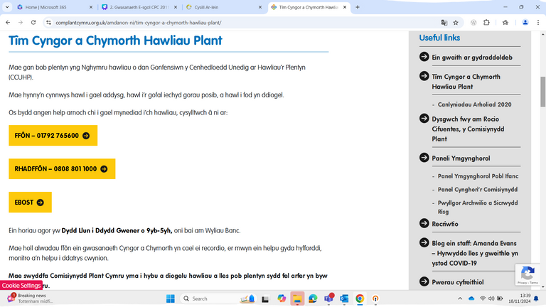


Helpu
Help
Gallwch gysylltu gyda’r tîm cymorth a chyngor trwy:
  ffonio: 01792 765600
  e-bostio cyngor@complantcymru.org.uk
  danfon neges ar y wefan
You can contact the advice and assistance team by:
  calling 01792 765600
  emailing post@childcomwales.org.uk
  send a message via the website
Notes:
Child Com Wales’ advice service.
Gwybodaeth am wasanaeth cymorth Comisiynydd Plant Cymru.

Slide 12

Cwestiynau
Questions
Notes:
If you have any trouble answering questions about rights and the commissioner you are welcome to get in touch with us via post@childcomwaled.org.uk
Os rydych chi’n cael trafferth i ateb cwestiynau am hawliau neu’r comisiynydd, mae croeso i chi gysylltu â ni drwy post@childcomwaled.org.uk

