Slide 1
Monthly Matter – June 2025

Slide 2
Last month, we asked you about the election that will be run in Wales next ​ May 2026. ​
And here’s what you told us:

Slide 3
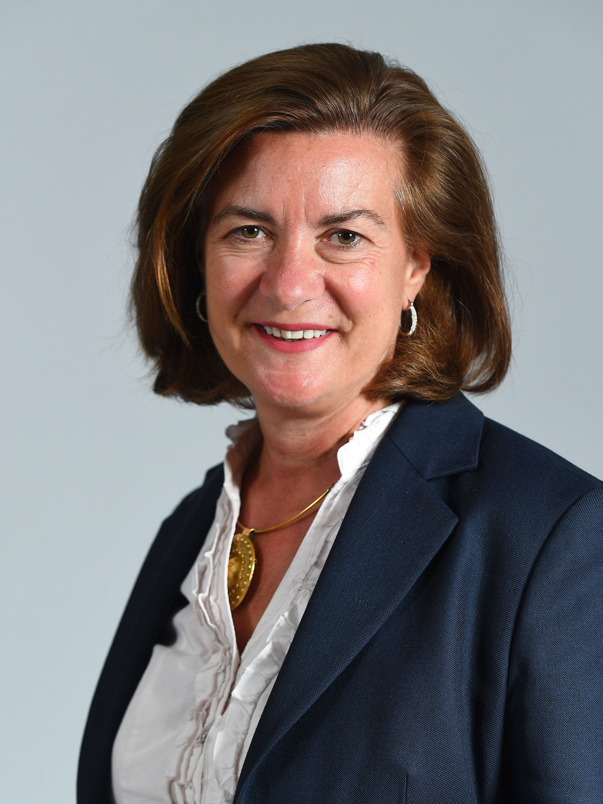
Over 700 of you took part​
92% of you didn’t know that Eluned Morgan is the first minister of Wales
77% of you know that the Senedd building is in Cardiff Bay
62% of you think it’s true that you can vote online in a Senedd election

Slide 4
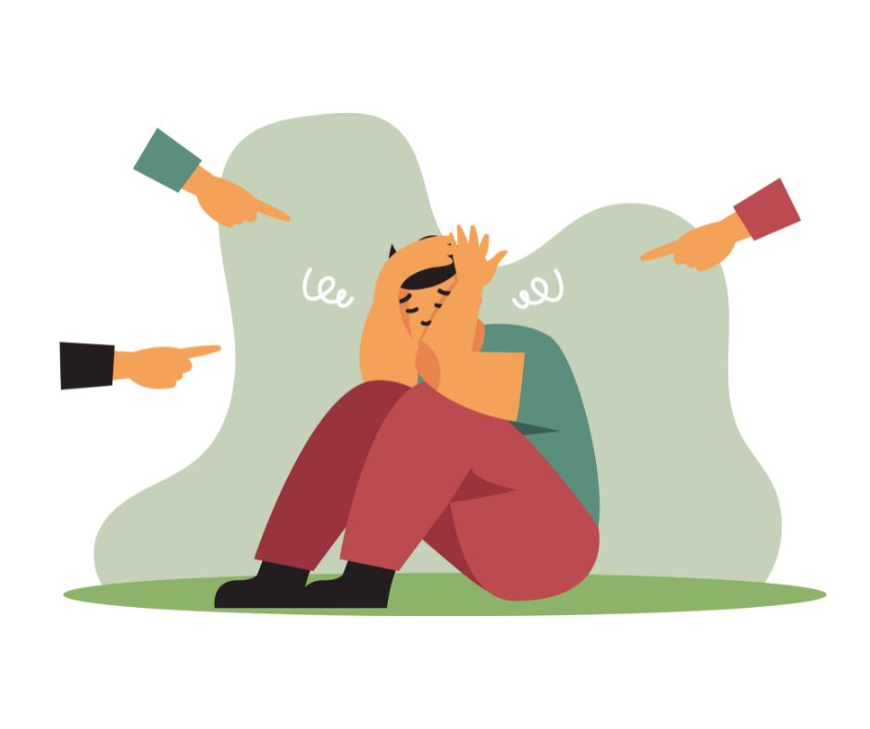
June’s Monthly Matter is about anti-bullying Remember: Article 19 – Right to be protected from being hurt or badly treated

Slide 5
Notes:
Link to the video: https://youtube.com/shorts/sYZ_8hX-V0g

Slide 6
An anti-bullying policy tells people how a school deals with bullying.
Discuss in pairs or groups:
Does your school have an anti-bullying policy?
Is there a version for children/ young people?
How would you want to learn about your school's anti-bullying policy?

Slide 7
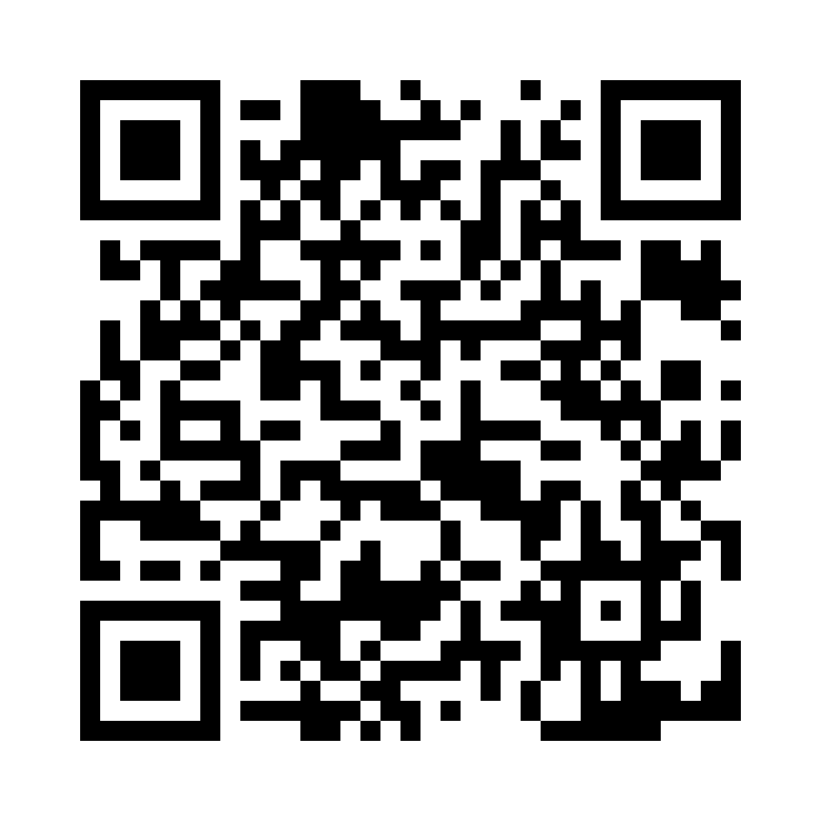
Share your ideas with us by using the QR code or survey link
(Each young person can do this individually or a teacher can do it on behalf of the class)
Notes:
Link to survey: https://online1.snapsurveys.com/rgj3iz

Slide 8
If you are worried about anything after today's session you should speak to a trusted adult.
You could also contact & speak to:
Childline – 0800 1111
Meic – 080880 23456
Or you can contact our
Advice Team:
0808 801 1000
advice@childcomwales.org.uk
www.childcomwales.org.uk
Notes:
You could also contact & speak to:
Childline – 0800 1111
Meic – 080880 23456
Or you can contact our Advice Team:
0808 801 1000
advice@childcomwales.org.uk
www.childcomwales.org.uk

Slide 9
Want to know more?
You can have a look at the Welsh Government website
https://www.gov.wales/rights-respect-equality-anti-bullying-guidance

Slide 10
Diolch! Thanks!
Our next Monthly Matter will be available on our website on
Monday, 7th of July

