Slide 1
Monthly Matter – July/August 2025

Slide 2
Last month, we asked you about
anti-bullying.
And here’s what you told us:

Slide 3
⭐️ 41% said of you said your school has an anti-bullying policy for children and young people
⭐️ Watching videos and assemblies were your preferred way to learn about your anti-bullying policy
⭐️ 73% of you felt like you had somebody to talk to in your school about bullying
⭐️ 32% of you had been asked what you think should be in your school's anti-bullying policy

Slide 4
July and August’s Monthly Matter is about how much time we spend on our screens or on our devices. Remember: Article 17 - You have the right to get information in lots of ways, so long as it’s safe.

Slide 5
Notes:
Link to the video: https://youtu.be/9tr6GHtMXGw

Slide 6
According to a BBC article, the UK Government are thinking about limiting the amount of time children and young people can spend on social media.
Some of the things they are thinking about are:
2-hour limit on the use of individual social media apps
10pm curfew on social media apps for those under 18 years old
Discuss in pairs or groups:
Do you agree or disagree with a 10pm curfew on social media apps for under 18s?
Do you agree or disagree with a 2-hour limit on individual social media apps?
How do you feel about your own screen time?

Slide 7
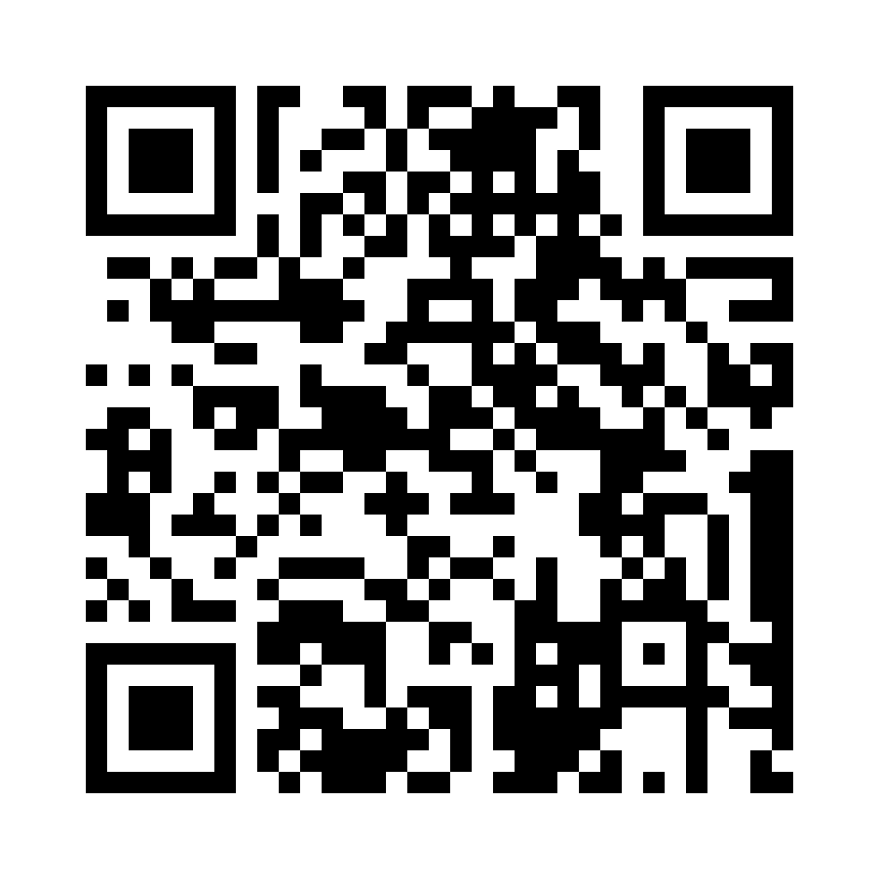
Share your ideas with us by using the QR code or survey link
(Each young person can do this individually or a teacher can do it on behalf of the class)
https://online1.snapsurveys.com/twihag
Notes:
Link to survey: https://online1.snapsurveys.com/twihag

Slide 8
If you are worried about anything after today's session you should speak to a trusted adult.
You could also contact & speak to:
Childline – 0800 1111
Meic – 080880 23456
Or you can contact our
Advice Team:
0808 801 1000
advice@childcomwales.org.uk
www.childcomwales.org.uk
Notes:
You could also contact & speak to:
Childline – 0800 1111
Meic – 080880 23456
Or you can contact our Advice Team:
0808 801 1000
advice@childcomwales.org.uk
www.childcomwales.org.uk

Slide 9
Diolch! Thanks!
Our next Monthly Matter will be available on our website on
Monday, 1st of September

