Slide 1
Right of the Month

Slide 2
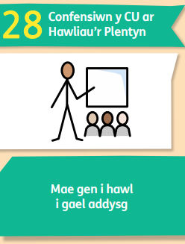
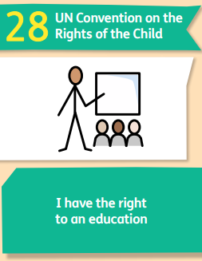
September - Article 28
Think about one subject or topic you think you're strong at and one you'd like to improve this year – share with your partner.
Do all young people get to access their right to an education? If not what may stop them and who could help them?

Slide 3
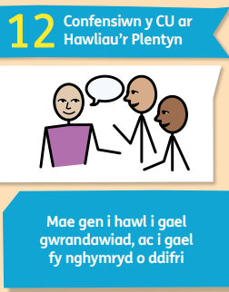
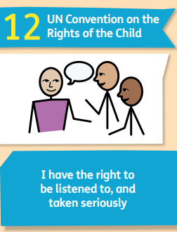
October – Article 12
*Link to pupil voice
Who listens to you in school?
Does your school have a school council or pupil voice group? How do they listen to you?
Can you think of other ways your school, local council or decision makers in your area listen to children and young people?

Slide 4
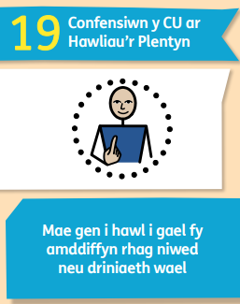
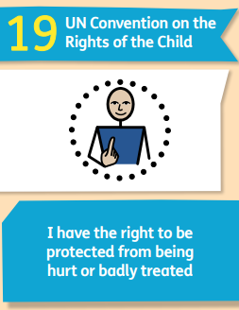
November – Article 19
*Link to anti-bullying week
What adults keep you safe in different situations? Think about safety at home, in school and in your community.
Does your school/group have rules or policies about keeping you safe? What do they include?
If you think somebody is not safe or being kept safe what could you do?
What should you do if you ever feel unsafe or unhappy?

Slide 5
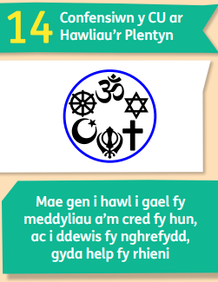
December – Article 14
In December lots of people celebrate Christmas.
What religion celebrates Christmas?
What do other religions celebrate?
What symbols can you recognise or learn about from the symbols card?

Slide 6
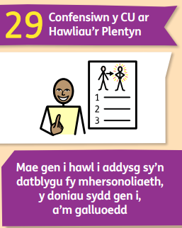
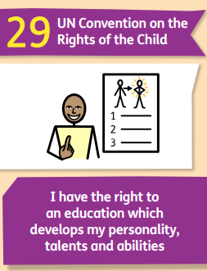
January – Article 29
Can you think about one thing you are good at doing? This maybe things in school or out of school - it could be art, sports, drama, cooking, music or even being a friend.
Is there anything you would like to learn this year? Where could you do this?

Slide 7
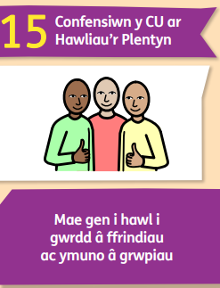
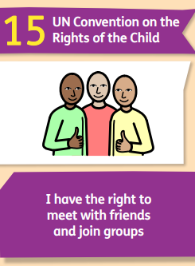
February – Article 15
What makes a good friend? You could draw a picture of your friend or write a list of what makes a good friend.
Can you think about what clubs/ groups there are already in your school/ community? Is there anything missing? Who can help with this?

Slide 8
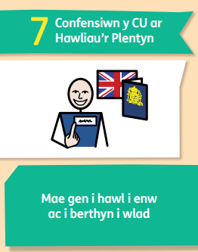
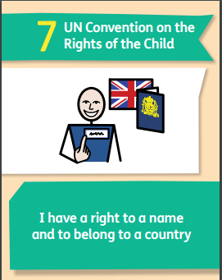
March – Article 7
In Wales on March 1st it’s St David’s day – this is a great chance to celebrate our nationality.
How do people traditionally celebrate St Davids day?
What do you enjoy about living Wales?

Slide 9
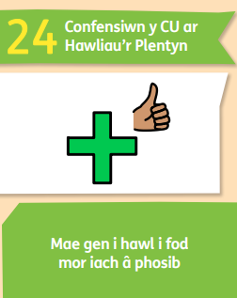
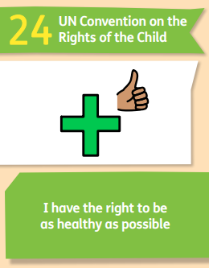
April and May – Article 24
*Links to World Health Day and Mental Health awareness week
Can you think about all the different ways that children and young people can be healthy and look after their well-being?
Can you think of 3 new things that you would like to try to keep a healthy body and mind.
Where can you go to get support for well-being?

Slide 10
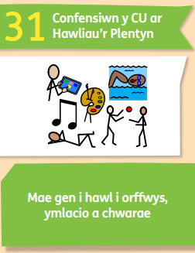
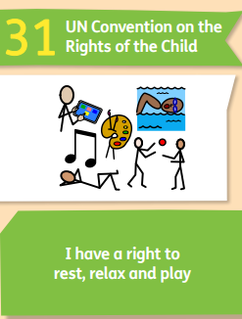
June/July – Article 31
*Links to international day of play; Sports Day; Fun & Fitness Week
What is your favourite game to play with friends and why?
How do you like to spend your free time?
What is the best thing about summer holidays?

Slide 11
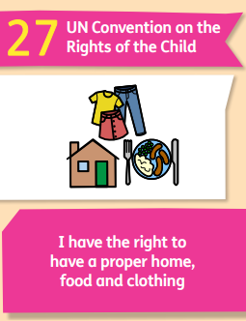
August – Article 31 & Article 27
What is your favourite game and why?
Is there any free clubs or play activities in your area?
Are there Food and Fun activities near you?

