Slide 1
Monthly Matter – May 2025

Slide 2
Last month, we asked you how you looked after your teeth.
And here’s what you told us:

Slide 3
Over 700 of you took part
66% of you have been to the dentist since the start of the school year
83% of you brush your teeth at least twice a week
49% of you wash the tooth paste out after brushing

Slide 4
May’s Monthly Matter is about the election that will be run in Wales next ​ May 2026. ​ Remember: Article 13 – Right to get information and share my views

Slide 5
Notes:
Link to the video: https://youtu.be/fVsDs5BAoJU

Slide 6
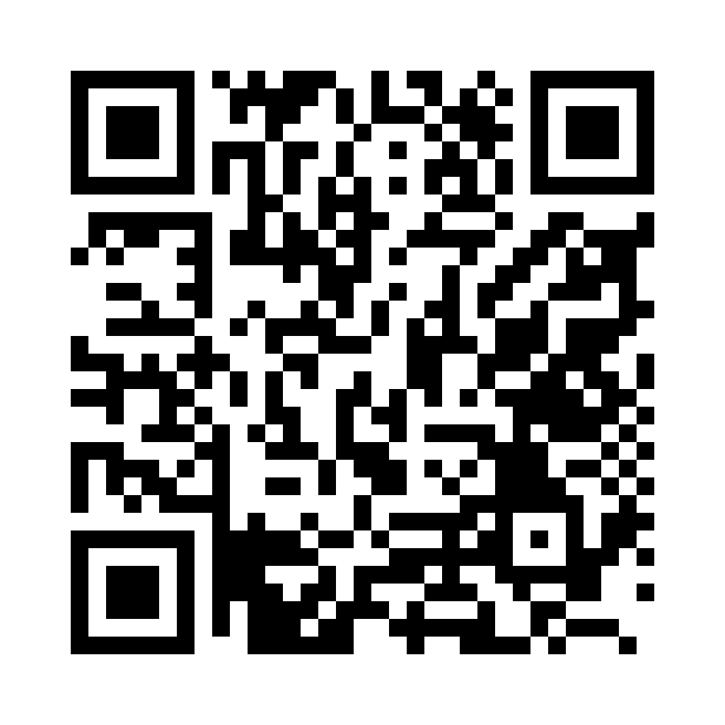
To take part in the survey, please click on the link below:
https://online1.snapsurveys.com/yx8fof
Notes:
Link to survey: https://online1.snapsurveys.com/yx8fof
There are supporting materials on our web page for children with additional learning needs

Slide 7
Here are the answers from the survey:​
Notes:
Link to video: https://youtu.be/kk56oLQgei0

Slide 8
Discuss in pairs or as a group:
What do you already know about politics and the election?
Have you ever seen or heard information from political parties and what did you think of it?
What do you know about the Senedd and the people who are in charge of Wales now?
Notes:
There are supporting materials on our web page for children with additional learning needs

Slide 9
In the run up to next year's election, please get in touch with us if you'd like resources to help your group learn more about the Senedd and elections in Wales.
Email post@childcomwales.org.uk
Notes:
Email address: post@childcomwales.org.uk

Slide 10
If you are worried about anything after today's session you should speak to a trusted adult.
You could also contact our Advice team:
0808 801 1000
advice@childcomwales.org.uk
www.childcomwales.org.uk
Notes:
You could also contact & speak to:
Childline – 0800 1111
Meic – 080880 23456

Slide 11
Diolch! Thanks!
Our next Monthly Matter will be available on our website on
Monday 2nd June

