Slide 1

Monthly Matter – December 2024

Slide 2

Last month, we asked you about the Environment.
Here’s what you told us:

Slide 3



In November almost 1000 of you told us what you were doing to help the environment
At home, lots of you are re-using shopping bags, turning off lights, and using food waste bins
Lots of you wanted more opportunities for litter picking at school or your community group
Only 20% of you knew what the Welsh Government are doing to help the environment
Teachers, there are free educational resources on the environment from the Welsh Government and from Size of Wales
Notes:
1st link - https://www.climateaction.gov.wales/
2nd link - https://sizeofwales.org.uk/education-resources/

Slide 4

December's Monthly Matter is about
Human Rights Day
Article 42 – everyone should know about children's rights.

Slide 5

Notes:
Link to video: https://youtube.com/shorts/L26tiK3A3oI

Slide 6
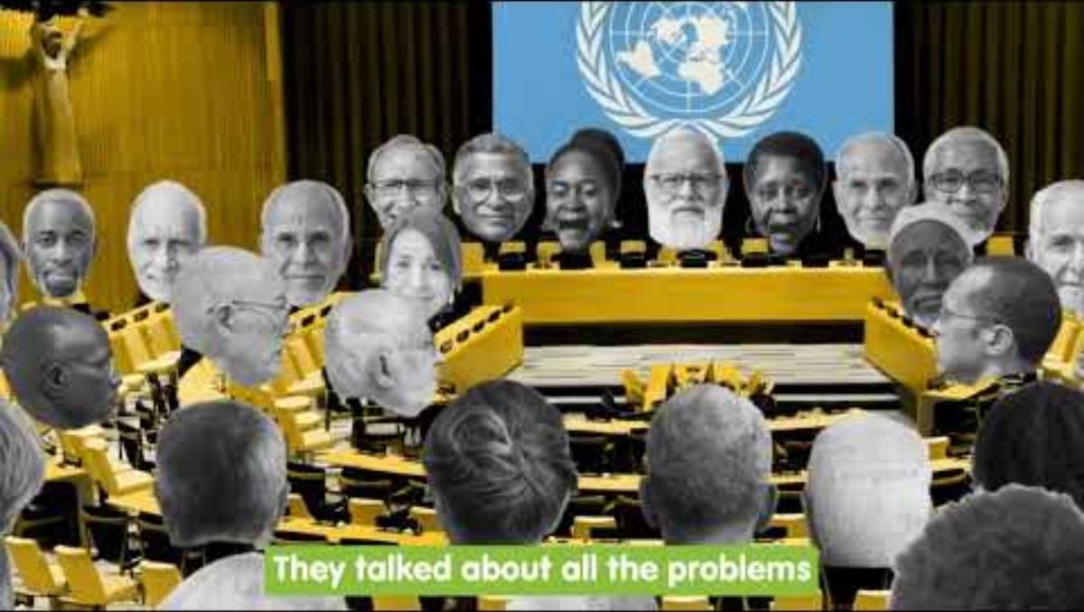
🎥 UNCRC Video
Notes:
Link to video: https://youtu.be/pMt0VXG3Crk

Slide 7
Time for a quiz...

Slide 8


TRUE or FALSE
Rights are what you need to grow up happy, healthy and safe.

Slide 9


TRUE

Slide 10
TRUE or FALSE
The United Nations Convention on the Rights of the Child (UNCRC) was created 2020

Slide 11


FALSE
It was agreed in 1989

Slide 12
TRUE or FALSE
Rocio Cifuentes is the Children's Commissioner for Wales

Slide 13
TRUE

Slide 14
TRUE or FALSE
All Children and young people have rights from when they are born

Slide 15
​TRUE
All children aged 0-18 have these rights

Slide 16
TRUE or FALSE
Children and Young People have 15 rights

Slide 17
FALSE
You have 42 rights​

Slide 18
TRUE or FALSE
It is children's responsibility to get their rights

Slide 19
FALSE
It is adults responsibility to support children to get their rights

Slide 20
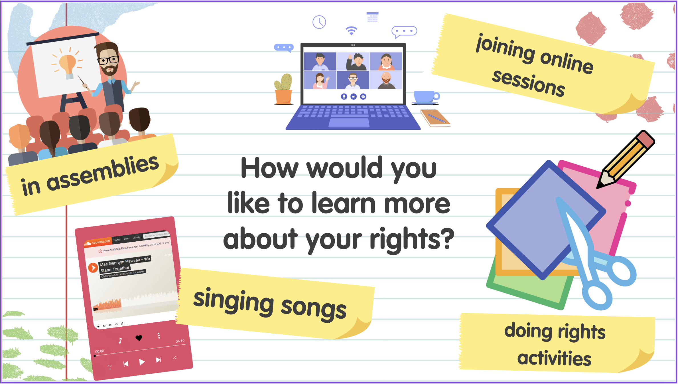

Slide 21
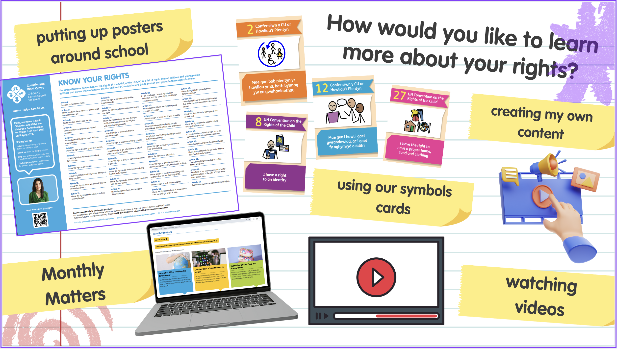

Slide 22

Discuss in pairs or as a group:
How would you like to learn more about your rights?​
Notes:
There are supporting materials on our web page for children with additional learning needs

Slide 23

Teachers – if you want us to get in touch with you directly with rights resources and ideas, add your name to this blank email and press send.
Diolch!
Notes:
Email address: post@childcomwales.org.uk

Slide 24

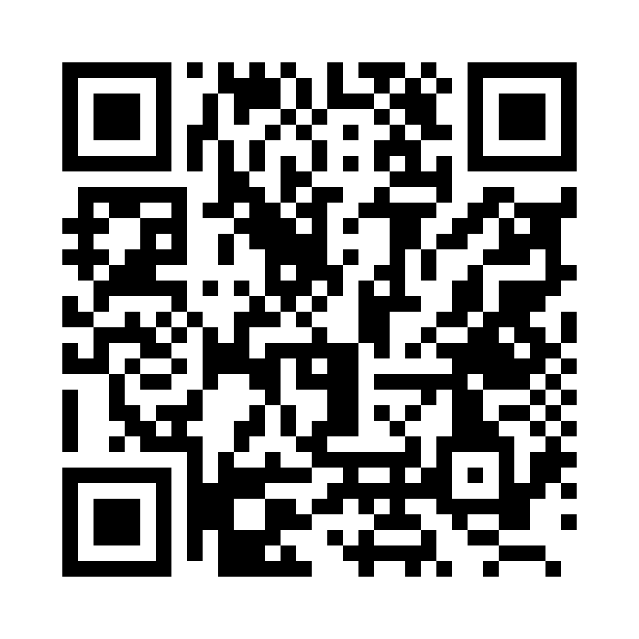
2) Share your ideas with us by using the QR code or survey link
(Each young person can do this individually or a teacher can do it on behalf of the class)
https://online1.snapsurveys.com/p5es7e
Notes:
Survey link - https://online1.snapsurveys.com/p5es7e

Slide 25

Diolch!
Thanks!
Our next Monthly Matter will be available on our website in the New Year:
Monday, January 6th

