Slide 1
Monthly Matter
October 2024

Slide 2

Last month, we asked you about where some foods and energy drinks are in shops.
Here’s what you told us:

Slide 3





In September 1800 of you told us your views on food placement in shops and energy drinks
31% of you think that where sugary, salty, or fatty food is displayed makes a difference to whether you buy them or not
38% of you said that deals like buy one get one free make you want to buy foods like sweets, chocolates and crisps
43% of you think that stopping restaurants and cafes from giving free refills on fizzy drinks is a bad idea
62% of you think energy drinks should not be sold to children under 16

Slide 4

October’s Monthly Matter is about using smartphones in school

Slide 5
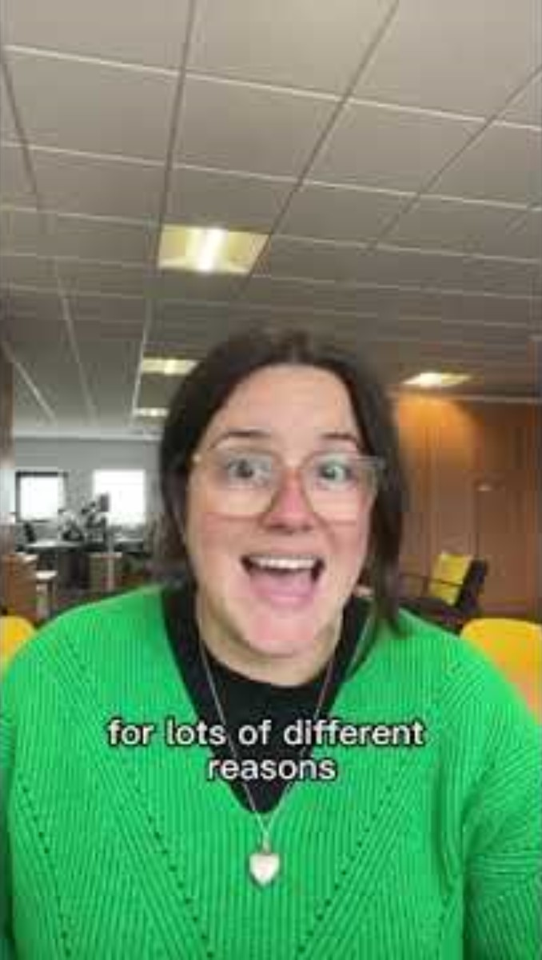
🎥 This month’s matter: Smart phones in school
Notes:
Video link – https://youtu.be/qbDWrBkdWZ4

Slide 6

1) Discuss in pairs or as a group:
Do you have a smartphone?
Do you take it to school? Why?
Do you think schools should have more rules about using smart phones?
Notes:
There are supporting materials on the web page for children with additional learning needs

Slide 7

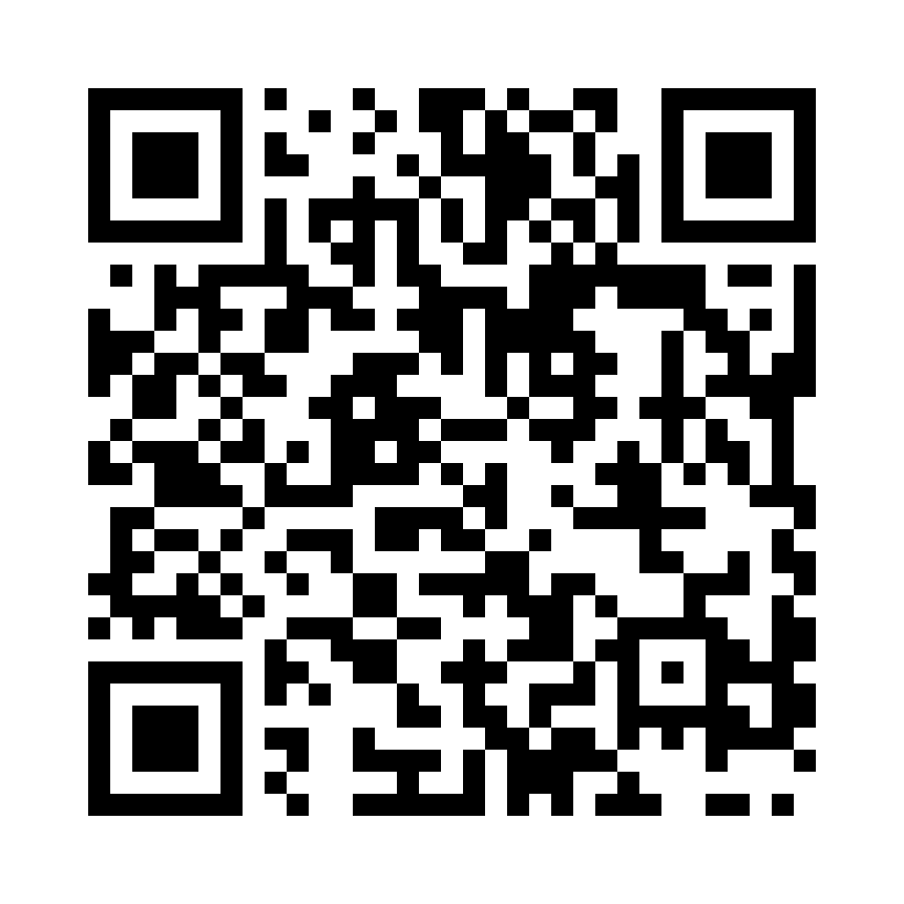
2) Share your ideas with us by using the QR code or survey link
(Each young person can do this individually or a teacher can do it on behalf of the class.)
https://online1.snapsurveys.com/a3314c
Notes:
Survey link - https://online1.snapsurveys.com/au0v9

Slide 8

Teachers can also share their personal views in the survey

Slide 9

Diolch!
Thanks!
Our next Monthly Matter will be available on our website on
Monday, November 4th.

