Slide 1

Monthly Matter – May 2024

Slide 2

Last month, we asked you about your journeys to school.
Here’s what you told us:

Slide 3




In April over 2000 of you told us about your journey to school
82% of you said you felt safe on the way to school
Some of you thought cars travelled too fast and there was too much traffic
Some of you said that there wasn’t a safe place to cross or cars didn’t stop to let you cross the road.
Some of you were worried about walking on your own

Slide 4



Lots of you said you enjoyed looking at nature on your way to school
Lots of you enjoyed being with your family on the way to school. You told us you like chatting to your family
Some of you liked singing and listening to the radio on the way to school.

Slide 5

May’s Monthly Matter is about Break time.
Remember - You all have a right to relax and play.

Slide 6
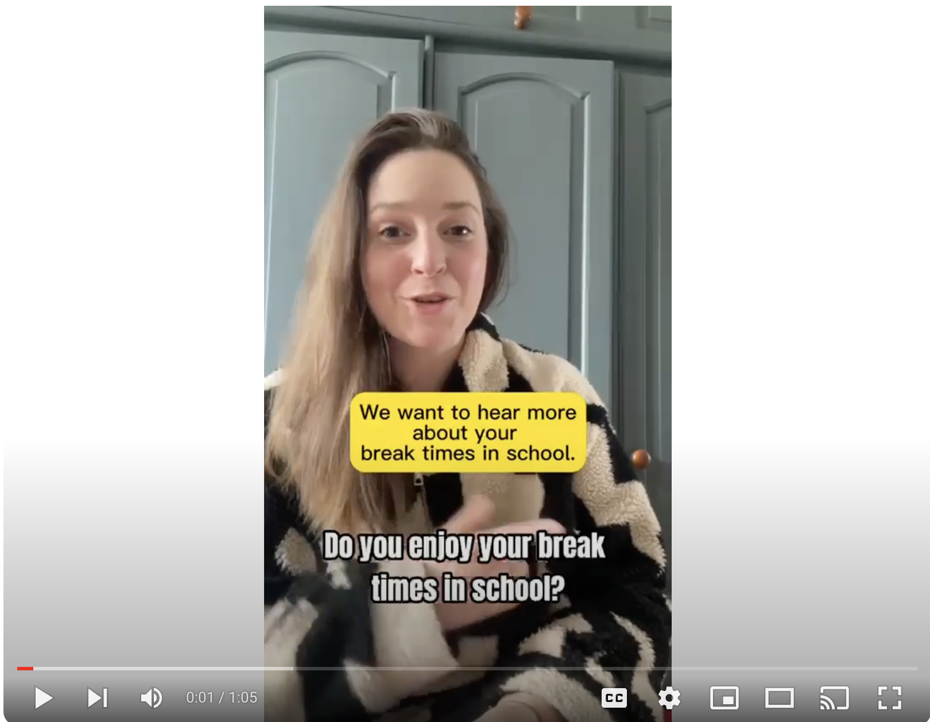
🎥 This month’s matter: Break time
Notes:
Video link – Monthly Matters May - Break time (youtube.com)

Slide 7

1) Discuss in pairs or as a group:
Do you enjoy break time? Why
Is break time important? Why?
Do you ever have to miss break time?
What would make break time better?
Notes:
There are supporting materials on the web page for young people with additional learning needs

Slide 8

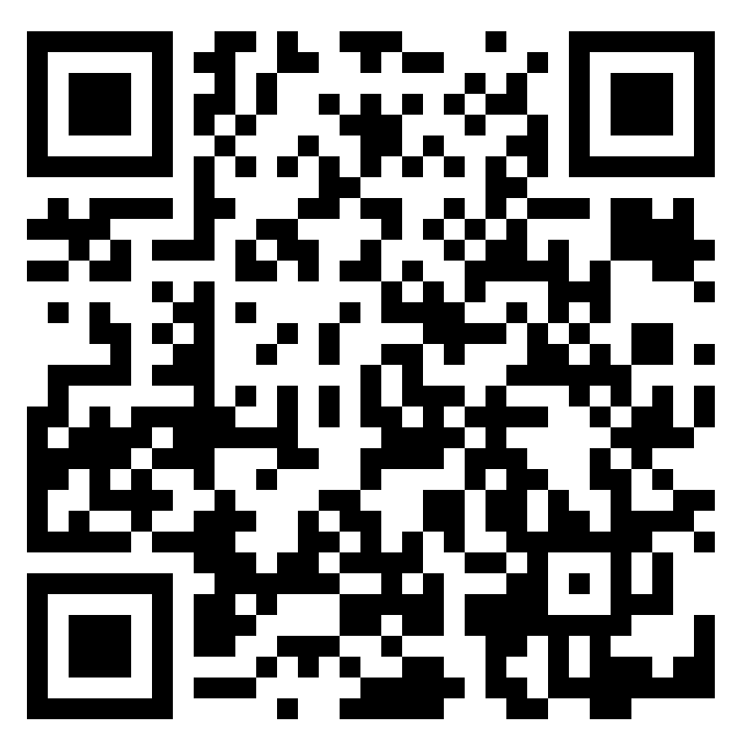
2) Share your ideas with us by using the QR code or survey link
(Each young person can do this individually or a teacher can do it on behalf of the class)
https://online1.snapsurveys.com/au0v9
Notes:
Survey link - https://online1.snapsurveys.com/au0v9

Slide 9

At the end of the survey, there’s an option for you to tell us what you think about Monthly Matters and how we can make it better.

Slide 10

Diolch! Thanks!
Our next Monthly Matter will be available on our website on Monday, June 3rd.

Slide 11
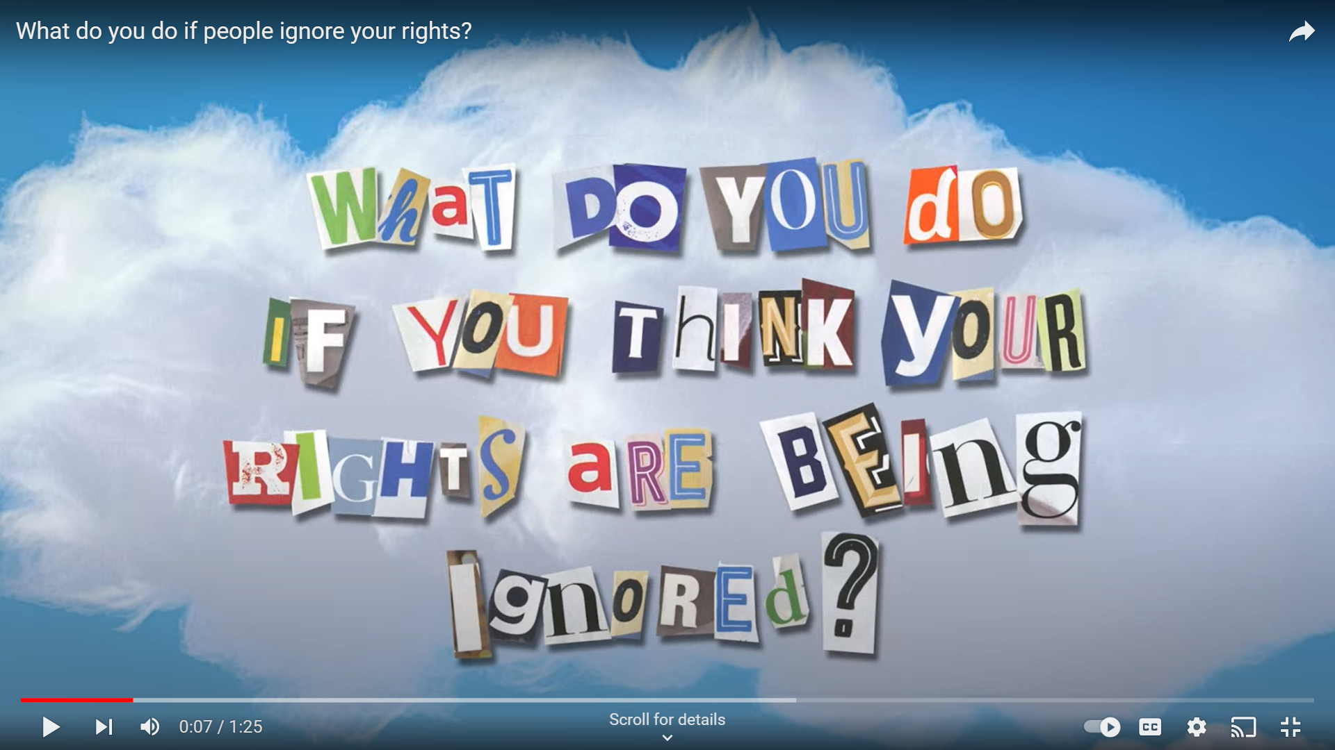
Did you know the Children’s Commissioner for Wales has a team of people who can help children if they feel they’re not getting their rights?
🎥 Here’s a 1 minute video that explains more about the team:
Notes:
Video Link: https://www.youtube.com/watch?v=5F_p8MOqvRk

