Slide 1

Monthly Matter – June 2024

Slide 2

Last month, we asked you about your break/play time.
Here’s what you told us:

Slide 3




In May over 2000 of you told us about your break/play time
95% of you enjoy play time in school.
Almost all of you think play time is important.
You love spending time with your friends, and you enjoy having fresh air and a break from your school work.
Almost half of you said you sometimes have to miss your break/play time. This makes you feel sad, annoyed, and frustrated.

Slide 4

June’s Monthly Matter is about online safety
Remember - You all have a right to be kept safe.

Slide 5
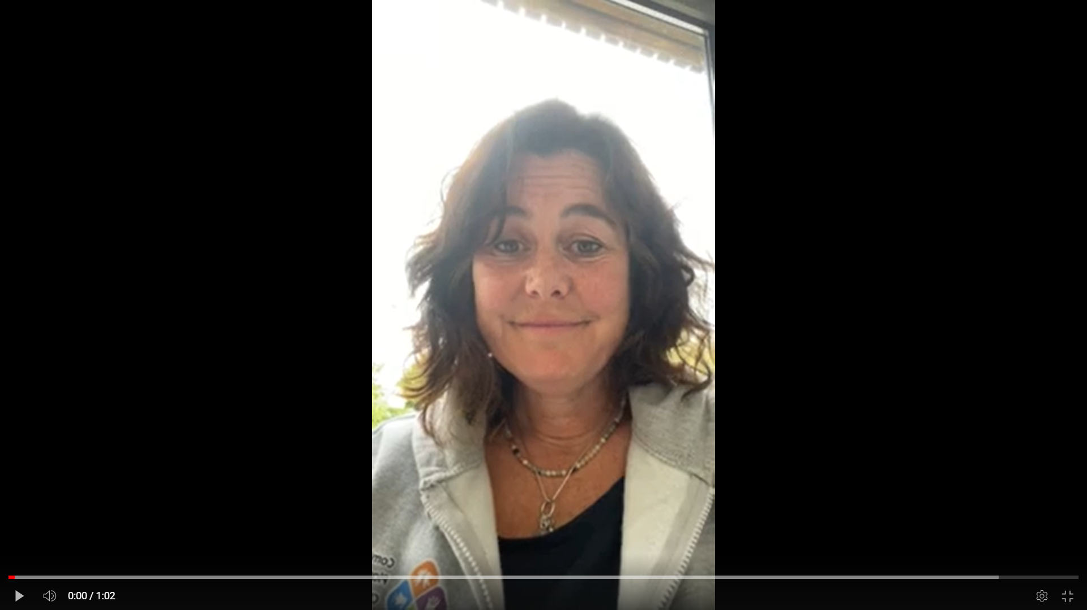
🎥 This month’s matter: Online safety
Notes:
Video link – https://youtu.be/QIC3_kZTsY0

Slide 6

1) Discuss in pairs or as a group:
What apps/games/websites do you use online?
Do you feel safe and happy when using them?
Do you know what to do if you see something that makes you feel unsafe or upset?

Slide 7



If you don’t feel safe online you should talk to someone you trust.
You could also talk to:
Notes:
You could also contact & speak to –
Childline – 0800 1111
Meic – 080880 23456

Slide 8

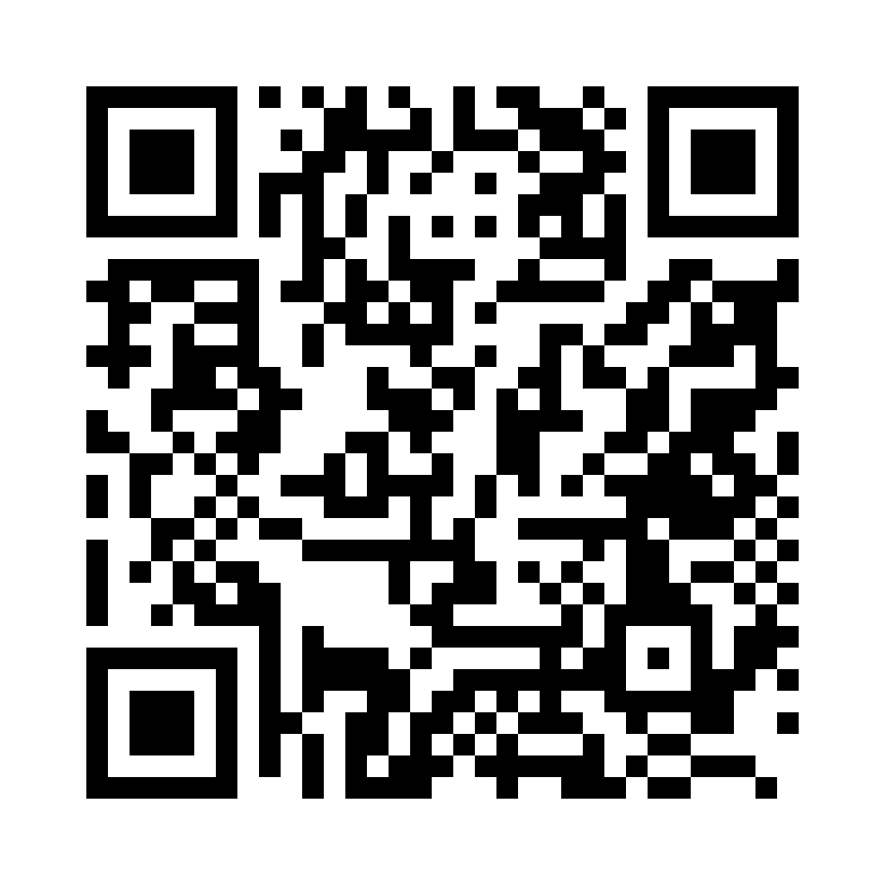
2) Share your ideas with us by using the QR code or survey link
(Each young person can do this individually or a teacher can do it on behalf of the class)
https://online1.snapsurveys.com/vwe2m3
Notes:
Survey link - https://online1.snapsurveys.com/vwe2m3

Slide 9

At the end of the survey, there’s an option for you to tell us what you think about Monthly Matters and how we can make it better.

Slide 10

Diolch!
Thanks!
Our next Monthly Matter will be available on our website on Monday, July 1st.

