Slide 1
Monthly Matters – April 2024

Slide 2
Last month, we asked you about your School Dinners.
Here’s what you told us:

Slide 3
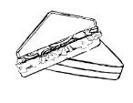
Over 1,700 children and young people took part
Lots of you told us that you preferred packed lunches:
“the portions are bigger”
“I’m a picky eater”
I don’t like school dinners”
Over 40% of you who eat school dinners said that you were still hungry
Lots of you told us the best thing about school dinners was the pizza
Lots of you said that the cost of food was too much and that portions were small.
“The portions are too small - infants have the same size meals as juniors.”

Slide 4
April’s Monthly Matter is about Travelling to School. This links to lots of your rights like the right to be safe, the right to education and the right to be healthy.

Slide 5
🎥 This month’s matter: Travelling to School
Notes:
Video link – https://www.youtube.com/watch?v=H4UcUR0Ss0g

Slide 6
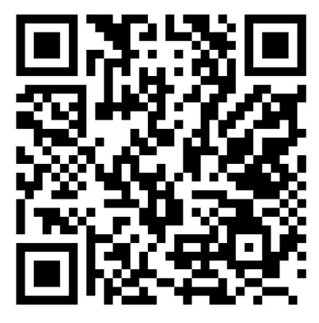
1) Discuss in pairs or as a group – what do you like about your journey to school? What could be better? 2) Share your ideas with us by using the survey QR code or survey link
(Each young person can do this individually or a teacher can do it on behalf of the class )
https://online1.snapsurveys.com/4s8jam
Notes:
Survey link: https://online1.snapsurveys.com/4s8jam

Slide 7
What we think: We hear from lots of families about the problems that they sometimes have with their journeys to school. We understand that sometimes these journeys can make getting to school difficult. We would like to see more actions from Welsh Government to make sure the transport to school is safe and fair for all children in Wales.
Notes:
We are sharing some policy context with pupils. Share this slide after all discussions.

Slide 8
Diolch! Thanks!
Our next Monthly Matter will be available on our website on Tueday May 7th.

