Slide 1
Monthly Matters - March 2024

Slide 2
Last month, we asked you “What would you change if you were the First Minister of Wales?”
Here’s what you told us:

Slide 3
👏 600 of you took part from all over Wales.
Here are the main things you would do:
💰 More money for families / make things less expensive
🚍 Better public transport
🚦Change the 20mph limit
🏥 More hospitals and shorter waiting lists for healthcare
🏫 Change some of the things you learn about in school
🌳 Make your local area cleaner
🏠 More help for people who are homeless
🗣️ Diolch! We’ll share all of your views with the new First Minister!

Slide 4
March’s Monthly Matter is about School Dinners.
It links to Article 24 of the UNCRC:
'I have the right to be as healthy as possible’

Slide 5
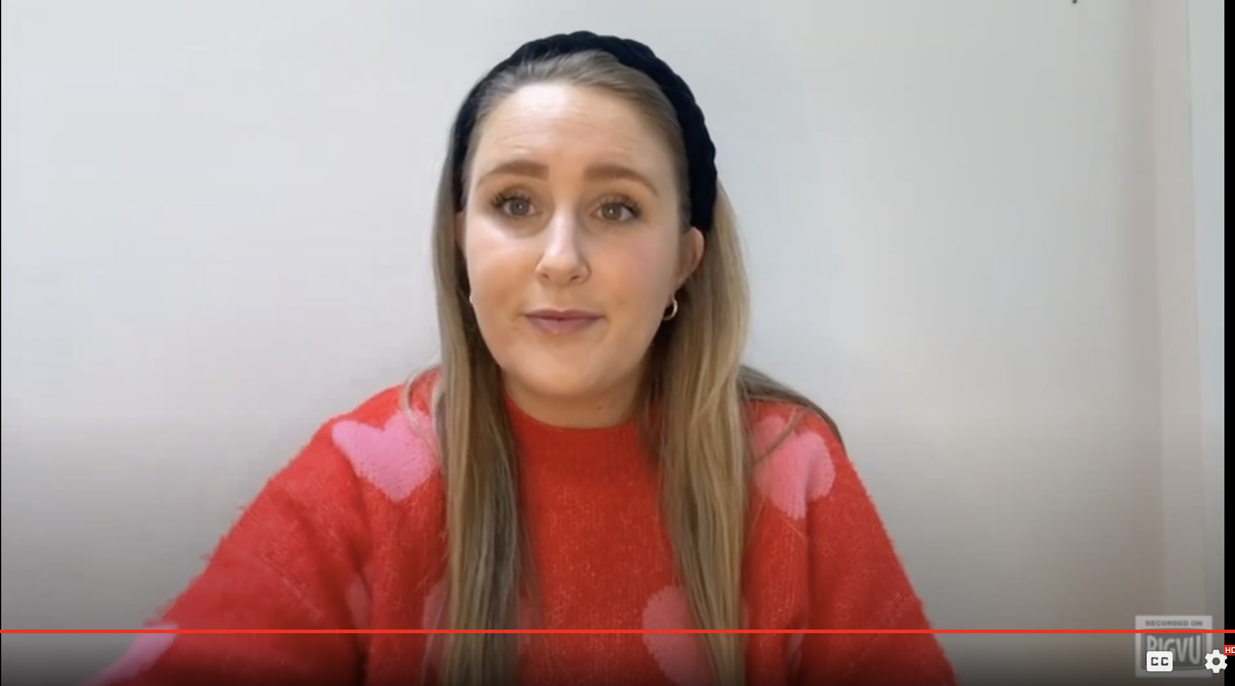
🎥 This month’s matter: School Dinners – what are they like?
Notes:
Video link – https://www.youtube.com/watch?v=ZF56shsCH5Q

Slide 6
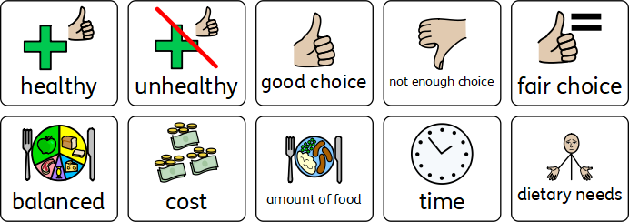
Think about -
What do you enjoy about school dinner?
What would you change to make them better?
Here are some ideas to get you thinking:
Notes:
The pictures on this slide are to support your learners think about what they enjoy about school dinners and what they would change to make them better.
Talking Mat PDF for additional support : https://www.childcomwales.org.uk/wp-content/uploads/2024/03/March-MM-Talking-Mat.pdf

Slide 7
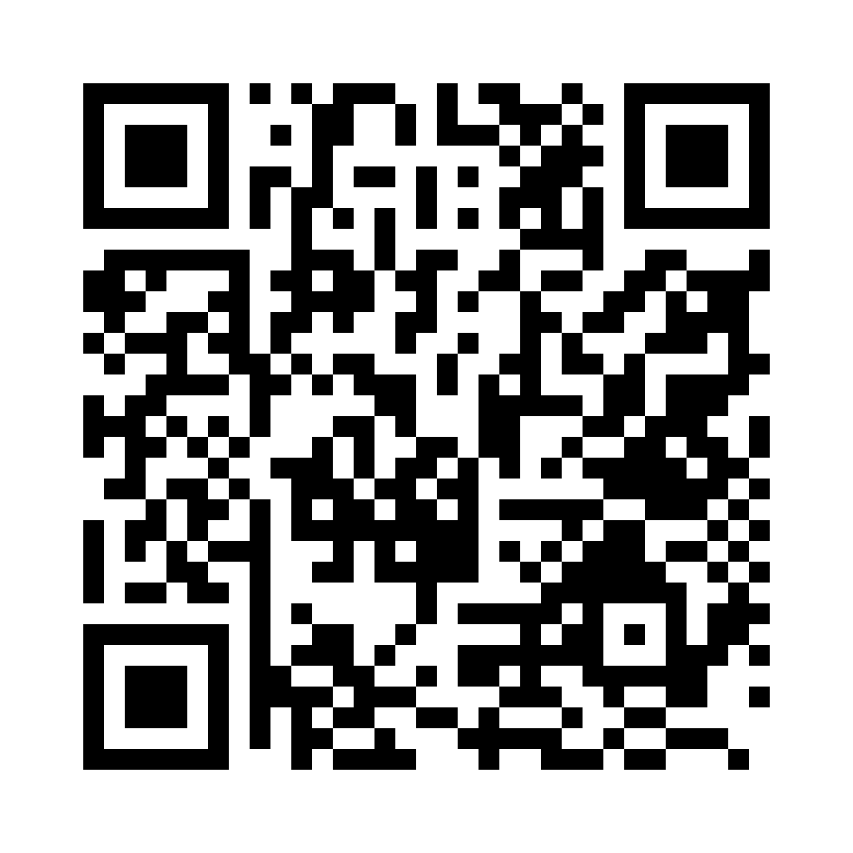
Share your ideas with us by using the survey QR code or survey link
Each young person can do this individually or a teacher can do it on behalf of the class
https://online1.snapsurveys.com/6jg2ly
Notes:
Survey link: https://online1.snapsurveys.com/6jg2ly

Slide 8
Diolch! Thanks!
Our next Monthly Matter will be about:
- School journeys
This will be available on our website on Monday April 8th.

