Slide 1
Monthly Matters - February 2024

Slide 2
Last month, we asked you what you like and don’t like about having six weeks off over the summer.
Here’s what you told us….

Slide 3
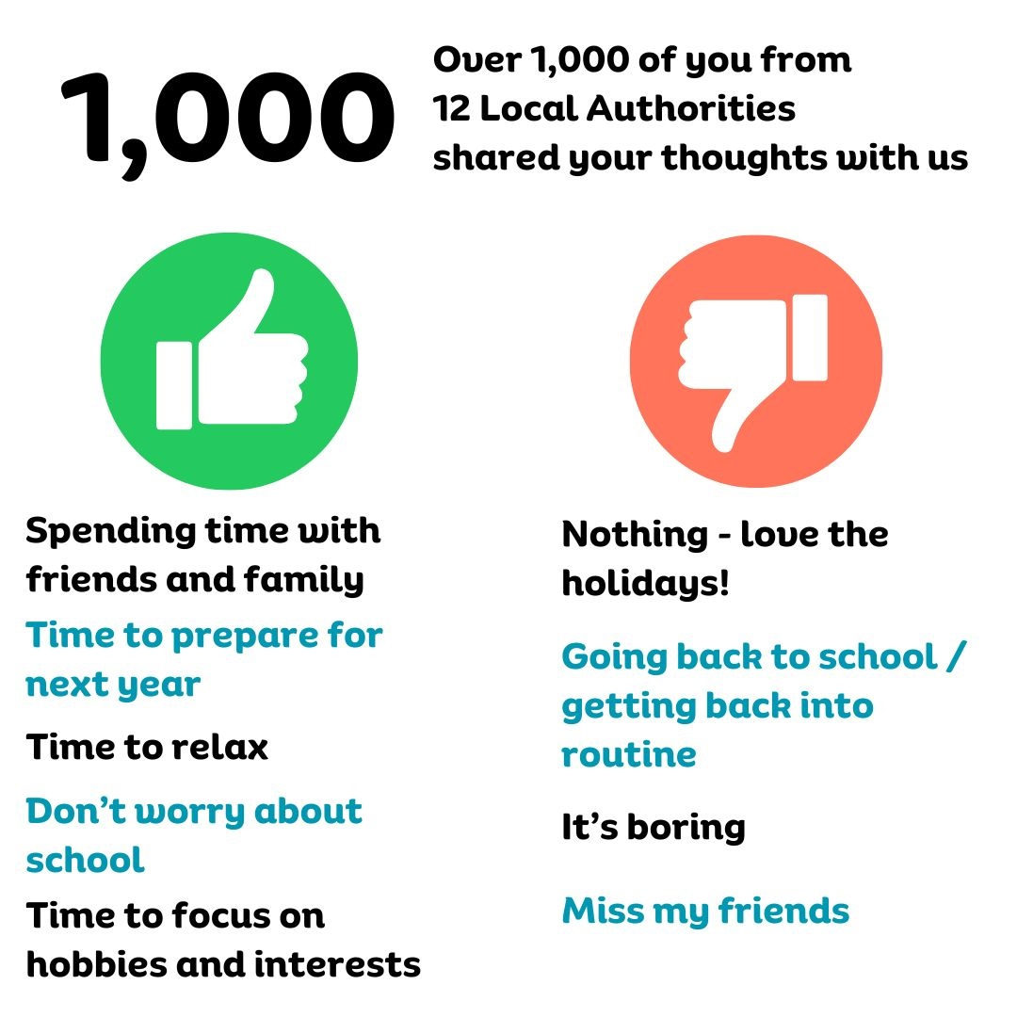

Slide 4
February’s Monthly Matter is about what you would do if you were in charge of Wales.
It links to Article 12 of the UNCRC:
Your right to be listened to, and taken seriously

Slide 5
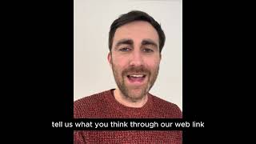
This month’s matter: A new First Minister - What would you do if you were in charge of Wales?
Notes:
Notes for teachers/youth workers
Video link - https://www.youtube.com/watch?v=gK6wkgZpJFc
Some young people might ask if there is going to be a public election to vote for a new First Minister. There won’t be.
The reason is this: ·
Welsh Labour won the last Senedd/Welsh Parliament election in 2021 and will be in power until the next Senedd election, due to take place in 2026.
Mark Drakeford is the leader of Welsh Labour and therefore the First Minister of Wales. He has decided to step down as leader of the Welsh Labour party and First Minister, and now members of the Welsh Labour party will have the chance to vote for a new leader, and new First Minister.
It won’t be until the next Senedd election that there will be a public vote on which party should be in power.

Slide 6
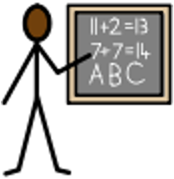
What would you change if you were the First Minister of Wales?
These pictures might help you to think of ideas:
Notes:
The pictures on this slide all represent things that the Welsh Government has power over: Education; Transport; Healthcare; Housing; Sport and leisure; Mental Health; Recycling and the Environment; Certain help with costs like free school meals and grants for buying school uniform.
DOWNLOAD THIS PAGE AS A PDF: https://www.childcomwales.org.uk/wp-content/uploads/2024/01/FM-Symbols-.pdf

Slide 7
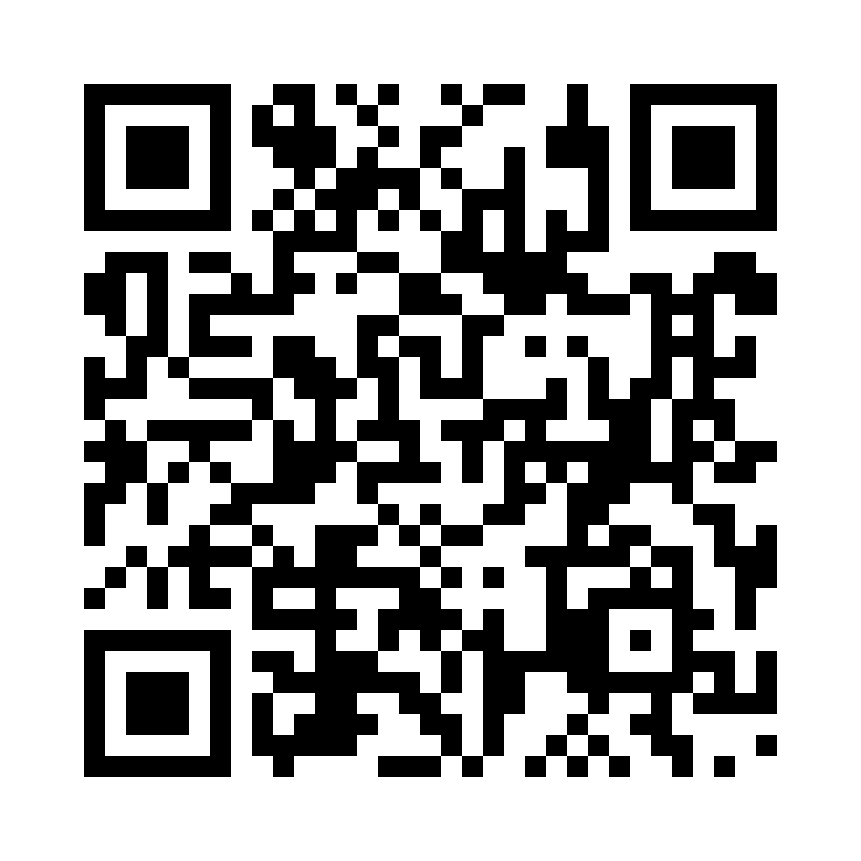
Share your ideas with us by using the survey QR code or survey link
Each young person can do this individually or a teacher can do it on behalf of the class
https://online1.snapsurveys.com/xqyuhc
Notes:
Survey link: https://online1.snapsurveys.com/xqyuhc

Slide 8
Diolch! Thanks!
Our next Monthly Matter will be about:
School dinners
This will be available on our website on 4 March

Slide 9
Next steps - Ideas for further learning
These are some ideas on how you could explore this further in the future
The Electoral Commission have a wide range of democracy resources. This month they’re publishing one that looks in detail at how the new First Minister is elected.
Use the Senedd’s ‘Our Senedd’ resource pack to learn more about how politics works in Wales. And read more about Wales’ Youth Parliament.
Find your local Member of the Senedd and write to them. Tell them what you would change about Wales and ask them what they’re doing to support that.
This year Save the Children are running a parallel election to coincide with the UK General election. Read more about that on their website.
Use our Make a Difference resource, which helps young people to think about using their voice to make a positive change

