Slide 1
Ambitions for Wales Under 7s feedback story

Slide 2
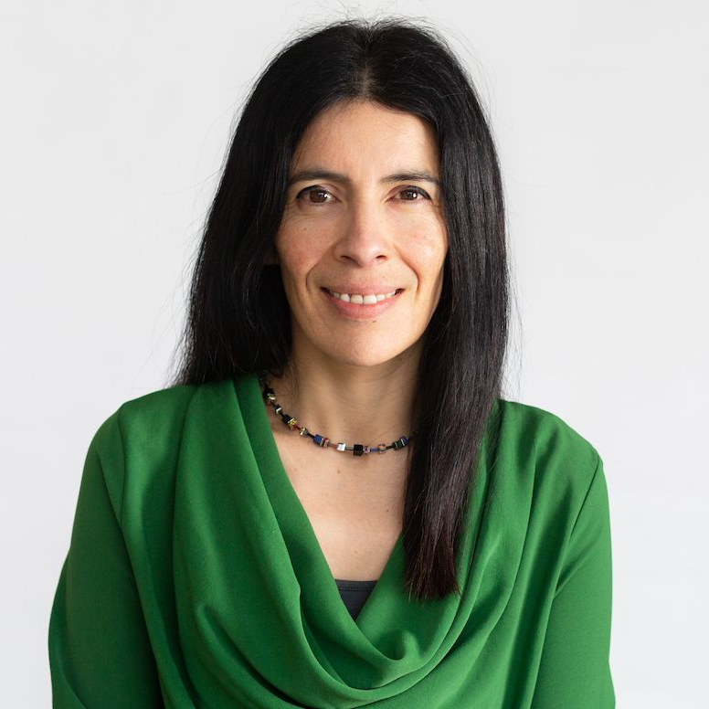
Rocio
Notes:
This is Rocio. Rocio is the Children’s Commissioner for Wales. (show picture)
Rocio’s job is to help children be happy, healthy and safe. (story teller to choose actions for each of these three words to repeat throughout the session)

Slide 3
Notes:
Rocio went on an adventure all around Wales to find out what things keep children happy, healthy and safe.
She also asked how Wales could be better for children.
She spoke to over 8,000 children, like you, to find this out.

Slide 4
Happy
Notes:
Can you guess what children said made them feel happy?
Family
Playing
Outdoor spaces e.g. parks, gardens, beaches
(these were the most common answers in the survey)

Slide 5
Healthy
Notes:
Can you guess what children said made them feel healthy?
A healthy diet
Exercise
Taking care of personal hygiene e.g. brushing teeth, washing hands/body
(these were the most common answers in the survey)

Slide 6
Safe
Notes:
Can you guess what children said made them feel safe?
Mum or dad
Teacher/school
Emergency services e.g. fire brigade, police
(these were the most common answers in the survey)

Slide 7
Notes:
The children also told Rocio what they thought would make Wales a better place to live in. This helped Rocio know what she should do to help. These are some of the things Rocio hopes to do over the next three years.

Slide 8
Notes:
Rocio will help families get the money and things they need

Slide 9
Notes:
Rocio will make sure all children are treated the same and with kindness

Slide 10
Notes:
Rocio will make sure adults listen to what children have to say

Slide 11
Thank You!
Notes:
Rocio wants to say a big thank you for helping her to make things better for children in Wales.
The End.

