Slide 1
📣 What are the biggest issues for young people? We want to hear your ideas and experiences in a new survey – Ambitions for Wales
📣 Beth yw’r materion mwyaf pwysig i bobl ifanc? Rydyn ni eisiau clywed eich syniadau a phrofiadau mewn holiadur newydd – Gobeithion i Gymru

Slide 2
Rocio Cifuentes
Comisiynydd Plant/ Children’s Commissioner
Gwrando ar safbwyntiau a phrofiadau pobl ifanc/ Listens to young people’s views and experiences
Dweud wrth y Llywodraeth beth sydd angen newid i wella bywydau pobl ifanc / Tells the Government what they should change to help young people

Slide 3
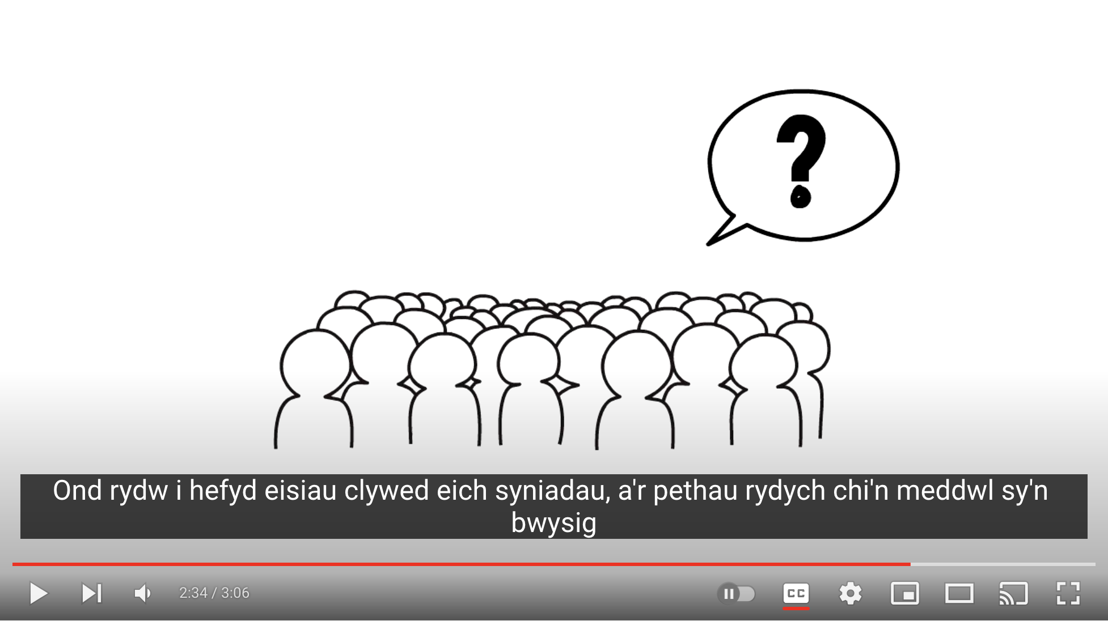
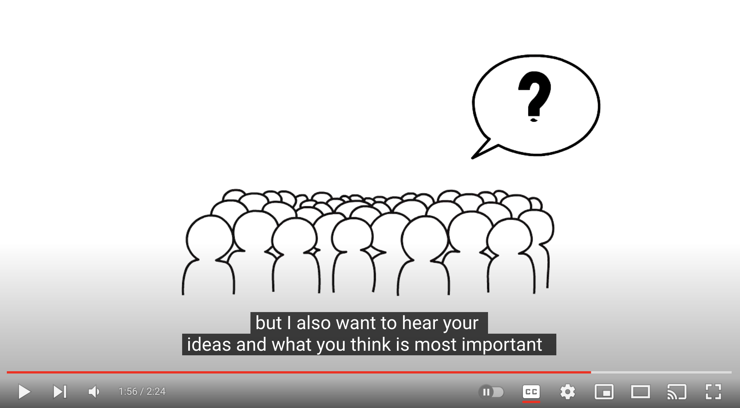
Agorwch y fideo yn Youtube – Pwy yw’r Comisiynydd?
Open the video in YouTube – Who is the Commissioner?

Slide 4
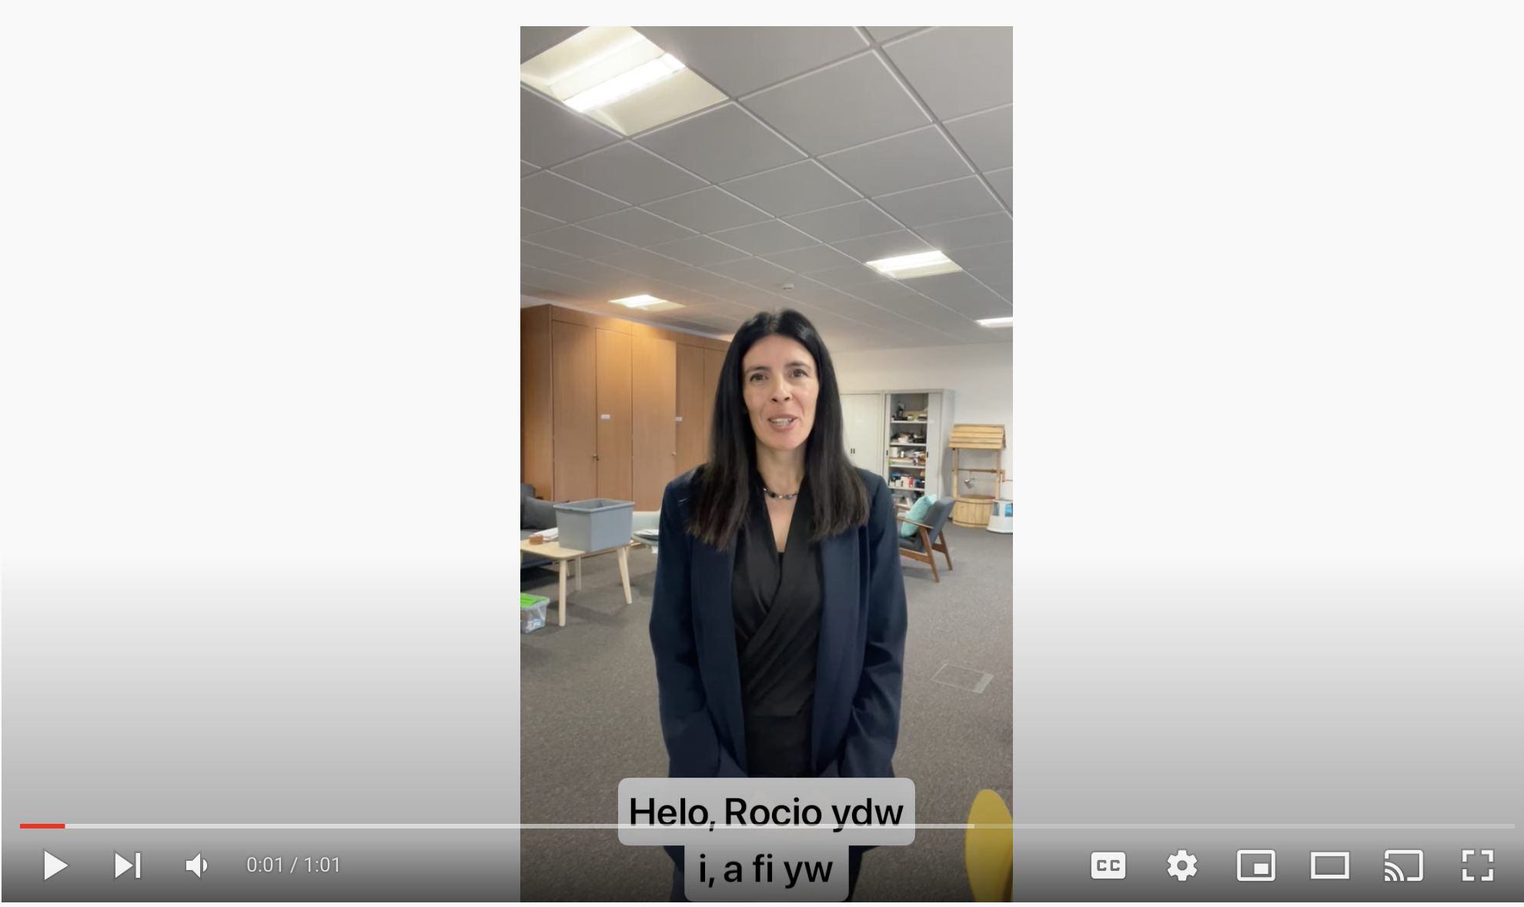
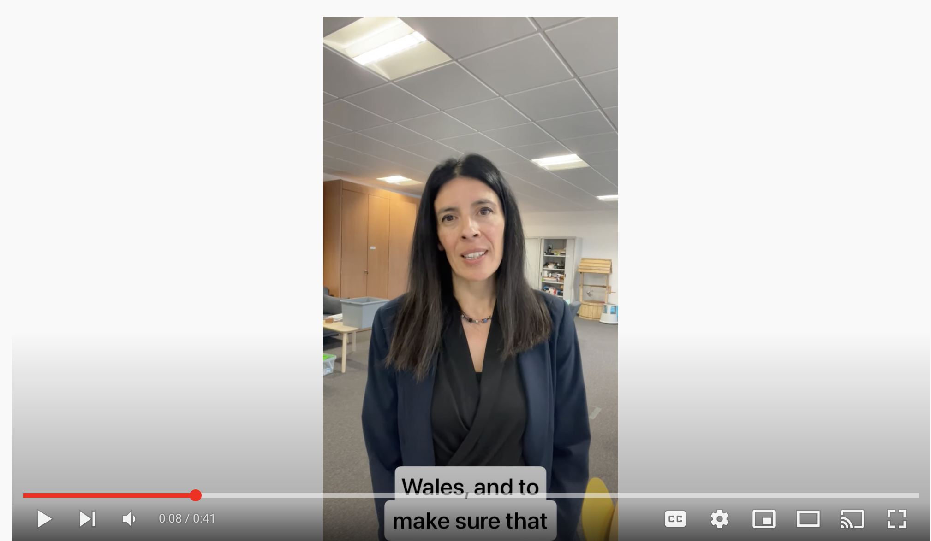
Dysgwch fwy am yr holiadur Gobeithion i Gymru – cliciwch i agor fideo YouTube
Learn more about the Ambitions for Wales survey – click to open Youtube Video

Slide 5
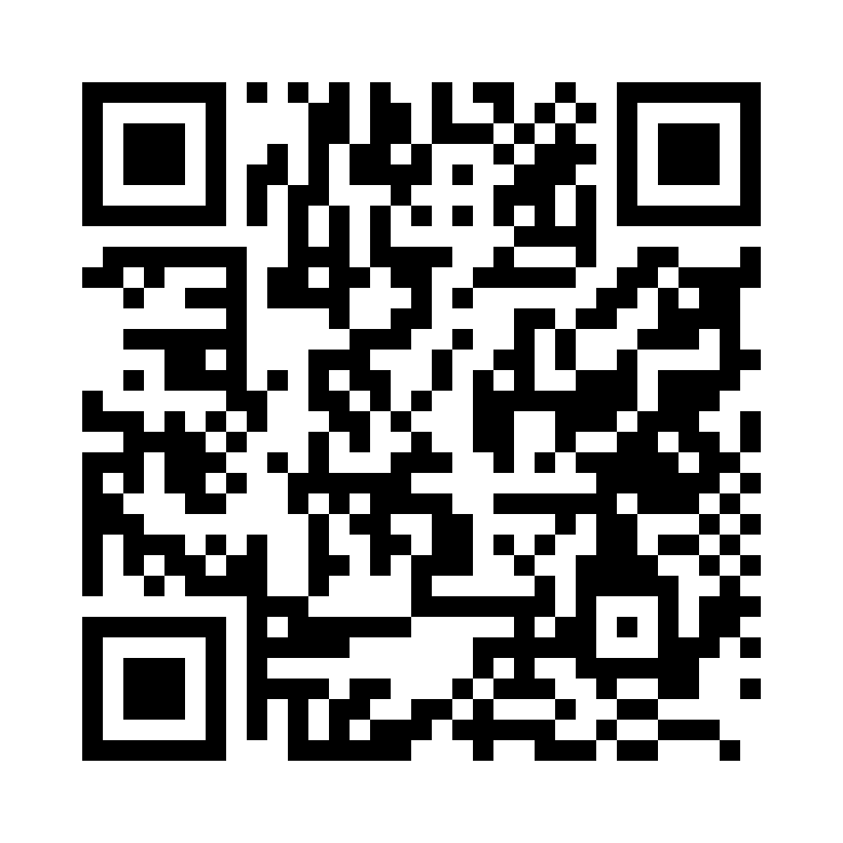
✅ Gwnewch yr holiadur / Do the survey
Cliciwch y linc yma.
Neu:
Click this link
Or:

Slide 6
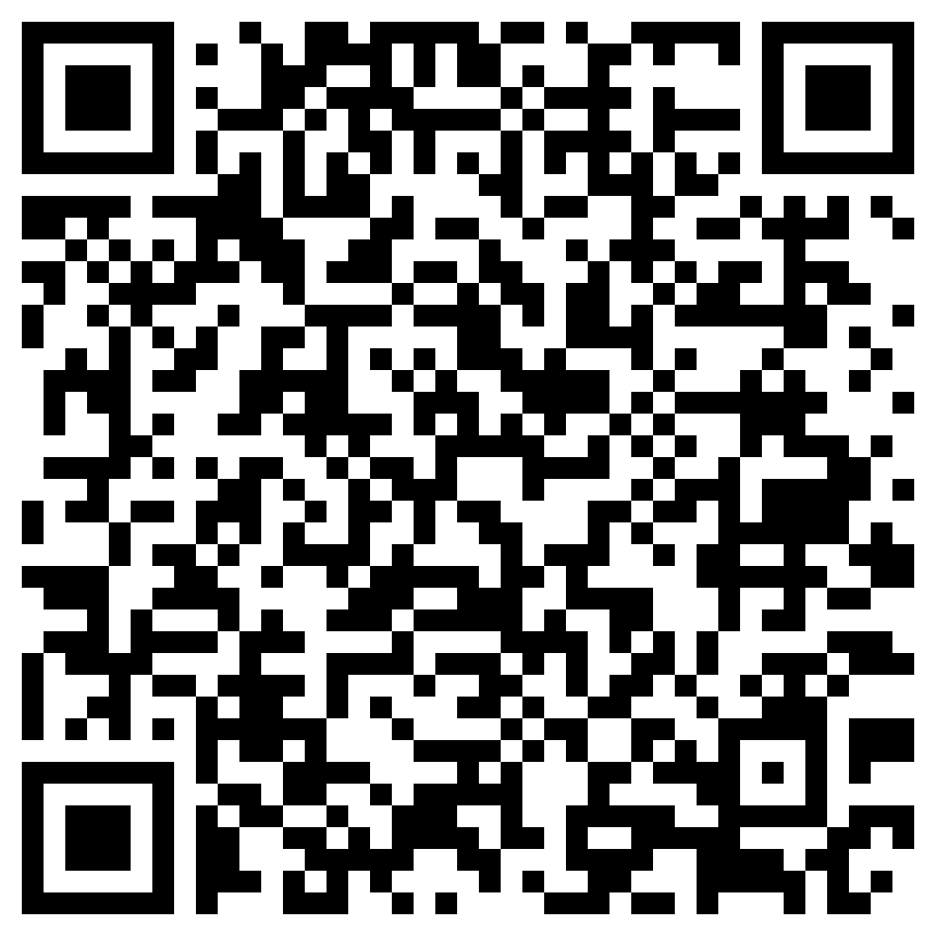
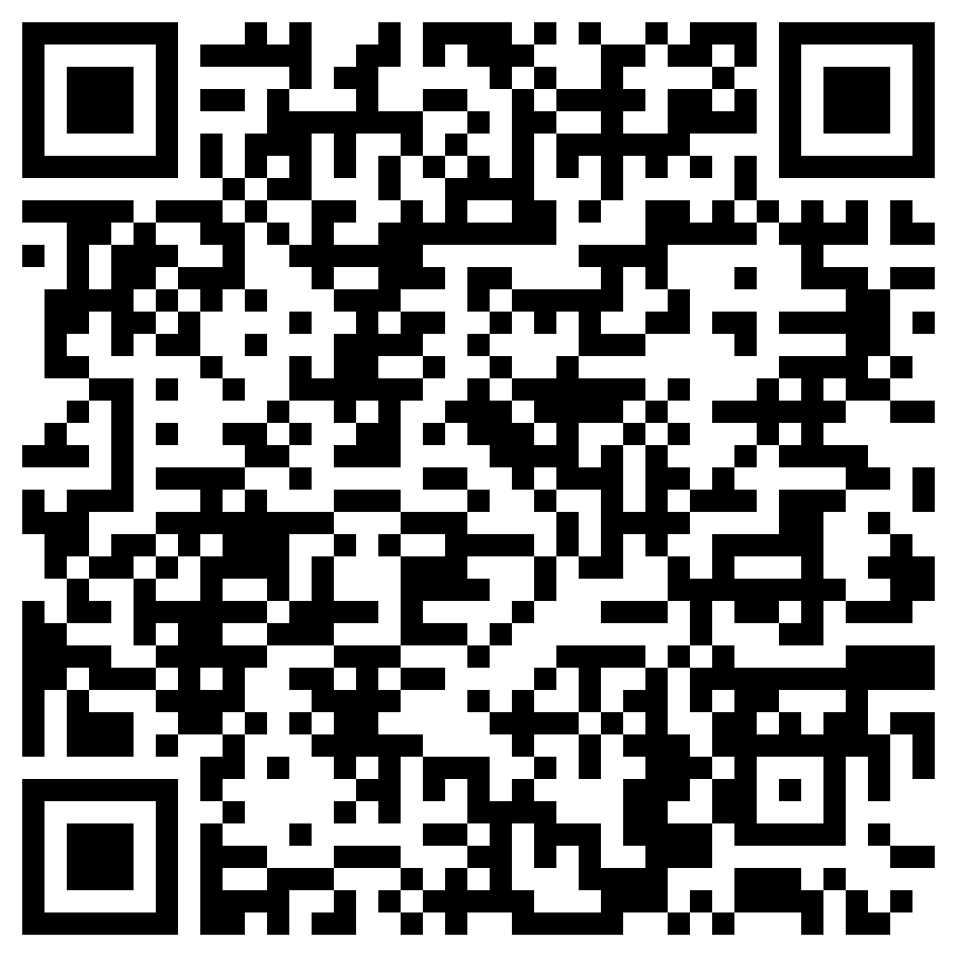
✅ Holiadur i staff / Survey for staff
Cliciwch y linc yma.
Neu:
Click this link
Or:

Slide 7
Beth nesaf? ❌ Cau 5 Tachwedd 🔊 Canlyniadau ym mis Ebrill + cynllun y Comisiynydd ar sut mae hi am helpu pobl ifanc
What Next? ❌ Closes 5 November 🔊 Results in April + the Commissioner’s plan for helping young people

Slide 8
DIOLCH 😊

