Slide 1
Dull Hawliau Plant: Blynyddoedd Cynnar a meithreinfeydd nas cynhelir
A Children’s Rights Approach: Early Years and non-maintained nursery settings
Notes:
Hello and welcome to our children’s rights training for Early Years practitioners. This PowerPoint should be used with your workbook to guide you through the Children’s Rights training.
Before you start the training today make sure you have your workbook and open the links on page two of your workbook.
You can do this training independently or as part of a group. You could do it in one go or break it down into smaller chunks.

Slide 2
Nodau’r Sesiwn
Aims of the Session
Adolygu Confensiwn y Cenhedloedd Unedig ar Hawliau'r Plentyn (CCUHP)
Esbonio rôl Comisiynydd Plant Cymru
Archwilio a thrafod sut mae hawliau plant yn gysylltiedig i’ch rôl fel ymarferwr blynyddoedd cynnar
Recap the United Nations Convention on the Rights of the Child (UNCRC)
Outline role of the Children’s Commissioner for Wales
Explore and discuss how children’s rights link to your role as an Early Years Practitioner.
Notes:
During this training we will be recapping
- The United Nations Convention on the Rights of the Child (we usually refer to the UNCRC as children’s rights)
- Talking about the Children’s Commissioner for Wales and their powers
- Thinking about children’s rights and how they link to your role as a practitioner.
When you are ready, move on to the next slide, which is a little activity to help you think about children’s rights.

Slide 3
Gweithgaredd 1: Beth sydd angen ar blant i dyfu’n hapus, yn iach ac yn ddiogel?
Defnyddiwch Daflen Gweithgaredd 1 (tudalen 3) yn eich llyfryn
Meddyliwch am beth sydd angen ar blentyn i dyfu’n hapus, yn iach ac yn ddiogel
Ysgrifennwch eich atebion tu fewn i’r corff
Gan ddefnyddio’r poster hawliau, gwiriwch eich atebion a nodwch sawl un sy’n hawl plentyn
Activity 1: What do children need to grow up happy, healthy and safe?
Use Activity Sheet One (page 3) in your workbook
Think about the things a child needs to grow up happy, healthy and safe
Write your answers inside the body
Using a rights poster, check over your answers and see how many of them are children’s rights.
Click here to see the Rights Poster
Cliciwch yma i weld y poster hawliau
Notes:
For this slide you will need to use Activity Sheet one on page 3 of your workbook.
Follow the instructions on the screen. Once you’ve finished, count up how many children’s rights you have managed to name.
Have another look at the list of children’s rights. Are any of them surprising to you?
It’s important to point out that when we talk about the UNCRC or children’s rights with younger children we explain that they are the things they need to grow up feeling happy, healthy and safe.
While there isn’t a right specifically stating that children should be happy, we recognise that small children will understand the emotion happy. We also recognise that if they are experiencing their rights then children will feel happy and safe.

Slide 4
How many rights do children have? What ages does the UNCRC cover? How long has the UNCRC been a convention?
Gweithgaredd 2: Hawliau Plant
Activity 2: Children’s Rights Check-In
Sawl hawl sydd gan blentyn?
Pa oedrannau mae’r CCUHP ar gyfer? Pa mor hir mae’r CCUHP wedi bod yn gonfensiwn?
Notes:
Use activity sheet two which is on page 4 in your work book. See if you can answer the questions in our Children’s Rights Check in.
Don’t worry if you don’t know the answers to these questions, we will go over them on the next few slides.

Slide 5
CCUHP – Confensiwn y Cenhedloedd Unedig ar Hawliau’r Plentyn. Cytundeb rhyngwladol yw hwn sy’n amddiffyn hawliau dynol pobl o dan 18 oed.
Mae’n rhestru’r hawliau sydd gan bob plentyn a pherson ifanc, bobman yn y byd.
Cafodd ei fabwysiadu gan y CU yn 1989, cafodd ei gadarnhau gan y Deyrnas Unedig yn 1991, a daeth i rym yn 1992.
UNCRC - United Nations Convention on the Rights of the Child is an international agreement that protects the human rights of those under the age of 18.
It lists the rights that all children and young people, everywhere in the world have.
It was adopted by the UN in 1989, the UK ratified it in 1991 and it came into force in 1992.
Notes:
As the slide states, the UNCRC protects the human rights of those under the age of 18.
Our office can support children up until the age of 18 or 21 if they are in care.
The UNCRC includes 54 rights. Articles 1 – 42 are the things that children and young people should know about and articles 43-54 are the things that adults, public bodies and government should know.
The UNCRC is now over 30 years old and at the time of creation was one of the most signed up to conventions. It was called the worlds greatest promise to children.

Slide 6
Mae gennym ni Hawliau Dynol, pam mae angen Hawliau Plant?
We have Human Rights, why do we need Children’s Rights?
Children are more vulnerable to abuse and exploitation
Dependent on age, children are entirely or mostly dependent on adults – their best interests are not always considered
Children face an array of legal minimum ages at which they are considered capable of making decisions for themselves
Children are often voiceless
Mae plant yn fwy agored i gael eu cam-drin a’u hecsbloetio
Yn dibynnu ar eu hoed, mae plant yn ddibynnol ar oedolion yn llwyr neu i raddau helaeth – nid yw eu lles pennaf bob amser yn cael ei ystyried
Mae plant yn wynebu llu o derfynau oed cyfreithiol pryd y bernir eu bod nhw’n gallu gwneud penderfyniadau drostynt eu hunain
Mae plant yn aml heb lais
Notes:
Working in the Early Years you will all understand the important reasons that children need an extra layer of protection on top of their human rights.
Children are more vulnerable to abuse and exploitation
Dependent on age, children are entirely or mostly dependent on adults – their best interests are not always considered
Children face an array of legal minimum ages at which they are considered capable of making decisions for themselves this would include voting and making medical decisions
Children are often voiceless
You probably recognise a few of the points above as being relevant to the children you work with. Younger children are more dependent on the adults who care for them and often Early Years pracitioners tell us that their children are not consulted with on issues that affect them.

Slide 7
Gweithgaredd 3: Hawliau Plant a Chi
Pa Hawliau allai fod yn bwysig i’ch rôl fel gweithiwr proffesiynol?
Gan ddefnyddio poster CCUHP, darllenwch trwy’r erthyglau mewn parau a thrafodwch pa dair erthygl yw’r rhai pwysicaf i’ch rôl.
Activity 3: Children’s Rights and You
What Rights could be important to your role as an early years practitioner?
Using a UNCRC poster, read through the articles and discuss which three articles are most important to your role
.
Notes:
Use Activity sheet 3 on page 5 of your workbook. Take some time now to reflect about which rights are most important to you and your work as an Early Years practitioner.
There are no wrong or right answers for this so look over the Know Your Rights Poster and write your answers.
Once you’ve thought about your answers and written them down, if you are part of a team share your thoughts with another member. Do you have similar thoughts or have you thought of different rights that are important?

Slide 8
Beth amdana ti?
Ar y cyd â’r Llywodraeth, mae dyletswydd ar bawb sy’n gofalu am blant a phobl ifanc o dan CCUHP. Mae hynny’n golygu bod cyfrifoldeb arnyn nhw i gynnal hawliau plant.
What about you?
Along with the Government, all people who care for children and young people are duty bearers under the UNCRC. That means they have a responsibility to uphold children’s rights.
Notes:
As an early years practitioner you are a duty bearer. It’s your responsibility to uphold children’s rights for the children in your care. Teaching children from a young age about their rights, gives them the language they need and empowers them to speak out if they aren’t getting their rights. Alongside this training we have created a resource pack for you to use in your settings. It includes songs, activities and provides you with ideas for responsive planning.
The resource pack will provide you with the tools to talk about and explore children’s rights with the children in your setting. It is really important to remember that when we discuss children’s rights with children it can often empower them to question things that happen in their life. You may find that children disclose information after a session, please follow your settings safeguarding policy and procedure if this happens.

Slide 9
Gweithgaredd 4: Trafodaeth
Edrychwch ar erthyglau 8, 16, 19, 24, 29 a 31.
Trafodaeth: Beth ydych chi’n gwneud yn barod i wireddu’r hawliau yma i blant yn eich lleoliad?
Activity 4: Discussion
Take a look at article 8, 16, 19, 24, 29 and 31
Discuss: What do you do to make this right a reality for children in your setting?
Notes:
Activity 4 on page 6 could be run as a group discussion if you work as part of a team. Looking at the rights on the slide. Think about what you already do to make that right a reality in your setting.
For example for article 19 the right to be safe you could link it to you safeguarding policy.
If you are working as a whole staff team you could choose more rights and see if you can link up every article in the UNCRC to an area of your work.

Slide 10
Comisiynydd Plant Cymru
The Children’s Commissioner for Wales
Notes:
Over the next few slides we will explore the role of the Children’s Commissioner for Wales. Each Commissioner sits for 7 years.
The current Children’s Commissioner for Wales is called Rocio Cifuentes.
You can find more information about Rocio and her role on our website.

Slide 11
Yn 2001, Cymru oedd y wlad gyntaf yn y Deyrnas Unedig i greu rôl y Comisiynydd Plant.
Roedd Aelodau’r Cynulliad yn sylweddoli bod angen rhywun ar blant a phobl ifanc i godi llais ar eu rhan, a gwneud yn siŵr eu bod nhw’n cael gwrandawiad ac yn cael eu trin yn deg.
Mae cyfres o gyfreithiau yn cynnwys: Deddf Safonau Gofal 2000 a Deddf Comisiynydd Plant Cymru 2001, sy’n esbonio rôl a chyfrifoldebau’r Comisiynydd.
In 2001, Wales was the first country in the UK to create the role of the Children’s Commissioner.
Assembly ministers recognised that children and young people need someone to speak up for them and make sure that they are listened to and treated fairly.
There is a set of laws including: the Care Standards Act 2000 and the Children’s Commissioner for Wales Act 2001 which explains the role and responsibilities of the Commissioner.
Notes:
Read slide

Slide 12
Five functions of our office
Support
Listen To
Advise
Influence
Speak Up
Pum swyddogaeth ein swyddfa
Cefnogi
Gwrando
Cynghori
Dylanwadu
Codi Llais
Notes:
The Commissioner has 5 functions. When we describe these to younger children we call them the Commissioners super powers.
Support – the commissioner has to support children and young people to learn about their rights
Listen to – the children’s commissioner for wales has to listen to children and young people and find out what’s important to them
Advise – our office has an advice service – our investigations and advice team are there to advise children, young people and the adults who care for them if they feel that their rights are being denied
Influence – Once we’ve listened to children and young people about what’s important to them we use that information to influence decision makers including welsh government
Speak up – the commissioner also speaks up on behalf of children and young people.

Slide 13
DIWEDD RHAN UN
END OF PART ONE
Notes:
You have completed Part One of our children’s rights training. Take some time to fill in page 7 of your workbook before moving on to part two.
In Part Two we will focus on our children’s rights approach and what that could look like in your setting.
We will lead you through our principles and using the information in your workbooks you will have opportunity to think about what you are doing well in your setting and the things you would like to change or develop.

Slide 14
Beth yw Dull Gweithredu Seiliedig ar Hawliau Plant?
Fframwaith egwyddorol ac ymarferol ar gyfer gweithio gyda phlant yw Dull Gweithredu Seiliedig ar Hawliau Plant, sydd â’i wraidd yng Nghonfensiwn y Cenhedloedd Unedig ar Hawliau’r Plentyn
Mae Dull Gweithredu Seiliedig ar Hawliau Plant yn ymwneud â gosod y CCUHP wrth wraidd cynllunio a darparu gwasanaeth, ac integreiddio hawliau plant ym mhob agwedd ar wneud penderfyniadau, polisïau ac ymarfer
What is a Children’s Rights Approach?
A Children’s Rights Approach is a principled and practical framework for working with children grounded in the UN Convention on the Rights of the Child
A Children’s Rights Approach is about placing the UNCRC at the Core of planning and service delivery and integrating children’s rights into every aspect of decision making , policy and practice
Notes:
Welcome to part two of the training. Before you start this session, make sure you have your work book. If you are working with colleagues - you may want to break up into small groups to discuss the questions under each principle.
Read from above.

Slide 15
The Right Way
Y Ffordd Gywir
Ymgorffori’r CCUHP
Cydraddoldeb ac anwahaniaethu
Galluogi plant
Cyfranogiad
Atebolrwydd
Embedding the UNCRC
Equality and non-discrimination
Empowering children
Participation
Accountability
Notes:
Our Right Way guidance follows five principles
We are going to walk you through each principle and then give you time to work through the questions in your workbook.

Slide 16
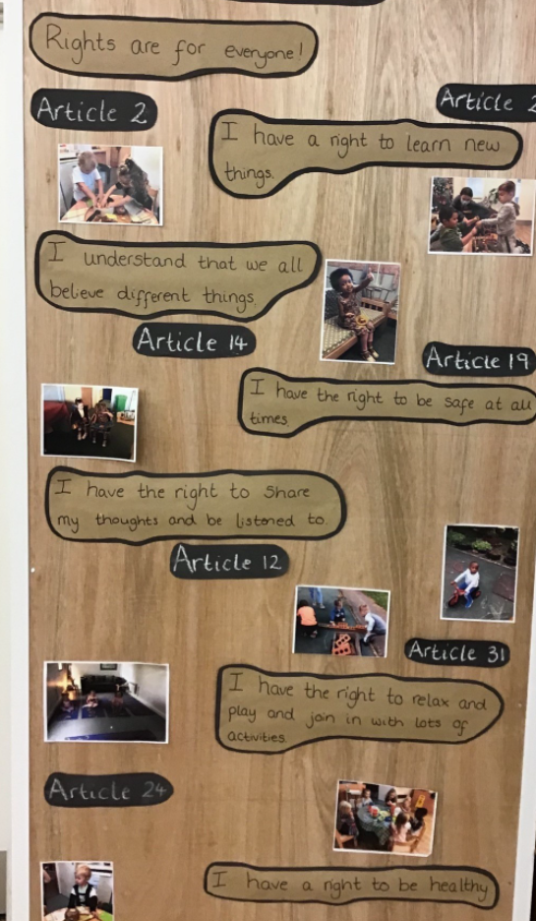
Ymgorffori’r CCUHP
Embedding the UNCRC
Dyma esiampl o Siarter Hawliau plant mewn meithrinfa. Mae’r lleoliad yma wedi creu cysylltiadau uniongyrchol i nifer o hawliau plant ac wedi symleiddio’r iaith ar gyfer eu dysgwyr.
This is an example of a children’s rights charter in a nursery setting. You’ll notice that the nursery has made direct links to a number of children’s rights and made slight changes to the language on our rights symbols cards to suit their children.
Notes:
Embedding means putting children’s rights at the core of planning and service delivery.
For example:
Taking part in rights training
Linking rights to your policies and procedures
Linking rights to areas of you setting
On your screen is an example from a nursery setting. The staff and children worked together to create a children’s charter. You’ll notice that the nursey has made direct links to a number of rights and made slight changes to the language to suit their children. Other examples of a children’s rights charter include children and adults putting their handprints on a display to show they have “signed up” to their nursery charter. The charter included quotes from children about what’s important to them:
Children said things like:
“Stop. I have a right to be safe!” (which links to Article 19)
And, “We play together and be friends.” (which links to Article 15 and 31)
Embedding the UNCRC can sometimes sound complicated, but it doesn’t have to be.
On page 9 and 10 of your workbook we have included examples of practical and straight forward ways that you can achieve this, we have also added some questions for you to think about your own setting and how you embed children’s rights. There is space on page 11 of your workbook for you to reflect your ideas and thoughts.

Slide 17
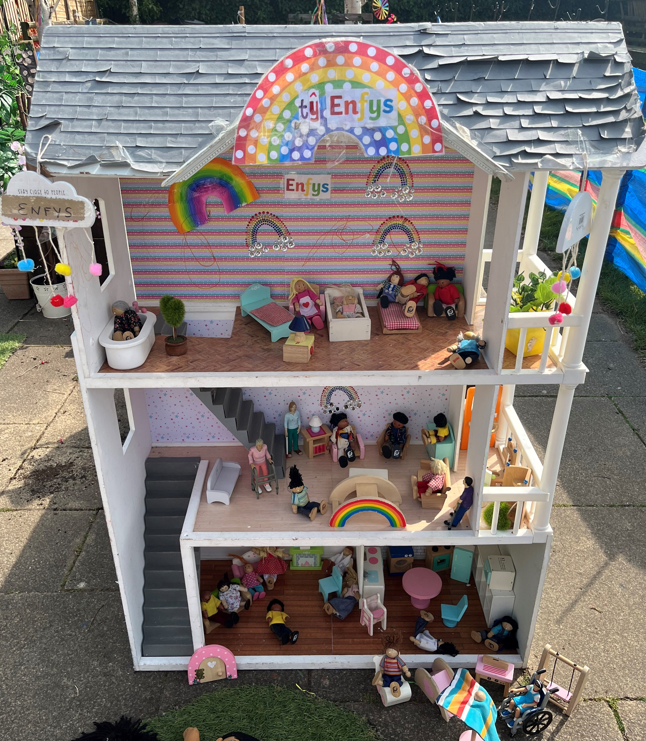
Equality and non-discrimination
Cydraddoldeb a pheidio â
chamwahaniaethu
Tŷ Enfys
Roedd hi’n bwysig iawn i’r meithrin yma bod pob plentyn a’i sefyllfa deuluol yn cael i gynrychioli o fewn yr ardaloedd dysgu.
Mae staff y meithrin wedi gwneud ymdrech mawr i ddod o hyd i a defnyddio amryw o ddoliau a theganau
i greu ardal chwarae gynhwysol i bob unigolyn.
Tŷ Enfys
It was important to the nursery that children could see their family forms reflected in their setting.
The staff made sure that they sourced dolls that showed all of the family forms and the children have really enjoyed playing with them.
Notes:
The next principle is Equality and non-discrimination.
Equality is about ensuring that every child has an equal opportunity to make the most of their talents and develop to their fullest potential, and that no child has to endure poor life chances because of discrimination. Many children and young people in Wales face discrimination in education settings. Sometimes children face discrimination due to their identity, for example, children and young people can experience bullying due to disability or because they are a member of a minority ethnic community.
On the screen you can see Ty Enfys, this nursery setting recognised that lots of their children had different family forms and so they took time to find dolls that represented each of the families in their setting. Children were able to see their family reflected back at them and use the dolls and Ty Enfys to learn more about different family forms.
Take some time now to look over the examples and questions on page 12 and 13 of your workbook.
Do you do anything similar, or is this something you need to focus on?
On page 14 of your workbook you will find space to reflect your thoughts and ideas on equality and non-discrimination.

Slide 18
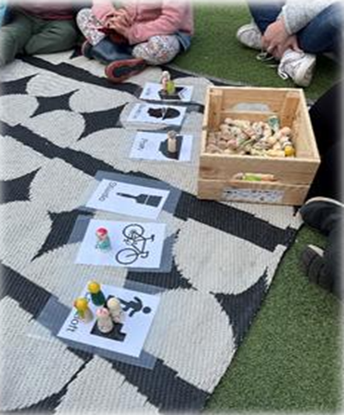
Grymuso plant
Empowering children
Un gweithgaredd dyddiol mae’r lleoliad yma yn gwneud ydy pleidlais grŵp i benderfynu pa weithgareddau i wneud y diwrnod hynny.
Mae pob unigolyn yn cael cyfle i bleidleisio gan ddefnyddio dol bren sydd wedi personoli.
Every day the children at this setting have the opportunity to take part in a group vote on the activities they would like to take part in.
The children vote using dolls that represent them and the top two choices are then offered to the children.
Notes:
Our third principle is Empowering Children.
Human rights should empower children. Empowerment means enhancing children’s capabilities as individuals so they are better able to take advantage of rights, and to engage with, influence and hold accountable the people and organisations that affect their lives. Children should be able to make choices and to affect outcomes for themselves.
On the screen you can see an example from a nursery setting. This might be something you already do, or might be something that you would like to introduce to your setting. IN order for children to feel empowered they should know about their rights, so using our activity pack and introducing some of the ideas in that will be a good first step.
Have a look over the examples and questions on page 15 of your workbook and think about how you empower children in your setting. Use page 16 to write down your thoughts.

Slide 19
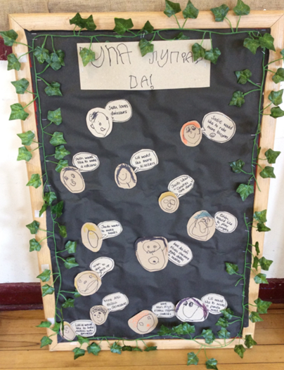
Participation
Cyfranogiad
Yn y lleoliad yma gofynnir i blant rhannu eu ‘syniadau da’. Gwnaeth y plant ymateb gydag amryw o bethau fel rhannu eu hoff weithgaredd neu ofyn am rywbeth newydd.
“Eisiau chwarae gyda tedi a dollies”
“I would like to make a volcano”
In this setting children were asked to share their “syniad da” (good idea), some children shared the things they like while others asked to do different activities.
“I would like to make a volcano”
“Eisiau chwarae gyda tedi a dollies” (want to play with teddy and dollies”
Notes:
Participation
Participation means listening to children and taking their views meaningfully into account. All children should be supported to freely express their opinion; they should be both heard and listened to. Children’s views will need to be taken into account and given due weight in light of their age, but young age is no reason for discounting children’s opinions or for giving them less attention in decision-making processes.
On the powerpoint you can see an example of listening to the voice of the child. Children in this setting were able to add their ideas with support from an adult when needed. This is a simple but affective way of showing children that you are listening to their voice and that what they say matters.
Spend some time thinking about what participation looks like in your setting by looking at the examples and questions on page 17 of your workbook. There’s space on page 18 for you to write down your thoughts.

Slide 20
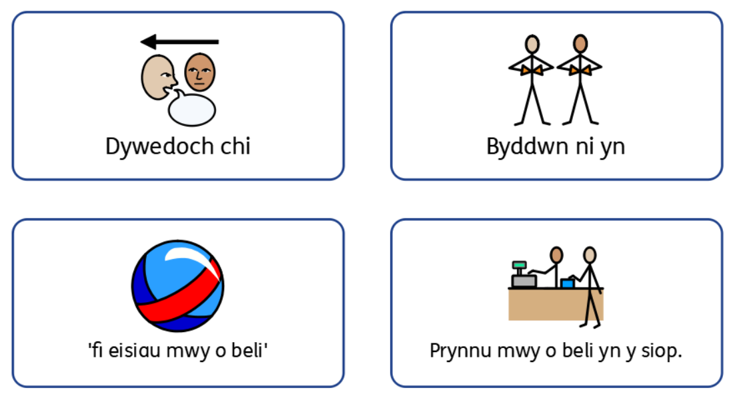
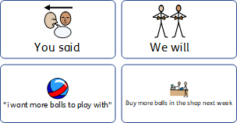
Atebolrwydd
Accountability
Notes:
The last principle is Accountability
All staff have responsibilities and make decisions and actions that impact on children. Children should be provided with information and given access to procedures which enable them to question and challenge decisions that have been taken in settings. For this to be effective settings need to be transparent and provide reasons for their decisions and actions. Wherever possible these should be linked to children’s rights.
You said, we did is a really simple and visual way that you can feed back to children in your setting. It shows children that you have listened and what will change (or stay the same as a result). Accountability is really important for showing children in your setting that their voice and opinions matter and that you take them seriously. If you can’t change something in your setting, be honest with children and explain why. For example if children asked for an extra slide in the playspace and you aren’t able to afford it, explain this to children and see if you can think of a solution together.
Accountability can sometimes feel tricky, especially whilst working with younger children.
We’ve added some thinking points on accountability on page 19 of your workbook. How do you achieve this in your setting? Use page 20 to write down your thoughts.
Yr egwyddor olaf yw Atebolrwydd
Mae gan bob aelod o staff gyfrifoldebau, ac maen nhw’n gwneud penderfyniadau ac yn cymryd camau sy’n effeithio ar blant. Dylai plant dderbyn gwybodaeth a chael mynediad at weithdrefnau sy’n eu galluogi i gwestiynu a herio penderfyniadau a wnaed mewn lleoliadau. Os yw hyn i fod yn effeithiol, mae angen i leoliadau fod yn dryloyw a rhoi rhesymau am eu penderfyniadau a’u gweithredoedd. Lle bynnag y bo modd, dylid cysylltu’r rhain â hawliau plant.
Ar eich sgrîn fe welwch chi enghraifft o XXXX
Weithiau gall atebolrwydd deimlo’n lletchwith, yn enwedig wrth weithio gyda phlant bach. Rydyn ni wedi ychwanegu rhai pwyntiau i feddwl amdanyn nhw ar eich taflen atebolrwydd. Sut rydych chi’n cyflawni hyn yn eich lleoliad?

Slide 21
Menu for Change
Bwydlen o syniadau
Edrychwch ar eich atebion a syniadau ar gyfer pob egwyddor.
Dewiswch tri pheth rydych yn gwneud yn dda.
Gan ddefnyddio’r ‘bwydlen o syniadau,’ dewiswch tri pheth hoffech wella.
Look over your answers and thoughts for each principle.
Pick three things you do well.
Using the menu for change (page 21), choose three things that you would like to improve on.
Notes:
Congratulations! You have almost finished our training session.
This is your opportunity now to look over the ideas you’ve put down in part two so far and create a menu for change.
A menu for change is a template you can use to help you prioritise the changes you will make in your setting. You can find the menu for change on page 21 of your workbook.
If you work as part of a team usually then this would be a good opportunity for you to come together and create a menu for change for your setting.
Start by choosing three thing that you do well as a setting.
If you are working with your team share your answers with them and celebrate your successes.
The next step is to think about improving your children’s rights approach by using our ‘menu for change’ template. You could complete this independently or within your group. You will need to use the headings on page 21 to help you prioritise your goals.
Your menu could include ideas like displaying a children’s rights poster or revisiting your policies and procedures to include children’s rights.
Your menu for change should be achievable, if you are completing it as a team make sure that you include as many views as possible.

Slide 22
Manylion Cyswllt | Contact Details
Trydar | Twitter @childcomwales
Instagram @childcomwales
Awr Hawliau |Rights Hour Dydd Gwener |Friday 12- 1
Ffôn | Phone 01792 765600
Ebost | Email post@childcomwales.org.uk | post@complantcymru.org.uk
Facebook https://www.facebook.com/childcomwales/
Gwefan | Website www.childcomwales.org.uk| www.complantcymru.org.uk
Notes:
Thank you for taking part in our children’s rights in early years training. We hope you found it beneficial.
If you would like a certificate for your records then please send your menu for change to the email address on this screen.
If you would like any further resources or support then you can contact us.

