Slide 1
Dull seiliedig ar Hawliau Plant ar gyfer Iechyd
A Children’s Rights Approach to Health

Slide 2

Nodau’r Sesiwn
Aims of the Session
Crynhoi Confensiwn y Cenhedloedd Unedig ar Hawliau'r Plentyn (CCUHP)
Amlinellu rôl Comisiynydd Plant Cymru
Archwilio a thrafod Dull Hawliau Plant ym maes Iechyd a mapio'r matrics
Recap on the United Nations Convention on the Rights of the Child (UNCRC)
Outline role of the Children’s Commissioner for Wales
Explore and discuss The Right Way in Health and map the matrix

Slide 3
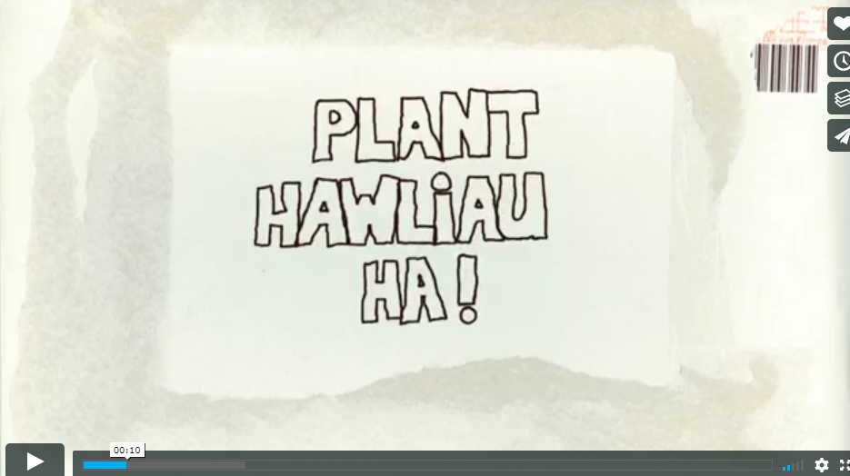

Fideo - Hawliau Plant? Ha
Video – Children’s Wrongs
Notes:
The Welsh Government have produced many training materials to support adults who work with young people to learn about their rights, and material for children to explore their rights.
This clip is called ‘Children’s Wrongs’.
You can find more bilingual resources online on the Children’s Commissioner website here - Resources - Children’s Commissioner for Wales (childcomwales.org.uk)
Following the clip there will be a short quiz, some of the answers may be in the clip!
-----------------------------------------------------------------------------------------------------------------------------------------------------------------------------------------------------------------------------------
Mae Llywodraeth Cymru wedi cynhyrchu llawer o ddeunyddiau hyfforddi i gefnogi oedolion sy’n gweithio gyda phobl ifanc i ddysgu am eu hawliau, a deunydd er mwyn i blant archwilio eu hawliau.
Yr enw ar y clip yma yw ‘Hawliau Plant? Ha!’.
Cewch hyd i ragor o adnoddau dwyieithog ar wefan y Comisiynydd Plant, yma – Adnoddau – Comisiynydd Plant Cymru (complantcymru.org.uk)
Bydd cwis cyflym yn dilyn y clip fideo, efallai bydd rhai o’r atebion yn y clip fideo!

Slide 4
Cwis
Ydych chi wedi cael hyfforddiant CCUHP o'r blaen?
Faint o hawliau sydd gan blant?
Pa oedrannau mae'n eu cynnwys?
Ym mha flwyddyn cafodd CCUHP ei gadarnhau?
Pwy sy’n gyfrifol yng Nghymru am gynnal hawliau plant?
Quiz
Have you had UNCRC training before?
How many rights do children have?
What ages does it cover?
What year was the UNCRC ratified?
Who is responsible in Wales for upholding children’s rights?
Notes:
This can be used to gauge level of knowledge in the room - Answers
1. How many rights do children have? 54 (42 of these are named rights such as education, health and safety and the other 12 are duties of Governments to implement those rights)
2. What ages does it cover – 0-18 (NB you may wish to note that unborn children are not included)
3. In what year was the UNCRC ratified by the UK? Answer – this is a tricky one. The UK signed up to the convention in 1990; it was ratified in 1991; and came into force in 1992. so you can have a point for any of those!
4. All of us adults, The Government and the Children’s Commissioner for Wales
………………………………………………………………………………………………………………………………………………………………………………………………………………………………………………………………………………………………………………………………………
Mae modd defnyddio hyn i fesur lefel yr wybodaeth yn yr ystafell - Atebion
1. Faint o hawliau sydd gan blant? 54 (mae 42 o’r rhain yn cael eu henwi, er enghraifft addysg, iechyd a diogelwch, ac mae’r 12 arall yn ddyletswyddau sydd gan Lywodraethau i weithredu’r hawliau hynny)
2. Pa oedrannau mae’n eu cynnwys – 0-18 (DS efallai byddwch chi am nodi nad yw plant sydd heb eu geni eto yn cael eu cynnwys)
3. Ym mha flwyddyn cafodd CCUHP ei gadarnhau gan y Deyrnas Unedig? Ateb – mae hwn yn un anodd. Ymrwymodd y Deyrnas Unedig i’r confensiwn yn 1990; cafodd ei gadarnhau yn 1991; a daeth i rym yn 1992. Felly gallwch chi gael pwynt am unrhyw un o’r rheiny!
4. Pawb ohonon ni oedolion, y Llywodraeth a Chomisiynydd Plant Cymru

Slide 5
Stepping Out activity
Gweithgaredd Camu Allan
Notes:
Participative activity to explore why Children have rights - Athrawon Cynradd - Children’s Commissioner for Wales (complantcymru.org.uk)
-----------------------------------------------------------------------------------------------------------------------------------------------------------------------------------------------------------------------------------
Gweithgaredd cyfranogol i archwilio pam mae gan Blant hawliau – Resources for Primary Teachers - Children’s Commissioner for Wales (childcomwales.org.uk)

Slide 6
Mae gennym ni Hawliau Dynol, pam mae angen Hawliau Plant?
We have Human Rights, why do we need Children’s Rights?
Children are more vulnerable to abuse and exploitation
Dependent on age, children are entirely or mostly dependent on adults – best interests not always considered
Children face an array of legal minimum ages at which they are considered capable of making decisions for themselves
Children are often voiceless
Mae plant yn fwy agored i gael eu cam-drin a’u hecsbloetio
Yn dibynnu ar eu hoed, mae plant yn ddibynnol ar oedolion yn llwyr neu gan mwyaf – dyw eu lles pennaf ddim bob amser yn cael ei ystyried
Mae plant yn wynebu llu o derfynau oed cyfreithiol pryd y bernir eu bod nhw’n gallu gwneud penderfyniadau drostynt eu hunain
Mae plant yn aml heb lais
Notes:
This gives a bit of context on why we have Children’s Rights – following stepping out
-----------------------------------------------------------------------------------------------------------------------------------------------------------------------------------------------------------------------------------
Mae hyn yn rhoi tipyn o gyd-destun ynghylch pam mae gennym ni Hawliau Plant – yn dilyn ymlaen o Camu Allan

Slide 7
CCUHP – Confensiwn y Cenhedloedd Unedig ar Hawliau’r Plentyn. Cytundeb rhyngwladol yw hwn sy’n amddiffyn hawliau dynol pobl o dan 18 oed.
Mae’n rhestru’r hawliau sydd gan bob plentyn a pherson ifanc, ym mhobman yn y byd.
Cafodd ei fabwysiadu gan y CU yn 1989, cafodd ei gadarnhau gan y Deyrnas Unedig yn 1991, a daeth i rym yn 1992.
UNCRC - United Nations Convention on the Rights of the Child is an international agreement that protects the human rights of those under the age of 18.
It lists the rights that all children and young people, everywhere in the world have.
It was adopted by the UN in 1989, the UK ratified it in 1991 and it came into force in 1992.
Notes:
These slides outline a little more about the UNCRC – it covers the age and global dimension of the UNCRC.
It is worth noting that it is the most signed up to piece of UN legislation and offers the world’s “Greatest promise to Children”.
When UN adopted it on November 20th 1989 this became recognised as Universal Children’s Day and it is often celebrated across Wales and the globe.
-----------------------------------------------------------------------------------------------------------------------------------------------------------------------------------------------------------------------------------
Mae’r sleidiau hyn yn cynnwys rhagor o wybodaeth am CCUHP – mae’n sôn am oed a dimensiwn byd-eang CCUHP.
Mae’n werth nodi mai dyma’r enghraifft o ddeddfwriaeth y CU y mae’r nifer mwyaf wedi ymrwymo iddo a’i bod yn cynnig yr ‘Addewid mwyaf i Blant’ yn y byd.
Pan gafodd ei fabwysiadu gan y CU ar 20 Tachwedd 1989 dewiswyd y dyddiad hwnnw’n Ddiwrnod Byd-eang y Plant, ac mae’n aml yn cael ei ddathlu yng Nghymru ac ar draws y byd.

Slide 8
Gweithgaredd 1:
Pa Hawliau allai fod yn bwysig i’ch rôl fel gweithiwr proffesiynol?
Gan ddefnyddio poster CCUHP, darllenwch trwy’r erthyglau mewn parau a thrafod pa dair erthygl yw’r rhai pwysicaf i’r rôl rydych am ei chyflawni yn y dyfodol.
Adborth cryno.
Activity 1:
What Rights could be important to your role as a professional?
Using a UNCRC poster, read through the articles and discuss which three articles are most important to your role you aim to have in the future.
Briefly feedback.
Notes:
This activity gives participants an opportunity to look through the range of articles and think about which ones are relevant to their role.
All are important and relevant in role of health services; just some more directly than others
Some that might come up:
article 24 – best standard of health; article 25 – regular review of treatment when in care (including hospitals); article 3 – best interests; article 12 – respect for views of the child; article 13 – access to information; article 16 – right to privacy; article 23 – special provision for disabled children; article 28 – education; article 31 – rest, leisure, play
-----------------------------------------------------------------------------------------------------------------------------------------------------------------------------------------------------------------------------------
Mae’r gweithgaredd hwn yn rhoi cyfle i’r cyfranogwyr edrych trwy’r amrywiaeth o erthyglau a meddwl pa rai ohonyn nhw sy’n berthnasol i’w rôl.
Mae pob un ohonyn nhw’n bwysig yn rôl y gwasanaethau iechyd; rhai yn fwy uniongyrchol nag eraill
Rhai a allai godi:
Erthygl 24 – y safon orau o iechyd; erthygl 25 – adolygu triniaeth yn rheolaidd mewn gofal (gan gynnwys ysbytai); erthygl 3 – lles pennaf; erthygl 12 – parch at farn y plentyn; erthygl 13 – mynediad at wybodaeth; erthygl 16 – hawl i breifatrwydd; erthygl 23 – darpariaeth arbennig i blant anabl; erthygl 28 – addysg; erthygl 31 – gorffwys, hamdden, chwarae

Slide 9
Beth amdana i?
Ar y cyd â’r Llywodraeth, mae dyletswydd ar bawb sy’n gofalu am blant a phobl ifanc o dan CCUHP. Mae hynny’n golygu bod cyfrifoldeb arnyn nhw i gynnal hawliau plant.
What about you?
Along with the Government, all people who care for children and young people are duty bearers under the UNCRC. That means they have a responsibility to uphold children’s rights.
Notes:
To access their needs, children have to rely on adults. Adults who make decisions that affect children are all responsible for making sure that children’s rights are upheld and respected. These are duties under the UNCRC. We as adults who care about and care for children are therefore “Duty Bearers” with a responsibility to ensure children get their rights.
----------------------------------------------------------------------------
Mae’n rhaid i blant ddibynnu ar oedolion i gael mynediad i’w hanghenion. Mae pob oedolyn sy’n gwneud penderfyniadau sy’n effeithio ar blant yn gyfrifol am sicrhau bod hawliau plant yn cael eu cynnal a’u parchu. Mae’r rhain yn ddyletswyddau o dan CCUHP. Rydym ni’n oedolion sydd â gofal ac yn gofalu am blant, ac felly rydym ni’n ‘Ddeiliaid Dyletswydd’ sydd â chyfrifoldeb i sicrhau bod plant yn cael eu hawliau.

Slide 10
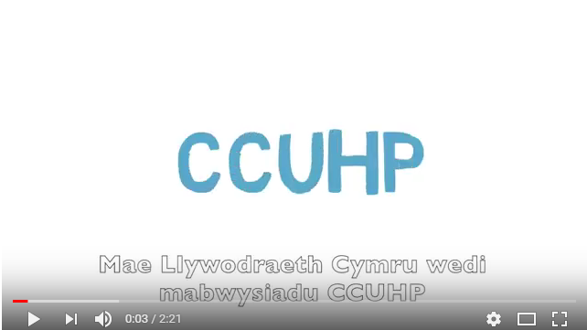

Fideo - Rhoi ‘Sylw Dyledus’ i’r Confensiwn
Video – Having ‘Due Regard’ to the Convention
Notes:
This video explains a little more about ‘Due Regard’
-----------------------------------------------------------------------------------------------------------------------------------------------------------------------------------------------------------------------------------
Mae’r fideo yma’n esbonio ychydig mwy am ‘Sylw Dyledus’

Slide 11
Gweithgaredd 2: Trafodaeth
Mewn grwpiau byddwch chi’n cael erthyglau i’w trafod, gall y rhain gynnwys;. 3, 6, 7, 12, 13, 14, 17, 19, 24, 27, 28, 31, 36, 42
Trafodaeth: Beth rydych chi eisoes yn ei wneud i wireddu’r hawl hon i blant a phobl ifanc?
Activity 2: Discussion
In groups you will be given some articles to discuss, these may include; 3, 6, 7, 12, 13, 14, 17, 19, 24, 27, 28, 31, 36, 42.
Discuss: What you already do to make this right a reality for children and young people?
Notes:
Activity - Ask participants to work in small groups and give them an article/s to discuss – they will need access to the poster see here – CCfW A2 Rights Poster ENGLISH AW (childcomwales.org.uk)
-----------------------------------------------------------------------------------------------------------------------------------------------------------------------------------------------------------------------------------
Gweithgaredd – Gofynnwch i’r cyfranogwyr weithio mewn grwpiau bach, a rhowch erthygl(au) iddyn nhw eu trafod – bydd angen iddyn nhw gael mynediad i’r poster yma – CCfW A2 Rights Poster CYMRAEG AW (childcomwales.org.uk)

Slide 12
Yn 2001, Cymru oedd y wlad gyntaf yn y Deyrnas Unedig i greu rôl y Comisiynydd Plant.
Roedd gweinidogion Llywodraeth Cymru yn sylweddoli bod angen rhywun ar blant a phobl ifanc i godi llais ar eu rhan, a gwneud yn siŵr eu bod nhw’n cael gwrandawiad ac yn cael eu trin yn deg.
Mae cyfres o gyfreithiau yn cynnwys: Deddf Safonau Gofal 2000 a Deddf Comisiynydd Plant Cymru 2001, sy’n esbonio rôl a chyfrifoldebau’r Comisiynydd.
In 2001, Wales was the first country in the UK to create the role of the Children’s Commissioner.
Welsh Government ministers recognised that children and young people need someone to speak up for them and make sure that they are listened to and treated fairly.
There is a set of laws including: the Care Standards Act 2000 and the Children’s Commissioner for Wales Act 2001 which explains the role and responsibilities of the Commissioner.
Notes:
These next few slides outline the role of the Children’s Commissioner
See more here - Home - Children’s Commissioner for Wales (childcomwales.org.uk)
-----------------------------------------------------------------------------------------------------------------------------------------------------------------------------------------------------------------------------------
Mae’r sleidiau nesaf yn amlinellu rôl y Comisiynydd Plant.
Mae rhagor o wybodaeth yma - Hafan – Comisiynydd Plant Cymru (complantcymru.org.uk)

Slide 13

PUM SWYDDOGAETH EIN SWYDDFA:
CEFNOGI
GWRANDO
CYNGHORI
DYLANWADU
CODI LLAIS
FIVE FUNCTIONS OF OUR OFFICE:
SUPPORT
LISTEN
ADVISE
INFLUENCE
SPEAK UP
Notes:
The Children’s Commissioner…
She SUPPORTS and LISTENS through her participation team who work with groups of children and young people across Wales to teach them about their rights and listen to them to find out what they want the Commissioner to change.
She ADVISES through her Investigation and Advice team.
She INFLUENCES through her policy team to affect government change
She SPEAKS up at all levels to be a voice for children in Wales.
--------------------------------------------------------------------------------------------------------
Y Comisiynydd Plant…
Mae hi’n CEFNOGI ac yn GWRANDO trwy ei thîm cyfranogiad sy’n gweithio gyda grwpiau o blant a phobl ifanc ledled Cymru i’w dysgu am eu hawliau ac yn gwrando arnyn nhw er mwyn cael gwybod beth maen nhw eisiau i’r Comisiynydd ei newid.
Mae hi’n CYNGHORI trwy’r tîm Ymchwiliadau a Chyngor.
Mae hi’n DYLANWADU trwy ei thîm polisi i gyflawni newid yn y llywodraeth
Mae hi’n CODI LLAIS ar bob lefel er mwyn bod yn llais i blant Cymru.

Slide 14
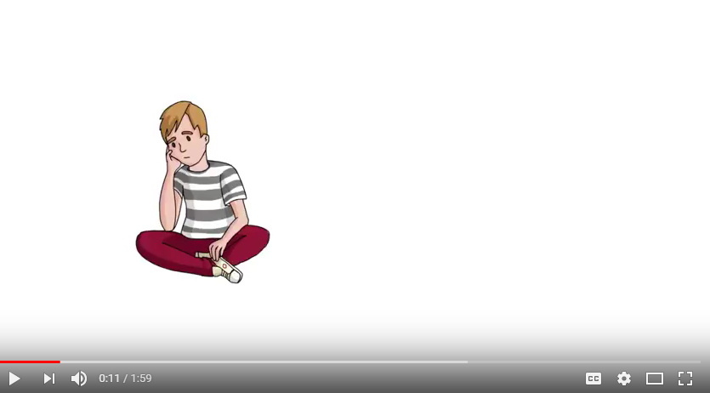
Fideo – Y Gwasanaeth Ymchwiliadau a Chyngor
Video – Investigations and Advice service
Notes:
This video explains a little more about our Investigations and advice line
-----------------------------------------------------------------------------------------------------------------------------------------------------------------------------------------------------------------------------------
Mae’r fideo yma yn esbonio ychydig mwy am ein gwasanaeth ymchwiliadau a chyngor

Slide 15
Beth yw Dull Gweithredu Seiliedig ar Hawliau Plant?
Fframwaith egwyddorol ac ymarferol ar gyfer gweithio gyda phlant yw Dull Gweithredu Seiliedig ar Hawliau Plant, wedi’i wreiddio yng Nghonfensiwn y Cenhedloedd Unedig ar Hawliau’r Plentyn
Mae Dull Gweithredu Seiliedig ar Hawliau Plant yn ymwneud â gwneud CCUHP yn ganolog i gynllunio a darparu gwasanaeth, ac integreiddio hawliau plant ym mhob agwedd ar wneud penderfyniadau, polisïau ac ymarfer
What is a Children’s Rights Approach?
A Children’s Rights Approach is a principled and practical framework for working with children grounded in the UN Convention on the Rights of the Child
A Children’s Rights Approach is about placing the UNCRC at the Core of planning and service delivery and integrating children’s rights into every aspect of decision making , policy and practice
Notes:
Notes - What is a Children’s Rights Approach
The aim of “The Right Way” is to help professionals embed a Children’s Rights Approach in a practical and meaningful way.
-----------------------------------------------------------------------------------------------------
Nodiadau – Beth yw Dull Gweithredu seiliedig ar Hawliau Plant?
Nod “Dull Hawliau Plant” yw helpu gweithwyr proffesiynol i wreiddio Dull seiliedig ar Hawliau Plant mewn modd ymarferol ac ystyrlon.

Slide 16
The Right Way
Dull Hawliau Plant
Seilio’r CCUHP
Cydraddoldeb a dim gwahaniaethu
Galluogi plant i ddefnyddio eu hawliau
Cyfranogiad
Atebolrwydd
Embedding the UNCRC
Equality and non-discrimination
Empowering children
Participation
Accountability
Notes:
On our website - https://www.childcomwales.org.uk/the-right-way-a-childrens-rights-approach/ you can see a range of examples and resources that maybe helpful for you to map a Children’s Rights Approach.
Our right way framework
The principles of a Children’s Rights Approach are:
1.Embedding children’s rights – putting children’s rights at the core of planning and service delivery
2. Equality and non-discrimination – ensuring that every child has an equal opportunity to be the best they can be
3. Empowering children – enhancing children’s capabilities as individuals so they’re better able to take advantage of rights, and engage with and hold accountable the institutions and individuals that affect their lives
4. Participation – listening to children and taking their views meaningfully into account
5. Accountability – authorities should be accountable to children for decisions and actions that affect their lives
Developed with the children’s rights observatory in Swansea and Bangor Universities
Provided a systematic method to implement children’s 42 rights in organisations large and small
…………………………………………………………………………………………………………………………………………………………………………………………………………………………………………………………………………………..
Ar ein gwefan - https://www.complantcymru.org.uk/adnoddau/dull-hawliau-plant-2/ fe welwch amrywiaeth o enghreifftiau ac adnoddau a allai fod o ddefnydd i chi fapio Dull seiliedig ar Hawliau Plant.
Dull Hawliau Plant
Egwyddorion Dull seiliedig ar Hawliau Plant yw:
1. Seilio hawliau plant – gwneud hawliau plant yn ganolog wrth gynllunio a chyflwyno gwasanaeth
2. Cydraddoldeb a dim gwahaniaethu– sicrhau bod pob plentyn yn cael cyfle cyfartal i fod y gorau gallan nhw fod
3. Galluogi plant – gwella galluoedd plant fel unigolion fel eu bod mewn sefyllfa well i fedru manteisio ar eu hawliau, ac ymgysylltu â’r sefydliadau a’r unigolion sy’n effeithio ar eu bywydau a’u gwneud yn atebol
4. Cyfranogiad – gwrando ar blant a rhoi sylw ystyrlon i’w barn
5. Atebolrwydd – dylai awdurdodau fod yn atebol i blant am benderfyniadau a chamau gweithredu sy’n effeithio ar eu bywydau
Datblygwyd gyda’r arsyllfa hawliau plant ym Mhrifysgolion Abertawe a Bangor
Darparu dull systematig o roi’r 42 o hawliau plant ar waith mewn sefydliadau bach a mawr

Slide 17
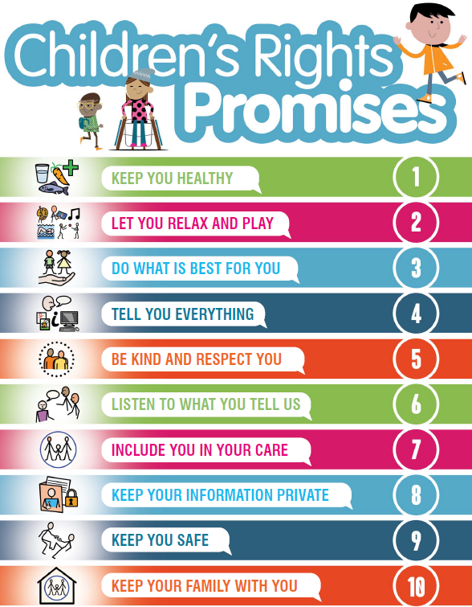
Seilio’r CCHUP
Embedding the UNCRC
Gwreiddio hawliau plant wrth i chi gynllunio a darparu gwasanaeth
Byrddau pwrpasol plant a phobl ifanc
Siarteri / Addewidion Plant – Powys, Bae Abertawe, Caerdydd a’r Fro, Ymddiriedolaeth Gwasanaethau Ambiwlans Cymru
Putting children’s rights at the core of planning and service delivery
Dedicated children and young people’s Boards
Children’s Charters / Promises – Powys, Swansea Bay, Cardiff & Vale, Welsh Ambulance Services Trust
Notes:
The first principle is embedding Children’s rights. This means making sure children’s human rights and plans to promote and protect them are visible and engrained in strategic planning and service delivery
To consider:
Do strategic plans link directly to the UNCRC? If not, how could it?
Leaders and staff – knowledge of children’s rights and how it can benefit organisation
Training – resources available from CCfW
Responsibility – is there an individual or team who can lead on this?
Resources – do you have all the human / financial resources you need? Have you thought about what that looks like?
Examples:
Forums for children and young people themselves to become involved in Boards’ work (examples such as Swansea Bay UHB & Cardiff and Vale UHB)
Forums to prioritise children and young people’s health services and ensure on the agenda of senior Board members (Examples such as Hywel Dda children’s voices group)
Children’s Charters. Process of making a charter involves children and embeds rights into the working of the Board, and the output empowers children as they can see the charter and know to expect their rights to be upheld and respected
…………………………………………………………………………………………………………………………………………………………………
Yr egwyddor gyntaf yw seilio hawliau plant. Ystyr hynny yw sicrhau bod hawliau dynol plant a chynlluniau i’w hybu a’u diogelu yn weladwy ac yn rhan annatod o gynllunio strategol a chyflwyno gwasanaeth
I’w hystyried:
Ydy cynlluniau strategol yn cysylltu’n uniongyrchol â CCUHP? Os nad ydyn nhw, sut gallai hynny ddigwydd?
Arweinwyr a staff – gwybodaeth am hawliau plant a sut gall fod o fudd i’r sefydliad
Hyfforddiant – adnoddau ar gael gennym CCfW
Cyfrifoldeb – oes yna unigolyn neu dîm sy’n gallu arwain ar hyn?
Adnoddau – oes gennych chi’r holl adnoddau dynol/ariannol angenrheidiol? Ydych chi wedi meddwl beth yw ystyr hynny?
Enghreifftiau:
Fforymau i blant a phobl ifanc eu hunain ymwneud â gwaith Byrddau (enghreifftiau fel Bwrdd Iechyd Prifysgol Bae Abertawe a Bwrdd Iechyd Prifysgol Caerdydd a’r Fro)
Fforymau i roi blaenoriaeth i wasanaethau iechyd plant a phobl ifanc a sicrhau eu bod ar agenda aelodau uwch y Bwrdd (Enghreifftiau fel grŵp lleisiau plant Hywel Dda)
Siarteri Plant. Mae’r broses o greu siarter yn cynnwys plant ac yn gwreiddio hawliau yng ngwaith y Bwrdd, ac mae’r allbwn yn grymuso plant gan eu bod yn gallu gweld y siarter a gwybod y gallan nhw ddisgwyl y bydd eu hawliau’n cael eu cynnal a’u parchu
Dyma rai enghreifftiau o sut mae Byrddau Iechyd wedi gwreiddio dull seiliedig ar Hawliau Plant, gan gynnwys siarter enghreifftiol.

Slide 18
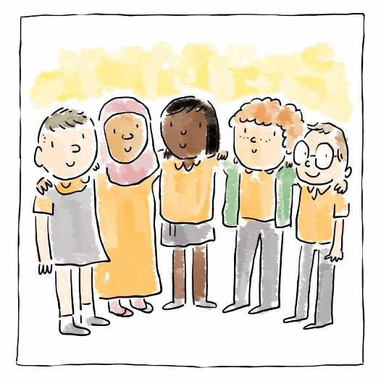
Equality and non-discrimination
Cydraddoldeb a dim gwahaniaethu
Cydraddoldeb i blant fel grŵp eu hunain; a chydraddoldeb rhwng gwahanol grwpiau o blant
Model Rhewfryn Aneurin Bevan & Fframwaith NYTH Cymru gyfan
Equality for children as a group themselves; and equality between different groups of children
Aneurin Bevan’s Iceberg Model & the Wales-wide NEST Framework
Notes:
Have a commitment to promoting equality and tackling discrimination – both against children as a group, and specific groups of children
Discrimination by age – e.g. Is there a gap in provision for 16 and 17 year olds in your service?
And also groups: e.g. What safeguards do you have in place to stop children having to act as translators for their parents in health appointments?
Do you have bespoke health services for children who may miss out, e.g. children from Traveller communities, or home educated children?
To consider:
Staff knowledge of the Equality Act and needs of different groups of children
CCfW recommends a children’s rights impact assessment – templates available on CCfW website. Feedback - help focus policy and identify needs
Review data collection – do you need to be collecting more data to reach all CYP?
Provide accessible information in language / format appropriate to age, maturity, disability etc
Examples:
Aneurin Bevan: Iceberg model/NEST framework - mental health practitioners recognising that children from the least resourced backgrounds were missing out on mental health support and being ‘bounced’ between services. Huge resource was being misplaced. So created a new panel model which brings services to the individual child in a timely way.
The NEST framework is the national effort to improve joint-working between services for the mental health and wellbeing of all children in Wales.
………………………………………………………………………………………………………………………………………………………………..
Ymrwymo i hybu cydraddoldeb a mynd i’r afael dim gwahaniaethu – yn erbyn plant fel grŵp, a grwpiau penodol o blant
Gwahaniaethu yn erbyn oedrannau penodol – e.e. oes yna fwlch yn narpariaeth eich gwasanaeth chi ar gyfer pobl ifanc 16 ac 17 oed?
A hefyd grwpiau: e.e. Pa fesurau diogelu sydd yn eu lle gennych chi i olygu bod dim rhaid i blant weithredu fel cyfieithwyr i’w rhieni mewn apwyntiadau iechyd?
Oes gennych chi wasanaethau iechyd wedi’u teilwra ar gyfer plant a allai golli cyfleoedd, e.e. plant o gymunedau Teithwyr, neu blant sy’n cael eu haddysgu gartref?
I’w hystyried:
Gwybodaeth staff am y Ddeddf Cydraddoldeb ac anghenion gwahanol grwpiau o blant
Mae CPC yn argymell asesiad effaith ar hawliau plant – templedi ar gael ar wefan CPC. Adborth – helpu i sicrhau ffocws i bolisi a chanfod anghenion
Adolygu’r data sy’n cael ei gasglu – oes angen i chi fod yn casglu mwy o ddata i gyrraedd pob plentyn a pherson ifanc?
Darparu gwybodaeth hygyrch mewn iaith/fformat priodol ar gyfer oed, aeddfedrwydd, anabledd etc
Enghreifftiau:
Aneurin Bevan: Model Rhewfryn/Fframwaith NYTH – ymarferwyr iechyd meddwl yn cydnabod bod plant oedd â chefndir lle roedd yr adnoddau lleiaf yn colli cyfle i gael cefnogaeth iechyd meddwl ac yn cael eu ‘bownsio’ rhwng gwasanaethau. Adnoddau aruthrol yn cael eu camleoli. Felly crëwyd model panel newydd sy’n dod â gwasanaethau at y plentyn unigol mewn modd amserol.
Fframwaith NYTH yw’r ymgais genedlaethol i wella’r gweithio ar y cyd rhwng gwasanaethau er iechyd meddwl a llesiant holl blant Cymru.

Slide 19
Galluogi plant i ddefnyddio eu hawliau
Empowering children
Enhancing children’s capabilities as individuals so they’re better able to take advantage of rights, and engage with and hold accountable the institutions and individuals that affect their lives
Swansea Bay and Cardiff and Vales’ coproduced websites
Interview panels
Gwella galluoedd plant fel unigolion fel eu bod yn gallu manteisio'n well ar hawliau, ac ymgysylltu â'r sefydliadau a'r unigolion sy'n effeithio ar eu bywydau a'u gwneud yn atebol
Gwefan Bae Abertawe, a gynhyrchwyd ar y cyd
Paneli cyfweld
Notes:
Create and promote opportunities for children to be empowered.
To consider:
What support do children need to be able to be empowered. What are the barriers to them being able to influence services which they use?
Do you give children accessible information about their rights and using health services?
Information and opportunities to influence decisions affecting them, including advocacy
How is your work scrutinised by children and young people? Is it effective?
Examples:
Coproducing work – Cardiff & Vale emotional and mental wellbeing website and Swansea Bay’s Tidy Minds website. These have been joint projects between the Health Board and young people to produce a website for mental health support
Cardiff & Vale: https://cavyoungwellbeing.wales/
Swansea Bay: https://tidyminds.org.uk/
Cardiff and Vale – worked with the children on their youth panel to produce an animated video sharing experiences of CYP, including when they have not felt respected by health practitioners.
https://cavyoungwellbeing.wales/young-people/emotional-wellbeing-mental-health/
Welsh Ambulance Services Trust – produced a video with messages from children on what they expect from the ambulance service
Membership of interview panels for child-facing roles within the health service. This happens in several health boards
……………………………………………………………………………………………………………………………………………………………………………………………………………..
Creu a hyrwyddo cyfleoedd i blant gael eu galluogi.
I’w hystyried:
Pa gefnogaeth sydd ei hangen ar blant i gael eu galluogi? Beth yw’r rhwystrau sy’n eu hatal rhag dylanwadu ar y gwasanaethau maen nhw’n eu defnyddio?
Ydych chi’n rhoi gwybodaeth hygyrch i blant am eu hawliau a defnyddio gwasanaethau iechyd?
Gwybodaeth a chyfleoedd i ddylanwadu ar benderfyniadau sy’n effeithio arnyn nhw, gan gynnwys eiriolaeth
Sut mae plant a phobl ifanc yn craffu ar eich gwaith? Ydy hynny’n effeithiol?
Enghreifftiau:
Cynhyrchu gwaith ar y cyd – mae gwefan ‘Tidy Minds’ Bae Abertawe yn dod yn fuan, sef prosiect ar y cyd rhwng y Bwrdd Iechyd a phobl ifanc i gynhyrchu gwefan sy’n cefnogi iechyd meddwl
https://cavyoungwellbeing.wales/cy/pobl-ifanc/lles-emosiynol-ac-iechyd-meddwl/
https://tidyminds.org.uk/
Caerdydd a’r Fro – wedi gweithio gyda’r plant ar eu panel ieuenctid i gynhyrchu fideo wedi’i animeiddio yn rhannu profiadau plant a phobl ifanc, gan gynnwys adegau pan fuon nhw’n teimlo nad oedd ymarferwyr iechyd yn eu parchu.
Ymddiriedolaeth Gwasanaethau Ambiwlans Cymru – cynhyrchwyd fideo gyda negeseuon gan blant ynghylch beth maen nhw’n ei ddisgwyl gan y gwasanaeth ambiwlans
Aelodaeth o baneli cyfweld ar gyfer rolau sy’n ymwneud â phlant yn y gwasanaeth iechyd. Mae hyn yn digwydd mewn sawl bwrdd iechyd

Slide 20
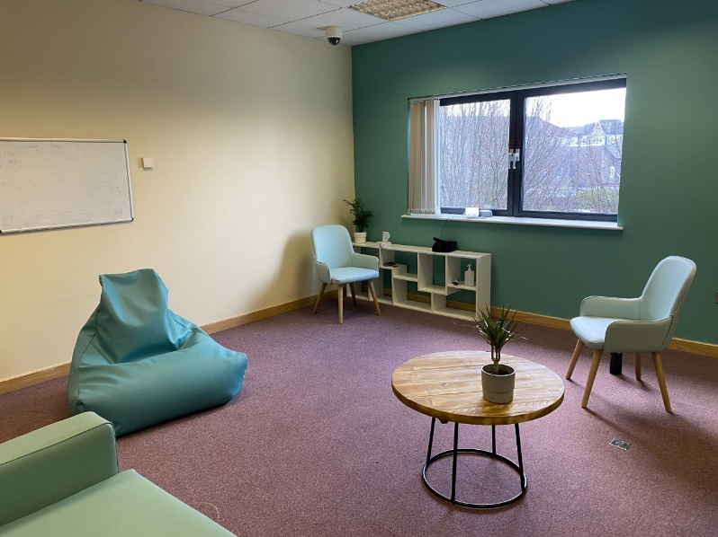
Participation
Cyfranogiad
Gwrando ar blant a rhoi sylw ystyrlon i’w barn
Bae Abertawe a Chaerdydd a’r Fro - cael dweud eu dweud wrth ddylunio gofod y mae plant yn ei ddefnyddio
Listening to children and taking their views meaningfully into account
Swansea Bay and Cardiff & Vale – having a say in the design of space children use
Notes:
To consider:
How do you listen to CYP and use the information they give you? What are the gaps and what are the opportunities?
Do you involve children directly in design, monitoring and evaluation of services they receive?
Has your organisation signed up to the National Participation Standards, which set out more practical considerations for participation?
How do children have a say in how spaces they use look and how they serve children and young people?
Example:
Cardiff & Vale’s Child and Adolescent Mental Health services (CAMHS) department was recently redesigned with input from children and young people who use the service themselves.
………………………………………………………………………………………………………..
I’w hystyried:
Sut mae gwrando ar blant a phobl ifanc a defnyddio’r wybodaeth maen nhw’n ei rhoi i chi? Beth yw’r bylchau a beth yw’r cyfleoedd?
Ydych chi’n cynnwys plant yn uniongyrchol wrth ddylunio, monitro a gwerthuso’r gwasanaethau maen nhw’n eu derbyn?
Ydy eich sefydliad wedi ymrwymo i’r Safonau Cyfranogiad Cenedlaethol, sy’n cyflwyno ystyriaethau mwy ymarferol ar gyfer cyfranogiad?
Sut mae plant yn cael rhoi barn ar sut mae’r mannau maen nhw’n eu defnyddio yn edrych, a sut maen nhw’n gwasanaethu plant a phobl ifanc?
Enghraifft:
Yn ddiweddar cafodd adran Gwasanaethau Iechyd Meddwl Plant a Phobl Ifanc (CAMHS) Caerdydd a’r Fro ei hailddylunio, gyda mewnbwn gan blant a phobl ifanc sy’n defnyddio’r gwasanaeth eu hunain.

Slide 21
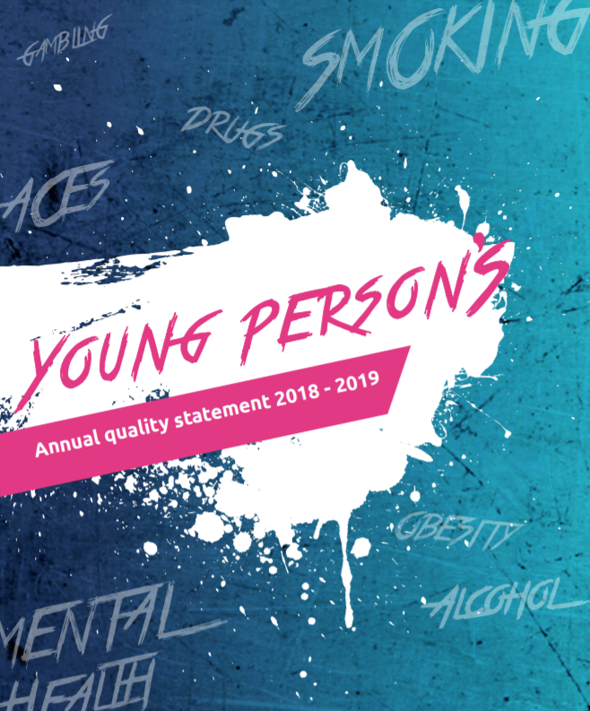
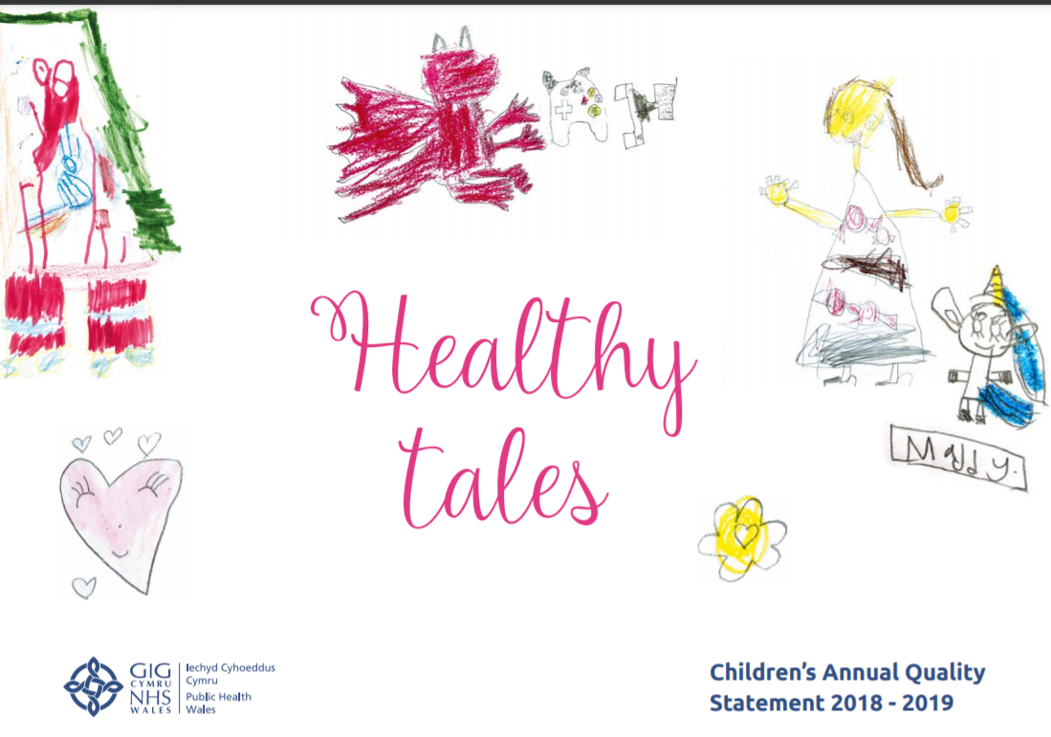
Atebolrwydd
Dylai awdurdodau fod yn atebol i blant am benderfyniadau a gweithredoedd sy'n effeithio ar eu bywydau
Datganiadau Ansawdd Blynyddol Iechyd Cyhoeddus Cymru
Accountability
Authorities should be accountable to children for decisions and actions that affect their lives
Public Health Wales Annual Quality Statements
Notes:
It is important that, as well as these first four principles which involve children and young people more, we then make sure we are held accountable to them. It is a very important step but one which can get lost after we do the ‘doing’ bit of getting children to contribute to our work.
How do you make sure you tell all children who use your services what you are doing better for children and young people and what they can expect to see change as a result?
For children who directly contributed to your plans, how do you make sure children know what influence their contribution had?
To consider:
Ensure staff understand responsibilities to children, including making this explicit in job descriptions and conduct policies etc
Publish annual update showing how you’ve worked toward a children’s rights approach and share it widely with CYP
Feed back regularly to children in suitable format. ‘You Said; We Did’ format?
Accessible information on complaints / holding staff to account
Providing feedback on actions taken based on views of children, and being held accountable
Examples:
Children and young people having the opportunity to scrutinise senior leaders. This has happened in several health boards
Public Health Wales have produced children’s and young person’s versions of their annual quality statements - illustrations and stories with public health messages (such as tooth loss) for younger children and public health messaging designed for teenagers (around smoking and sexual health for example)
………………………………………………………………………………………………………………………………………………………………………
Yn ogystal â’r pedair egwyddor cyntaf hyn sy’n cynnwys plant a phobl ifanc yn fwy, mae’n bwysig ein bod ni wedyn yn sicrhau ein bod ni’n atebol iddyn nhw. Mae hwn yn gam pwysig iawn, ond yn un sy’n gallu mynd ar goll ar ôl i ni wneud y cam ‘cyflawni’ o sicrhau bod plant yn cyfrannu at ein gwaith.
Sut mae gwneud yn siŵr eich bod chi’n dweud wrth yr holl blant sy’n defnyddio eich gwasanaethau beth rydych chi’n ei wneud yn well i blant a phobl ifanc a beth gallan nhw ddisgwyl ei weld yn newid o ganlyniad?
Yn achos plant a gyfrannodd yn uniongyrchol i’ch cynlluniau, sut gallwch chi sicrhau bod plant yn gwybod pa ddylanwad gafodd eu cyfraniad?
I’w hystyried:
Sicrhau bod staff yn deall eu cyfrifoldebau i blant, gan gynnwys nodi hynny’n benodol mewn disgrifiadau swyddi, polisïau ymddygiad etc
Cyhoeddi diweddariad blynyddol yn dangos sut rydych chi wedi gweithio tuag at ddull seiliedig ar hawliau plant a’i rannu’n eang gyda phlant a phobl ifanc
Rhoi adborth rheolaidd i blant mewn fformat addas. Fformat ‘Fe ddwedsoch chi: Fe wnaethon ni’?
Gwybodaeth hygyrch am gwynion / galw staff i gyfrif
Rhoi adborth ar gamau a gymerwyd ar sail barn plant, a chael eu gwneud yn atebol
Enghreifftiau:
Plant a phobl ifanc yn cael cyfle i graffu ar arweinwyr uwch. Mae hyn wedi digwydd mewn sawl bwrdd iechyd
Mae Iechyd Cyhoeddus Cymru wedi cynhyrchu fersiynau plant a phobl ifanc o’u datganiadau ansawdd blynyddol – darluniadau a hanesion gyda negeseuon iechyd cyhoeddus (fel colli dannedd) i blant iau a negeseuon iechyd cyhoeddus ar gyfer arddegwyr (ynghylch smygu a iechyd rhywiol, er enghraifft)

Slide 22
Beth gallwch chi ei wneud er mwyn cefnogi Plant a Phobl ifanc i gael mynediad i’w hawliau?
I deimlo eu bod nhw’n cael gwrandawiad ac yn cael eu cymryd o ddifri?
I deimlo’n ddiogel?
I dderbyn gwybodaeth maen nhw’n ei deall
I gwyno os bydd angen?
Beth gallwch chi ei wneud yn yr wythnos nesa? Y 3 mis nesa? Y flwyddyn nesa i lywio’ch ymarfer ac ymarfer eraill yn y bwrdd iechyd?
What can you do to support Children and Young people to access their rights?
To feel listened to and taken seriously?
To feel safe?
To get information in a way they understand
To complain if they need to?
What can you do in next week? Next 3 months? Next year to inform your practice and the practice of others within the health board?
Notes:
Following todays training we welcome participants to reflect on their learning and think about how they can support a Children’s Rights approach, here are some questions to reflect upon.
-----------------------------------------------------------------------------------------------------------------------------------------------------------------------------------------------------------------------------------
Yn dilyn hyfforddiant heddiw, bydden ni’n falch petai’r cyfranogwyr yn myfyrio ar eu dysgu ac yn ystyried sut gallan nhw gefnogi dull gweithredu seiliedig ar Hawliau Plant, dyma rai cwestiynau i’w hystyried.

Slide 23
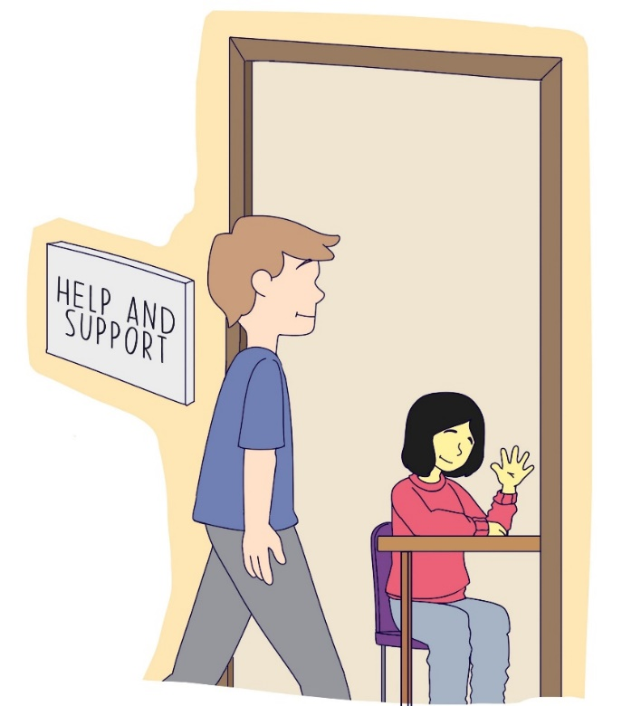
Trafodaeth
Discussion

Slide 24
Manylion Cyswllt | Contact Details
Trydar | Twitter @childcomwales
Instagram @childcomwales
Ffôn | Phone 01792 765600
Ebost | Email post@childcomwales.org.uk | post@complantcymru.org.uk
Facebook https://www.facebook.com/childcomwales/
Gwefan | Website www.childcomwales.org.uk| www.complantcymru.org.uk

