Slide 1
Dull seiliedig ar Hawliau Plant
A Children’s Rights Approach

Slide 2
Nodau’r Sesiwn
Aims of the Session
Cyflwyniad i Gonfensiwn y Cenhedloedd Unedig ar Hawliau'r Plentyn (CCUHP)
Amlinellu rôl Comisiynydd Plant Cymru
Archwilio a thrafod Dull Hawliau Plant
Introduce the United Nations Convention on the Rights of the Child (UNCRC)
Outline role of the Children’s Commissioner for Wales
Explore and discuss The Right Way
Notes:
Outline the aims of the session – there is a separate handout with session overview and expected timings
………………………………………………………………………………………………………………………………………………………………………………
Amlinellwch nodau’r sesiwn – mae yna daflen arwahan gyda throsolwg o’r sesiwn a’r amseroedd disgwyliedig

Slide 3
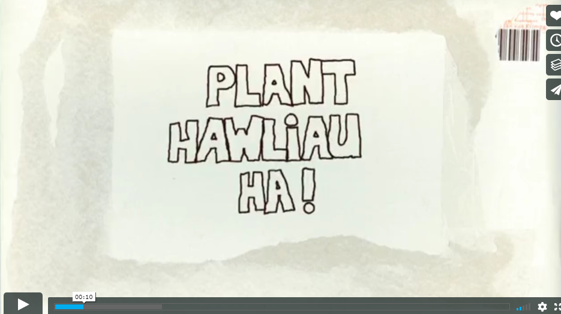
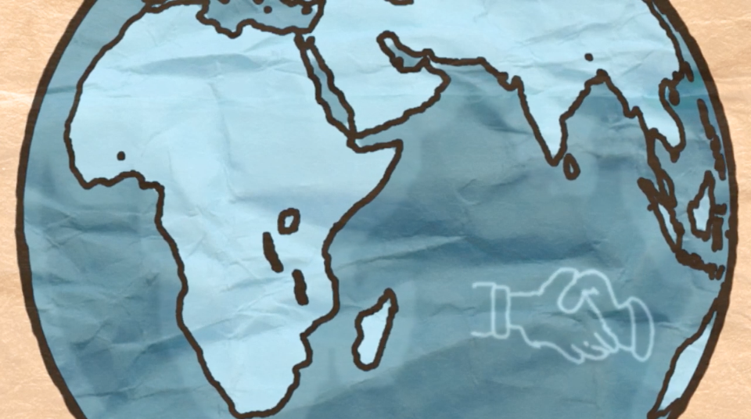
Fideo - Hawliau Plant? Ha
Video – Children’s Wrongs
https://vimeo.com/29319794
Notes:
The Welsh Government have produced many training materials to support adults who work with young people to learn about their rights, and material for children to explore their rights.
This clip is called ‘Children’s Wrongs’.
You can find more bilingual resources online on the Children’s Commissioner website here - Resources - Children’s Commissioner for Wales (childcomwales.org.uk)
Following the clip there will be a short quiz, some of the answers may be in the clip!
-----------------------------------------------------------------------------------------------------------------------------------------------------------------------------------
Mae Llywodraeth Cymru wedi cynhyrchu llawer o ddeunyddiau hyfforddi i gefnogi oedolion sy’n gweithio gyda phobl ifanc i ddysgu am eu hawliau, a deunydd er mwyn i blant archwilio eu hawliau.
Yr enw ar y clip yma yw ‘Hawliau Plant? Ha!’.
Cewch hyd i ragor o adnoddau dwyieithog ar wefan y Comisiynydd Plant, yma – Adnoddau – Comisiynydd Plant Cymru (complantcymru.org.uk)
Bydd cwis cyflym yn dilyn y clip fideo, efallai bydd rhai o’r atebion yn y clip fideo!

Slide 4
Cwis
Ydych chi wedi cael hyfforddiant CCUHP o'r blaen?
Faint o hawliau sydd gan blant?
Pa oedrannau mae'n eu cynnwys?
Ym mha flwyddyn cafodd CCUHP ei gadarnhau?
Pwy sy’n gyfrifol yng Nghymru am gynnal hawliau plant?
Quiz
Have you had UNCRC training before?
How many rights do children have?
What ages does it cover?
What year was the UNCRC ratified?
Who is responsible in Wales for upholding children’s rights?
Notes:
This can be used to gauge level of knowledge in the room - Answers
1. How many rights do children have? the answer is 54 (42 of these are named rights such as education, health and safety and the other 12 are duties of Governments to implement those rights)
2. What ages does it cover – the answer is 0-18 (NB you may wish to note that unborn children are not included)
3. In what year was the UNCRC ratified by the UK? the answer– this is a tricky one. The UK signed up to the convention in 1990; it was ratified in 1991; and came into force in 1992. so you can have a point for any of those!
4. the answer is All of us adults, The Government and the Children’s Commissioner for Wales
………………………………………………………………………………………………………………………………………………………………………………………………………………………………………………………………….
Mae modd defnyddio hyn i fesur lefel yr wybodaeth yn yr ystafell - Atebion
1. Faint o hawliau sydd gan blant? 54 (mae 42 o’r rhain yn cael eu henwi, er enghraifft addysg, iechyd a diogelwch, ac mae’r 12 arall yn ddyletswyddau sydd gan Lywodraethau i weithredu’r hawliau hynny)
2. Pa oedrannau mae’n eu cynnwys – 0-18 (DS efallai byddwch chi am nodi nad yw plant sydd heb eu geni eto yn cael eu cynnwys)
3. Ym mha flwyddyn cafodd CCUHP ei gadarnhau gan y Deyrnas Unedig? Ateb – mae hwn yn un anodd. Ymrwymodd y Deyrnas Unedig i’r confensiwn yn 1989; cafodd ei gadarnhau yn 1991; a daeth i rym yn 1992. Felly gallwch chi gael pwynt am unrhyw un o’r rheiny!
4. Pawb ohonon ni oedolion, y Llywodraeth a Chomisiynydd Plant Cymru

Slide 5
Stepping Out Activity
Gweithgaredd Camu Allan
Notes:
Participative activity to explore why Children have rights– Resources for Primary Teachers - Children’s Commissioner for Wales (childcomwales.org.uk)
………………………………………………………………………………………………………………………………………………………………………………………………………………………………
Gweithgaredd cyfranogol i archwilio pam mae gan Blant hawliau - Athrawon Cynradd - Children’s Commissioner for Wales (complantcymru.org.uk)

Slide 6
Mae gennym ni Hawliau Dynol, pam mae angen Hawliau Plant?
We have Human Rights, why do we need Children’s Rights?
Children are more vulnerable to abuse and exploitation
Dependent on age, children are entirely or mostly dependent on adults – best interests not always considered
Children face an array of legal minimum ages at which they are considered capable of making decisions for themselves
Children are often voiceless
Mae plant yn fwy agored i gael eu cam-drin a’u hecsbloetio
Yn dibynnu ar eu hoed, mae plant yn ddibynnol ar oedolion yn llwyr neu gan mwyaf – dyw eu lles pennaf ddim bob amser yn cael ei ystyried
Mae plant yn wynebu llu o derfynau oed cyfreithiol pryd y bernir eu bod nhw’n gallu gwneud penderfyniadau drostynt eu hunain
Mae plant yn aml heb lais
Notes:
This gives a bit of context on why we have Children’s Rights – following Stepping out
………………………………………………………………………………………………………………………………………………………………………………………….
Mae hyn yn rhoi tipyn o gyd-destun ynghylch pam mae gennym ni Hawliau Plant – yn dilyn ymlaen o Camu Allan

Slide 7
CCUHP – Confensiwn y Cenhedloedd Unedig ar Hawliau’r Plentyn. Cytundeb rhyngwladol yw hwn sy’n amddiffyn hawliau dynol pobl o dan 18 oed.
Mae’n rhestru’r hawliau sydd gan bob plentyn a pherson ifanc, ym mhobman yn y byd.
Cafodd ei fabwysiadu gan y CU yn 1989, cafodd ei gadarnhau gan y Deyrnas Unedig yn 1991, a daeth i rym yn 1992.
UNCRC - United Nations Convention on the Rights of the Child is an international agreement that protects the human rights of those under the age of 18.
It lists the rights that all children and young people, everywhere in the world have.
It was adopted by the UN in 1989, the UK ratified it in 1991 and it came into force in 1992.
Notes:
These slides outline a little more about the UNCRC – it covers the age and global dimension of the UNCRC.
It is worth noting that it is the most signed up to piece of UN legislation and offers the world’s “Greatest promise to Children”.
When UN adopted it on November 20th 1989 this became recognised as Universal Children’s Day and it often celebrated across Wales and the globe.
------------------------------------------------------------------------------------------------------------------------------------------------------------------------------
Mae’r sleidiau hyn yn cynnwys rhagor o wybodaeth am CCUHP – mae’n sôn am oed a dimensiwn byd-eang CCUHP.
Mae’n werth nodi mai dyma’r enghraifft o ddeddfwriaeth y CU y mae’r nifer mwyaf wedi ymrwymo iddo a’i bod yn cynnig yr ‘Addewid mwyaf i Blant’ yn y byd.
Pan gafodd ei fabwysiadu gan y CU ar 20 Tachwedd 1989 dewiswyd y dyddiad hwnnw’n Ddiwrnod Byd-eang y Plant, ac mae’n aml yn cael ei ddathlu yng Nghymru ac ar draws y byd.

Slide 8
Gweithgaredd 1:
Pa Hawliau allai fod yn bwysig i’ch rôl fel gweithiwr proffesiynol?
Gan ddefnyddio poster CCUHP, darllenwch trwy’r erthyglau mewn parau a thrafod pa dair erthygl yw’r rhai pwysicaf i’r rôl.
Adborth cryno.
Activity 1:
What Rights could be important to your role as a professional?
Using a UNCRC poster, read through the articles and discuss which three articles are most important to your role
Briefly feedback.
Notes:
This activity gives participants an opportunity to look through the range of articles and think about which ones are relevant to their role.
All are important and relevant in work with children and young people, it may be that you have more of an influence as a professional over some rights more than others
……………………………………………………………………………………………………………………………………………………………………………………………………………………………………………………………………….
Mae’r gweithgaredd hwn yn rhoi cyfle i’r cyfranogwyr edrych trwy’r amrywiaeth o erthyglau a meddwl pa rai ohonyn nhw sy’n berthnasol i’w rôl.
Mae pob un ohonynt yn bwysig ac yn berthnasol pan chi’n gweithio gyda phlant a phobl ifanc, efallai bod gennych chi fwy o ddylanwad fel gweithiwr proffesiynol dros rai hawliau yn fwy nag eraill.

Slide 9
Beth amdana i?
Ar y cyd â’r Llywodraeth, mae dyletswydd ar bawb sy’n gofalu am blant a phobl ifanc o dan CCUHP. Mae hynny’n golygu bod cyfrifoldeb arnyn nhw i gynnal hawliau plant.
What about you?
Along with the Government, all people who care for children and young people are duty bearers under the UNCRC. That means they have a responsibility to uphold children’s rights.
Notes:
To access their needs, children have to rely on adults. Adults who make decisions that affect children are all responsible for making sure that children’s rights are upheld and respected. These are duties under the UNCRC. We as adults who care about and care for children are therefore “Duty Bearers” with a responsibility to ensure children get their rights.
------------------------------------------------------------------------------------------------------------------------------------------------------------------------------------
Mae’n rhaid i blant ddibynnu ar oedolion i gael mynediad i’w hanghenion. Mae pob oedolyn sy’n gwneud penderfyniadau sy’n effeithio ar blant yn gyfrifol am sicrhau bod hawliau plant yn cael eu cynnal a’u parchu. Mae’r rhain yn ddyletswyddau o dan CCUHP. Rydym ni’n oedolion sydd â gofal ac yn gofalu am blant, ac felly rydym ni’n ‘Ddeiliaid Dyletswydd’ sydd â chyfrifoldeb i sicrhau bod plant yn cael eu hawliau.

Slide 10
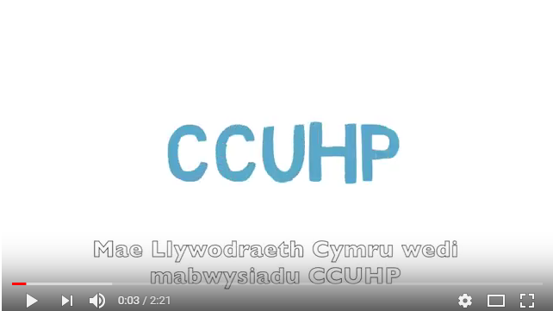
Fideo - Rhoi ‘Sylw Dyledus’ i’r Confensiwn
Video – Having ‘Due Regard’ to the Convention
.
Notes:
This video explains a little more
……………………………………………………………………………………………………………..
Mae’r fideo yma’n esbonio ychydig mwy

Slide 11
Gweithgaredd 2: Trafodaeth
Mewn grwpiau byddwch chi’n cael erthyglau i’w trafod, gall y rhain gynnwys;. 3, 6, 7, 12, 13, 14, 17, 19, 24, 27, 28, 31, 36, 42
Trafodaeth: Beth rydych chi eisoes yn ei wneud i wireddu’r hawl hon i blant a phobl ifanc?
Activity 2: Discussion
In groups you will be given some articles to discuss, these may include; 3, 6, 7, 12, 13, 14, 17, 19, 24, 27, 28, 31, 36, 42.
Discuss: What you already do to make this right a reality for children and young people?
Notes:
Ask participants to work in small groups and give them an article/s to discuss – they will need access to the poster see here – CCfW A2 Rights Poster ENGLISH AW (childcomwales.org.uk)
……………………………………………………………………………………………………………………………………………………………………………………………………………………………………………………………………….
Gofynnwch i’r cyfranogwyr weithio mewn grwpiau bach, a rhowch erthygl(au) iddyn nhw eu trafod – bydd angen iddyn nhw gael mynediad i’r poster yma – CCfW A2 Rights Poster CYMRAEG AW (childcomwales.org.uk)

Slide 12
Yn 2001, Cymru oedd y wlad gyntaf yn y Deyrnas Unedig i greu rôl y Comisiynydd Plant.
Roedd gweinidogion Llywodraeth Cymru yn sylweddoli bod angen rhywun ar blant a phobl ifanc i godi llais ar eu rhan, a gwneud yn siŵr eu bod nhw’n cael gwrandawiad ac yn cael eu trin yn deg.
Mae cyfres o gyfreithiau yn cynnwys: Deddf Safonau Gofal 2000 a Deddf Comisiynydd Plant Cymru 2001, sy’n esbonio rôl a chyfrifoldebau’r Comisiynydd.
In 2001, Wales was the first country in the UK to create the role of the Children’s Commissioner.
Welsh Government ministers recognised that children and young people need someone to speak up for them and make sure that they are listened to and treated fairly.
There is a set of laws including: the Care Standards Act 2000 and the Children’s Commissioner for Wales Act 2001 which explains the role and responsibilities of the Commissioner.
Notes:
These next few slides outline the role of the Children’s Commissioner
See more here - Home - Children’s Commissioner for Wales (childcomwales.org.uk)
……………………………………………………………………………………………………………………………………………………………………………
Mae’r sleidiau nesaf yn amlinellu rôl y Comisiynydd Plant.
Mae rhagor o wybodaeth yma - Hafan – Comisiynydd Plant Cymru (complantcymru.org.uk)

Slide 13
Pum swyddogaeth ein swyddfa:
Five functions of our office:
Support
Listen
Advise
Influence
Speak up
Cefnogi
Gwrando
Cynghori
Dylanwadu
Codi llais
Notes:
The Children’s Commissioner…
She SUPPORTS and LISTENS through her participation team who work with groups of children and young people across Wales to teach them about their rights and listen to them to find out what they want the Commissioner to change.
She ADVISES through her Investigation and Advice team.
She INFLUENCES through her policy team to affect government change
She SPEAKS up at all levels to be a voice for children in Wales.
----------------------------------------------------------------------------------------------------------------------------------------------------------------------------------
Y Comisiynydd Plant…
Mae hi’n CEFNOGI ac yn GWRANDO trwy ei thîm cyfranogiad sy’n gweithio gyda grwpiau o blant a phobl ifanc ledled Cymru i’w dysgu am eu hawliau ac yn gwrando arnyn nhw er mwyn cael gwybod beth maen nhw eisiau i’r Comisiynydd ei newid.
Mae hi’n CYNGHORI trwy’r tîm Ymchwiliadau a Chyngor.
Mae hi’n DYLANWADU trwy ei thîm polisi i gyflawni newid yn y llywodraeth
Mae hi’n CODI LLAIS ar bob lefel er mwyn bod yn llais i blant Cymru.

Slide 14
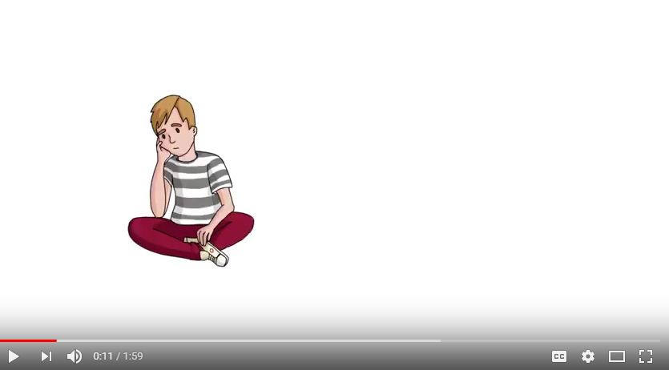
Fideo – Y Gwasanaeth Ymchwiliadau a Chyngor
Video – Investigations and Advice service
Notes:
This video explains a little more about our Investigations and advice line
…………………………………………………………………………………………………………………………………………
Mae’r fideo yma yn esbonio ychydig mwy am ein gwasanaeth ymchwiliadau a chyngor

Slide 15
EGWYL
BREAK

Slide 16
Beth yw Dull Gweithredu Seiliedig ar Hawliau Plant?
Fframwaith egwyddorol ac ymarferol ar gyfer gweithio gyda phlant yw Dull Gweithredu Seiliedig ar Hawliau Plant, wedi’i wreiddio yng Nghonfensiwn y Cenhedloedd Unedig ar Hawliau’r Plentyn
Mae Dull Gweithredu Seiliedig ar Hawliau Plant yn ymwneud â gwneud CCUHP yn ganolog i gynllunio a darparu gwasanaeth, ac integreiddio hawliau plant ym mhob agwedd ar wneud penderfyniadau, polisïau ac ymarfer
What is a Children’s Rights Approach?
A Children’s Rights Approach is a principled and practical framework for working with children grounded in the UN Convention on the Rights of the Child
A Children’s Rights Approach is about placing the UNCRC at the Core of planning and service delivery and integrating children’s rights into every aspect of decision making , policy and practice
Notes:
What is a Children’s Rights Approach
The aim of “The Right Way” is to help professionals embed a Children’s Rights Approach in a practical and meaningful way.
----------------------------------------------------------------------------------------------------------------------------------------------
Beth yw Dull Gweithredu seiliedig ar Hawliau Plant?
Nod “Y Ffordd Gywir” yw helpu gweithwyr proffesiynol i wreiddio Dull seiliedig ar Hawliau Plant mewn modd ymarferol ac ystyrlon.

Slide 17
Dull Hawliau Plant
The Right Way
Embedding the UNCRC
Equality and non-discrimination
Empowering children
Participation
Accountability
Seilio’r CCUHP
Cydraddoldeb a dim gwahaniaethu
Galluogi plant i ddefnyddio eu hawliau
Cyfranogiad
Atebolrwydd
Notes:
On our website - https://www.childcomwales.org.uk/the-right-way-a-childrens-rights-approach/ you can see a range of examples and resources that maybe helpful for you to map a Children’s Rights Approach.
The principles of a Children’s Rights Approach are:
1.Embedding children’s rights – putting children’s rights at the core of planning and service delivery
2. Equality and non-discrimination – ensuring that every child has an equal opportunity to be the best they can be
3. Empowering children – enhancing children’s capabilities as individuals so they’re better able to take advantage of rights, and engage with and hold accountable the institutions and individuals that affect their lives
4. Participation – listening to children and taking their views meaningfully into account
5. Accountability – authorities should be accountable to children for decisions and actions that affect their lives
Developed with the children’s rights observatory in Swansea and Bangor Universities
Provided a systematic method to implement children’s 42 rights in organisations large and small
……………………………………………………………………………………………………………………………………………………………………………………………………………………………………………………………………
Ar ein gwefan - https://www.childcomwales.org.uk/the-right-way-a-childrens-rights-approach/ fe welwch amrywiaeth o enghreifftiau ac adnoddau a allai fod o ddefnydd i chi fapio Dull seiliedig ar Hawliau Plant.
Dull Hawliau Plant
Egwyddorion Dull seiliedig ar Hawliau Plant yw:
1. Seilio hawliau plant – gwneud hawliau plant yn ganolog wrth gynllunio a chyflwyno gwasanaeth
2. Cydraddoldeb a dim gwahaniaethu– sicrhau bod pob plentyn yn cael cyfle cyfartal i fod y gorau gallan nhw fod
3. Galluogi plant – gwella galluoedd plant fel unigolion fel eu bod mewn sefyllfa well i fedru manteisio ar eu hawliau, ac ymgysylltu â’r sefydliadau a’r unigolion sy’n effeithio ar eu bywydau a’u gwneud yn atebol
4. Cyfranogiad – gwrando ar blant a rhoi sylw ystyrlon i’w barn
5. Atebolrwydd – dylai awdurdodau fod yn atebol i blant am benderfyniadau a chamau gweithredu sy’n effeithio ar eu bywydau
Datblygwyd gyda’r arsyllfa hawliau plant ym Mhrifysgolion Abertawe a Bangor
Darparu dull systematig o roi’r 42 o hawliau plant ar waith mewn sefydliadau bach a mawr

Slide 18
Seilio’r CCHUP
Embedding the UNCRC
Seilio hawliau plant wrth i chi gynllunio a darparu gwasanaeth:
Byrddau pwrpasol plant a phobl ifanc
Siarteri / Addewidion Plant
Putting children’s rights at the core of planning and service delivery:
Dedicated children and young people’s Boards
Children’s Charters / Promises
Notes:
The first principle is Embedding Children’s rights. This means making sure children’s human rights and plans to promote and protect them are visible and engrained in strategic planning and service delivery.
To consider:
Do strategic plans link directly to the UNCRC? If not, how could it?
Leaders and staff – knowledge of children’s rights and how it can benefit organisation
Training – resources available from CCfW
Responsibility – is there an individual or team who can lead on this?
Resources – do you have all the human / financial resources you need? Have you thought about what that looks like?
…………………………………………………………………………………………………………………………………………………………………………………………………………………………………………………………………….
Yr egwyddor gyntaf yw seilio hawliau plant. Ystyr hynny yw sicrhau bod hawliau dynol plant a chynlluniau i’w hybu a’u diogelu yn weladwy ac yn rhan annatod o gynllunio strategol a chyflwyno gwasanaeth
I’w hystyried:
Ydy cynlluniau strategol yn cysylltu’n uniongyrchol â CCUHP? Os nad ydyn nhw, sut gallai hynny ddigwydd?
Arweinwyr a staff – gwybodaeth am hawliau plant a sut gall fod o fudd i’r sefydliad
Hyfforddiant – adnoddau ar gael gennym CCfW
Cyfrifoldeb – oes yna unigolyn neu dîm sy’n gallu arwain ar hyn?
Adnoddau – oes gennych chi’r holl adnoddau dynol/ariannol angenrheidiol? Ydych chi wedi meddwl beth yw ystyr hynny?

Slide 19
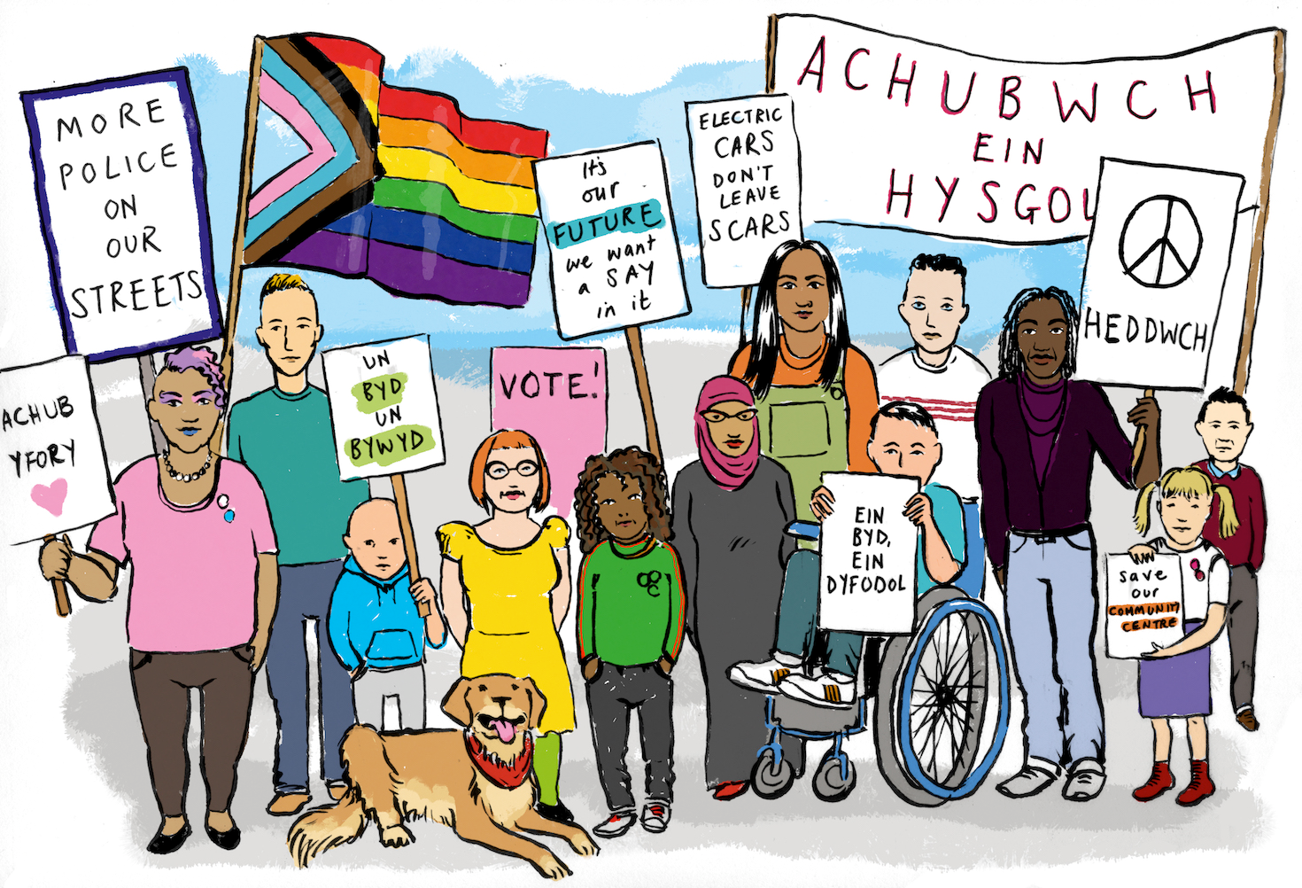
Equality and non-discrimination
Cydraddoldeb a dim gwahaniaethu
Defnyddio data i ddadansoddi mynediad at wasanaethau
Sicrhau bod cynrychiolwyr grwpiau ymylol yn ymwneud yn uniongyrchol â gwella gwasanaethau
Sicrhau bod cyfathrebu ysgrifenedig a llafar yn hygyrch
Using data to analyse access to services
Ensure that representatives of marginalised groups are directly involved in service improvement
Make sure written and verbal communications are accessible
Notes:
Equality and non-discrimination. This is a fundamental human rights principle. We know that children and their families are more likely to be caught up in statutory children’s services when they live in poverty. Disabled children and adults face systematic barriers, Children from Black, Asian and other ethnic minority backgrounds including Gypsy, Roma and traveller children face racism and many face other economic and institutional barriers. Recognising these barriers and taking active steps to combat them is human rights work in practice.
To consider:
Staff knowledge of the Equality Act and needs of different groups of children
CCfW recommends a children’s rights impact assessment – templates available on CCfW website. Feedback - help focus policy and identify needs
Review data collection – do you need to be collecting more data to reach all CYP?
Provide accessible information in language / format appropriate to age, maturity, disability etc
…………………………………………………………………………………………………………………………………………………………………………………………………………………………………………………………………….
Cydraddoldeb a dim gwahaniaethu. Mae hon yn egwyddor hawliau dynol sylfaenol. Rydyn ni’n gwybod bod plant a’u teuluoedd yn fwy tebygol o ymwneud â gwasanaethau plant statudol pan fyddan nhw’n byw mewn tlodi. Mae plant ac oedolion anabl yn wynebu rhwystrau systematig, mae Plant o gefndiroedd Du, Asiaidd a lleiafrifoedd ethnig eraill, gan gynnwys plant Sipsiwn, Roma a Theithwyr yn wynebu hiliaeth, ac mae llawer yn wynebu rhwystrau economaidd a sefydliadol eraill. Mae cydnabod y rhwystrau hyn a chymryd camau gweithredol i’w gwrthweithio yn waith hawliau dynol ymarferol.
I’w hystyried:
Gwybodaeth staff am y Ddeddf Cydraddoldeb ac anghenion gwahanol grwpiau o blant
Mae CPC yn argymell asesiad effaith ar hawliau plant – templedi ar gael ar wefan CPC. Adborth – helpu i sicrhau ffocws i bolisi a chanfod anghenion
Adolygu’r data sy’n cael ei gasglu – oes angen i chi fod yn casglu mwy o ddata i gyrraedd pob plentyn a pherson ifanc?
Darparu gwybodaeth hygyrch mewn iaith/fformat priodol ar gyfer oed, aeddfedrwydd, anabledd etc

Slide 20
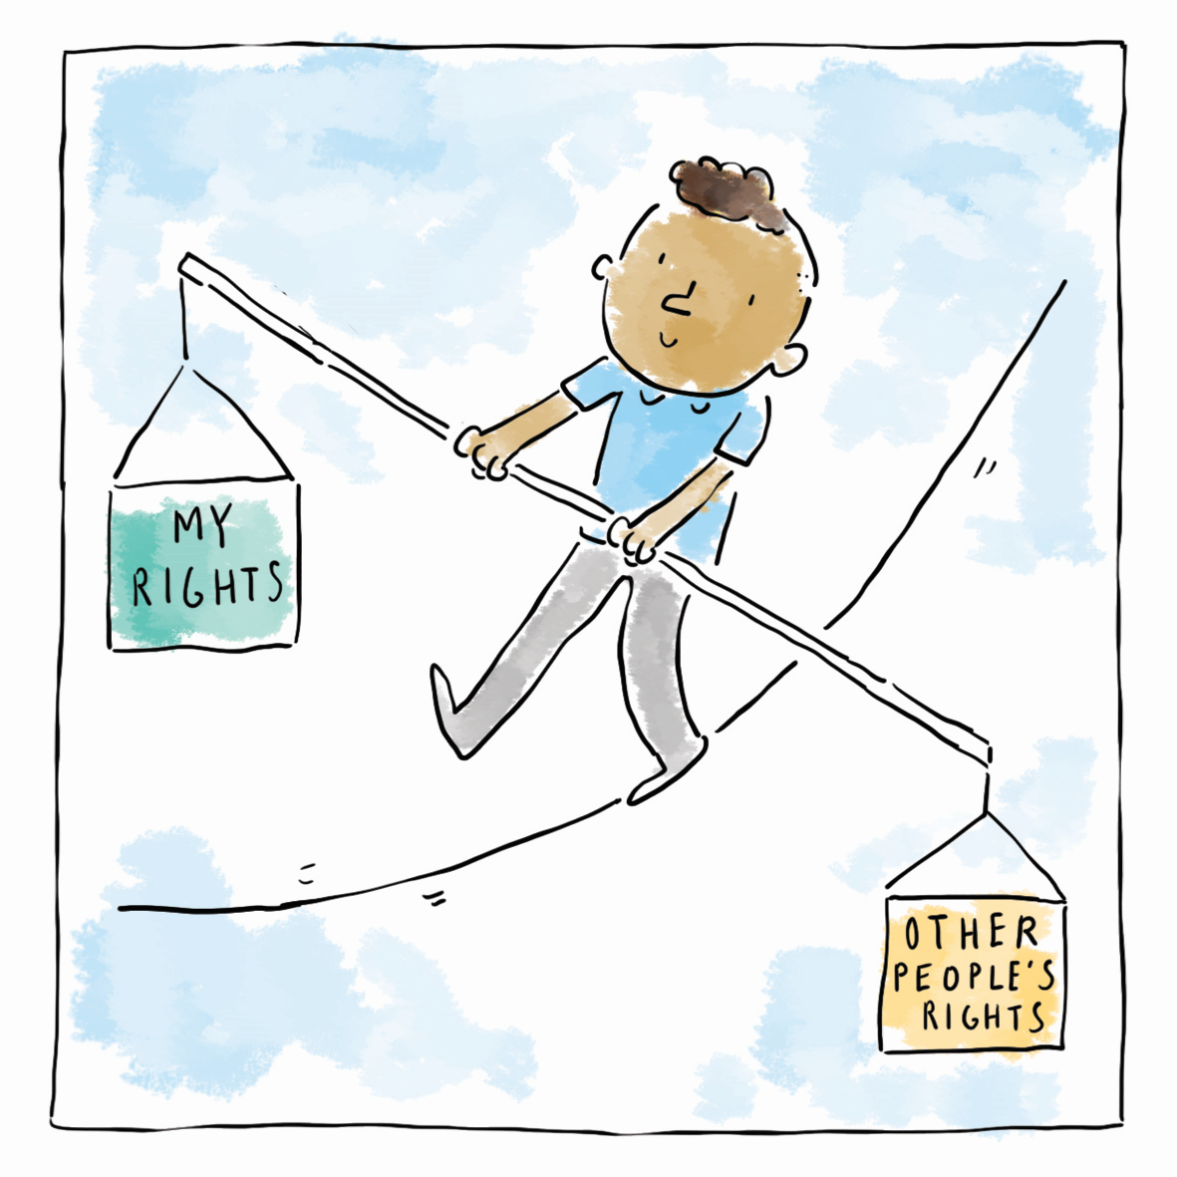
Galluogi plant i ddefnyddio eu hawliau
Empowering children
Gwella galluoedd plant fel unigolion fel eu bod yn gallu manteisio'n well ar hawliau, ac ymgysylltu â'r sefydliadau a'r unigolion sy'n effeithio ar eu bywydau a'u gwneud yn atebol
Enhancing children’s capabilities as individuals so they’re better able to take advantage of rights, and engage with and hold accountable the institutions and individuals that affect their lives
Notes:
Human rights should empower children. Empowerment means enhancing children’s capabilities as individuals so they are better able to take advantage of rights, and to engage with, influence and hold accountable the people and organisations that affect their lives. Children need to understand that they have rights and to have positive experiences of receiving them to help them feel empowered.
This takes many different forms for children; from using rights language with children, to making sure they can see their rights reflected in their interactions with professionals and the support they receive, to having their rights protected when they are faced barriers to accessing them. This element of a children’s rights approach is about making rights a reality for children.
Individual practitioners’ role:
Ensure children know about their rights.
Children (and adults) feel disempowered when they don’t think they will be listened to, when they don’t trust those they are working with and when they don’t have faith that positive change will happen. When children are feeling disempowered they may not feel motivated to take up their rights to say what they want and need, to take part in decision-making and to engage with services on offer.
Empowerment is based on developing trusting relationships. Trust is developed by being seen to be fair, honest, reliable and caring. Being back in touch when you say you will be, even if it’s to explain that a decision has not yet been taken, is important to young people.
Work with children and young people to identify what information they are missing and what information they would like to receive. Work could be done with young people to produce information for others.
………………………………………………………………………………………………………………………………………………………………………………………………………………
Dylai hawliau dynol galluogi plant. Ystyr galluogi yw gwella galluoedd plant fel unigolion, fel eu bod nhw’n gallu manteisio’n well ar hawliau, ac ymgysylltu â’r bobl a’r sefydliadau sy’n effeithio ar eu bywydau, dylanwadu arnyn nhw a’u gwneud yn atebol. Mae angen i blant ddeall bod ganddyn nhw hawliau, a chael profiadau cadarnhaol o’u derbyn, i’w helpu i deimlo eu bod wedi’u galluogi.
Mae hynny’n digwydd mewn llawer o wahanol ffurfiau i blant; o ddefnyddio iaith hawliau gyda phlant, i sicrhau eu bod yn gallu gweld eu hawliau wedi’u hadlewyrchu â gweithwyr proffesiynol a’r gefnogaeth maen nhw’n ei derbyn, i ddiogelu eu hawliau pan fyddan nhw’n wynebu rhwystrau i’w derbyn. Mae’r elfen hon o ddull seiliedig ar hawliau plant yn ymwneud â gwireddu hawliau i blant.
Rôl ymarferwyr unigol:
Sicrhau bod plant yn gwybod am eu hawliau.
Mae plant (ac oedolion) yn teimlo wedi’u dadrymuso os byddan nhw’n meddwl na fydd neb yn gwrando arnyn nhw, os nad ydyn nhw’n trystio’r rhai sy’n gweithio gyda nhw, ac os nad oes ganddyn nhw ffydd y bydd newid cadarnhaol yn digwydd. Pan fydd plant yn teimlo wedi’u dadrymuso efallai na fydd cymhelliad iddyn nhw fanteisio ar eu hawliau i ddweud beth maen nhw eisiau ac angen, i fod yn rhan o benderfyniadau ac i ymgysylltu â’r gwasanaethau sydd ar gael.
Mae grymuso wedi’i seilio ar ddatblygu perthnasoedd o ymddiriedaeth. Mae ymddiriedaeth yn cael ei datblygu os gwelir eich bod yn deg, yn onest, yn ddibynadwy ac yn ofalgar. Cysylltu eto ar ôl dweud byddwch chi’n gwneud hynny, hyd yn oes os bydd rhaid esbonio nad oes penderfyniad eto – mae hynny’n bwysig i bobl ifanc.
Gweithio gyda phlant a phobl ifanc i ganfod pa wybodaeth sydd ddim ganddyn nhw a pha wybodaeth hoffen nhw ei derbyn. Gallech chi weithio gyda phobl ifanc i gynhyrchu gwybodaeth i eraill.

Slide 21
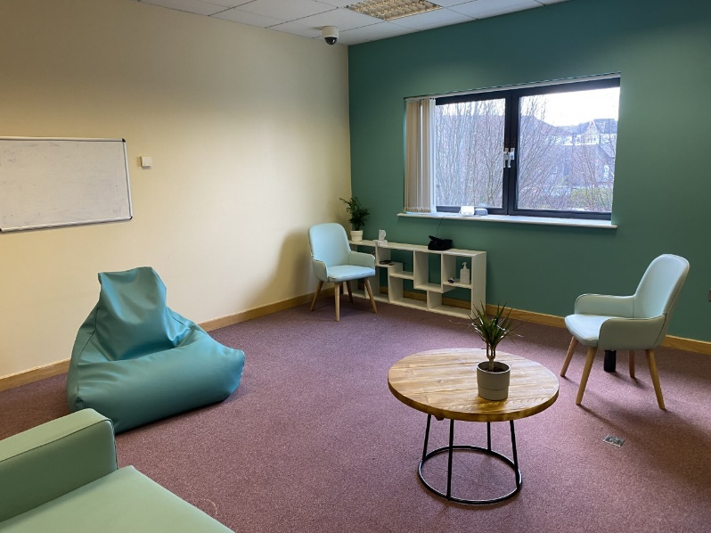
Participation
Cyfranogiad
Gwrando ar blant a rhoi sylw ystyrlon i’w barn
Bae Abertawe a Chaerdydd a’r Fro - cael dweud eu dweud wrth ddylunio gofod y mae plant yn ei ddefnyddio
Listening to children and taking their views meaningfully into account
Swansea Bay and Cardiff & Vale – having a say in the design of space children use
Notes:
To consider:
How do you listen to CYP and use the information they give you? What are the gaps and what are the opportunities?
Do you involve children directly in design, monitoring and evaluation of services they receive?
Has your organisation signed up to the National Participation Standards, which set out more practical considerations for participation?
How do children have a say in how spaces they use look and how they serve children and young people?
………………………………………………………………………………………………………………………………………………………………………………………………………………………………………………………………
I’w hystyried:
Sut mae gwrando ar blant a phobl ifanc a defnyddio’r wybodaeth maen nhw’n ei rhoi i chi? Beth yw’r bylchau a beth yw’r cyfleoedd?
Ydych chi’n cynnwys plant yn uniongyrchol wrth ddylunio, monitro a gwerthuso’r gwasanaethau maen nhw’n eu derbyn?
Ydy eich sefydliad wedi ymrwymo i’r Safonau Cyfranogiad Cenedlaethol, sy’n cyflwyno ystyriaethau mwy ymarferol ar gyfer cyfranogiad?
Sut mae plant yn cael rhoi barn ar sut mae’r mannau maen nhw’n eu defnyddio yn edrych, a sut maen nhw’n gwasanaethu plant a phobl ifanc?

Slide 22
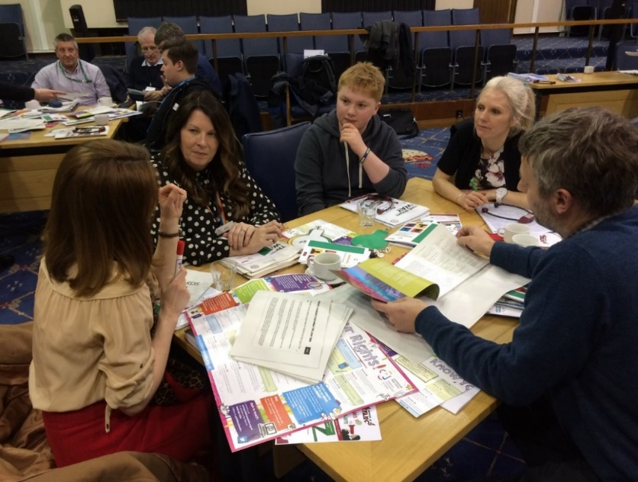
Atebolrwydd
Dylai awdurdodau fod yn atebol i blant am benderfyniadau a gweithredoedd sy'n effeithio ar eu bywydau
Dolenni adborth: fe ddwedsoch chi – fe wnaethon ni
Gwybodaeth hygyrch
Mynediad plant i gwynion
Accountability
Authorities should be accountable to children for decisions and actions that affect their lives
Feedback loops: you said – we did
Accessible information
Children’s access to complaints
Notes:
It is important that, as well as these first four principles which involve children and young people more, we then make sure we are held accountable to them. It is a very important step but one which can get lost after we do the ‘doing’ bit of getting children to contribute to our work.
How do you make sure you tell all children who use your services what you are doing better for children and young people and what they can expect to see change as a result?
For children who directly contributed to your plans, how do you make sure children know what influence their contribution had?
To consider:
Ensure staff understand responsibilities to children, including making this explicit in job descriptions and conduct policies etc
Publish annual update showing how you’ve worked toward a children’s rights approach and share it widely with CYP
Feed back regularly to children in suitable format. ‘You Said; We Did’ format?
Accessible information on complaints / holding staff to account
Providing feedback on actions taken based on views of children, and being held accountable
……………………………………………………………………………………………………………………………………………………………………………………………………………………………………………………………………..
Yn ogystal â’r pedair egwyddor cyntaf hyn sy’n cynnwys plant a phobl ifanc yn fwy, mae’n bwysig ein bod ni wedyn yn sicrhau ein bod ni’n atebol iddyn nhw. Mae hwn yn gam pwysig iawn, ond yn un sy’n gallu mynd ar goll ar ôl i ni wneud y cam ‘cyflawni’ o sicrhau bod plant yn cyfrannu at ein gwaith.
Sut mae gwneud yn siŵr eich bod chi’n dweud wrth yr holl blant sy’n defnyddio eich gwasanaethau beth rydych chi’n ei wneud yn well i blant a phobl ifanc a beth gallan nhw ddisgwyl ei weld yn newid o ganlyniad?
Yn achos plant a gyfrannodd yn uniongyrchol i’ch cynlluniau, sut gallwch chi sicrhau bod plant yn gwybod pa ddylanwad gafodd eu cyfraniad?
I’w hystyried:
Sicrhau bod staff yn deall eu cyfrifoldebau i blant, gan gynnwys nodi hynny’n benodol mewn disgrifiadau swyddi, polisïau ymddygiad etc
Cyhoeddi diweddariad blynyddol yn dangos sut rydych chi wedi gweithio tuag at ddull seiliedig ar hawliau plant a’i rannu’n eang gyda phlant a phobl ifanc
Rhoi adborth rheolaidd i blant mewn fformat addas. Fformat ‘Fe ddwedsoch chi: Fe wnaethon ni’?
Gwybodaeth hygyrch am gwynion / galw staff i gyfrif
Rhoi adborth ar gamau a gymerwyd ar sail barn plant, a chael eu gwneud yn atebol

Slide 23
ASTUDIAETHAU ACHOS
CASE STUDIES
Gan ddefnyddio astudiaeth achos a roddwyd i chi ei hystyried
Pa hawliau y mae hyn yn eu cynnwys?
2. Beth fyddech chi'n ei wneud fel gweithiwr proffesiynol?
Using a case study that has been given to you consider
What rights does this cover?
What would you do as a professional?
Notes:
Case studies:
Youth Work – Case studies Youth Work- bi-lingual.docx
Youth Justice – Case Studies Youth Justice - Bi-lingual.docx
Equalities – Case Studies - equalities - bilingual.docx
Police – Case studies - Police - bilingual.docx
……………………………………………………………………………….
Astudiaethau Achos:
Gwaith Ieuenctid – Case studies Youth Work- bi-lingual.docx
Cyfiawnder Ieuenctid – Case Studies Youth Justice - Bi-lingual.docx
Cydraddoldeb – Case Studies - equalities - bilingual.docx
Heddlu – Case studies - Police - bilingual.docx

Slide 24
Beth gallwch chi ei wneud er mwyn cefnogi Plant a Phobl ifanc i gael mynediad i’w hawliau?
I deimlo eu bod nhw’n cael gwrandawiad ac yn cael eu cymryd o ddifri?
I deimlo’n ddiogel?
I dderbyn gwybodaeth maen nhw’n ei deall
I gwyno os bydd angen?
Beth gallwch chi ei wneud yn yr wythnos nesa? Y 3 mis nesa? Y flwyddyn nesa i lywio’ch ymarfer ac ymarfer eraill?
What can you do to support Children and Young people to access their rights?
To feel listened to and taken seriously?
To feel safe?
To get information in a way they understand
To complain if they need to?
What can you do in next week? Next 3 months? Next year to inform your practice and the practice of others?
Notes:
Following todays training we welcome participants to reflect on their learning and think about how they can support a Children’s Rights approach, here are some questions to reflect upon.
…………………………………………………………………………………………………………………………………………………………………………………………………………………………………………………………………….
Yn dilyn hyfforddiant heddiw, bydden ni’n falch petai’r cyfranogwyr yn myfyrio ar eu dysgu ac yn ystyried sut gallan nhw gefnogi dull gweithredu seiliedig ar Hawliau Plant, dyma rai cwestiynau i’w hystyried.

Slide 25
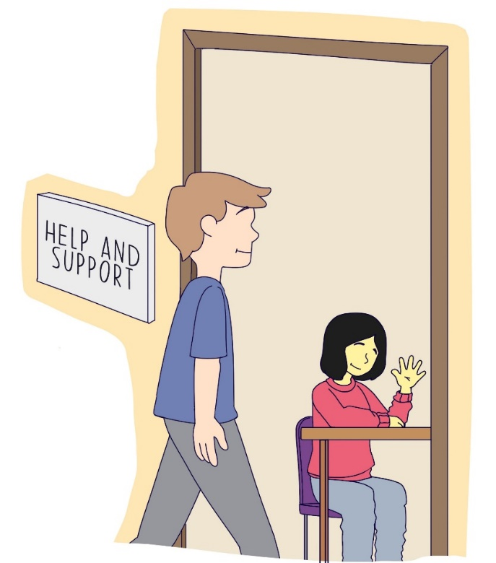
Trafodaeth Discussion

Slide 26
ADNODDAU
RESOURCES
https://www.complantcymru.org.uk/adnoddau
DULL HAWLIAU PLANT
https://www.complantcymru.org.uk/adnoddau/dull-hawliau-plant-2/
https://www.childcomwales.org.uk/resources/
THE RIGHT WAY
https://www.childcomwales.org.uk/resources/the-right-way-a-childrens-rights-approach/
Notes:
For a wide range of bi-lingual resources please share our website here - https://www.childcomwales.org.uk/resources/
For further information and more in depth ideas you can download your own copy of “The Right Way” from our website
--------------------------------------------------------------------------------------------------------------------------------------------------------------
Am ystod eang o adnoddau dwyieithog rhannwch ein gwefan yma os gwelwch yn - https://www.complantcymru.org.uk/adnoddau/
I gael rhagor o wybodaeth a syniadau dyfnach gallwch chi lawrlwytho eich copi eich hun o “Y Ffordd Gywir” o’n gwefan

Slide 27
Manylion Cyswllt | Contact Details
Trydar | Twitter @childcomwales
Instagram @childcomwales
Ffôn | Phone 01792 765600
Ebost | Email post@childcomwales.org.uk | post@complantcymru.org.uk
Facebook https://www.facebook.com/childcomwales/
Gwefan | Website www.childcomwales.org.uk| www.complantcymru.org.uk

