Slide 1
The Right Way: Social Care Dull Hawliau Plant: Gofal Cymdeithasol

Slide 2
Aims of the Session
Nodau’r Sesiwn
Archwilio Confensiwn y Cenhedloedd Unedig ar Hawliau'r Plentyn (CCUHP)
Amlinellu rôl Comisiynydd Plant Cymru
Trafod Y Ffordd Gywir ym maes Gofal Cymdeithasol
Explore the United Nations Convention on the Rights of the Child (UNCRC)
Outline role of the Children’s Commissioner for Wales
Discuss The Right Way in Social Care

Slide 3
“ When I was little I was not looked after properly, I was not in a safe environment for a child to grow up in ... Me and my brother were taken into the care system where we lived with foster carers. Just after his 6th birthday we were separated and he was put into a different care home. I have not seen him since.
“I don’t think my rights as a child have ever been taken into account when it came to being parted from my brother. This experience came into my mind when I read this quote from Sally’s introduction to The Right Way: Social Care Report:
“Despite being experts on their own lives, children are often excluded from decisions that affect them. A Children’s Rights Approach means that children are provided meaningful opportunities to influence decisions about their lives.”
Notes:
This was a statement from a teenager who was also part of the Children’s Commissioner’s advisory panel. She is happy and safe with a permanent family but the long term impact of her separation from her brother and the lack of voice or choice for her as a child is striking.
……………………………………………………………………………………………………
Roedd hwn yn rhywbeth ddywedwyd gan ferch yn ei harddegau a oedd hefyd yn rhan o banel ymgynghorol y Comisiynydd. Mae hi’n hapus ac yn ddiogel gyda theulu parhaol, ond mae effaith hirdymor ei gwahanu oddi wrth ei brawd a’r diffyg llais na dewis iddi pan oedd hi’n blentyn yn drawiadol.

Slide 4
STEPPING OUT
CAMU ALLAN
Notes:
We will now do a short activity to help explore how people access their rights. This can be done online or in person, but has most impact when done in-person
Stepping out – Resources for Primary Teachers - Children’s Commissioner for Wales (childcomwales.org.uk)
…………………………………………………………………………….
Nawr mae gennym ni weithgaredd byr fydd yn ein helpu i archwilio sut mae pobl yn cael mynediad i’w hawliau. Mae modd gwneud hyn ar-lein neu wyneb yn wyneb, ond mae wyneb yn wyneb yn fwy effeithiol.
Camu allan – Athrawon Cynradd - Children’s Commissioner for Wales (complantcymru.org.uk)

Slide 5
Mae gennym ni Hawliau Dynol, pam mae angen Hawliau Plant?
We have Human Rights, why do we need Children’s Rights?
Children are more vulnerable to abuse and exploitation
Dependent on age, children are entirely or mostly dependent on adults - best interests not always considered
Children face an array of legal minimum ages at which they are considered capable of making decisions for themselves
Children are often voiceless
Mae plant yn fwy agored i gael eu cam-drin a’u hecsbloetio
Yn dibynnu ar eu hoed, mae plant yn ddibynnol ar oedolion yn llwyr neu gan mwyaf - dyw eu lles pennaf ddim bob amser yn cael ei ystyried
Mae plant yn wynebu llu o derfynau oed cyfreithiol pryd y bernir eu bod nhw’n gallu gwneud penderfyniadau drostynt eu hunain
Mae plant yn aml heb lais
Notes:
This gives a bit of context on why we have Children’s Rights –following the Stepping Out
………………………………………………………………………………………..
Mae hyn yn rhoi ychydig o gyd-destun i ni ar pam mae gennym ni Hawliau Plant – yn dilyn ymlaen o Camu Allan

Slide 6
Children’s Rights – UNCRC
UNCRC - United Nations Convention on the Rights of the Child is an international agreement that protects the human rights of those under the age of 18.
It lists the rights that all children and young people, everywhere in the world have.
It was adopted by the UN in 1989, the UK ratified it in 1991 and it came into force in 1992.
Hawliau Plant - CCUHP
CCUHP – Confensiwn y Cenhedloedd Unedig ar Hawliau’r Plentyn. Cytundeb rhyngwladol yw hwn sy’n amddiffyn hawliau dynol pobl o dan 18 oed.
Mae’n rhestru’r hawliau sydd gan bob plentyn a pherson ifanc, ym mhobman yn y byd.
Cafodd ei fabwysiadu gan y CU yn 1989, cafodd ei gadarnhau gan y Deyrnas Unedig yn 1991, a daeth i rym yn 1992.
Notes:
These slides outline a little more about the UNCRC – it covers the age and global dimension of the UNCRC.
It is worth noting that it is the most signed up to piece of UN legislation and offers the worlds “Greatest promise to Children”.
When UN adopted it on November 20th 1989 this became recognised as Universal Children’s Day and it often celebrated across Wales and the globe.
------------------------------------------------------------------------------------
Mae’r sleidiau hyn yn cynnwys rhagor o wybodaeth am CCUHP – mae’n sôn am oed a dimensiwn byd-eang CCUHP.
Mae’n werth nodi mai dyma’r enghraifft o ddeddfwriaeth y CU y mae’r nifer mwyaf wedi ymrwymo iddo a’i bod yn cynnig yr ‘Addewid mwyaf i Blant’ yn y byd.
Pan gafodd ei fabwysiadu gan y CU ar 20 Tachwedd 1989 dewiswyd y dyddiad hwnnw’n Ddiwrnod Byd-eang y Plant, ac mae’n aml yn cael ei ddathlu yng Nghymru ac ar draws y byd.

Slide 7
Activity 1:
What Rights could be important to your role as a professional?
Using a UNCRC poster, read through the articles and discuss which three articles are most important to your role you aim to have in the future.
Briefly feedback.
Gweithgaredd 1:
Pa Hawliau allai fod yn bwysig i’ch rôl fel gweithiwr proffesiynol?
Gan ddefnyddio poster CCUHP, darllenwch trwy’r erthyglau mewn parau a thrafod pa dair erthygl yw’r rhai pwysicaf i’r rôl rydych am ei chyflawni yn y dyfodol.
Adborth cryno.
Notes:
This activity gives participants an opportunity to look through the range of articles and think about which ones are relevant to their role.
Mae’r gweithgaredd hwn yn rhoi cyfle i’r cyfranogwyr edrych trwy’r amrywiaeth o erthyglau a meddwl pa rai ohonyn nhw sy’n berthnasol i’w rôl.

Slide 8
Mae pedair egwyddor craidd CCUHP yn nodau gofal cymdeithasol craidd hefyd:
The four core principles of the UNCRC are also core social work goals:
Non-discrimination
Rights to survival and development
The best interests of the child are paramount
Involvement of the child
Peidio â chamwahaniaethu
Hawliau i oroesi a datblygu
Mae lles pennaf y plentyn yn hollbwysig
Cyfranogiad y plentyn
Notes:
Which rights are relevant to social work? Well, children’s rights are often treated synonymously with voice but there is so much more!
On the slide you can see the 4 core principles of the UNCRC but there are 42 separate rights of children in the convention as a whole, plus further articles that lay duties on states to uphold the rights.
All rights are relevant to social work but there are some that are particularly important in social work settings, including: non-discrimination, health, education and a good standard of living, family life, to be listened to and take part in decisions, to information, privacy, identity, to speak your own language, not to be harmed and to be kept safe, additional protections if you can’t live with your birth parents, additional protections if you’re disabled, article 3 – the best interests of the child are paramount, to be treated fairly if involved in criminal justice system, protection from drugs, from being trafficked, to be helped to recover from abuse and trauma, and to know about your rights.
The Right Way guide created by The Children’s Commissioner for Wales (which we will go on to talk about) highlights these under the 5 principles of a children’s rights approach.
………………………………………………………………………………………………………………
Pa hawliau sy’n berthnasol i waith cymdeithasol? Wel, mae hawliau plant yn aml yn cael eu trin yn gyfystyr â llais, ond mae llawer mwy na hynny!
Ar y sleid fe welwch 4 egwyddor craidd CCUHP, ond mae’r confensiwn cyfan yn cynnwys 42 o hawliau gwahanol i blant, yn ogystal ag erthyglau eraill sy’n gosod dyletswyddau ar wladwriaethau i gynnal yr hawliau.
Mae pob hawl yn berthnasol i waith cymdeithasol, ond mae rhai yn arbennig o bwysig mewn lleoliadau gwaith cymdeithasol, gan gynnwys: peidio â chamwahaniaethu, iechyd, addysg a safon byw sy’n dda, bywyd teuluol, cael gwrandawiad a bod yn rhan o benderfyniadau, a hefyd wybodaeth, preifatrwydd, hunaniaeth, siarad eich iaith eich hun, peidio â chael eich niweidio a chael eich cadw’n ddiogel, mesurau diogelu ychwanegol os ydych chi’n methu byw gyda’ch rhieni biolegol, mesurau diogelu ychwanegol os ydych chi’n anabl, erthygl 3 – mae lles pennaf y plentyn yn hollbwysig, cael eu trin yn deg os byddan nhw’n rhan o’r system cyfiawnder troseddol, amddiffyniad rhag cyffuriau, rhag cael eich masnachu, cael eich helpu i adfer wedi camdriniaeth a thrawma, a gwybod am eich hawliau.
Mae canllaw Y Ffordd Gywir a luniwyd gan Gomisiynydd Plant Cymru (y byddwn ni’n ei drafod) yn amlygu’r rhain o dan 5 egwyddor dull gweithredu seiliedig ar hawliau plant.

Slide 9
Activity 2: Discussion
In groups you will be given some articles to discuss, these may include; 3, 6, 7, 12, 13, 14, 17, 19, 24, 27, 28, 31, 36, 42.
Discuss: What you already do to make this right a reality for children and young people?
Gweithgaredd 2: Trafodaeth
Mewn grwpiau byddwch chi’n cael erthyglau i’w trafod, gall y rhain gynnwys;. 3, 6, 7, 12, 13, 14, 17, 19, 24, 27, 28, 31, 36, 42
Trafodaeth: Beth rydych chi eisoes yn ei wneud i wireddu’r hawl hon i blant a phobl ifanc?
Notes:
Activity - Ask participants to work in small groups and give them an article/s to discuss – they will need access to the poster see here – CCfW A2 Rights Poster ENGLISH AW (childcomwales.org.uk)
Gweithgaredd – Gofynnwch i’r cyfranogwyr weithio mewn grwpiau bach, a rhowch erthygl(au) iddyn nhw eu trafod – bydd angen iddyn nhw gael mynediad i’r poster yma – CCfW A2 Rights Poster CYMRAEG AW (childcomwales.org.uk)

Slide 10
Background to the role of the Children’s Commissioner for Wales
2000: The Lost in Care Report was published;
2001: The National Assembly For Wales legislated to create the Office of the Children’s Commissioner for Wales
2001: The First Children’s Commissioner Peter Clarke was appointed, with children being involved in his appointment;
2001: Children’s Commissioner for Wales Bill enacted setting out the powers and remit of the Commissioner, including;
Cefndir i rôl Comisiynydd Plant Cymru
2000: Adroddiad Ar Goll mewn Gofal yn cael ei gyhoeddi
2001: Cynulliad Cenedlaethol Cymru yn deddfu i greu swyddfa Comisiynydd Plant Cymru
2001: Y Comisiynydd Plant cyntaf yn cael ei apwyntio, gyda phlant yn rhan o’i benodiad
2001: Bil Comisiynydd Plant Cymru yn dod i rym, yn pennu pwerau a chylch gorchwyl y Comisiynydd, gan gynnwys
Notes:
The Waterhouse inquiry (1997-99) was set up following abuse cases in N.Wales care homes led to the creation of the role of Children’s Commissioner in Wales. Wales was the first in the UK to have a Children’s Commissioner.
Initially this was planned to be just for children in care, but concept of role expanded before legislation passed.
The creation of the Children’s Commissioners office was one of the first pieces of legislation to be passed by Wales’ newly established National Assembly for Wales. They assigned the role specific legal duties and functions, with the primary role of protecting and promoting the rights and interests of all children in Wales.
Fast forward to today, and the role for the Children’s Commissioner is to work for every child and young person in Wales who is under 18 years old or 25 years old if they have been in care.
The CCFW Office is aware that social workers have worked hard to ensure children who are in care have seen improvements, have their voices heard and their rights realized and respected.
We know that care is not perfect for many. As a nation there are many things we can all do to better help children in care be the best they can. This is why CCFW wants to continue to listen to children and young people in care – who share such incredibly valuable insights into our “system” and help bring those vital solutions forward – so no child is “Lost In Care”.
…………………………………………………………………………………………………………………
Sefydlwyd Ymchwiliad Waterhouse (1997-99) wedi i achosion o gam-drin mewn cartrefi gofal yng ngogledd Cymru arwain at greu rôl Comisiynydd Plant yng Nghymru. Cymru oedd y wlad gyntaf yn y Deyrnas Unedig i gael Comisiynydd Plant.
Y bwriad gwreiddiol oedd bod hyn ar gyfer plant mewn gofal yn unig, ond ehangodd y cysyniad ar gyfer y rôl cyn i’r ddeddfwriaeth gael ei phasio.
Creu swyddfa’r Comisiynydd Plant oedd un o’r darnau cyntaf o ddeddfwriaeth i gael ei basio gan Gynulliad Cenedlaethol Cymru, oedd newydd ei sefydlu. Rhoddwyd dyletswyddau a swyddogaethau cyfreithiol penodol i’r rôl, gyda rôl sylfaenol o ddiogelu a hybu hawliau a buddiannau holl blant Cymru.
Wrth neidio ymlaen i heddiw, rôl y Comisiynydd Plant yw gweithio dros bob plentyn a pherson ifanc yng Nghymru sydd o dan 18 oed neu 25 oed os ydyn nhw wedi bod mewn gofal.
Mae Swyddfa CPC yn ymwybodol bod gweithwyr cymdeithasol wedi gweithio’n galed i sicrhau bod plant sydd mewn gofal wedi gweld gwelliannau, bod eu lleisiau wedi cael eu clywed, a’u hawliau wedi cael eu gwireddu a’u parchu.
Rydyn ni’n gwybod bod gofal ddim yn berffaith i lawer. Fel cenedl, mae llawer o bethau gall pawb ohonon ni wneud i helpu plant mewn gofal i fod y gorau gallan nhw fod. Dyna pam mae CPC eisiau parhau i wrando ar blant a phobl ifanc mewn gofal – sy’n rhannu cipolwg mor anhygoel o werthfawr ar ein “system” ac yn helpu i gyflwyno atebion hanfodol – fel nad oes unrhyw blentyn “Ar Goll mewn Gofal”.

Slide 11
Upholding the UN Convention on the Rights of the Child (UNCRC) in Wales / Cynnal Confensiwn y Cenhedloedd Unedig ar Hawliau’r Plentyn yng Nghymru
Represent children in all areas of service and policy that affect them and influence change / Cynrychioli plant ym mhob ardal gwasanaeth a pholisi sy’n effeithio arnyn nhw a dylanwadu ar newid
Examine and intervene on cases or policy / Archwilio ac ymyrryd mewn achosion neu bolisi
Support all children to 18, and 25 if they have been in care / Cefnogi pob plentyn hyd at 18, a 25 os ydyn nhw wedi bod mewn gofal
Notes:
The role of Children’s Commissioner is a 7 year post, in Wales we have had Peter Clarke (2001-2007) , Keith Towler (2008-2015), Sally Holland (2015-2022), Rocio Cifuentes (2022-2029).
………………………………………………………………………………………………….
Swydd 7 mlynedd yw rôl y Comisiynydd Plant. Yng Nghymru bu gennym ni Peter Clarke (2001-2007), Keith Towler (2008-2015), Sally Holland (2015-2022), Rocio Cifuentes (2022-2029).
ADD PHOTO ROCIO TO SLIDES 8 and 9

Slide 12
What about you?
Along with the Government, all people who care for children and young people are duty bearers under the UNCRC. That means they have a responsibility to uphold children s rights.
Beth amdanoch chi?
Ar y cyd â’r Llywodraeth, mae dyletswydd ar bawb sy’n gofalu am blant a phobl ifanc o dan CCUHP. Mae hynny’n golygu bod cyfrifoldeb arnyn nhw i gynnal hawliau plant.
Notes:
To access their needs, children have to rely on adults. Adults who make decisions that affect children are all responsible for making sure that children’s rights are upheld and respected. These are duties under the UNCRC. We as adults who care about and care for children are therefore “Duty Bearers” with a responsibility to ensure children get their rights.
----------------------------------------------------------------------------
Mae’n rhaid i blant ddibynnu ar oedolion i gael mynediad i’w hanghenion. Mae pob oedolyn sy’n gwneud penderfyniadau sy’n effeithio ar blant yn gyfrifol am sicrhau bod hawliau plant yn cael eu cynnal a’u parchu. Mae’r rhain yn ddyletswyddau o dan CCUHP. Rydym ni’n oedolion sydd â gofal ac yn gofalu am blant, ac felly rydym ni’n ‘Ddeiliaid Dyletswydd’ sydd â chyfrifoldeb i sicrhau bod plant yn cael eu hawliau.

Slide 13
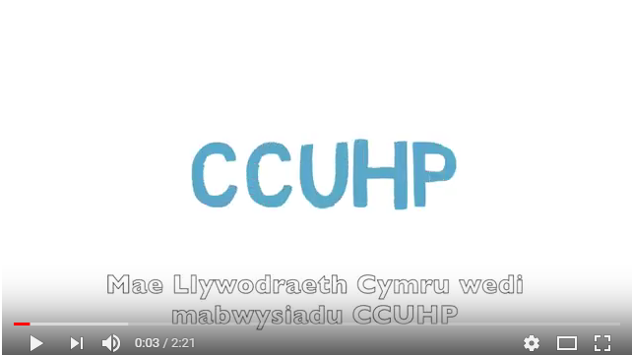
Video – Having ‘Due Regard’ to the Convention
Fideo - Rhoi ‘Sylw Dyledus’ i’r Confensiwn
.
Notes:
This video explains a little more
…………………………………………………………………………………..
Mae’r fideo yma yn esbonio ychydig mwy

Slide 14
Hawliau Plant mewn gofal cymdeithasol: sylfaen gyfreithiol a’r cysylltiad â gwerthoedd gwaith cymdeithasol
Children’s Rights in social care: legal underpinning and link to social work values
Notes:
The Rights of Children and Young Persons (Wales) Measure 2011 – means Ministers must, when exercising their function, have due regard to Children’s Rights.
When the Social Services and Well-being (Wales) Act was passed in 2014 it contained an amendment stating that all those carrying out the functions of the Act bear the duty to pay due regard to children’s rights, alongside other crucial human rights treaties. This means that social workers and other social services staff are ‘duty-bearers’ under the UNCRC, with a duty to uphold and defend children’s human rights. They are designated, in short, as human rights workers.
………………………………………………………………………
Mae Mesur Hawliau Plant a Phobl Ifanc (Cymru) 2011 yn golygu bod rhaid i Weinidogion, wrth ymarfer eu swyddogaeth, roi sylw dyledus i Hawliau Plant.
Pan basiwyd Deddf Gwasanaethau Cymdeithasol a Llesiant (Cymru) yn 2014 roedd yn cynnwys newid yn nodi bod dyletswydd ar bawb sy’n cyflawni swyddogaethau’r Ddeddf i roi sylw dyledus i hawliau plant, ochr yn ochr â chytuniadau hawliau dynol eraill hollbwysig. Mae hynny’n golygu bod gweithwyr cymdeithasol a staff gwasanaethau cymdeithasol eraill yn ‘ddeiliaid dyletswydd’ o dan CCUHP, a bod dyletswydd arnyn nhw i gynnal ac amddiffyn hawliau dynol plant. Yn gryno, maen nhw wedi’u dynodi’n weithwyr hawliau dynol.

Slide 15
The Right Way
Dull Hawliau Plant
Embedding the UNCRC
Equality and non-discrimination
Empowering children
Participation
Accountability
Gwreiddio CCUHP
Cydraddoldeb a pheidio â chamwahaniaethu
Grymuso plant
Cyfranogiad
Atebolrwydd
Notes:
Our right way framework – https://www.childcomwales.org.uk/wp-content/uploads/2017/04/The-Right-Way.pdf
Has been developed with the children’s rights observatory in Swansea and Bangor Universities
Provides a systematic method to implement children’s 42 rights in organisations large and small
Organisations across Wales are using this framework including; individual schools, Parc, national museums, natural resources Wales, all of the health boards and police forces and a number of local authorities.
We have developed sector specific guides including The Right Way – to Social Care - https://www.childcomwales.org.uk/wp-content/uploads/2021/04/RightWaySocialCare_Final-Amendments.pdf
Encourage your students to explore the web pages – which include positive examples of rights in social care settings
………………………………………………………………………………………………………………………..
Ein fframwaith ar gyfer Y Ffordd Gywir - https://www.childcomwales.org.uk/wp-content/uploads/2017/04/Y-Ffordd-Gywir.pdf
Mae wedi cael ei ddatblygu gyda’r arsyllfa hawliau plant ym Mhrifysgolion Abertawe a Bangor
Mae’n darparu dull systematig o weithredu’r 42 o hawliau sydd gan blant mewn sefydliadau mawr a bach
Mae sefydliadau ar draws Cymru yn defnyddio’r fframwaith hwn, gan gynnwys: ysgolion unigol, Parc, Amgueddfa Cymru, Cyfoeth Naturiol Cymru, yr holl fyrddau iechyd a heddluoedd a nifer o awdurdodau lleol.
Rydyn ni wedi datblygu canllawiau sector-benodol, gan gynnwys Y Ffordd Gywir – ar gyfer Gofal Cymdeithasol - https://www.childcomwales.org.uk/wp-content/uploads/2021/04/RightWaySocialCare-Wel_FinalAmendments.pdf
Anogwch eich myfyrwyr i archwilio’r tudalennau ar y we – sy’n cynnwys enghreifftiau cadarnhaol o hawliau mewn lleoliadau gofal cymdeithasol

Slide 16
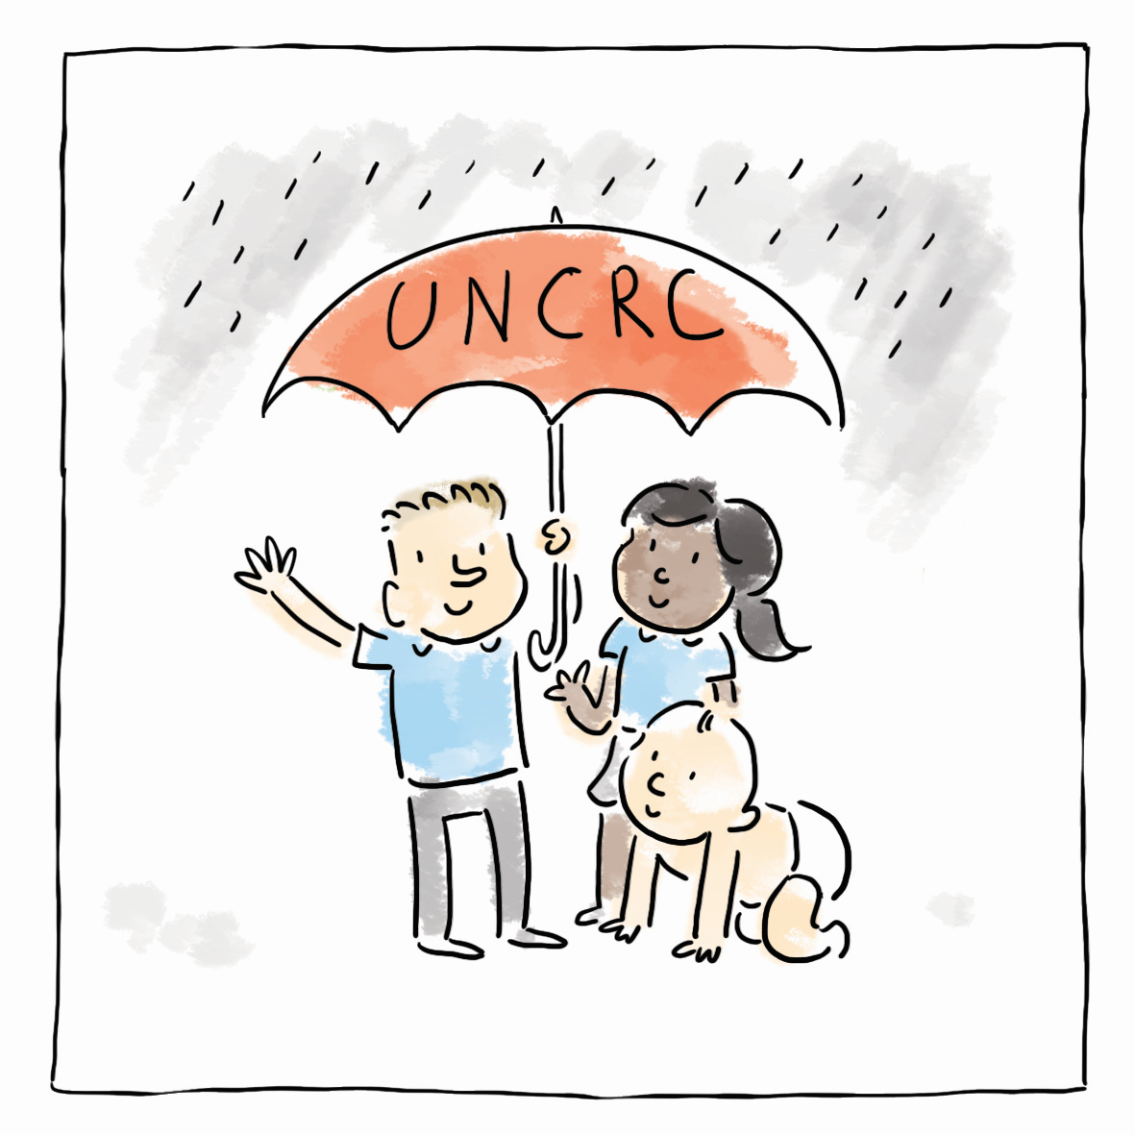
Embedding the UNCRC Seilio’r CCUHP
Corporate level commitment – charters/promises
Rights in policies
Training
Practitioners: using rights language avoids a deficit approach and strengthens advocacy
Ymrwymiad ar lefel gorfforaethol - siarteri / addewidion
Hawliau mewn polisïau
Hyfforddiant
Ymarferwyr: mae defnyddio iaith hawliau yn osgoi dull diffygiol ac yn cryfhau eiriolaeth
Notes:
Embedding rights. This means at an executive level there is a commitment to rights, they are written into policies, staff are trained and organisations make public commitments to protect and promote children’s human rights. Children and their families receive the important message that they are not receiving services because of what they lack – a deficit approach – but because all children have the same rights to be supported to fulfil their potential.
In TRW Social Care guide there are case study examples for each principle.
Embedding - Following work with Wrexham Public Service Board (PSB), Wrexham Council agreed to pilot The Right Way, by involving senior leaders and winning the hearts and minds of senior leaders, the commitment to a Children’s Rights Approach has been able to embed across the Service.
Individual practitioners: Practitioners can mirror their organisational commitment by use of rights language in your everyday practice with children and their families. For example, ‘You have a right to be listened to and taken seriously. That’s why I want to meet up and hear more about…..’
Use of rights language to advocate on behalf of the children and young people you are working with. For example, ‘She has a right to the support she needs to recover from the abuse she experienced (article 39, UNCRC) therefore there is a strong case for providing this psychological support.’
You can all encourage consideration of children’s rights in team discussions and supervision sessions.
Gwreiddio hawliau. Ystyr hyn yw bod ymrwymiad i hawliau ar lefel weithredol, eu bod yn cael eu cynnwys mewn polisïau, bod staff yn cael eu hyfforddi, a bod sefydliadau’n gwneud ymrwymiadau cyhoeddus i ddiogelu a hybu hawliau dynol plant. Mae plant a’u teuluoedd yn derbyn y neges bwysig nad rhywbeth sydd ar goll sy’n golygu eu bod yn derbyn gwasanaethau – dull diffygiol – ond y ffaith bod gan bob plentyn yr un hawliau i dderbyn cefnogaeth i gyflawni eu potensial.
Yng nghanllaw YFfG ar gyfer Gofal Cymdeithasol mae enghreifftiau o astudiaethau achos ar gyfer pob egwyddor.
Gwreiddio – Yn dilyn gwaith gyda Bwrdd Gwasanaethau Cyhoeddus Wrecsam (BGC), cytunodd Cyngor Wrecsam i beilota Y Ffordd Gywir, trwy gynnwys arweinwyr uwch ac ennill eu calonnau a’u meddyliau. Trwy wneud hynny, mae’r ymrwymiad i Ddull seiliedig ar Hawliau Plant wedi gallu cael ei wreiddio ar draws y Gwasanaeth.
Ymarferwyr unigol: Gall ymarferwyr adlewyrchu ymrwymiad eu sefydliad trwy ddefnyddio iaith hawliau yn eu hymarfer pob dydd gyda phlant a’u teuluoedd. Er enghraifft, “Mae gennych chi hawl i gael eich gwrando a’ch cymryd o ddifri. Dyna pam rydw i eisiau cwrdd â chi a chlywed mwy am…’
Defnyddio iaith hawliau i eiriol ar ran y plant a’r bobl ifanc rydych chi’n gweithio gyda nhw. Er enghraifft, ‘Mae ganddi hawl i’r gefnogaeth sydd ei hangen arni i adfer wedi’r gamdriniaeth mae hi wedi’i brofi (erthygl 39, CCUHP), felly mae achos cryf dros ddarparu’r gefnogaeth seicolegol yma.’
Gall pawb ohonoch chi annog ystyried hawliau plant mewn trafodaethau tîm a sesiynau goruchwylio.

Slide 17
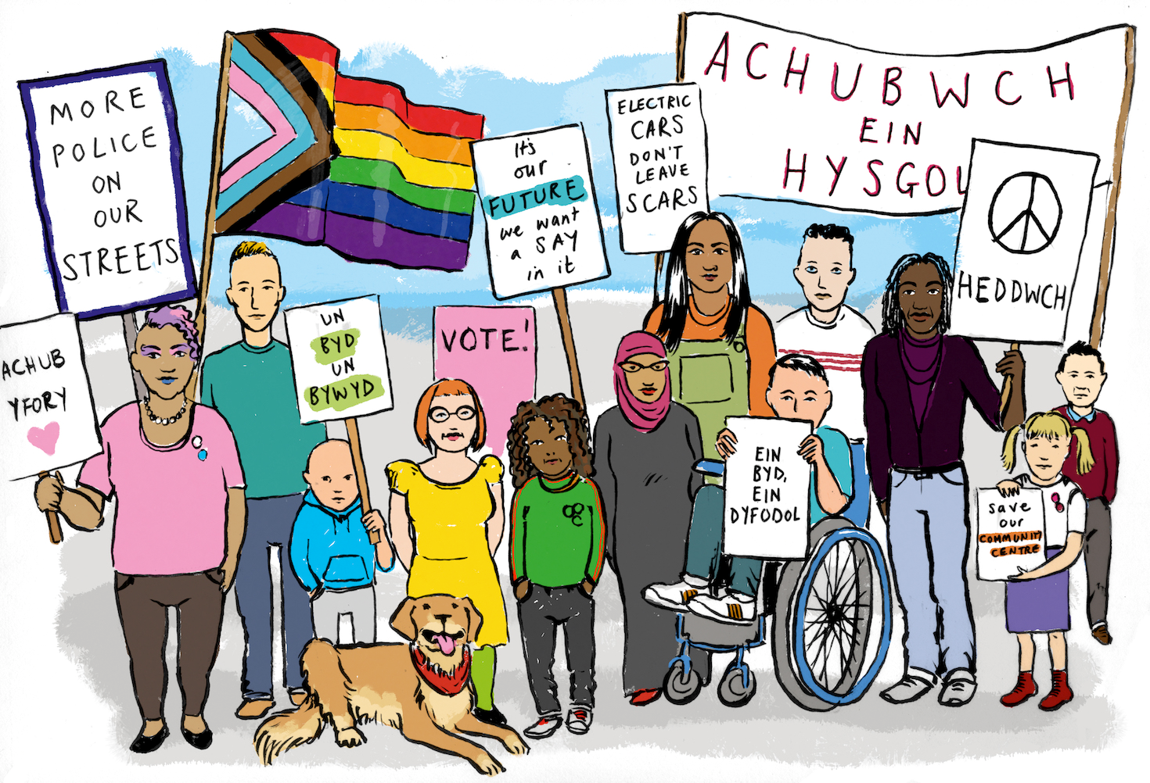
Equality and Non-Discrimination Cydraddoldeb a dim gwahaniaethu
Using data to analyse access to services
Ensure that representatives of marginalised groups are directly involved in service improvement
Make sure written and verbal communications are accessible
Take steps to reduce power differentials in meetings
Defnyddio data i ddadansoddi mynediad at wasanaethau
Sicrhau bod cynrychiolwyr grwpiau ymylol yn ymwneud yn uniongyrchol â gwella gwasanaethau
Sicrhau bod cyfathrebu ysgrifenedig a llafar yn hygyrch
Cymryd camau i leihau gwahaniaethau pŵer mewn cyfarfodydd
Notes:
Equality and non-discrimination. This is a fundamental human rights principle. We know that children and their families are more likely to be caught up in statutory children’s services when they live in poverty. Disabled children and adults face systematic barriers, Children from Black, Asian and other ethnic minority backgrounds including Gypsy, Roma and traveller children face racism and many face other economic and institutional barriers. Recognising these barriers and taking active steps to combat them is human rights work in practice.
Case example in the report the case study is from Swansea – Jigso multi-disciplinary team supporting young parents – recognised the discrimination and challenges many face based on age and took active steps to build support.
There are many steps practitioners can take, many of which are bread and butter to social workers and you will be already doing without thinking of yourself as taking action to protect a child’s human rights: e.g. communication preferences – how can you understand a non-verbal child’s needs and preferences? How will you protect a child’s right to speak Welsh, when they are a fluent speaker and are placed over the border? Have you taken steps to understand and learn about Irish Traveller culture before attempting a parenting assessment?
Cydraddoldeb a pheidio â chamwahaniaethu. Mae hon yn egwyddor hawliau dynol sylfaenol. Rydyn ni’n gwybod bod plant a’u teuluoedd yn fwy tebygol o ymwneud â gwasanaethau plant statudol pan fyddan nhw’n byw mewn tlodi. Mae plant ac oedolion anabl yn wynebu rhwystrau systematig, mae Plant o gefndiroedd Du, Asiaidd a lleiafrifoedd ethnig eraill, gan gynnwys plant Sipsiwn, Roma a Theithwyr yn wynebu hiliaeth, ac mae llawer yn wynebu rhwystrau economaidd a sefydliadol eraill. Mae cydnabod y rhwystrau hyn a chymryd camau gweithredol i’w gwrthweithio yn waith hawliau dynol ymarferol.
Enghraifft o achos. Yn yr adroddiad mae’r astudiaeth achos yn dod o Abertawe – tîm amlddisgyblaeth Jigso yn cefnogi rhieni ifanc – roedden nhw’n cydnabod y camwahaniaethu a’r heriau roedd llawer yn eu hwynebu ar sail eu hoed, ac fe wnaethon nhw gymryd camau gweithredol i feithrin cefnogaeth.
Mae llawer o gamau gall ymarferwyr eu cymryd, y mae llawer ohonynt yn rhan o drefn arferol gweithwyr cymdeithasol, ac y byddwch yn eu gwneud eisoes heb feddwl amdanoch eich hun yn cymryd camau i ddiogelu hawliau dynol plentyn: e.e. dewisiadau cyfathrebu – sut gallwch chi ddeall anghenion a dewisiadau plentyn nad yw’n defnyddio geiriau? Sut byddwch chi’n diogelu hawl plentyn i siarad Cymraeg, os ydyn nhw’n siaradwr rhugl, ond wedi’u lleoli dros y ffin? Ydych chi wedi cymryd camau i ddeall a dysgu am ddiwylliant Teithwyr Gwyddelig cyn ceisio cynnal asesiad rhianta?

Slide 18
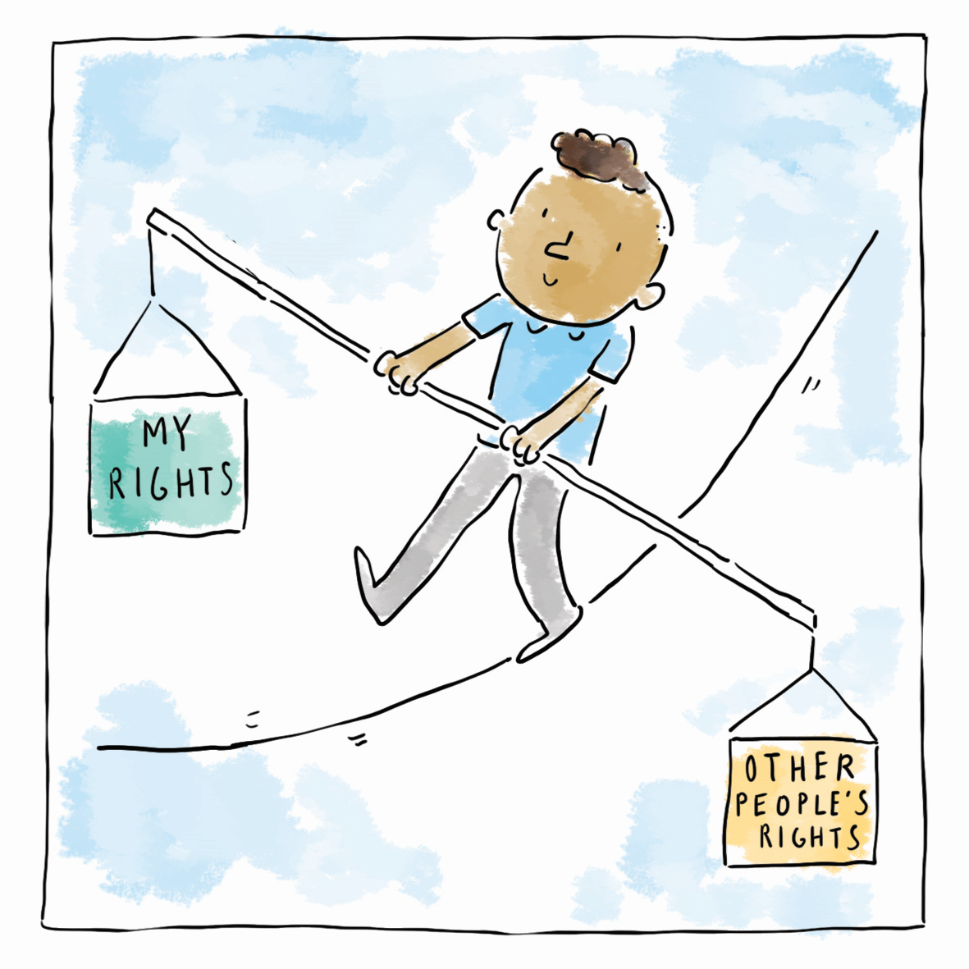
Empowering Children Galluogi plant i
defnyddio hawliau plant
Enhance children’s capabilities as individuals so they are able to take advantage of their rights
Gwella galluoedd plant fel unigolion, fel eu bod nhw’n gallu manteisio ar eu hawliau
Notes:
Human rights should empower children. Empowerment means enhancing children’s capabilities as individuals so they are better able to take advantage of rights, and to engage with, influence and hold accountable the people and organisations that affect their lives. Children need to understand that they have rights and to have positive experiences of receiving them to help them feel empowered. Those working with children in a social care context have a duty to help ensure children know that they have rights, have real opportunities to take them up and feel empowered by their rights. This takes many different forms for children; from using rights language with children, to making sure they can see their rights reflected in their interactions with professionals and the support they receive, to having their rights protected when they are faced barriers to accessing them. This element of a children’s rights approach is about making rights a reality for children. Children who receive support from social services may not always feel empowered if they believe decisions are made about them, as opposed to being made with them.
Individual practitioners’ role:
Ensure children know about their rights.
Children (and adults) feel disempowered when they don’t think they will be listened to, when they don’t trust those they are working with and when they don’t have faith that positive change will happen. When children are feeling disempowered they may not feel motivated to take up their rights to say what they want and need, to take part in decision-making and to engage with services on offer.
Empowerment is based on developing trusting relationships. Trust is developed by being seen to be fair, honest, reliable and caring. Being back in touch when you say you will be, even if it’s to explain that a decision has not yet been taken, is important to young people.
Work with children and young people to identify what information they are missing and what information they would like to receive. Work could be done with young people to produce information for others.
Case study in our guide: Ceredigion’s Safe Stars junior safeguarding programme – mix of fun activities and consultation builds confidence and knowledge
Dylai hawliau dynol rymuso plant. Ystyr grymuso yw gwella galluoedd plant fel unigolion, fel eu bod nhw’n gallu manteisio’n well ar hawliau, ac ymgysylltu â’r bobl a’r sefydliadau sy’n effeithio ar eu bywydau, dylanwadu arnyn nhw a’u gwneud yn atebol. Mae angen i blant ddeall bod ganddyn nhw hawliau, a chael profiadau cadarnhaol o’u derbyn, i’w helpu i deimlo eu bod wedi’u grymuso. Mae dyletswydd ar y rhai sy’n gweithio gyda phlant mewn cyd-destun gofal cymdeithasol i helpu i sicrhau bod plant yn gwybod bod ganddyn nhw hawliau, bod ganddyn nhw gyfleoedd gwirioneddol i fanteisio arnynt, a theimlo bod eu hawliau’n eu grymuso. Mae hynny’n digwydd mewn llawer o wahanol ffurfiau i blant; o ddefnyddio iaith hawliau gyda phlant, i sicrhau eu bod yn gallu gweld eu hawliau wedi’u hadlewyrchu yn eu hymwneud â gweithwyr proffesiynol a’r gefnogaeth maen nhw’n ei derbyn, i ddiogelu eu hawliau pan fyddan nhw’n wynebu rhwystrau i’w derbyn. Mae’r elfen hon o ddull seiliedig ar hawliau plant yn ymwneud â gwireddu hawliau i blant. Efallai na fydd plant sy’n derbyn cefnogaeth gan y gwasanaethau cymdeithasol bob amser yn teimlo wedi’u grymuso os byddan nhw’n meddwl bod penderfyniadau’n cael eu gwneud amdanyn nhw, yn hytrach na’u gwneud gyda nhw.
Rôl ymarferwyr unigol:
Sicrhau bod plant yn gwybod am eu hawliau.
Mae plant (ac oedolion) yn teimlo wedi’u dadrymuso os byddan nhw’n meddwl na fydd neb yn gwrando arnyn nhw, os nad ydyn nhw’n trystio’r rhai sy’n gweithio gyda nhw, ac os nad oes ganddyn nhw ffydd y bydd newid cadarnhaol yn digwydd. Pan fydd plant yn teimlo wedi’u dadrymuso efallai na fydd cymhelliad iddyn nhw fanteisio ar eu hawliau i ddweud beth maen nhw eisiau ac angen, i fod yn rhan o benderfyniadau ac i ymgysylltu â’r gwasanaethau sydd ar gael.
Mae grymuso wedi’i seilio ar ddatblygu perthnasoedd o ymddiriedaeth. Mae ymddiriedaeth yn cael ei datblygu os gwelir eich bod yn deg, yn onest, yn ddibynadwy ac yn ofalgar. Cysylltu eto ar ôl dweud byddwch chi’n gwneud hynny, hyd yn oes os bydd rhaid esbonio nad oes penderfyniad eto – mae hynny’n bwysig i bobl ifanc.
Gweithio gyda phlant a phobl ifanc i ganfod pa wybodaeth sydd ddim ganddyn nhw a pha wybodaeth hoffen nhw ei derbyn. Gallech chi weithio gyda phobl ifanc i gynhyrchu gwybodaeth i eraill.
Astudiaeth achos yn ein canllaw: Rhaglen ddiogelu iau Sêr Diogel/Safe Stars Ceredigion – cyfuniad o weithgareddau difyr ac ymgynghori yn meithrin hyder a gwybodaeth

Slide 19
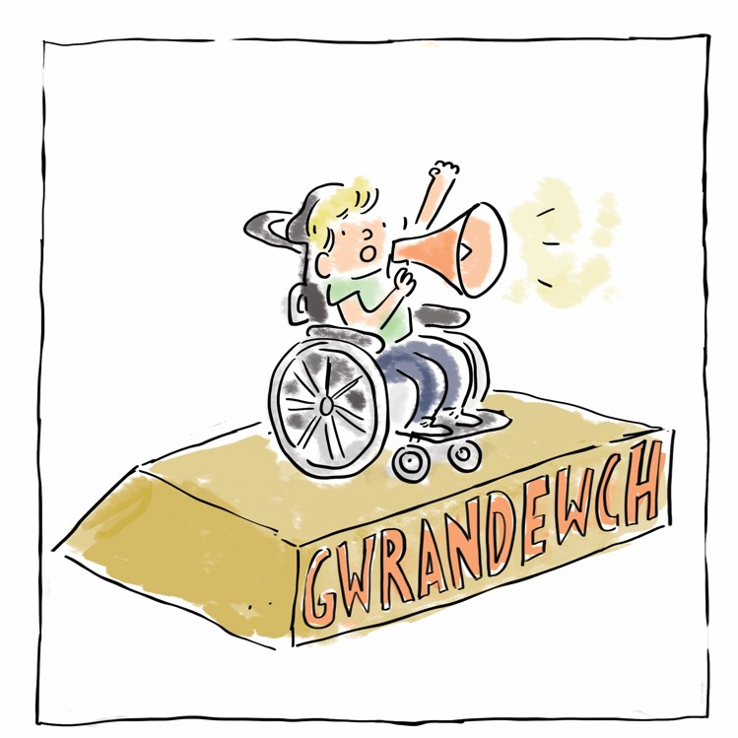
Participation Cyfranogiad
Participation in individual care and support
Participation in service development
Cyfranogi mewn gofal a chefnogaeth unigol
Cyfranogi mewn datblygu gwasanaeth
Notes:
Organisations make better decisions when they involve the people they are there to serve. This includes participation of individuals in their own care plans as well as at an institutional level. Our guide showcases good examples of participation practice, including online during the pandemic.
Case study in our guide: YoVo group in Neath Port Talbot – care experienced young people. conducted peer research and have implemented practice improvement as a result
and “Pitchin in the Kitchen” in Swansea with support from a theatre group Mess up the Mess created an online method to engage with children in care through fun activities to ensure participation and communication was built upon during the pandemic.
Mae sefydliadau’n gwneud penderfyniadau gwell wrth gynnwys y bobl maen nhw yno i’w gwasanaethu. Mae hynny’n cynnwys cyfranogiad unigolion yn eu cynlluniau gofal eu hunain, yn ogystal ag ar lefel sefydliadol. Mae ein canllaw yn arddangos enghreifftiau da o ymarfer cyfranogiad, gan gynnwys ar-lein yn ystod y pandemig.
Astudiaeth achos yn ein canllaw: Grŵp YoVo yng Nghastell-Nedd Port Talbot – bu pobl ifanc oedd â phrofiad o ofal yn gwneud gwaith ymchwil gyda chyfoedion ac o ganlyniad maen nhw wedi rhoi gwelliannau ymarfer ar waith.
Hefyd, yn Abertawe, creodd “Pitchin in the Kitchen”, gyda chefnogaeth y grŵp theatr “Mess up the Mess”, ddull ar-lein o ymgysylltu â phlant mewn gofal trwy weithgareddau difyr i sicrhau bod cyfranogiad a chyfathrebu yn cael eu datblygu yn ystod y pandemig.

Slide 20
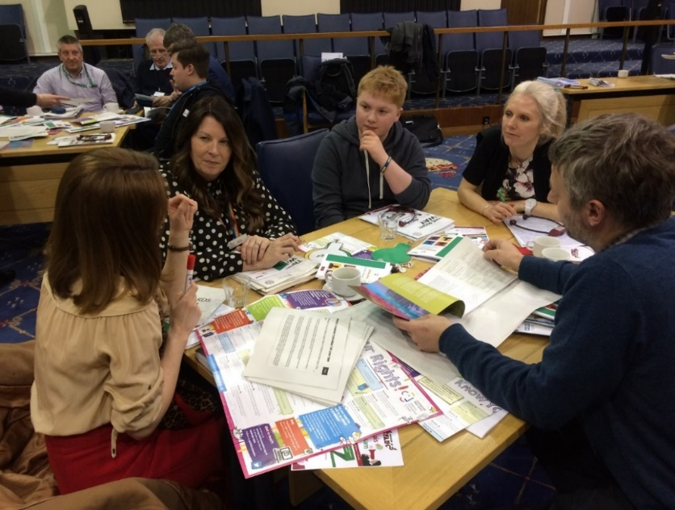
Accountability Atebolrwydd
Provide opportunities for senior leaders to be held to account
Feedback loops: you said – we did
Accessible information
Children’s access to complaints
Rhoi cyfleoedd i uwch arweinwyr gael eu gwneud yn atebol
Dolenni adborth: fe ddwedsoch chi – fe wnaethon ni
Gwybodaeth hygyrch
Mynediad plant i gwynion
Notes:
Organisations who provide services need to put themselves in a position where they can be held accountable. That includes governments, local authorities and all kinds of providers. This can include publishing documents in accessible ways, being transparent about budgets and outcomes, having accessible complaints systems and boards, senior leaders and elected members opening themselves up to scrutiny sessions, including by children.
Case study: Wrexham Social Services and The Young People’s Care Council and Senedd Yr Ifanc have created a Child friendly complaints procedure.
Mae angen i sefydliadau sy’n darparu gwasanaethau roi eu hunain mewn sefyllfa lle mae modd eu gwneud yn atebol. Mae hynny’n cynnwys llywodraethau, awdurdodau lleol a phob math o ddarparwyr. Gall hynny gynnwys cyhoeddi dogfennau mewn ffyrdd hygyrch, bod yn dryloyw ynghylch cyllidebau a chanlyniadau, sicrhau bod eu systemau cwynion a’u byrddau yn hygyrch, bod arweinwyr uwch ac aelodau etholedig yn agored i sesiynau craffu, gan gynnwys gan blant.
Astudiaeth achos: Mae Gwasanaethau Cymdeithasol Wrecsam a’r Cyngor Gofal Pobl Ifanc a Senedd yr Ifanc wedi creu gweithdrefn gwynion hwylus i blant.

Slide 21
Offer i gefnogi Crynodeb o Y Ffordd Gywir Dechrau Arni Matrics Hawliau Plant - nodi cyflawniadau a meysydd i'w datblygu Asesiadau Effaith ar Hawliau Plant – canllaw syml Astudiaethau achos ar ein gwefan
Tools to support Summary of TRW
Getting started Children’s Rights Matrix – identifying achievements and areas for development Children’s Rights Impact Assessments – a simple guide Case studies on our website
Notes:
You will already be doing much human rights work in your every day practice, even if you don’t recognise it as such. The Children’s Commissioners office have created a range of tools will help you further embed this at individual, team and organisational level.
PLEASE SHARE LINK AFTER TRAINING –
Summary TRW - https://www.childcomwales.org.uk/wp-content/uploads/2021/12/TRW_onepagesummary_ENG.pdf
TRW - https://www.childcomwales.org.uk/the-right-way-a-childrens-rights-approach/a-childrens-rights-approach-for-social-care-in-wales/
Look at resources on this page for Getting started, top tips and great examples of work done by others - https://www.childcomwales.org.uk/the-right-way-a-childrens-rights-approach/a-childrens-rights-approach-for-social-care-in-wales/
Byddwch chi eisoes yn gwneud llawer o waith hawliau dynol yn eich ymarfer pob dydd, hyd yn oed os nad ydych chi’n sylweddoli hynny. Mae swyddfa’r Comisiynydd Plant wedi creu ystod o offer a fydd yn eich helpu i wreiddio hynny ymhellach ar lefel yr unigolyn, y tîm a’r sefydliad.
COFIWCH RANNU’R DDOLEN AR ÔL YR HYFFORDDIANT –
Crynodeb o’r Ffordd Gywir - https://www.childcomwales.org.uk/wp-content/uploads/2021/12/TRW_onepagesummary_CYM.pdf
Y Ffordd Gywir (YFfG) - https://www.complantcymru.org.uk/y-ffordd-gywir-dull-hawliau-plant/dull-gweithredu-seiliedig-ar-hawliau-plant-ar-gyfer-gofal-cymdeithasol-yng-nghymru/
Edrychwch ar yr adnoddau ar y dudalen hon i gael Dechrau arni, cynghorion gwych ac enghreifftiau arbennig o waith gan eraill - https://www.complantcymru.org.uk/y-ffordd-gywir-dull-hawliau-plant/dull-gweithredu-seiliedig-ar-hawliau-plant-ar-gyfer-gofal-cymdeithasol-yng-nghymru/

Slide 22
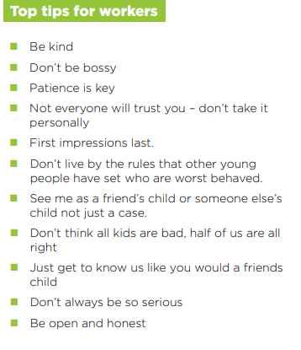
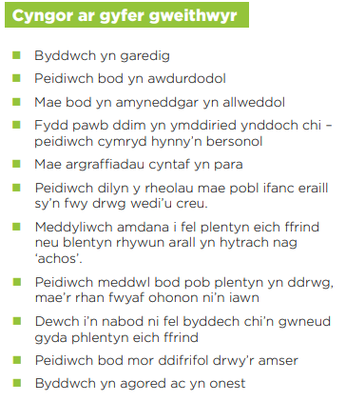
Young People’s views Barn pobl ifanc
Notes:
Here is a list of Top Tips created by young people in Social Care
Dyma restr o’r Cynghorion Gwych gafodd eu creu gan bobl ifanc ym maes Gofal Cymdeithasol

Slide 23
Which rights are at stake here? What is the social worker role?
A girl aged 16 with mild learning difficulties appears to have been in an exploitative relationship with a man aged 30. She’s confident he is her boyfriend.
A first language Welsh speaker age 12 is in a Secure Children’s Home in Manchester. He isn’t allowed to speak Welsh in supervised contact sessions with his Nain/grandmother
Pa hawliau sydd dan sylw yma? Beth yw rôl y gweithiwr cymdeithasol?
Mae’n ymddangos bod merch 16 oed sydd ag anawsterau dysgu ysgafn wedi bod mewn perthynas lle roedd dyn 30 oed yn ei hecsbloetio. Mae hi’n hyderus bod e’n gariad iddi.
Mae siaradwr Cymraeg iaith gyntaf 12 oed mewn Cartref Plant Diogel ym Manceinion. Dyw e ddim yn cael siarad Cymraeg mewn sesiynau cyswllt dan oruchwyliaeth gyda’i Nain
Notes:
If time it would be helpful to create some discussion in training and here is an example of two case studies to help students explore UNCRC in practice.
…………………………………………………..
Os bydd amser byddai’n ddefnyddiol creu peth trafodaeth yn yr hyfforddiant, a dyma enghraifft o ddwy astudiaeth achos i helpu’r myfyrwyr i archwilio CCUHP yn ymarferol.

Slide 24
What can you do to support Children and Young people to access their rights?
To feel listened to and taken seriously?
To feel safe?
To get information in a way they understand
To complain if they need to?
Beth gallwch chi ei wneud er mwyn cefnogi plant a phobl ifanc i dderbyn eu hawliau?
I deimlo eu bod nhw’n cael gwrandawiad ac yn cael eu cymryd o ddifri?
I deimlo’n ddiogel?
I dderbyn gwybodaeth maen nhw’n ei deall
I gwyno os bydd angen?
Notes:
In summary we would welcome participants reflecting on the training to think about what they can do as a result of this session.
………………………………………………..
Wrth grynhoi bydden ni’n falch petai’r cyfranogwyr yn myfyrio ar yr hyfforddiant er mwyn meddwl beth gallan nhw wneud o ganlyniad i’r sesiwn hon.

Slide 25
Questions? Comments? Cwestiynau? Sylwadau?

Slide 26
Contact Details|Manylion Cyswllt
Trydar | Twitter @complantcymru @childcomwales
Instagram @complantcymru @childcomwales
Ffôn | Phone 01792 765600
Ebost | Email post@childcomwales.org.uk | post@complantcymru.org.uk
Facebook https://www.facebook.com/childcomwales/
Gwefan | Website www.childcomwales.org.uk| www.complantcymru.org.uk

