Slide 1
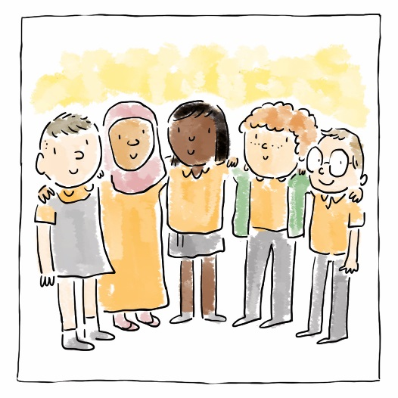
Hawliau Plant/
Comisiynydd Plant Cymru
Children’s Rights
Children’s Commissioner for Wales

Slide 2
Nodau’r Sesiwn
Cyflwyniad i Gonfensiwn y Cenhedloedd Unedig ar Hawliau’r Plentyn (CCUHP)
Amlinellu rôl Comisiynydd Plant Cymru
Aims of the Session
Introduction to the United Nations Convention on the Rights of the Child (UNCRC)
Outline role of the Children’s Commissioner for Wales
Notes:
This session will give participants an introduction to children’s rights and the work of the Children’s Commissioner for Wales.
We’ve also created two additional resources to help participants explore how children’s rights can be implemented in any work involving children and young people, which are on our website.
----------------------------------------------------------------------------------------------
Bydd y sesiwn hon yn rhoi cyflwyniad i hawliau plant a gwaith Comisiynydd Plant Cymru i’r cyfranogwyr.
Rydyn ni hefyd wedi creu dau adnodd ychwanegol i helpu’r cyfranogwyr i archwilio sut gall hawliau plant gael eu gweithredu mewn unrhyw waith sy’n ymwneud â phlant a phobl ifanc; maen nhw ar ein gwefan.

Slide 3
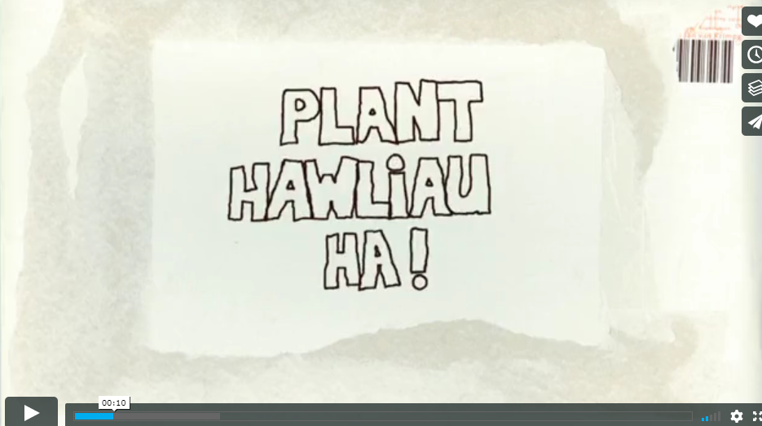
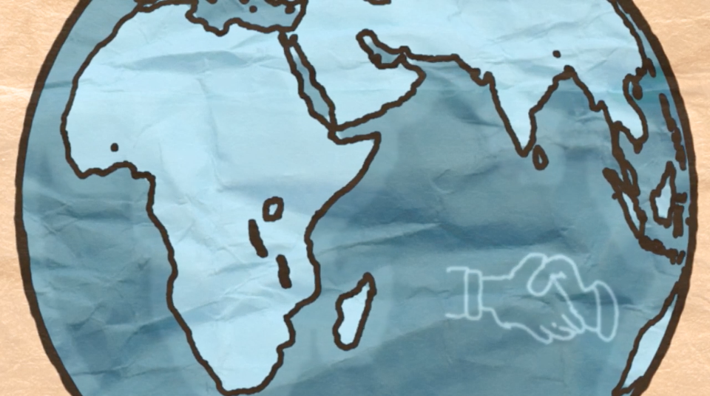
Fideo - Hawliau Plant? Ha!
Video - Children’s Wrongs
Notes:
The Welsh Government have produced many training materials to support adults who work with young people to learn about their rights, and material for children to explore their rights.
This clip is called ‘Children’s Wrongs’, and is from their website. You can find more bilingual resources online.
Following the clip there will be a short quiz, some of the answers may be in the clip!
------------------------------------------------------------------------------
Mae Llywodraeth Cymru wedi cynhyrchu llawer o ddeunyddiau hyfforddi i gefnogi oedolion sy’n gweithio gyda phobl ifanc i ddysgu am eu hawliau, a deunydd er mwyn i blant archwilio eu hawliau.
Yr enw ar y clip yma yw ‘Hawliau Plant? Ha!’, ac mae’n dod o’u gwefan. Mae rhagor o adnoddau dwyieithog ar gael ar-lein.
Bydd cwis cyflym yn dilyn y clip fideo, efallai bydd rhai o’r atebion yn y clip fideo!

Slide 4
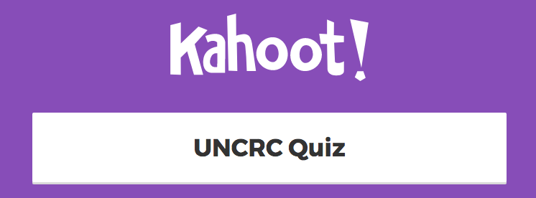
Notes:
This quiz will help introduce the UNCRC and the Children’s Commissioner for Wales to participants.
To take part in this interactive version, click the image to follow the link. All participants must have access to a mobile device with an internet connection to take part.
If that isn’t possible, we have uploaded the questions so you can do the quiz using a pen and paper –
https://www.childcomwales.org.uk/wp-content/uploads/2018/06/UNCRC-Quiz-English.pdf
-----------------------------------------------------------------------------------------
Bydd y cwis yma’n helpu i gyflwyno CCUHP a Chomisiynydd Plant Cymru i’r cyfranogwyr.
I gymryd rhan yn y fersiwn ryngweithiol yma, cliciwch ar y ddelwedd i ddilyn y ddolen. Rhaid bod gan bob cyfranogwr fynediad at ddyfais symudol sydd â chysylltiad â’r rhyngrwyd i gymryd rhan.
Os nad yw hynny’n bosib, rydyn ni wedi cynnwys y cwestiynau yma fel gallwch wneud y cwis ar bapur –
https://www.childcomwales.org.uk/wp-content/uploads/2018/06/Cwis-Confensiwn-y-Cenhedloedd-Unedig-ar-Hawliau-cwis-kahoot-cymraeg.pdf

Slide 5
Mae gennym ni Hawliau Dynol, pam mae angen Hawliau Plant?
Mae plant yn fwy agored i gael eu cam-drin a’u hecsbloetio
Yn dibynnu ar eu hoed, mae plant yn ddibynnol ar oedolion yn llwyr neu i raddau helaeth – nid yw eu lles pennaf bob amser yn cael ei ystyried
Mae plant yn wynebu llu o derfynau oed cyfreithiol pryd y bernir eu bod nhw’n gallu gwneud penderfyniadau drostynt eu hunain
Mae plant yn aml heb lais
We have Human Rights, why do we need Children’s Rights?
Children are more vulnerable to abuse and exploitation
Dependent on age, children are entirely or mostly dependent on adults – best interests not always considered
Children face an array of legal minimum ages at which they are considered capable of making decisions for themselves
Children are often voiceless

Slide 6
CCUHP – Confensiwn y Cenhedloedd Unedig ar Hawliau’r Plentyn. Cytundeb rhyngwladol yw hwn sy’n amddiffyn hawliau dynol pobl o dan 18 oed.
Mae’n rhestru’r hawliau sydd gan bob plentyn a pherson ifanc, ym mhobman yn y byd.
Cafodd ei fabwysiadu gan y CU yn 1989, cafodd ei gadarnhau gan y Deyrnas Unedig yn 1991, a daeth i rym yn 1992.
UNCRC - United Nations Convention on the Rights of the Child is an international agreement that protects the human rights of those under the age of 18.
It lists the rights that all children and young people, everywhere in the world have.
It was adopted by the UN in 1989, the UK ratified it in 1991 and it came into force in 1992.
Notes:
These slides outline a little more about the UNCRC – it covers the age and global dimension of the UNCRC.
It is worth noting that it is the most signed up to piece of UN legislation and offers the worlds “Greatest promise to Children”.
When UN adopted it on November 20th 1989 this became recognised as Universal Children’s Day and it often celebrated across Wales and the globe.
------------------------------------------------------------------------------------
Mae’r sleidiau hyn yn cynnwys rhagor o wybodaeth am CCUHP – mae’n sôn am oed a dimensiwn byd-eang CCUHP.
Mae’n werth nodi mai dyma’r enghraifft o ddeddfwriaeth y CU y mae’r nifer mwyaf wedi ymrwymo iddo a’i bod yn cynnig yr ‘Addewid mwyaf i Blant’ yn y byd.
Pan gafodd ei fabwysiadu gan y CU ar 20 Tachwedd 1989 dewiswyd y dyddiad hwnnw’n Ddiwrnod Byd-eang y Plant, ac mae’n aml yn cael ei ddathlu yng Nghymru ac ar draws y byd.

Slide 7
Mae 54 o ‘erthyglau’ neu hawliau yn y Confensiwn
Mae Erthyglau 1 – 42 yn amlinellu hawliau penodol plant
Mae Erthyglau 43 – 54 yn amlinellu’r rhwymedigaethau sydd ar Bartïon Gwladol ac eraill sydd ‘o dan ddyletswydd’
There are 54 ‘articles’ or rights in the Convention
Articles 1 – 42 outline the rights specific to children
Articles 43 – 54 outline the obligations of State Parties and other ‘duty-bearers’
Notes:
There are 54 articles in the convention, though most children and young people will think it is 42.
On posters and information for children you will see Articles 0-42 s rights for children, as 43-54 are more the logistical side of what Governments have to do to ensure children access those rights.
---------------------------------------------------------------
Mae 54 o erthyglau yn y confensiwn, er y bydd y rhan fwyaf o blant a phobl ifanc yn meddwl am ffigur o 42.
Ar bosteri a gwybodaeth i blant, byddwch chi’n gweld amlinelliad o Erthyglau 0-42, gan fod 43-54 yn ymwneud yn fwy ag agwedd logistaidd yr hyn mae’n rhaid i Lywodraethau ei wneud i sicrhau bod plant yn cael mynediad i’r hawliau hynny.

Slide 8
Gweithgaredd 1: Corff o Hawliau
Mewn grwpiau bach, tynnwch lun siâp corff ar ddarn mawr o bapur – A3. Os yw hyn yn cynrychioli plentyn neu berson ifanc sy’n tyfu i fyny yng Nghymru heddiw, trafodwch beth allai fod ei angen arnyn nhw i dyfu i fyny’n hapus, yn iach ac yn ddiogel. Rhowch y pethau rydych chi’n meddwl amdanynt fel anghenion y tu mewn i’r corff, a phethau maen nhw eisiau y tu allan. (gan ddefnyddio nodiadau gludiog neu binnau ysgrifennu).
Rhowch adborth cryno
Activity 1: Body of Rights
In small groups, draw the shape of a body on a piece of large paper - A3. If this is a child or young person growing up in Wales today have a discussion about what they may want to grow up happy, healthy and safe. Place what you think are someone’s needs in the middle of the body and wants on the outside. (using post-its or pens).
Briefly feedback
Notes:
To explore your own understanding of Children’s Rights we are going to do an activity called Body of Rights. You will need access to A3/large paper and a pen.
Start by drawing the outline of a body on the paper.
In small groups talk about things that children aged 0-18 would like to grow up happy, healthy and safe.
If you identify this as a need then place the post-it/write it inside the body
If you identify this as a want then place the post-it/write it on the outside of the body
-----------------------------------------------------------------------------------------------
I archwilio eich dealltwriaeth eich hun o Hawliau Plant rydyn ni’n mynd i wneud gweithgaredd o’r enw Corff o Hawliau. Bydd arnoch chi angen darn mawr/A3 o bapur a phin ysgrifennu.
I ddechrau, gwnewch amlinelliad o gorff ar y papur.
Mewn grwpiau bach, trafodwch y pethau y byddai plant 0-18 oed yn hoffi eu cael er mwyn tyfu i fyny’n hapus, yn iach ac yn ddiogel yng Nghymru heddiw.
Rhowch y pethau rydych chi’n meddwl amdanynt fel anghenion y tu mewn i’r corff, a phethau maen nhw eisiau y tu allan.

Slide 9
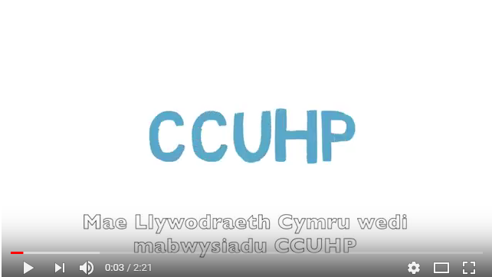
Fideo - Rhoi ‘Sylw Dyledus’ i’r Confensiwn
Video – Having ‘Due Regard’ to the Convention

Slide 10
.
Beth amdana i?
Ar y cyd â’r Llywodraeth, mae dyletswydd ar bawb sy’n gofalu am blant a phobl ifanc o dan CCUHP. Mae hynny’n golygu bod cyfrifoldeb arnyn nhw i gynnal hawliau plant.
What about me?
Along with the Government, all people who care for children and young people are duty bearers under the UNCRC. That means they have a responsibility to uphold children’s rights.
Notes:
To access their needs, children have to rely on adults. Adults who make decisions that affect children are all responsible for making sure that children’s rights are upheld and respected. These are duties under the UNCRC. We as adults who care about and care for children are therefore “Duty Bearers” with a responsibility to ensure children get their rights.
----------------------------------------------------------------------------
Mae’n rhaid i blant ddibynnu ar oedolion i gael mynediad i’w hanghenion. Mae pob oedolyn sy’n gwneud penderfyniadau sy’n effeithio ar blant yn gyfrifol am sicrhau bod hawliau plant yn cael eu cynnal a’u parchu. Mae’r rhain yn ddyletswyddau o dan CCUHP. Rydym ni’n oedolion sydd â gofal ac yn gofalu am blant, ac felly rydym ni’n ‘Ddeiliaid Dyletswydd’ sydd â chyfrifoldeb i sicrhau bod plant yn cael eu hawliau.

Slide 11
Gweithgaredd 2:
Pa Hawliau allai fod yn bwysig i’ch rôl fel gweithiwr proffesiynol?
Gan ddefnyddio poster CCUHP, darllenwch trwy’r erthyglau mewn parau a thrafod pa dair erthygl yw’r rhai pwysicaf i’r rôl rydych am ei chyflawni yn y dyfodol.
Adborth cryno
Activity 2:
What Rights could be important to your role as a professional?
Using a UNCRC poster, read through the articles in pairs and discuss which three articles are most important to the role you aim to have in the future.
Briefly feedback
Notes:
The purpose of this activity is to allow participants an opportunity to explore the range of articles.
Use the poster here - https://www.childcomwales.org.uk/wp-content/uploads/2017/01/6331-CCfW-A2-Rights-Poster-AW-1.pdf
There is no right or wrong articles to choose as All children have ALL articles though sometimes they can conflict with each other and as adults we have to do what is in children’s best interests. (Article 3)
Articles 2, 3, 6 and 12 are often seen as the underpinning articles to the UNCRC.
----------------------------------------------------------------------------
Diben y gweithgaredd hwn yw rhoi cyfle i’r cyfranogwyr archwilio’r amrywiaeth o erthyglau.
Defnyddiwch y poster yma - https://www.childcomwales.org.uk/wp-content/uploads/2017/01/CCfW-A2-Rights-Poster-CYM.pdf
Nid oes erthyglau cywir neu anghywir i’w dewis gan fod POB erthygl yn berthnasol i BOB plentyn, er eu bod weithiau’n gallu gwrthdaro, ac fel oedolion mae’n rhaid i ni wneud beth sydd er lles pennaf y plant. (Erthygl 3)
Mae erthyglau 2, 3, 6 a 12 yn aml yn cael eu hystyried fel erthyglau sylfaenol/egwyddorion tywys i’r CCUHP.

Slide 12
Gweithgaredd 3: Trafodaeth
Mae pob grŵp bach yn cymryd cerdyn o’r pecyn o gardiau symbolau – gan ddefnyddio erthyglau 7, 12, 14, 15, 19, 24, 27, 28, 29, 29, 31, 36, 42.
Trafodaeth: Beth mae ysgolion yn ei wneud i wireddu’r hawl hon i blant a phobl ifanc?
Activity 3: Discussion
Each small group takes a card from the symbols card pack – using articles 7, 12, 14, 15, 19, 24, 27,28,29, 29, 31, 36, 42.
Discuss: What do schools do to make this right a reality for children and young people?
Notes:
Focus of Slide – Activity
Context Before going onto look at the five principles of the Right Way we will do a practical activity to explore how rights link to school life.
Activity - Ask participants to work in small groups and hand out a symbols card – these can be downloaded here - https://www.childcomwales.org.uk/uncrc-childrens-rights/uncrc-symbols-resource/
-----------------------------------------------------------------------------------------------------
Ffocws y Sleid – Gweithgaredd
Cyd-destun Cyn mynd ymlaen i edrych ar 5 egwyddor y Ffordd Gywir, byddwn ni’n gwneud gweithgaredd ymarferol i archwilio’r cysylltiad rhwng hawliau a bywyd ysgol.
Gweithgaredd – Gofynnwch i gyfranogwyr i weithio mewn grwpiau bach a darparwch gerdyn symbolau – gall y rhain cael eu lawr lwytho yma - https://www.complantcymru.org.uk/ccuhp-hawliau-plant/adnodd-symbolau-ccuhp/

Slide 13
Arfer Adferol | Restorative Practice
Articles | Erthyglau 12/36/17
Gwrthfwlio | Anti Bullying
Article | Erthygl 19
Y Cyfnod Sylfaen | Foundation Phase
Article | Erthyglau 28/29/31
Llais y disgybl | Pupil voice
Article | Erthygl 12 – Right to be heard / Hawl i gael eu clywed
ADCDF| ESDGC
Article | Erthygl 2
CCUHP
UNCRC
Ysgolion Iach/Eco
|Healthy/Eco Schools
Article | Erthygl 24 –
Gweithgareddau Allgyrsiol | Extra Curricular Activities
Article | Erthygl 15
Ethos yr Ysgol | School Ethos
Articles | Erthyglau 28 / 29
Notes:
Focus of Slide – How UNCRC links to education
Context -This was created by teachers in 2015 to show that schools do lots of work linked to rights.
In fact, everything schools do can be underpinned by the rights of the child.
It’s not an add-on, it underpins what schools are already doing – and it can be very powerful if teachers and pupils can make the link and understand that the work they do is helping them experience their rights.
If teachers were doing this mapping exercise today, it would be different. (see next slide)
-----------------------------------------------------------------------------------------------------
Ffocws y Sleid – Beth yw’r cysylltiad rhwng CCUHP ac addysg
Cyd-destun - Cafodd hyn ei greu gan athrawon yn 2015, ac mae’n dangos bod ysgolion eisoes yn gwneud llawer o waith sy’n gysylltiedig â hawliau. Yn wir, gall popeth mae ysgolion yn ei wneud gael ei seilio ar hawliau’r plentyn. Nid rhyw atodiad yw hynny, mae’n sylfaen ar gyfer y gwaith mae ysgolion eisoes yn ei wneud – a gall fod yn rymus iawn os gall athrawon a disgyblion greu’r cysylltiad a deall bod y gwaith maen nhw’n ei wneud yn eu helpu i gael profiad o’u hawliau.
Pe bae athrawon yn gwneud y gweithgaredd yma heddiw, byddai hi’n wahanol. (ewch i’r sleid nesaf)

Slide 14
Pedwar Diben y Cwricwlwm newydd. Creu:
ddysgwyr uchelgeisiol, galluog sy’n barod i ddysgu drwy gydol eu hoes
cyfranwyr mentrus, creadigol sy’n barod i chwarae eu rhan yn llawn yn eu bywyd a’u gwaith
dinasyddion egwyddorol, gwybodus yng Nghymru a’r byd
unigolion iach, hyderus sy’n barod i fyw bywyd gan wireddu eu dyheadau fel aelodau gwerthfawr o gymdeithas
The Four Purposes of the new Curriculum. Creating:
ambitious, capable learners, ready to learn throughout their lives
enterprising, creative contributors, ready to play a full part in life and work
ethical, informed citizens of Wales and the world, ready to be citizens of Wales and the world
healthy, confident individuals, ready to lead fulfilling lives as valued members of society
Notes:
Focus of Slide - Four Purposes of the Curriculum for Wales
Context - Just as the last slide showed that the work done in a school was underpinned by the United Nations Rights of the Child, so to, the developing curriculum for Wales is also underpinned by rights.
Professor Donaldson cites the United Nations Convention on the Rights of the Child (UNCRC) in the discussion of the principles of curriculum design in Successful Futures.
You can see how these purposes could link to rights, and we’ll do an exercise to explore this in Session 2.
----------------------------------------------------------------------
Ffocws y Sleid - Pedwar Diben y cwricwlwm i Gymru
Cyd-destun - Yn union fel y dangosodd y sleid diwethaf fod y gwaith sy’n cael ei wneud mewn ysgol yn cael ei seilio ar Hawliau’r Plentyn yn ôl y Cenhedloedd Unedig, ac mae’r cwricwlwm sy’n cael ei ddatblygu i Gymru hefyd yn cael ei seilio ar hawliau.
Mae’r Athro Donaldson yn cyfeirio at Gonfensiwn y Cenhedloedd Unedig ar Hawliau’r Plentyn (CCUHP) wrth drafod egwyddorion dylunio’r cwricwlwm Dyfodol Llwyddiannus.
Gallwch weld sut mae pob diben yn gysylltu gyda hawliau, a byddwn ni’n archwilio hyn yn sesiwn 2.

Slide 15
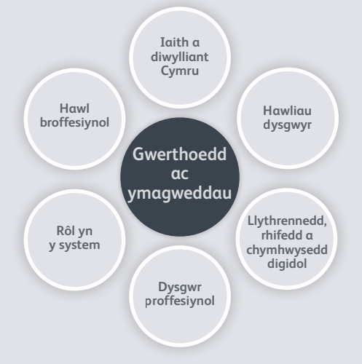
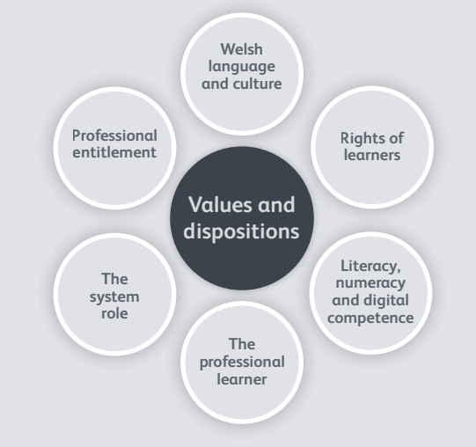
Safonau proffesiynol ar gyfer addysgu ac arweinyddiaeth |
Professional standards for teaching and leadership
Notes:
Focus of Slide - Professional standards for teaching and leadership
Context – This slide shows how children’s rights link to the professional standards for teaching and leadership which will be adopted by all serving teachers and leaders by September 2018 and will apply to student teachers on all ITE programmes by September 2019; and all school support staff by September 2019.
https://hwb.gov.wales/professional-development/professional-standards/
Central to the values and disposition of all professionals in education is the Rights of Learners.
This is further explained in the standards as:
The needs and rights of learners will be central and take priority in the teacher’s approach to their job. The teacher exhibits high expectations and commitment
to the achievement of each learner.
Within Sustained highly-effective formal leadership descriptor (p.80):
The rights and needs of learners are paramount in all the school does, ensuring every learner benefits from an entitlement to the best possible experience of
schooling in Wales.
-----------------------------------------------------------------------------
Ffocws y Sleid – Safonau proffesiynol ar gyfer addysgu ac arweinyddiaeth
Cyd-destun - Mae’r sleid hwn yn dangos y cysylltiad rhwng hawliau plant a’r safonau proffesiynol ar gyfer addysgu ac arweinyddiaeth, fydd yn cael eu mabwysiadu gan bob athro ac arweinydd gweithredol erbyn mis Medi 2018, ac a fydd yn berthnasol i ddarpar athrawon ar bob rhaglen ITE erbyn mis Medi 2019; a holl staff ategol ysgolion erbyn mis Medi 2019.
https://hwb.gov.wales/datblygiad-proffesiynol/safonau-proffesiynol/
Mae Hawliau Dysgwyr yn ganolog i werthoedd ac ymagwedd pob gweithiwr proffesiynol ym myd addysg.
Mae hyn yn cael ei esbonio ymhellach yn y safonau fel hyn:
Bydd anghenion a hawliau dysgwyr yn ganolog ac yn cael blaenoriaeth yn null athrawon o wneud eu gwaith. Bydd athrawon yn arddangos disgwyliadau uchel ac ymrwymiad i gyflawniad pob dysgwr..
Oddi mewn i’r Disgrifiad o arweinyddiaeth ffurfiol, hynod effeithiol a gynhelir (t.80):
Mae hawliau ac anghenion dysgwyr yn hollbwysig yn holl waith yr ysgol, gan sicrhau bod pob dysgwr yn elwa o fedru hawlio’r profiad gorau posibl o addysgu yng Nghymru.

Slide 16
I bob athro:
“Bydd anghenion a hawliau’r dysgwyr yn ganolog ac yn cael blaenoriaeth yn null athrawon o gyflawni eu gwaith. Bydd athrawon yn arddangos disgwyliadau uchel ac ymrwymiad i gyflawniad pob dysgwr.”
Ar lefel ysgol:
“Mae hawliau ac anghenion dysgwyr yn rhan hanfodol o holl waith yr ysgol, gan sicrhau bod pob dysgwr yn elwa o fedru hawlio’r profiad gorau posibl o addysgu yng Nghymru.”
https://hwb.gov.wales/datblygiad-proffesiynol/safonau-proffesiynol/
For each teacher:
“The needs and rights of learners will be central and take priority in the teacher’s approach to their job. The teacher exhibits high expectations and commitment to the achievement of each learner.”
At a school level:
“The rights and needs of learners are paramount in all the school does, ensuring every learner benefits from an entitlement to the best possible experience of schooling in Wales.”
https://hwb.gov.wales/professional-development/professional-standards/
Notes:
Focus of Slide – Values of the teacher
Context – This is further explained as forming the values of each teacher as:
“The needs and rights of learners will be central and take priority in the teacher’s approach to their job. The teacher exhibits high expectations and commitment
to the achievement of each learner.” (p.8)
The standards also describe how rights are paramount to school leadership and whole-school approaches, in the Sustained highly-effective formal leadership descriptor (p.80):
“The rights and needs of learners are paramount in all the school does, ensuring every learner benefits from an entitlement to the best possible experience of
schooling in Wales.”
---------------------------------------------------------------------------------------
Ffocws y Sleid – Gwerthoedd i bob athro
Cyd-destun - Mae’r esboniad pellach ar hyn yn nodi’r canlynol fel gwerthoedd i bob athro:
“Bydd anghenion a hawliau dysgwyr yn ganolog ac yn cael blaenoriaeth yn null athrawon o gyflawni eu gwaith. Bydd athrawon yn arddangos disgwyliadau uchel ac ymrwymiad i gyflawniad pob dysgwr.” (t. 8)
Mae’r safonau hefyd yn disgrifio sut mae hawliau’n rhan hanfodol o arweinyddiaeth ysgol a dull gweithredu ysgol gyfan, yn y Disgrifiwr arweinyddiaeth ffurfiol hynod effeithiol a gynhelir (t.80):
“Mae hawliau ac anghenion dysgwyr yn rhan hanfodol o holl waith yr ysgol, gan sicrhau bod pob dysgwr yn elwa o fedru hawlio’r profiad gorau posibl o addysgu yng Nghymru.”

Slide 17
Camu Ymlaen – Pam mae gyda ni Gomisiynydd Plant?
Stepping Out – Why do we have a Children’s Commissioner?
Notes:
This activity is a great way to understand the purpose of the role of Children’s Commissioner.
If you are in a lecture theatre you will need to think about running it from the front with some volunteers to draw out the learning.
Please see separate hand out for this activity and prepare materials in advance –
https://www.childcomwales.org.uk/wp-content/uploads/2018/06/Stepping-out_English1-1-1.docx
---------------------------------------------------------------------------------------------------------------------
Mae’r gweithgaredd yma’n ffordd wych o ddeall diben rôl y Comisiynydd Plant.
Os ydych chi mewn darlithfa bydd angen i chi feddwl am gynnal hyn o’r blaen, gyda rhai gwirfoddolwyr i ddangos y dysgu’n eglur.
Gweler y daflen ar wahân ar gyfer y gweithgaredd yma, a pharatowch ddeunyddiau ymlaen llaw –
https://www.childcomwales.org.uk/wp-content/uploads/2018/06/Camu-Ymlaen_Cymraeg-1.docx

Slide 18
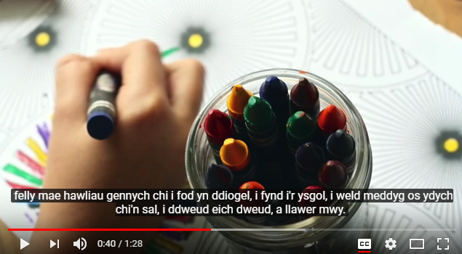
Fideo – Cyflwyniad i Sally a’i gwaith (yn wreiddiol i ysgolion)
Video – Introduction to Sally and her work (originally for schools)
Notes:
This video allows participants to see who Sally Holland is and explains her role as Children’s Commissioner.
https://www.youtube.com/watch?v=UNy9Xq5AILI&feature=youtu.be
Mae’r fideo yma’n gyfle i’r cyfranogwyr weld pwy yw Sally Holland, ac mae’n esbonio’i rôl fel Comisiynydd Plant.
https://www.youtube.com/watch?v=518ku6xDg2E

Slide 19
Yn 2001, Cymru oedd y wlad gyntaf yn y Deyrnas Unedig i greu rôl y Comisiynydd Plant.
Roedd Aelodau’r Cynulliad yn sylweddoli bod angen rhywun ar blant a phobl ifanc i godi llais ar eu rhan, a gwneud yn siŵr eu bod nhw’n cael gwrandawiad ac yn cael eu trin yn deg.
Mae cyfres o gyfreithiau yn cynnwys: Deddf Safonau Gofal 2000 a Deddf Comisiynydd Plant Cymru 2001, sy’n esbonio rôl a chyfrifoldebau’r Comisiynydd.
In 2001, Wales was the first country in the UK to create the role of the Children’s Commissioner.
Assembly ministers recognised that children and young people need someone to speak up for them and make sure that they are listened to and treated fairly.
There is a set of laws including:
the Care Standards Act 2000
and the Children’s Commissioner
for Wales Act 2001 which explains
the role and responsibilities of
the Commissioner.
Notes:
Following a number of abuse cases in N.Wales care homes during the 1970’s and 80’s an independent review culminated in the “Waterhouse Report”.
It was identified that children in care needed a National Voice to ensure they were listened to and supported to access their rights, the role of the Commissioner was created in 2001.
----------------------------------------------------------------------------------------------------------------------------------
Yn dilyn nifer o achosion o gam-drin mewn cartrefi gofal yng Ngogledd Cymru yn ystod y 1970au a’r 80au, cafwyd ‘Adroddiad Waterhouse’ yn ddiweddglo ar adolygiad annibynnol.
Nodwyd bod angen Llais Cenedlaethol ar blant mewn gofal i sicrhau eu bod yn cael gwrandawiad ac yn cael eu cefnogi i gael mynediad i’w hawliau, a chrewyd rôl y Comisiynydd yn 2001.

Slide 20
CEFNOGI plant a phobl ifanc i gael gwybod am hawliau plant
GWRANDO ar blant a phobl ifanc i ddarganfod beth sy’n bwysig iddyn nhw
CYNGHORI plant, pobl ifanc a’r rhai sy’n gofalu amdanyn nhw os ydyn nhw’n teimlo bod ganddyn nhw ddim lle arall i fynd am gefnogaeth
DYLANWADU ar y llywodraeth a chyrff eraill sy’n dweud eu bod nhw’n mynd i wneud gwahaniaeth i fywydau plant, gan wneud yn siŵr eu bod nhw’n cadw eu haddewidion i blant a phobl ifanc
CODI LLAIS dros blant a phobl ifanc yn genedlaethol ar faterion pwysig - bod yn bencampwr i blant Cymru
PUM SWYDDOGAETH EIN SWYDDFA
FIVE FUNCTIONS OF OUR OFFICE
SUPPORT children and young people to find out about children’s rights
LISTEN TO children and young people to find out what is important to them
ADVISE children, young people and those who care for them if they feel that they have nowhere else to go with their problems
INFLUENCE government and other organisations who say that they are going to make a difference to children’s lives, making sure that they keep their promises to children and young people
SPEAK UP for children and young people nationally on important issues – being the children's champion in Wales
Notes:
She SUPPORTS and LISTENS through her participation team who work with groups of children and young people across Wales to teach them about their rights and listen to them to find out what they want the Commissioner to change.
She ADVISES through her Investigation and Advice team.
She INFLUENCES through her policy team to affect government change
She SPEAKS up at all levels to be a voice for children in Wales.
--------------------------------------------------------------------------------------------------------
Mae hi’n CEFNOGI ac yn GWRANDO trwy ei thîm cyfranogiad sy’n gweithio gyda phlant a phobl ifanc ledled Cymru i’w dysgu am eu hawliau ac yn gwrando arnyn nhw er mwyn cael gwybod beth maen nhw eisiau i’r Comisiynydd ei newid.
Mae hi’n CYNGHORI trwy’r tîm Ymchwiliadau a Chyngor.
Mae hi’n DYLANWADU trwy ei thîm polisi i ddylanwadu ar newid yn y llywodraeth
Mae hi’n CODI LLAIS ar bob lefel er mwyn bod yn llais i blant Cymru.

Slide 21
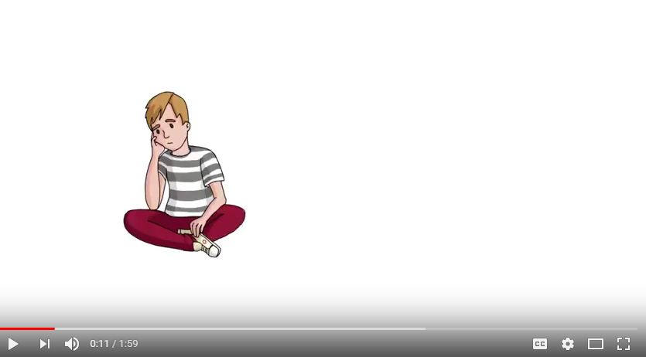
Fideo - Gwasanaeth Ymchwiliadau a Chyngor
Video – Investigations and Advice service
Notes:
Sally’s Investigations and Advice team are there for children and young people and adults who care about them and this video will tell you a little bit more about this service.
--------------------------------------------------------------------------------
Mae tîm Ymchwiliadau a Chyngor Sally yno ar gyfer plant a phobl ifanc a’r oedolion sy’n gofalu amdanyn nhw, a bydd y fideo yma’n sôn rhagor wrthych chi am y gwasanaeth yma.

Slide 22
DIWEDD SESIWN 1
Erbyn hyn dylai fod gan y cyfranogwyr ddealltwriaeth o’r canlynol:
CCUHP
Rôl CPC
Yn y sesiwn nesaf byddwn ni’n edrych ar hawliau ar waith.
END OF SESSION 1
Participants should now have an understanding of:
UNCRC
Role of CCfW
In the next session we will explore rights in practice.
Notes:
This first session has covered an introduction to the UNCRC and the role of the CCfW in the next session we will look at her documents The Right Way or The Right Way to Education to explore how we can put rights into reality in our daily lives. Meanwhile, if you want more information please visit the website www.childcomwales.org.uk
-----------------------------------------------------------------------------------------------------------
Mae’r sesiwn gyntaf hon wedi rhoi cyflwyniad i CCUHP a rôl CPC. Yn y sesiwn nesaf byddwn ni’n edrych ar ei dogfennau Y Ffordd Gywir neu’r Ffordd Gywir i Addysg, er mwyn archwilio sut gallwn ni wireddu hawliau yn ein bywydau pob dydd. Yn y cyfamser, i gael rhagor o wybodaeth ewch i’r wefan www.complantcymru.org.uk

Slide 23
SESIWN 2 | SESSION 2

Slide 24
Crynhoi’r ddarlith/Sesiwn ddiwethaf
Cyflwynwyd Confensiwn y Cenhedloedd Unedig ar Hawliau’r Plentyn (CCUHP)
Amlinellwyd rôl Comisiynydd Plant Cymru
Nodau’r Sesiwn hon
Archwilio a thrafod Y Ffordd Gywir i Addysg
Recap of the last lecture/Session
Introduced the United Nations Convention on the Rights of the Child (UNCRC)
Outlined the role of the Children’s Commissioner for Wales
Aims of this Session
Explore and discuss The Right Way to Education
Notes:
Focus of Slide – Recap Session 1 and Aims
Context In recapping the last session you can ask some questions – How many rights are there in the UNCRC? What articles do you remember? What is the name of the CCfW?
Then go on to explain this session is about understanding, exploring and discussing What a Rights based approach is and how they as professionals can support this in their future work.
-----------------------------------------------------------------------------------------------------
Ffocws y Sleid – Crynhoi Sesiwn 1 a’r Nodau
Cyd-destun – wrth grynhoi’r sesiwn ddiwethaf gallwch chi ofyn rhai cwestiynau – Faint o hawliau sydd yn CCUHP? Pa erthyglau rydych chi’n eu cofio? Beth yw enw CPC?
Yna ewch ymlaen i esbonio bod y sesiwn hon yn ymwneud â deall, archwiio a thrafod beth yw dull gweithredu seiliedig ar Hawliau a sut gallan nhw, fel gweithwyr proffesiynol, gefnogi hynny yn eu gwaith yn y dyfodol.

Slide 25
Beth yw Dull Gweithredu Seiliedig ar Hawliau Plant?
Fframwaith egwyddorol ac ymarferol ar gyfer gweithio gyda phlant yw Dull Gweithredu Seiliedig ar Hawliau Plant, sydd â’i wraidd yng Nghonfensiwn y Cenhedloedd Unedig ar Hawliau’r Plentyn
Mae Dull Gweithredu Seiliedig ar Hawliau Plant yn ymwneud â gosod y CCUHP wrth wraidd cynllunio a darparu gwasanaeth, ac integreiddio hawliau plant ym mhob agwedd ar wneud penderfyniadau, polisïau ac ymarfer
What is a Children’s Rights Approach?
A Children’s Rights Approach is a principled and practical framework for working with children grounded in the UN Convention on the Rights of the Child
A Children’s Rights Approach is about placing the UNCRC at the Core of planning and service delivery and integrating children’s rights into every aspect of decision making , policy and practice
Notes:
Focus of Slide - What is a Childrens Rights Approach
Context The aim of the Rights Way to Education is to help professionals in education embed a Children’s Rights Approach in a practical and meaningful way.
-----------------------------------------------------------------------------------------------------
Ffocws y Sleid – Beth yw Dull Gweithredu seiliedig ar Hawliau Plant
Cyd-destun Nod y Ffordd Gywir i Addysg yw helpu gweithwyr proffesiynol ym myd addysg i wreiddio Dull Gweithredu seiliedig ar Hawliau Plant mewn ffordd ymarferol ac ystyrlon.

Slide 26
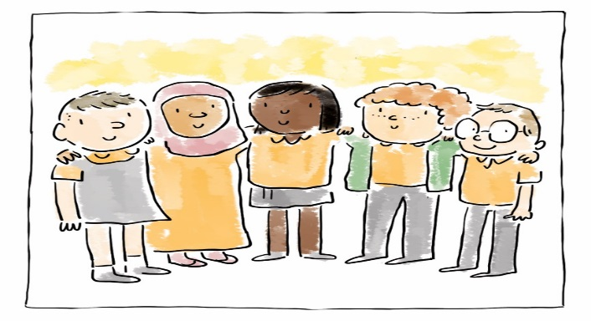
Ymgorffori CCUHP
Cydraddoldeb a pheidio â chamwahaniaethu
Grymuso plant
Cyfranogiad
Atebolrwydd
Embedding the UNCRC
Equality and non-discrimination
Empowering Children
Participation
Accountability
Notes:
Focus of Slide – Five principles
Context These five principles support the work that schools are doing to make it meaningful by placing the UNCRC at the core of a child’s experience of education and at the core of school planning, teaching, decision-making, policies and practice rights become a reality for children and young people.
The next few slides will explain these in a little more detail, we will then go onto look at some case studies.
--------------------------------------------------------------------------------
Ffocws y Sleid – Pum egwyddor
Cyd-destun Mae’r pum egwyddor hon yn cefnogi’r gwaith mae ysgolion yn ei wneud i sicrhau ei fod yn ystyrlon trwy wneud CCUHP yn greiddiol i brofiad plentyn o addysg a hefyd i gynllunio, addysgu, gwneud penderfyniadau, polisi ac ymarfer mewn ysgolion, fel bod hawliau’n cael eu gwireddu i blant a phobl ifanc.
Bydd y sleidiau nesaf yn esbonio’r rhain yn fwy manwl, wedyn byddwn yn edrych ar astudiaethau achos.

Slide 27
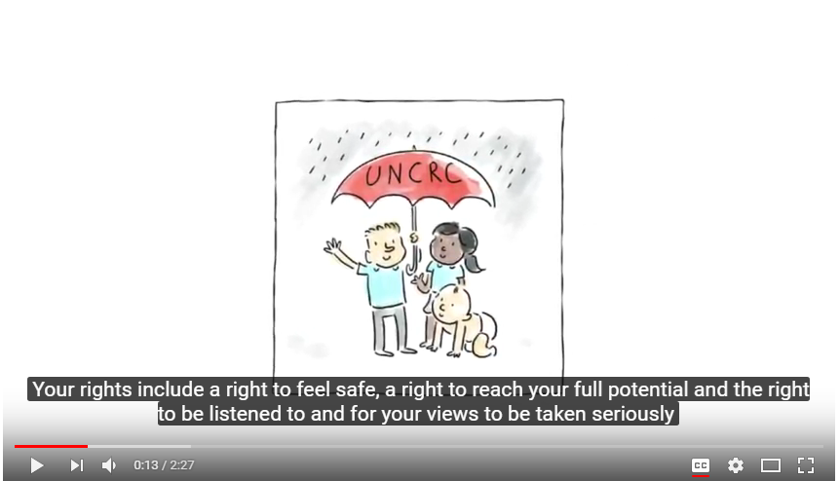
Notes:
Focus of Slide – Video on Right Way
Context ENGLISH VIDEO - This video is designed to share with pupils to explain what a Rights Based approach means
Activity – video

Slide 28
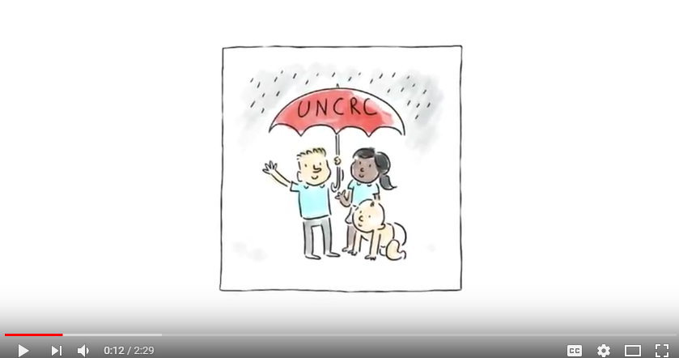
Notes:
Ffocws y Sleid – Fideo ar y Ffordd Gywir
Cyd-destun FIDEO SAESNEG a luniwyd i’w rannu gyda disgyblion er mwyn esbonio beth mae dull gweithredu seiliedig ar hawliau yn ei olygu
Gweithgaredd - fideo

Slide 29
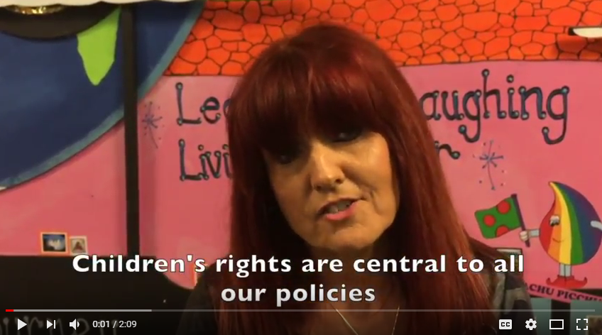
Notes:
Focus of Slide – Video example
Context Here is an example of rights in practice in a primary school setting – this is from Hafod Primary School in Swansea which has embedded rights into practice and here staff and pupils explain how important this is to them.
Activity – Video
-------------------------------------------------------------------------------------------------
Ffocws y Sleid – Enghraifft o fideo
Cyd-destun Dyma enghraifft o hawliau ar waith mewn cyd-destun ysgol gynradd – sef Ysgol Gynradd yr Hafod yn Abertawe sydd wedi ymgorffori hawliau yn eu hymarfer, ac yma mae’r staff a’r disgyblion yn esbonio pa mor bwysig yw hynny iddyn nhw.
Gweithgaredd - Fideo

Slide 30
Y Ffordd Gywir arolwg addysg o 2018 a 2019
2018: 391 athrawon
6392 plant a pobl ifanc
108 ysgolion
2019: 360 athrawon
7404 plant a pobl ifanc
98 ysgolion
The Right Way Education Survey
2018 and 2019
2018: 391 teachers
6392 children and young people
108 schools
2019: 360 teachers
7404 children and young people
98 schools
Notes:
Why do we need a children’s right approach?
Let’s look at what children and young people tell us about their education. In 2018 and 2019 the Children’s Commissioner for Wales surveyed children, young people and professionals across Wales. You can see the numbers taking part in this survey on this slide.
Pam bod angen dull hawliau plant?
Dyma beth mae plant wedi dweud am eu haddysg. Yn 2018 a 2019 wnaethon ni cwestiynnu plant, pobl ifanc ac oedolion trwy holiadur. Mae’r sleid yma yn dangos faint wnaeth ateb yr holiadur.

Slide 31
Holiadur Y Ffordd Gywir i Addysg
Canfyddiadau allweddol o ddata 2018
Athrawon
76% eisiau mwy o hyfforddiant am hawliau plant
19% dywedodd bod holl bolisiau’r ysgol yn cysylltu a hawliau plant
27% peidiwch a chysylltu unrhyw gynllunio cwricwlwm a hawliau
The Right Way Education Survey
Key findings from 2018 data
Teachers
76% want more training about children’s rights
19% said all school policies link to children’s rights
27% don’t link any curriculum planning to rights
Notes:
This shows us key findings from the survey from teachers
Discussion point: To what extent do these findings surprise you? How do they relate to your own experience?
Mae’r sleid yma yn dangos y brif ganfyddiadau o’r holiadur athrawon
Trafodwch: I ba raddau ydy’r canfyddiadau yn eich synnu? Ydyn nhw’n debyg i’ch profiadau chi?

Slide 32
Holiadur Y Ffordd Gywir i Addysg
Canfyddiadau allweddol o ddata 2018
Cyfnod Sylfaen/Plant CA2
77% wedi clywed am hawliau plant
72% yn meddwl bod ganddyn nhw gyfle i gymryd rhan mewn penderfyniadau
73% yn meddwl bod croeso i bob plentyn yn eu hysgol
Plant CA3/CA4
67% wedi clywed am hawliau plant
42% yn meddwl bod ganddyn nhw gyfle i gymryd rhan mewn penderfyniadau
46% yn meddwl bod croeso i bob plentyn yn eu hysgol
The Right Way Education Survey
Key findings from 2018 data
Foundation Phase/KS2 Children
77% had heard of children’s rights
72% think they have a chance to take part in decisions
73% think all children feel welcome in their school
KS3/KS4 children
67% had heard of children’s rights
42% think they have a chance to take part in decisions
46% think all young people feel welcome in their school
Notes:
This shows us key findings from the survey from children and young people
Discussion point: To what extent do these findings surprise you? How do they relate to your own experience?

Slide 33
Cwricwlwm i Gymru 2022
Dyfodol Llwyddiannus yn dweud bod cefnogaeth yng Nghymru i hawliau plant wedi effeithio ar egwyddorion y cwricwlwm.
Mae cynnwys hawliau dynol yn gryf ym maes dysgu a phrofiad Dyniaethau, sy’n ei gwneud yn ofynnol i bob plentyn i ddatblygu dealltwriaeth o hawliau plant a’r Confensiwn.
Maes dysgu a phrofiad Iechyd a Lles yn ei gwneud yn ofynnol i bob plentyn ddatblygu dealltwriaeth o hawliau eu hunain, a’r sgil i weld eu perthnasoedd personol trwy y ddealltwriaeth honno ac i amddiffyn hawliau eraill.
Curriculum for Wales 2022
Successful Futures states that support in Wales for the UNCRC informed the principles of curriculum design.
Human rights content is strong in the Humanities AoLE – which requires all children to develop an understanding of the UNCRC and the human rights of all people.
The Health and Wellbeing AoLE requires all children to develop an understanding of their own rights and the skill to apply this knowledge to their own relationships and to stand up for the rights of others.
Notes:
So HOW do you embed children’s rights into your practice? We’ll look at how you can do this in the CLASSROOM, across the WHOLE SCHOOL, and OUT THE SCHOOL GATE.
First, we’ll look at in the classroom. The good news is that there’s lots of opportunities in the new curriculum to support learning about rights. In fact, young people are required to learn about rights in the Humanities and the Health and Wellbeing AoLEs. Children and young people are also required to develop the skills and understanding to stand up for their own rights and the rights of others.
So that’s really cool.
Felly sut ydych chi’n cynnwys hawliau plant yn y ffordd rydych chi’n gweithio? Byddwn ni’n edrych ar sut i wneud hyn yn yr ystafell ddosbarth, yr ysgol gyfan, a thu fas i’r ysgol.
Dechreuwn gyda’r ystafell ddosbarth. Mae sawl cyfle trwy’r cwricwlwm newydd i helpu plant i ddysgu am eu hawliau, ac mae’n rhaid i blant dysgu am hawliau yn y Meysydd Dysgu a Phrofiad Dyniaethau ac Iechyd a Lles. Mae disgwyl i blant a phobl ifanc hefyd i ddatblygu y sgiliau a’r dealltwriaeth i amddiffyn hawliau eu hunain ac hawliau eraill.
Mae hynny’n wych!

Slide 34
Cwricwlwm i Gymru 2022
Gweithgaredd: Defnyddio’r poster hawliau a phoster y pedwar diben i ystyried pa hawliau sy’n berthnasol i bob diben y cwricwlwm newydd
Dysgwyr uchelgeisiol, galluog
Cyfranwyr mentrus a chreadigol
Uniogolion iach a hyderus
dinasyddion moesegol.
Pob grwp I fapio un pwrpas yn erbyn hawliau plant perthnasol.
Curriculum for Wales 2022
Activity: using the rights poster and the Four Purposes poster consider how rights are realised through the four purposes of the new curriculum.
ambitious, capable learners
enterprising, creative contributors
healthy, confident individuals
ethical, informed citizens
Each group to map one purpose against relevant children’s rights.
Notes:
Activity: explore how to embed this in your approach to the curriculum.
Gweithgaredd: trafodwch sut i ddefnyddio’r dull hwn yn y ffordd rydych chi’n mynd ati i ddysgu trwy’r cwricwlwm newydd.
Use the 4 Purposes Poster: https://gov.wales/sites/default/files/publications/2018-03/the-four-purposes-of-the-curriculum-for-wales.pdf
Defnyddiwch y poster pedwar diben: https://llyw.cymru/sites/default/files/publications/2018-03/pedwar-diben-y-cwricwlwm-i-gymru.pdf
Use the Children’s Rights Poster: https://www.childcomwales.org.uk/wp-content/uploads/2017/01/6331-CCfW-A2-Rights-Poster-AW-1.pdf
Defnyddiwch y poster hawliau plant - https://www.childcomwales.org.uk/wp-content/uploads/2017/01/CCfW-A2-Rights-Poster-CYM.pdf

Slide 35
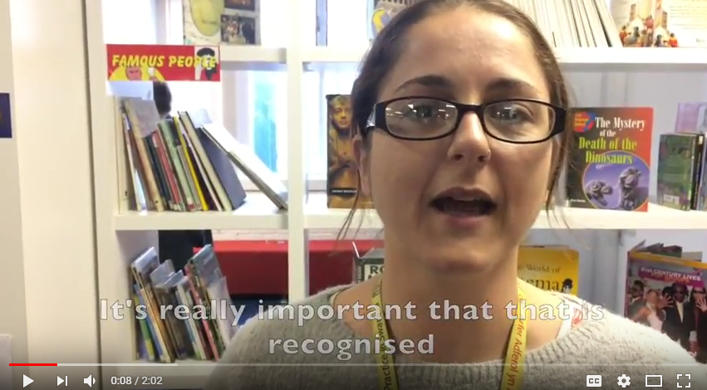
Notes:
Now we’ll look at how you can go beyond the doors of the classroom to develop a whole school approach to children’s rights.
Focus of Slide – Video example in secondary setting
Context - Here is a short video from a Secondary School in Swansea – Pentrehafod Comprehensive where you will hear from pupils about and staff why they have embedded the Right Way approach to education.
Activity – video
----------------------------------------------------------------
Ffocws y Sleid – Enghraifft o fideo mewn lleoliad uwchradd
Cyd-destun – Dyma fideo fer o Ysgol Uwchradd yn Abertawe – Ysgol Gyfun Pentrehafod, lle byddwch chi’n clywed gan ddisgyblion a staff pam maen nhw wedi ymgorffori dull gweithredu’r Ffordd Gywir i addysg.
Gweithgaredd - fideo

Slide 36
Y Ffordd Gywir – Dull Gweithredu seiliedig ar Hawliau Plant i Addysg yng Nghymru
The Right Way – A Children’s Rights Approach to Education in Wales
Notes:
Focus of Slide – Case studies
Context- This will allow participants an opportunity to see practical examples of the Right Way and consider how they as Duty Bearers can support children and young people to access their rights
Activity - Split into groups and supply each group with case studies around one of the principles and ask them to consider how they can use these examples to influence their practice using a Menu for Change.
Case studies - https://www.childcomwales.org.uk/wp-content/uploads/2018/06/TRW-education-case-studies-bilingual-1.docx
Menu for change - https://www.childcomwales.org.uk/wp-content/uploads/2018/06/Menu-Education_headed-1.docx
---------------------------------------------------------------------------------
Ffocws y Sleid – Astudiaethau achos
Cyd-destun – Bydd hyn yn rhoi cyfle i’r cyfranogwyr weld enghreifftiau ymarferol o’r Ffordd Gywir ac ystyried sut gallan nhw, fel Deiliaid Dyletswydd, gefnogi plant a phobl ifanc i gael mynediad i’w hawliau
Gweithgaredd – Rhannu’n grwpiau a rhoi astudiaethau achos i bob grŵp sy’n ymwneud ag un o’r egwyddorion a gofynnwch iddyn nhw ystyried sut gallan nhw ddefnyddio’r enghreifftiau hyn i ddylanwadu ar eu hymarfer trwy ddefnyddio Dewislen ar gyfer Newid.
Astudiaethau Achos - https://www.childcomwales.org.uk/wp-content/uploads/2018/06/TRW-education-case-studies-bilingual-1.docx
Dewislen ar gyfer Newid - https://www.childcomwales.org.uk/wp-content/uploads/2018/06/Dewislen-Addysg_headed.docx

Slide 37
Astudiaethau achos
GWEITHGAREDD: Gan ddefnyddio sampl o astudiaethau achos o’r Ffordd Gywir i Addysg ac Awgrymiadau Gwych, gwnewch gynlluniau i Wireddu Hawliau. Ffurfiwch grwpiau i edrych ar astudiaethau achos sy’n ymwneud ag un o’r egwyddorion ac ystyriwch sut gallwch chi ddefnyddio’r enghreifftiau hyn i ddylanwadu ar eich ymarfer eich hun.
Case studies
ACTIVITY: Using a sample of case studies from the Right Way to Education and Top Tips, make plans to Make Rights a Reality. Split into groups to look at case studies around one of the principles and consider how you can use these examples to influence your own practice.
Notes:
Now we’ll look at how you can go beyond the doors of the classroom to develop a whole school approach to children’s rights.
Nawr byddwn ni’n edrych ar sut gallwch chi datblygu dull hawliau plant sy’n effeithio yr ysgol gyfan

Slide 38
Mae cynlluniau Llysgenhadon Comisiynydd Plant Cymru yn annog disgyblion i hyrwyddo hawliau plant yn eu hysgolion neu eu Grwpiau Cymunedol.
Mae plant a phobl ifanc yn arwain ar hyrwyddo Confensiwn y Cenhedloedd Unedig ar Hawliau’r Plentyn (CCUHP) a rôl y Comisiynydd Plant.
The Children’s Commissioner for Wales’ Ambassador schemes are initiatives that empower pupils to become children’s rights champions within their schools or Community Groups.
Children and young people -take a lead role in promoting the United Nations Convention on the Rights of the Child (UNCRC) and the role of the Children’s Commissioner.
Notes:
And how do you make a difference outside the school gate? One way is to get involved with the Children’s Commissioner’s national Ambassadors scheme, which empowers children and young people to make a difference on a national level.
Focus of Slide – Purpose of Ambassador schemes
Context – this outlines the role of the free school schemes that the Children’s Commissioners office supports to find out more please visit their website and go to ‘Our Schemes’
------------------------------------------------------------------
A sut mae gwneud gwahaniaeth tu fas i’r ysgol? Un ffordd yw i ddod yn rhan o gynlluniau cenedlaethol y Comisiynydd Plant, ei chynlluniau Llysgenhadon, sy’n annog ac ysbrydoli plant a phobl ifanc i wneud gwahaniaeth ar lefel cenedlaethol.
Ffocws y Sleid Diben cynlluniau Llysgenhadon
Cyd-destun – mae hyn yn amlinellu rôl y cynlluniau ysgol di-dâl y mae swyddfa’r Comisiynydd Plant yn eu cefnogi. I gael rhagor o wybodaeth, ewch i’w gwefan ac i’r dudalen ‘Ein Cynlluniau’

Slide 39
Notes:
Focus of Slide – Purpose of Ambassador schemes
Context – this outlines the role of the free school schemes that the Children’s Commissioners office supports to find out more please visit their website and go to ‘Our Schemes’
------------------------------------------------------------------
Ffocws y Sleid Diben cynlluniau Llysgenhadon
Cyd-destun – mae hyn yn amlinellu rôl y cynlluniau ysgol di-dâl y mae swyddfa’r Comisiynydd Plant yn eu cefnogi. I gael rhagor o wybodaeth, ewch i’w gwefan ac i’r dudalen ‘Ein Cynlluniau’

Slide 40
Recap on Aims
Session one- gained knowledge and understanding of UNCRC and role of CCfW
Session two – considered the Right Way to Education, the five principles and reflected on how you as professionals can ensure children and young people access the UNCRC
Crynhoi’r Amcanion
Sesiwn un – datblygu gwybodaeth a dealltwriaeth o CCUHP a rôl CPC
Sesiwn dau – ystyried y Ffordd Gywir i Addysg, y pum egwyddor, a meddwl am sut gallwch chi, fel gweithwyr proffesiynol, sicrhau bod plant a phobl ifanc yn cael mynediad i CCUHP
Notes:
Focus of Slide - Recap and revisit Aims
Context – By the end of these two sessions we hope that participants have gained an understanding of UNCRC and the role of the Children’s Commissioner for Wales. Participants should be aware of their duty to support the UNCRC and have had an opportunity to reflect on how they would make this a reality in practice.
---------------------------------------------------------------------------------
Ffocws y Sleid – Crynhoi ac adolygu’r Nodau
Cyd-destun – Erbyn diwedd y ddwy sesiwn hon rydyn ni’n gobeithio bydd y cyfranogwyr wedi dod i ddeall CCUHP a rôl Comisiynydd Plant Cymru. Dylai’r cyfranogwyr fod yn ymwybodol o’u dyletswydd i gefnogi CCUHP, a byddant wedi cael cyfle i fyfyrio ar sut bydden nhw’n gwireddu hynny’n ymarferol.

Slide 41
Manylion Cyswllt | Contact Details
Trydar | Twitter @complantcymru | @childcomwales
Instagram @childcomwales
Awr Hawliau |Rights Hour Dydd Gwener |Friday 12- 1
Ffôn | Phone 01792 765600
Ebost | Email post@childcomwales.org.uk | post@complantcymru.org.uk
Facebook https://www.facebook.com/childcomwales/
Gwefan | Website www.childcomwales.org.uk| www.complantcymru.org.uk

