Slide 1





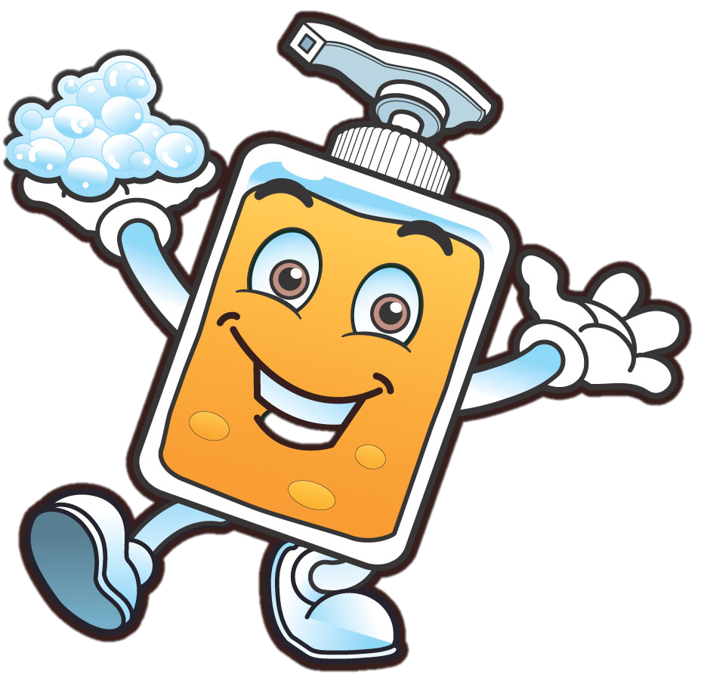
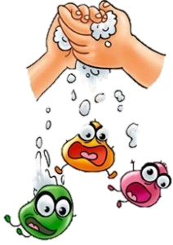
CORONA VIRUS is a friend of the flu who brings things like a fever, cough and cold.
But most people get better and we can find a way to destroy this virus if we work together!
If we follow these simple steps
Washing your hands with water and soap whilst singing along to your favourite song eg Happy Birthday
Using hand sanitiser after being outside or touching surfaces and leaving it to dry on your hands
The virus won’t visit and will go away!
Saiba Ahuja

