Slide 1

Y Ffordd Gywir: Dull Gweithredu seiliedig ar Hawliau Plant i Addysg yng Nghymru
The Right Way: A Children’s Rights Approach for Education in Wales
Comisiynydd Plant Cymru
Children’s Commissioner for Wales
Notes:
Focus of Slide - Introduction
Context - A Children’s Rights based approach is a framework for working with children, grounded in the UNCRC. These slides will tell you a little bit more about The Right Way to Education and we will do some activities and share some videos to explore how this links to your practice.
-----------------------------------------------------------------------------------------------------
Ffocws y Sleid – Cyflwyniad
Cyd-destun – Mae dull gweithredu seiliedig ar Hawliau Plant yn fframwaith ar gyfer gweithio gyda phlant. Mae wedi ei seilio yn CCUHP. Bydd y sleidiau yma’n dweud rhagor wrthych chi am Y Ffordd Gywir i Addysg, a byddwn ni’n gwneud rhai gweithgareddau ac yn rhannu rhai fideos er mwyn edrych ar y cysylltiad rhwng hyn a’ch ymarfer.

Slide 2
Crynhoi’r ddarlith/Sesiwn ddiwethaf
Cyflwynwyd Confensiwn y Cenhedloedd Unedig ar Hawliau’r Plentyn (CCUHP)
Amlinellwyd rôl Comisiynydd Plant Cymru
Nodau’r Sesiwn hon
Archwilio a thrafod Y Ffordd Gywir i Addysg
Recap of the last lecture/Session
Introduced the United Nations Convention on the Rights of the Child (UNCRC)
Outlined the role of the Children’s Commissioner for Wales
Aims of this Session
Explore and discuss The Right Way to Education
Notes:
Focus of Slide – Recap Session 1 and Aims
Context In recapping the last session you can ask some questions – How many rights are there in the UNCRC? What articles do you remember? What is the name of the CCfW?
Then go on to explain this session is about understanding, exploring and discussing What a Rights based approach is and how they as professionals can support this in their future work.
-----------------------------------------------------------------------------------------------------
Ffocws y Sleid – Crynhoi Sesiwn 1 a’r Nodau
Cyd-destun – wrth grynhoi’r sesiwn ddiwethaf gallwch chi ofyn rhai cwestiynau – Faint o hawliau sydd yn CCUHP? Pa erthyglau rydych chi’n eu cofio? Beth yw enw CPC?
Yna ewch ymlaen i esbonio bod y sesiwn hon yn ymwneud â deall, archwiio a thrafod beth yw dull gweithredu seiliedig ar Hawliau a sut gallan nhw, fel gweithwyr proffesiynol, gefnogi hynny yn eu gwaith yn y dyfodol.

Slide 3
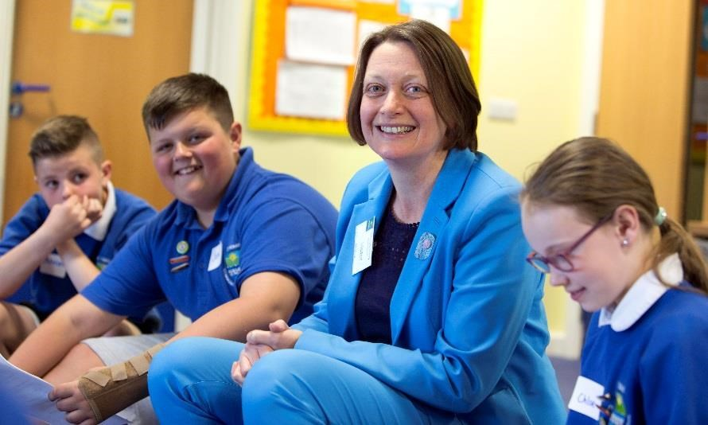
Pam Dull Gweithredu Seiliedig ar Hawliau Plant?
Eisiau gweld Cymru lle mae pob un plentyn a pherson ifanc â chyfle cyfartal i gyrraedd ei botensial llawn………..
Why a Children’s Rights Approach?
Aspires to a Wales where all children and young people have an equal chance to be the best that they can be………..
Sally Holland
Comisiynydd Plant Cymru
Children’s Commissioner for Wales
Notes:
Focus of Slide – Why a Childrens Rights Approach
Context Before going on to look at the Five principles of a Children’s Rights approach this is Sally Holland wants to embed a rights based approach
-----------------------------------------------------------------------------------------------------
Ffocws y Sleid – Pam dull gweithredu seiliedig ar Hawliau Plant
Cyd-destun Cyn mynd ymlaen i edrych ar 5 egwyddor dull gweithredu seiliedig ar Hawliau Plant, dyma Sally Holland, sydd eisiau gwreiddio dull gweithredu seiliedig ar hawliau

Slide 4
Beth yw Dull Gweithredu Seiliedig ar Hawliau Plant?
Fframwaith egwyddorol ac ymarferol ar gyfer gweithio gyda phlant yw Dull Gweithredu Seiliedig ar Hawliau Plant, sydd â’i wraidd yng Nghonfensiwn y Cenhedloedd Unedig ar Hawliau’r Plentyn
Mae Dull Gweithredu Seiliedig ar Hawliau Plant yn ymwneud â gosod y CCUHP wrth wraidd cynllunio a darparu gwasanaeth, ac integreiddio hawliau plant ym mhob agwedd ar wneud penderfyniadau, polisïau ac ymarfer
What is a Children’s Rights Approach?
A Children’s Rights Approach is a principled and practical framework for working with children grounded in the UN Convention on the Rights of the Child
A Children’s Rights Approach is about placing the UNCRC at the Core of planning and service delivery , and integrating children’s rights into every aspect of decision making , policy and practice
Notes:
Focus of Slide - What is a Childrens Rights Approach
Context The aim of the Rights Way to Education is to help professionals in education embed a Children’s Rights Approach in a practical and meaningful way.
-----------------------------------------------------------------------------------------------------
Ffocws y Sleid – Beth yw Dull Gweithredu seiliedig ar Hawliau Plant
Cyd-destun Nod y Ffordd Gywir i Addysg yw helpu gweithwyr proffesiynol ym myd addysg i wreiddio Dull Gweithredu seiliedig ar Hawliau Plant mewn ffordd ymarferol ac ystyrlon.

Slide 5
Gweithgaredd: Trafodaeth
Mae pob grŵp bach yn cymryd cerdyn o’r pecyn o gardiau symbolau – gan ddefnyddio erthyglau 7, 12, 14, 15, 19, 24, 27, 28, 29, 29, 31, 36, 42.
Trafodaeth: Beth mae ysgolion yn ei wneud i wireddu’r hawl hon i blant a phobl ifanc?
Activity: Discussion
Each small group takes a card from the symbols card pack – using articles 7, 12, 14, 15, 19, 24, 27,28,29, 29, 31, 36, 42.
Discuss: What do schools do to make this right a reality for children and young people?
Notes:
Focus of Slide – Activity
Context Before going onto look at the five principles of the Right Way we will do a practical activity to explore how rights link to school life.
Activity - Ask participants to work in small groups and hand out a symbols card – these can be downloaded here - https://www.childcomwales.org.uk/uncrc-childrens-rights/uncrc-symbols-resource/
-----------------------------------------------------------------------------------------------------
Ffocws y Sleid – Gweithgaredd
Cyd-destun Cyn mynd ymlaen i edrych ar 5 egwyddor y Ffordd Gywir, byddwn ni’n gwneud gweithgaredd ymarferol i archwilio’r cysylltiad rhwng hawliau a bywyd ysgol.
Gweithgaredd – Gofynnwch gyfranogwyr i weithio mewn grwpiau bach a darparwch gerdyn symbolau – gall y rhain cael eu lawr lwytho yma - https://www.complantcymru.org.uk/ccuhp-hawliau-plant/adnodd-symbolau-ccuhp/

Slide 6
Arfer Adferol | Restorative Practice
Articles | Erthyglau 12/36/17
Gwrthfwlio | Anti Bullying
Article | Erthygl 19
Y Cyfnod Sylfaen | Foundation Phase
Article | Erthyglau 28/29/31
Llais y disgybl | Pupil voice
Article | Erthygl 12 – Right to be heard / Hawl i gael eu clywed
ADCDF| ESDGC
Article | Erthygl 2
CCUHP
UNCRC
Gweithgareddau Allgyrsiol | Extra Curricular Activities
Article | Erthygl 15
Ysgolion Iach/Eco
|Healthy/Eco Schools
Article | Erthygl 24 –
Ethos yr Ysgol | School Ethos
Articles | Erthyglau 28 / 29
Notes:
Focus of Slide – How UNCRC links to education
Context -This was created by teachers to show that schools already do lots of work linked to rights. In fact, everything schools do can be underpinned by the rights of the child. It’s not an add-on, it underpins what schools are already doing – and it can be very powerful if teachers and pupils can make the link and understand that the work they do is helping them experience their rights.
-----------------------------------------------------------------------------------------------------
Ffocws y Sleid – Beth yw’r cysylltiad rhwng CCUHP ac addysg
Cyd-destun - Cafodd hyn ei greu gan athrawon, ac mae’n dangos bod ysgolion eisoes yn gwneud llawer o waith sy’n gysylltiedig â hawliau. Yn wir, gall popeth mae ysgolion yn ei wneud gael ei seilio ar hawliau’r plentyn. Nid rhyw atodiad yw hynny, mae’n sylfaen ar gyfer y gwaith mae ysgolion eisoes yn ei wneud – a gall fod yn rymus iawn os gall athrawon a disgyblion greu’r cysylltiad a deall bod y gwaith maen nhw’n ei wneud yn eu helpu i gael profiad o’u hawliau.

Slide 7
Pedwar Diben y Cwricwlwm newydd. Creu:
ddysgwyr uchelgeisiol, galluog sy’n barod i ddysgu drwy gydol eu hoes
cyfranwyr mentrus, creadigol sy’n barod i chwarae eu rhan yn llawn yn eu bywyd a’u gwaith
dinasyddion egwyddorol, gwybodus yng Nghymru a’r byd
unigolion iach, hyderus sy’n barod i fyw bywyd gan wireddu eu dyheadau fel aelodau gwerthfawr o gymdeithas.
The Four Purposes of the new Curriculum. Creating:
ambitious, capable learners, ready to learn throughout their lives
enterprising, creative contributors, ready to play a full part in life and work
ethical, informed citizens of Wales and the world , ready to be citizens of Wales and the world
healthy, confident individuals, ready to lead fulfilling lives as valued members of society
Notes:
Focus of Slide - Four Purposes of the Curriculum for Wales
Context - Just as the last slide showed that the work done in a school was underpinned by the United Nations Rights of the Child, so to, the developing curriculum for Wales is also underpinned by rights. Professor Donaldson cites the United Nations Convention on the Rights of the Child (UNCRC) in the discussion of the principles of curriculum design in Successful Futures.
Invite participants to consider how the rights they have been discussing and exploring also underpin the four purposes of the new curriculum.
ambitious, capable learners
enterprising, creative contributors
healthy, confident individuals
ethical, informed citizens
----------------------------------------------------------------------
Ffocws y Sleid - Pedwar Diben y cwricwlwm i Gymru
Cyd-destun - Yn union fel y dangosodd y sleid diwethaf fod y gwaith sy’n cael ei wneud mewn ysgol yn cael ei seilio ar Hawliau’r Plentyn yn ôl y Cenhedloedd Unedig, ac mae’r cwricwlwm sy’n cael ei ddatblygu i Gymru hefyd yn cael ei seilio ar hawliau. Mae’r Athro Donaldson yn cyfeirio at Gonfensiwn y Cenhedloedd Unedig ar Hawliau’r Plentyn (CCUHP) wrth drafod egwyddorion dylunio’r cwricwlwm Dyfodol Llwyddiannus.
Gwahoddwch y cyfranogwyr i ystyried sut mae’r hawliau maen nhw wedi bod yn eu trafod a’u harchwilio hefyd yn sylfaen ar gyfer pedwar diben y cwricwlwm newydd.
dysgwyr uchelgeisiol, galluog
cyfranwyr mentrus, creadigol
unigolion iach, hyderus
dinasyddion egwyddorol, gwybodus

Slide 8
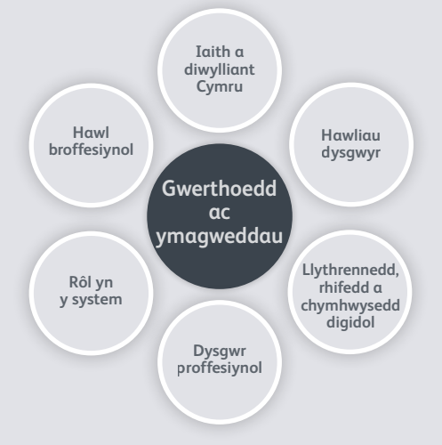
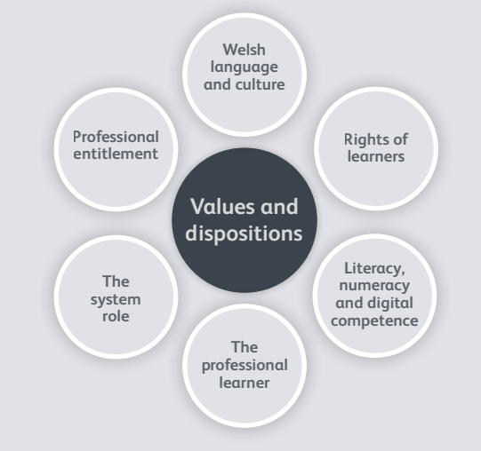
Safonau proffesiynol ar gyfer addysgu ac arweinyddiaeth |
Professional standards for teaching and leadership
Notes:
Focus of Slide - Professional standards for teaching and leadership
Context – This slide shows how children’s rights link to the professional standards for teaching and leadership which will be adopted by all serving teachers and leaders by September 2018 and will apply to student teachers on all ITE programmes by September 2019; and all school support staff by September 2019.
http://learning.gov.wales/docs/learningwales/publications/170901-professional-standards-for-teaching-and-leadership-en.pdf
Central to the values and disposition of all professionals in education is the Rights of Learners.
This is further explained in the standards as:
The needs and rights of learners will be central and take priority in the teacher’s approach to their job. The teacher exhibits high expectations and commitment
to the achievement of each learner.
Within Sustained highly-effective formal leadership descriptor (p.80):
The rights and needs of learners are paramount in all the school does, ensuring every learner benefits from an entitlement to the best possible experience of
schooling in Wales.
-----------------------------------------------------------------------------
Ffocws y Sleid – Safonau proffesiynol ar gyfer addysgu ac arweinyddiaeth
Cyd-destun - Mae’r sleid hwn yn dangos y cysylltiad rhwng hawliau plant a’r safonau proffesiynol ar gyfer addysgu ac arweinyddiaeth, fydd yn cael eu mabwysiadu gan bob athro ac arweinydd gweithredol erbyn mis Medi 2018, ac a fydd yn berthnasol i ddarpar athrawon ar bob rhaglen ITE erbyn mis Medi 2019; a holl staff ategol ysgolion erbyn mis Medi 2019.
http://learning.gov.wales/docs/learningwales/publications/180521-professional-standards-pdf-cy.pdf
Mae Hawliau Dysgwyr yn ganolog i werthoedd ac ymagwedd pob gweithiwr proffesiynol ym myd addysg.
Mae hyn yn cael ei esbonio ymhellach yn y safonau fel hyn:
Bydd anghenion a hawliau dysgwyr yn ganolog ac yn cael blaenoriaeth yn null athrawon o wneud eu gwaith. Bydd athrawon yn arddangos disgwyliadau uchel ac ymrwymiad i gyflawniad pob dysgwr..
Oddi mewn i’r Disgrifiad o arweinyddiaeth ffurfiol, hynod effeithiol a gynhelir (t.80):
Mae hawliau ac anghenion dysgwyr yn hollbwysig yn holl waith yr ysgol, gan sicrhau bod pob dysgwr yn elwa o fedru hawlio’r profiad gorau posibl o addysgu yng Nghymru.

Slide 9
Yn achos pob athro:
“Bydd anghenion a hawliau’r dysgwyr yn ganolog ac yn cael blaenoriaeth yn null athrawon o gyflawni eu gwaith. Bydd athrawon yn arddangos disgwyliadau uchel ac ymrwymiad i gyflawniad pob dysgwr.”
Ar lefel ysgol:
“Mae hawliau ac anghenion dysgwyr yn rhan hanfodol o holl waith yr ysgol, gan sicrhau bod pob dysgwr yn elwa o fedru hawlio’r profiad gorau posibl o addysgu yng Nghymru.”
http://learning.gov.wales/docs/learningwales/publications/170901-professional-standards-for-teaching-and-leadership-en.pdf
For each teacher:
“The needs and rights of learners will be central and take priority in the teacher’s approach to their job. The teacher exhibits high expectations and commitment to the achievement of each learner.”
At a school level:
“The rights and needs of learners are paramount in all the school does, ensuring every learner benefits from an entitlement to the best possible experience of schooling in Wales.”
http://learning.gov.wales/docs/learningwales/publications/170901-professional-standards-for-teaching-and-leadership-en.pdf
Notes:
Focus of Slide – Values of the teacher
Context – This is further explained as forming the values of each teacher as:
“The needs and rights of learners will be central and take priority in the teacher’s approach to their job. The teacher exhibits high expectations and commitment
to the achievement of each learner.” (p.8)
The standards also describe how rights are paramount to school leadership and whole-school approaches, in the Sustained highly-effective formal leadership descriptor (p.80):
“The rights and needs of learners are paramount in all the school does, ensuring every learner benefits from an entitlement to the best possible experience of
schooling in Wales.”
---------------------------------------------------------------------------------------
Ffocws y Sleid – Gwerthoedd i bob athro
Cyd-destun - Mae’r esboniad pellach ar hyn yn nodi’r canlynol fel gwerthoedd i bob athro:
“Bydd anghenion a hawliau dysgwyr yn ganolog ac yn cael blaenoriaeth yn null athrawon o gyflawni eu gwaith. Bydd athrawon yn arddangos disgwyliadau uchel ac ymrwymiad i gyflawniad pob dysgwr.” (t. 8)
Mae’r safonau hefyd yn disgrifio sut mae hawliau’n rhan hanfodol o arweinyddiaeth ysgol a dull gweithredu ysgol gyfan, yn y Disgrifiwr arweinyddiaeth ffurfiol hynod effeithiol a gynhelir (t.80):
“Mae hawliau ac anghenion dysgwyr yn rhan hanfodol o holl waith yr ysgol, gan sicrhau bod pob dysgwr yn elwa o fedru hawlio’r profiad gorau posibl o addysgu yng Nghymru.”

Slide 10
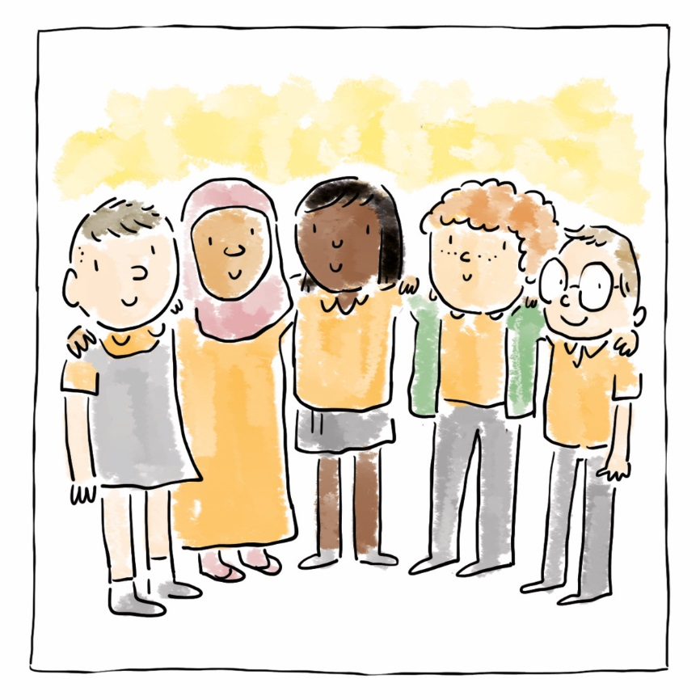
Ymgorffori CCUHP
Cydraddoldeb a pheidio â chamwahaniaethu
Grymuso plant
Cyfranogiad
Atebolrwydd
Embedding the UNCRC
Equality and non-discrimination
Empowering Children
Participation
Accountability
Notes:
Focus of Slide – Five principles
Context These five principles support the work that schools are doing to make it meaningful by placing the UNCRC at the core of a child’s experience of education and at the core of school planning, teaching, decision-making, policies and practice rights become a reality for children and young people.
The next few slides will explain these in a little more detail, we will then go onto look at some case studies.
--------------------------------------------------------------------------------
Ffocws y Sleid – Pum egwyddor
Cyd-destun Mae’r pum egwyddor hon yn cefnogi’r gwaith mae ysgolion yn ei wneud i sicrhau ei fod yn ystyrlon trwy wneud CCUHP yn greiddiol i brofiad plentyn o addysg a hefyd i gynllunio, addysgu, gwneud penderfyniadau, polisi ac ymarfer mewn ysgolion, fel bod hawliau’n cael eu gwireddu i blant a phobl ifanc.
Bydd y sleidiau nesaf yn esbonio’r rhain yn fwy manwl, wedyn byddwn yn edrych ar astudiaethau achos.

Slide 11
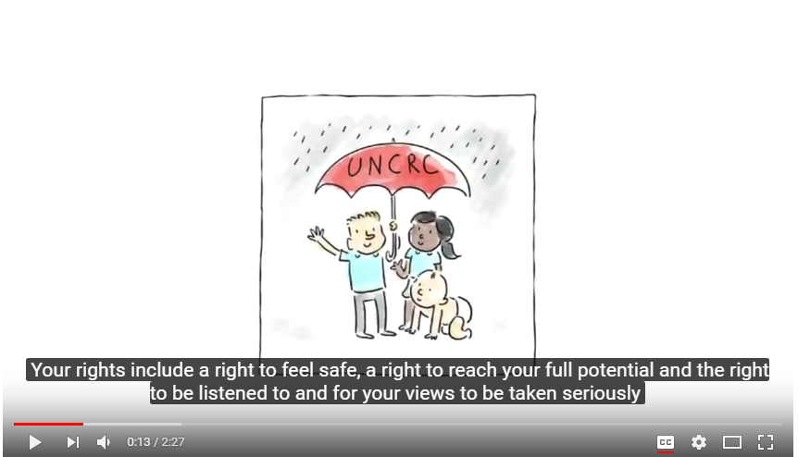
Notes:
Focus of Slide – Video on Right Way
Context ENGLISH VIDEO - This video is designed to share with pupils to explain what a Rights Based approach means
Activity – video
-----------------------------------------------------------------------------
Ffocws y Sleid – Fideo ar y Ffordd Gywir
Cyd-destun FIDEO SAESNEG a luniwyd i’w rannu gyda disgyblion er mwyn esbonio beth mae dull gweithredu seiliedig ar hawliau yn ei olygu
Gweithgaredd - fideo

Slide 12
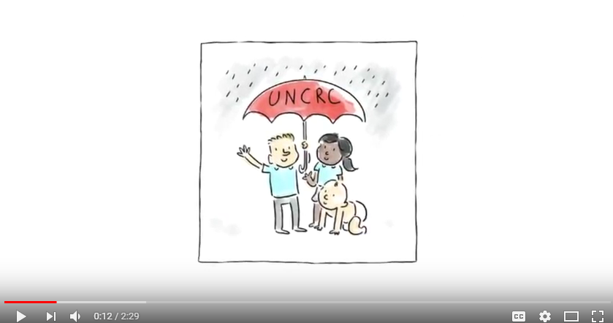
Notes:
WELSH VIDEO - Show video
FIDEO CYMRAEG

Slide 13
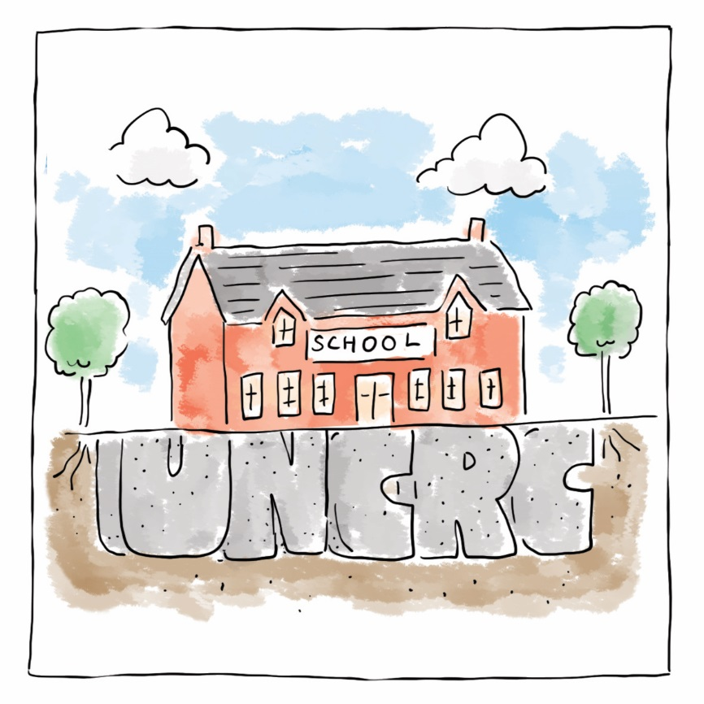

Ymgorffori'r Confensiwn (CCUHP)
| Embedding the UNCRC
Notes:
Focus of Slide – Embedding the UNCRC
Context The First Principle Embedding the UNCRC means Children’s Rights should be at the core of whole school planning and delivery. This requires that all staff in the school, including associate and support staff understand the UNCRC as a framework for the work of the school.
----------------------------------------------------------------------------------------------------
Ffocws y Sleid – Ymgorffori CCUHP
Cyd-destun Ystyr yr Egwyddor Gyntaf sy’n ymgorffori CCUHP yw y dylai Hawliau Plant fod yn greiddiol i gynllunio a chyflawni ysgol gyfan. Mae hyn yn gofyn bod holl staff yr ysgol, gan gynnwys staff cyswllt a chymorth, yn deall CCUHP fel fframwaith ar gyfer gwaith yr ysgol.

Slide 14
“Every single member of staff needs to understand that these are the principles that guide you”
Deputy Head, Primary School
“Mae angen i bob aelod o staff ddeall mai dyma’r egwyddorion sy’n eich tywys”
Dirprwy Bennaeth, Ysgol Gynradd
Notes:
Focus of Slide - quote
Context Here is an example of a quote
---------------------------------------------------------------------
Ffocws y Sleid – dyfyniad
Cyd-destun Dyma enghraifft o ddyfyniad

Slide 15
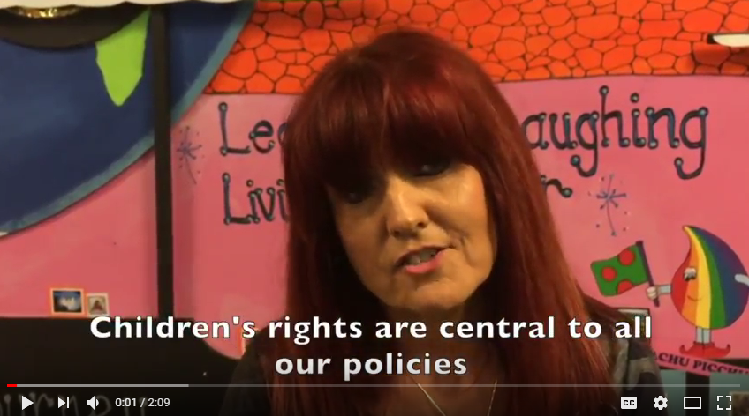
Notes:
Focus of Slide – Video example
Context Here is an example of rights in practice in a primary school setting – this is from Hafod Primary School in Swansea which has embedded rights into practice and here staff and pupils explain how important this is to them.
Activity – Video
-------------------------------------------------------------------------------------------------
Ffocws y Sleid – Enghraifft o fideo
Cyd-destun Dyma enghraifft o hawliau ar waith mewn cyd-destun ysgol gynradd – sef Ysgol Gynradd yr Hafod yn Abertawe sydd wedi ymgorffori hawliau yn eu hymarfer, ac yma mae’r staff a’r disgyblion yn esbonio pa mor bwysig yw hynny iddyn nhw.
Gweithgaredd - Fideo

Slide 16
Cydraddoldeb a Pheidio â Chamwahaniaethu
| Equality and Non-Discrimination
Notes:
Focus of Slide – Equality and Non-Discrimination
Context The Second principle – Equality and Non- Discrimination – is about ensuring that every child has an equal opportunity to make the most of their talents and develop to their fullest potential, and that no child has to endure poor life chances because of discrimination.
-------------------------------------------------------------------
Ffocws y Sleid – Cydraddoldeb a Pheidio â Chamwahaniaethu
Cyd-destun Ystyr yr ail egwyddor – Cydraddoldeb a Pheidio â Chamwahaniaethu – yw sicrhau bod pob plentyn yn cael cyfle cyfartal i fanteisio’n llawn ar eu doniau a datblygu hyd eithaf eu potensial, ac nad oes rhaid i unrhyw blentyn oddef cyfleoedd gwael mewn bywyd oherwydd camwahaniaethu.

Slide 17

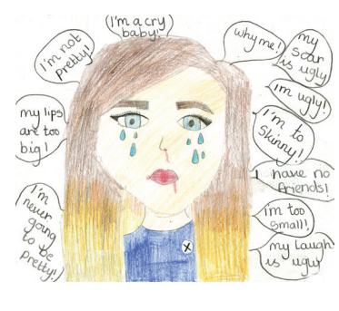

Notes:
Focus of Slide – Childrens Commissioner’s work to address Bullying
Context Some examples of work that the Children’s Commissioner’s office has done directly on this issue:
Many children feel discriminated against, and bullying was identified the most important issue for Children and Young people when Sally Holland started her post. The Commissioner’s office asked over 2000 children across Wales about their experiences of bullying in 2017, and found that difference was seen as one of the main reasons a child is bullied. It looked at how schools and national Government can improve the experiences of children across Wales . Lesson plans around this issue can be found on our website under Our Schemes – Primary/Secondary – Useful Resources
--------------------------------------------------------------------------------------------
Ffocws y Sleid – Gwaith y Comisiynydd Plant i ymdrin â Bwlio
Cyd-destun Rhai enghreifftiau o waith y mae swyddfa’r Comisiynydd Plant wedi’i wneud yn uniongyrchol ar y mater hwn:
Mae llawer o blant yn teimlo eu bod yn dioddef camwahaniaethu, a nodwyd bwlio fel y mater pwysicaf i Blant a Phobl Ifanc pan gychwynnodd Sally Holland yn ei swydd, Gofynnodd swyddfa’r Comisiynydd i fwy na 2000 o blant ledled Cymru am eu profiadau o fwlio yn 2017, a darganfod ei bod hi’n ymddangos mai gwahaniaeth oedd un o’r prif resymau dros fwlio plentyn. Edrychodd ar sut gall ysgolion a’r Llywodraeth genedlaethol wella profiadau plant ledled Cymru. Mae cynlluniau gwersi sy’n ymwneud â’r mater hwn ar gael ar ein gwefan o dan Ein Cynlluniau – Cynradd/Uwchradd – Adnoddau defnyddiol

Slide 18

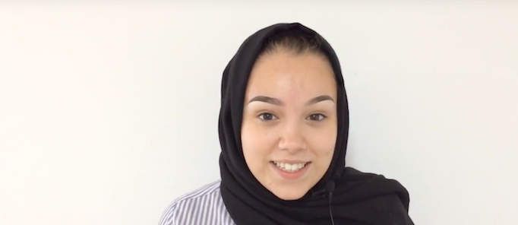
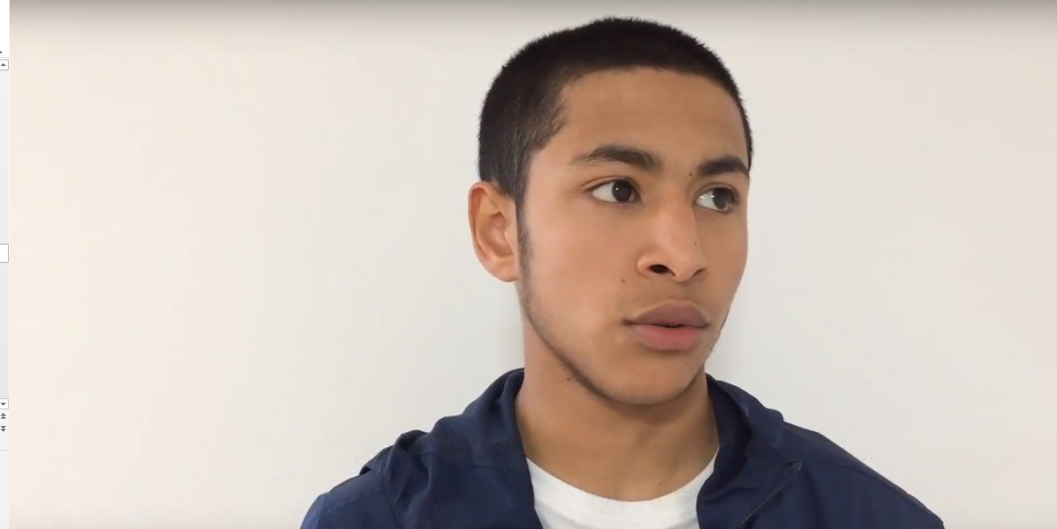
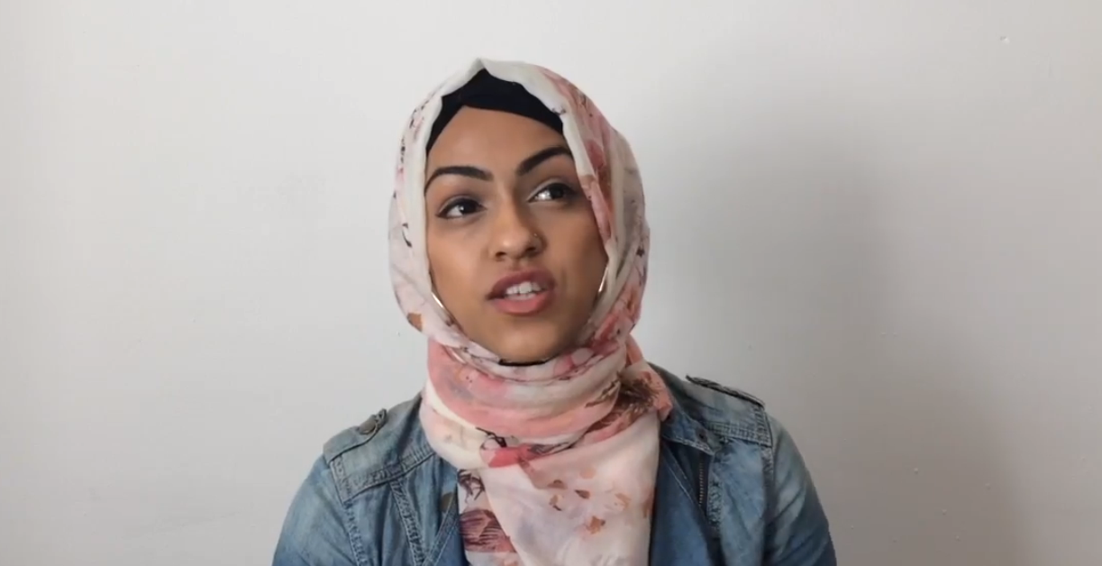
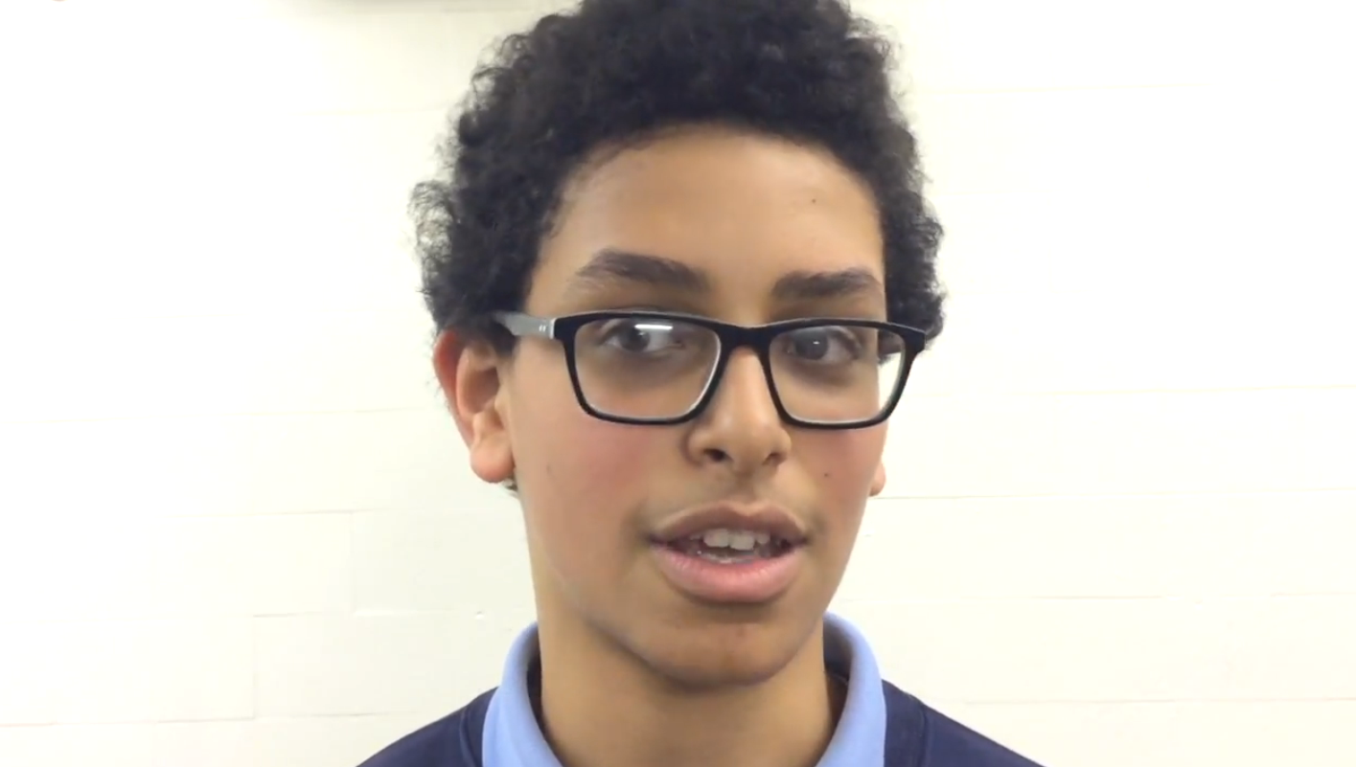
Islamophobia Resource
Notes:
Focus of Slide – Islamophobia resources
Context The Commissioner’s office has also produced a resource that specifically looks at Islamophobia. Concerns were raised with the Commissioner by young people and professionals about the safety of Muslim pupils in school and their communities; concerns backed up by recent studies that show a rise in Islamophobic hate crime. This resource provides lesson plans for Secondary aged pupils using video as a stimulus for debate and exploration of stereotypes and the impact of discrimination on young peoples lives in Wales today. Find them on our website by going to Our Work – Resources
----------------------------------------------------------------------
Ffocws y Sleid – adnoddau Islamoffobia
Cyd-destun Mae swyddfa’r Comisiynydd hefyd wedi cynhyrchu adnodd sy’n edrych yn benodol ar Islamoffobia. Bu pobl ifanc a gweithwyr proffesiynol yn codi pryderon gyda’r Comisiynydd ynghylch diogelwch disgyblion Mwslimaidd yn yr ysgol ac yn eu cymunedau; pryderon a ategwyd gan astudiaethau diweddar sy’n dangos cynnydd mewn troseddau atgasedd Islamoffobig. Mae’r adnodd hwn yn darparu cynlluniau gwersi ar gyfer disgyblion Uwchradd gan ddefnyddio fideo’n sbardun ar gyfer trafod ac archwilio stereoteipiau ac effaith camwahaniaethu ar fywydau pobl ifanc yng Nghymru heddiw. Mae’r rhain i’w gweld ar ein gwefan trwy fynd i Ein Gwaith - Adnoddau

Slide 19
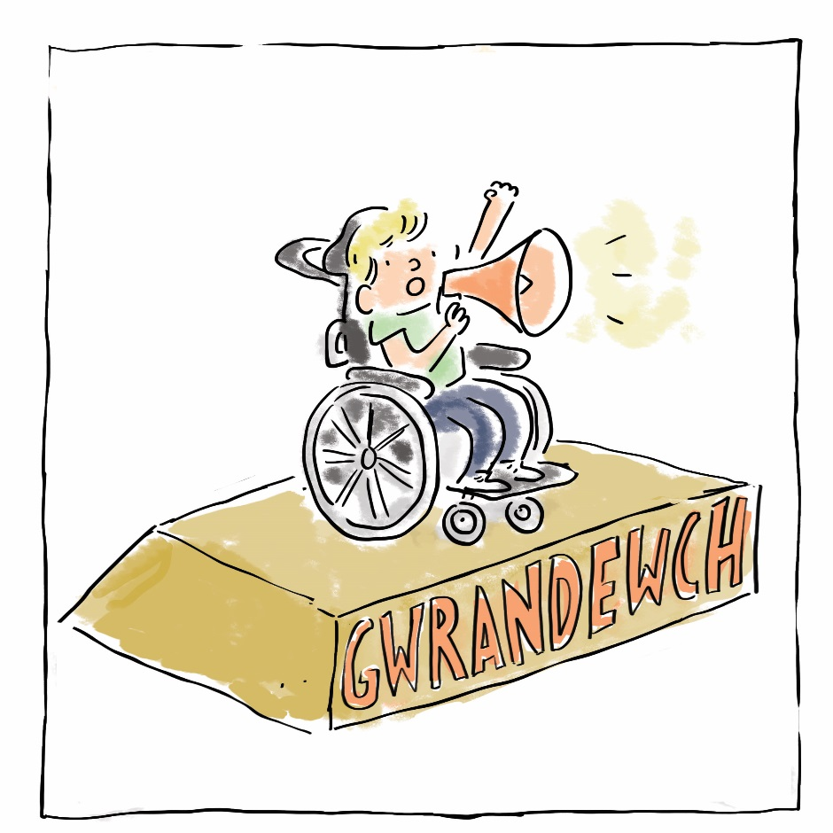
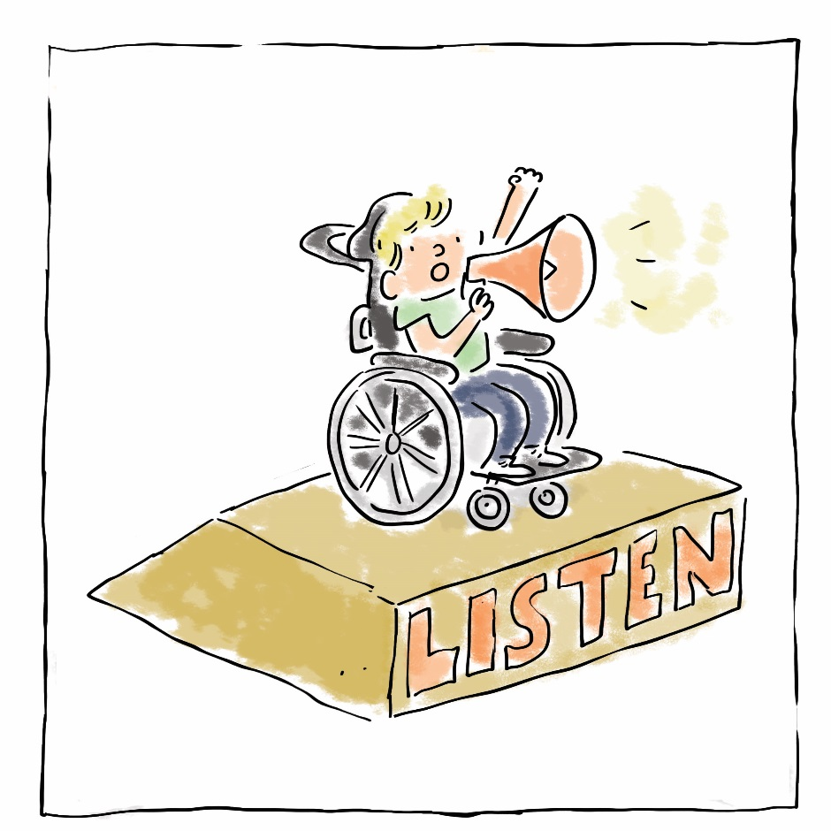
Bywydau Llawn: Mynediad Cyfartal
Adroddiad dilynol ar hygyrchedd i ddefnyddwyr cadair olwyn mewn ysgolion yng Nghymru
Full Lives: Equal Access
A follow up report on wheelchair accessibility in schools in Wales
Notes:
Focus of Slide – Accessibility in schools
Context This report published in March 2018 is a follow up report on wheelchair accessibility in schools in Wales and explores how authorities, Government, and schools can make sure that the voices of young disabled people and their families are included in accessibility planning. Find this report by going to the Publications section of our website.
-------------------------------------------------------------------------------
Ffocws y Sleid – Hygyrchedd mewn ysgolion
Cyd-destun Mae’r adroddiad hwn, a gyhoeddwyd ym mis Mawrth 2018, yn adroddiad dilynol ar hygyrchedd ysgolion yng Nghymru i ddefnyddwyr cadeiriau olwyn ac yn edrych ar sut mae awdurdodau, y Llywodraeth, ac ysgolion yn gallu gwneud yn siŵr bod lleisiau pobl ifanc anabl a’u teuluoedd yn cael eu cynnwys wrth gynllunio hygyrchedd. Gallwch ddod o hyd i’r adroddiad hwn trwy fynd i adran Cyhoeddiadau ein gwefan.

Slide 20
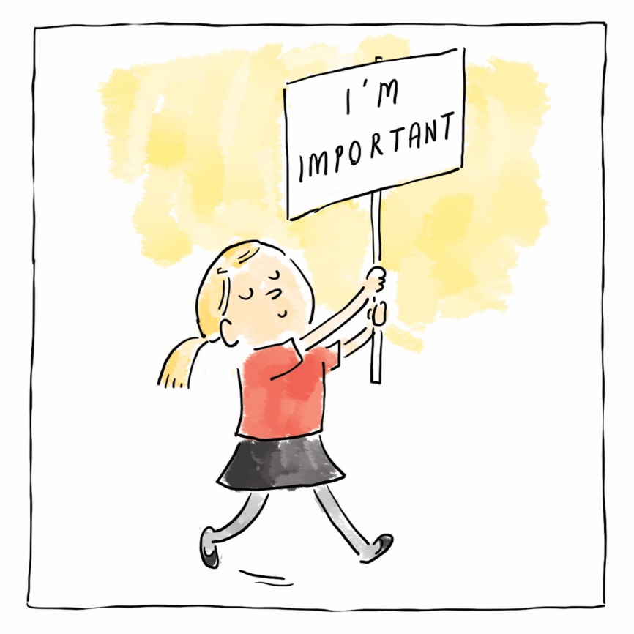
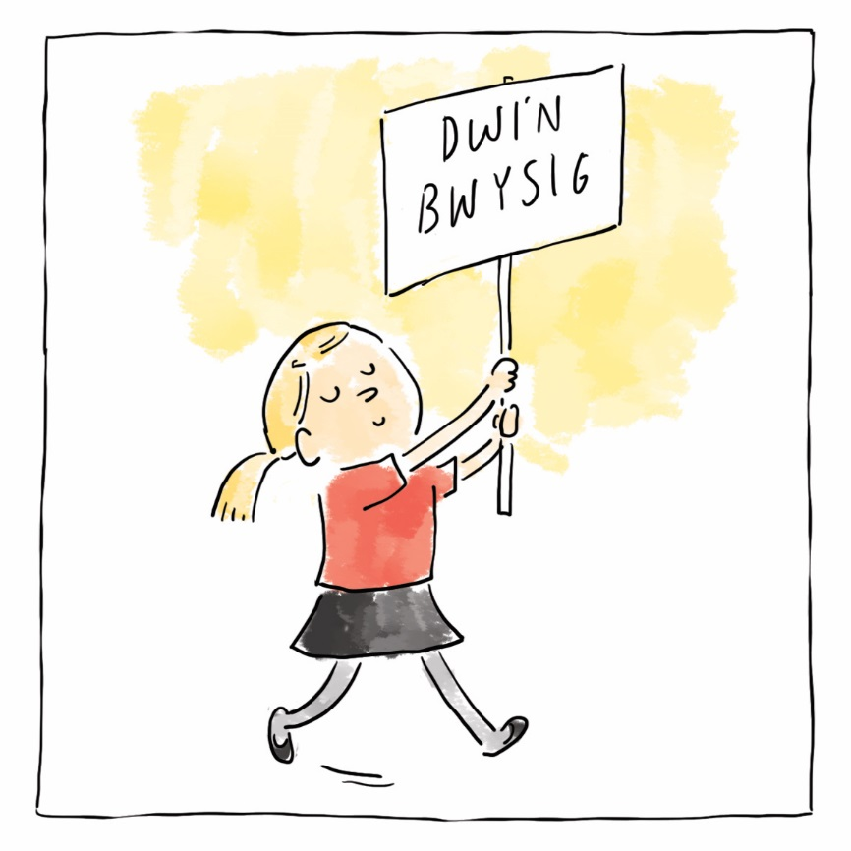
Grymuso Plant | Empowering Children
Notes:
Focus of Slide – Empowering Children
Context - The Third principle – Empowering Children and young people means enhancing their capabilities as individuals so they are better able to take advantage of their rights, and to engage with, influence and hold accountable the people and organisations that affect their lives.
------------------------------------------------------------------------
Ffocws y Sleid – Grymuso Plant
Cyd-destun – Mae’r drydedd egwyddor – Grymuso Plant a Phobl Ifanc yn golygu gwella’u galluoedd fel unigolion fel eu bod mewn sefyllfa well i fedru manteisio ar eu hawliau, ac ymgysylltu â’r bobl a’r sefydliadau sy’n effeithio ar eu bywydau, dylanwadu arnynt a’u galw i gyfrif.

Slide 21

www.agenda.cymru| www.agenda.wales
Notes:
Focus of Slide – Agenda resource
Context The Office for the Children’s Commissioner has co-produced this resource to explore relationships that empowers children and young people to create environments that support healthy relationships, and gender equality in their schools.
------------------------------------------------------------------------------------
Ffocws y Sleid Adnodd Agenda
Cyd-destun Mae Swyddfa’r Comisiynydd Plant wedi cynhyrchu’r adnodd hwn ar y cyd er mwyn archwilio perthnasoedd sy’n grymuso plant a phobl ifanc i greu amgylcheddau sy’n cynnal perthnasoedd iach a chydraddoldeb rhywedd yn eu hysgolion.

Slide 22
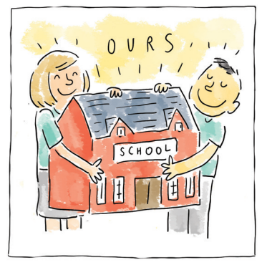
Cyfranogiad | Participation
Notes:
Focus of Slide - Participation
Context - The fourth principle is Participation – this means listening to children and young people and taking their views meaningfully into account. All children and young people should be supported to freely express their opinion; they should be both heard and listened to.
-------------------------------------------------------------------------------
Ffocws y Sleid – Cyfranogiad
Cyd-destun – Y pedwerydd egwyddor yw Cyfranogiad – ystyr hynny yw gwrando ar blant a phobl ifanc a chymryd eu barn i ystyriaeth mewn ffordd ystyrlon. Dylai pob plentyn a pherson ifanc gael eu cefnogi i fynegi eu barn yn rhydd; dylen nhw gael eu clywed a chael gwrandawiad.

Slide 23




Article 19
I have the right to be protected from all forms of violence, abuse, neglect and bad treatment by the people who look after me.
Llysgenhadon Cymunedol
Community Ambassadors
Notes:
Focus of Slide – Ambassador schemes
Context The Children’s Commissioner has three schemes that support young people to become participate and get their voices heard.
The school schemes are for ALL schools in Wales and offer a free scheme for teachers and pupils to embed a rights based approach.
The Community Ambassador scheme is targeted at special interest groups across Wales mostly in youth settings.
-----------------------------------------------------------------------------------
Ffocws y Sleid – Cynlluniau Llysgenhadon
Cyd-destun Mae gan y Comisiynydd Plant dri chynllun sy’n cefnogi pobl ifanc i gyfranogi a dweud eu dweud.
Mae’r cynlluniau ysgol ar gyfer HOLL ysgolion Cymru ac yn cynnig cynllun di-dâl er mwyn i athrawon a disgyblion ymgorffori dull gweithredu seiliedig ar hawliau.
Mae’r cynllun Llysgenhadon Cymunedol yn targedu grwpiau diddordeb arbennig ledled Cymru,yn bennaf mewn lleoliadau ieuenctid.

Slide 24
Mae cynlluniau Llysgenhadon Comisiynydd Plant Cymru yn fentrau sy’n grymuso disgyblion i ddod yn hyrwyddwyr hawliau plant yn eu hysgolion neu eu Grwpiau Cymunedol.
Mae plant a phobl ifanc yn cymryd yr awenau o ran hyrwyddo Confensiwn y Cenhedloedd Unedig ar Hawliau’r Plentyn (CCUHP) a rôl y Comisiynydd Plant.
The Children’s Commissioner for Wales’ Ambassador schemes are initiatives that empower pupils to become children’s rights champions within their schools or Community Groups.
Children and young people -take a lead role in promoting the United Nations Convention on the Rights of the Child (UNCRC) and the role of the Children’s Commissioner.
Notes:
Focus of Slide – Purpose of Ambassador schemes
Context – this outlines the role of the free school schemes that the Children’s Commissioners office supports to find out more please visit their website and go to ‘Our Schemes’
------------------------------------------------------------------
Ffocws y Sleid Diben cynlluniau Llysgenhadon
Cyd-destun – mae hyn yn amlinellu rôl y cynlluniau ysgol di-dâl y mae swyddfa’r Comisiynydd Plant yn eu cefnogi. I gael rhagor o wybodaeth, ewch i’w gwefan ac i’r dudalen ‘Ein Cynlluniau’

Slide 25
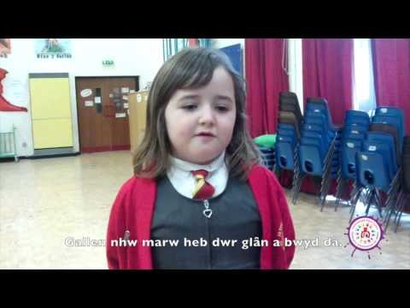
Notes:
Focus of Slide –Why learning about Rights is important
Context This short clip outlines why it is important to learn about Children’s Rights
Activity – video
--------------------------------------------------------------
Ffocws y Sleid – Pam mae dysgu am Hawliau yn bwysig
Cyd-destun Mae’r clip byr hwn yn amlinellu pam mae’n bwysig dysgu am Hawliau Plant
Gweithgaredd - fideo

Slide 26
“I can talk to adults and explain…what my rights are and what I want to change.”
Year 6 Pupil
“Galla i siarad ag oedolion ac esbonio... beth yw ein hawliau a beth hoffen ni newid.”
Disgybl Blwyddyn 6
Notes:
Focus of Slide – Quotes
Context Empowering means ensuring not only that children are aware of their rights but that the access their rights!
----------------------------------------------------------------
Ffocws y Sleid – Dyfyniadau
Cyd-destun Ystyr grymuso yw sicrhau nid yn unig bod plant yn ymwybodol o’u hawliau, ond eu bod yn cael mynediad i’w hawliau!

Slide 27
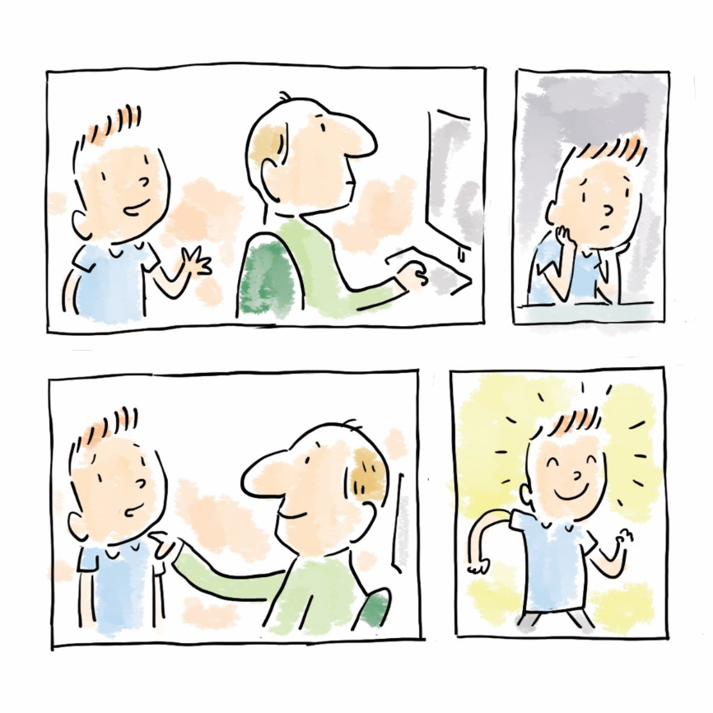
Atebolrwydd | Accountability
Notes:
Focus of Slide - Accountability
Context The fifth and last principle is Accountability – All staff in education settings have responsibilities and take decisions and actions that impact on children. Children should be provided with information and given access to procedures which enable them to question and challenge decisions that have been taken in educational settings.
-----------------------------------------------------------------
Ffocws y Sleid – Atebolrwydd
Cyd-destun Y pumed egwyddor, yr un olaf, yw Atebolrwydd – Mae gan holl staff lleoliadau addysg gyfrifoldebau, ac maent yn cymryd penderfyniadau a chamau sy’n effeithio ar blant. Dylai plant gael gwybodaeth a mynediad i weithdrefnau sy’n eu galluogi i gwestiynu a herio penderfyniadau a wnaed mewn lleoliadau addysgol.

Slide 28
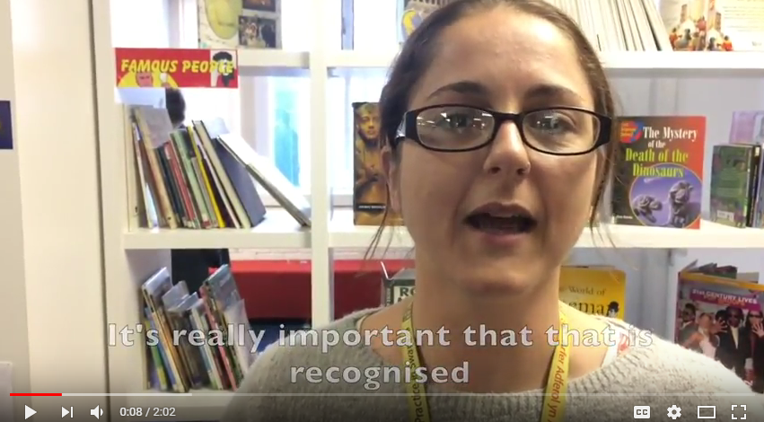
Notes:
Focus of Slide – Video example in secondary setting
Context - Here is a short video from a Secondary School in Swansea – Pentrehafod Comprehensive where you will hear from pupils about and staff why they have embedded the Right Way approach to education.
Activity – video
----------------------------------------------------------------
Ffocws y Sleid – Enghraifft o fideo mewn lleoliad uwchradd
Cyd-destun – Dyma fideo fer o Ysgol Uwchradd yn Abertawe – Ysgol Gyfun Pentrehafod, lle byddwch chi’n clywed gan ddisgyblion a staff pam maen nhw wedi ymgorffori dull gweithredu’r Ffordd Gywir i addysg.
Gweithgaredd - fideo

Slide 29
Astudiaethau
achos
Case studies
Gan ddefnyddio sampl o astudiaethau achos o’r Ffordd Gywir i Addysg ac Awgrymiadau Gwych, gwnewch gynlluniau i Wireddu Hawliau. Ffurfiwch grwpiau i edrych ar astudiaethau achos sy’n ymwneud ag un o’r egwyddorion ac ystyriwch sut gallwch chi ddefnyddio’r enghreifftiau hyn i ddylanwadu ar eich ymarfer eich hun.
Using a sample of case studies from the Right Way to Education and Top Tips, make plans to Make Rights a Reality. Split into groups to look at case studies around one of the principles and consider how you can use these examples to influence your own practice.
Notes:
Focus of Slide – Case studies
Context- This will allow participants an opportunity to see practical examples of the Right Way and consider how they as Duty Bearers can support children and young people to access their rights
Activity - Split into groups and supply each group with case studies around one of the principles and ask them to consider how they can use these examples to influence their practice using a Menu for Change.
Case studies - https://www.childcomwales.org.uk/wp-content/uploads/2018/06/TRW-education-case-studies-bilingual-1.docx
Menu for change - https://www.childcomwales.org.uk/wp-content/uploads/2018/06/Menu-Education_headed-1.docx
---------------------------------------------------------------------------------
Ffocws y Sleid – Astudiaethau achos
Cyd-destun – Bydd hyn yn rhoi cyfle i’r cyfranogwyr weld enghreifftiau ymarferol o’r Ffordd Gywir ac ystyried sut gallan nhw, fel Deiliaid Dyletswydd, gefnogi plant a phobl ifanc i gael mynediad i’w hawliau
Gweithgaredd – Rhannu’n grwpiau a rhoi astudiaethau achos i bob grŵp sy’n ymwneud ag un o’r egwyddorion a gofynnwch iddyn nhw ystyried sut gallan nhw ddefnyddio’r enghreifftiau hyn i ddylanwadu ar eu hymarfer trwy ddefnyddio Dewislen ar gyfer Newid.
Astudiaethau Achos - https://www.childcomwales.org.uk/wp-content/uploads/2018/06/TRW-education-case-studies-bilingual-1.docx
Dewislen ar gyfer Newid - https://www.childcomwales.org.uk/wp-content/uploads/2018/06/Dewislen-Addysg_headed.docx

Slide 30
The Rights Way – A Children’s Rights Approach for Education in Wales
Y Ffordd Gywir – Dull Gweithredu seiliedig ar Hawliau Plant i Addysg yng Nghymru
Notes:
Focus of Slide – The Right Way to Education publication
Context For more details on the Right Way to Education and to obtain your own copy, go to
https://www.childcomwales.org.uk/publications/childrens-rights-approach-education-wales/
-------------------------------------------------------------------------------------
Ffocws y Sleid – Cyhoeddiad y Ffordd Gywir i Addysg
Cyd-destun I gael rhagor o fanylion ynghylch y Ffordd Gywir i Addysg ac i lawrlwytho copi, ewch i
https://www.complantcymru.org.uk/cyhoeddiadau/dull-gweithredu-seiliedig-ar-hawliau-plant-i-addysg-yng-nghymru/

Slide 31
Crynhoi’r Nodau
Sesiwn un – datblygu gwybodaeth a dealltwriaeth o CCUHP a rôl CPC
Sesiwn dau – ystyried y Ffordd Gywir i Addysg, y pum egwyddor, a myfyrio ar sut gallwch chi, fel gweithwyr proffesiynol, sicrhau bod plant a phobl ifanc yn cael mynediad i CCUHP
Recap on Aims
Session one- gained knowledge and understanding of UNCRC and role of CCfW
Session two – considered the Right Way to Education, the five principles and reflected on how you as professionals can ensure children and young people access the UNCRC
Notes:
Focus of Slide - Recap and revisit Aims
Context – By the end of these two sessions we hope that participants have gained an understanding of UNCRC and the role of the Children’s Commissioner for Wales. Participants should be aware of their duty to support the UNCRC and have had an opportunity to reflect on how they would make this a reality in practice.
---------------------------------------------------------------------------------
Ffocws y Sleid – Crynhoi ac adolygu’r Nodau
Cyd-destun – Erbyn diwedd y ddwy sesiwn hon rydyn ni’n gobeithio bydd y cyfranogwyr wedi dod i ddeall CCUHP a rôl Comisiynydd Plant Cymru. Dylai’r cyfranogwyr fod yn ymwybodol o’u dyletswydd i gefnogi CCUHP, a byddant wedi cael cyfle i fyfyrio ar sut bydden nhw’n gwireddu hynny’n ymarferol.

Slide 32
Manylion Cyswllt | Contact Details
Trydar | Twitter @childcomwales | @complantcymru
Awr Hawliau |Rights Hour Dydd Gwener |Friday 12- 1
Ffôn | Phone 01792 765600
Ebost | Email post@childcomwales.org.uk | post@complantcymru.org.uk
Facebook https://www.facebook.com/childcomwales/
Gwefan | Website www.childcomwales.org.uk| www.complantcymru.org.uk
Notes:
Focus of Slide – Contact details for Childrens Commissioner for Wales
Context For further information about our work and our contacts details please look at our website
------------------------------------------------------------------------------------------
Ffocws y Sleid – Manylion cyswllt ar gyfer Comisiynydd Plant Cymru
Cyd-destun I gael rhagor o wybodaeth am ein gwaith a’n manylion cyswllt, edrychwch ar ein gwefan

