Slide 1
Y Ffordd Gywir: Dull Gweithredu seiliedig ar Hawliau Plant yng Nghymru
The Right Way: A Children’s Rights Approach in Wales
Comisiynydd Plant Cymru
Children’s Commissioner for Wales
Notes:
Focus of Slide - Children’s Rights approach
Context - A Children’s Rights based approach is a coherent, politically neutral and practical framework for working with children. Grounded in the UNCRC. These slides will tell you a little bit more about The Right Way and we will do some activities and share some videos to explore how this links to your practice.
-------------------------------------------------------------------------------------------
Ffocws y Sleid – Dull gweithredu seiliedig ar Hawliau Plant
Cyd-destun – Mae dull gweithredu seiliedig ar Hawliau Plant yn fframwaith cydlynus, gwleidyddol niwtral, ymarferol ar gyfer gweithio gyda phlant. Mae wedi’i wreiddio yn CCUHP. Bydd y sleidiau hyn yn dweud rhagor wrthych chi am Y Ffordd Gywir, a byddwn ni’n gwneud rhai gweithgareddau ac yn rhannu rhai fideos er mwyn edrych ar y cysylltiad rhwng hyn a’ch ymarfer.

Slide 2
Crynhoi’r ddarlith/Sesiwn ddiwethaf
Cyflwyniad i Gonfensiwn y Cenhedloedd Unedig ar Hawliau’r Plentyn (CCUHP)
Amlinellu rôl Comisiynydd Plant Cymru
Nodau’r Sesiwn hon
Archwilio a thrafod Y Ffordd Gywir – gwireddu hawliau
Recap of the last lecture/Session
Introduced the United Nations Convention on the Rights of the Child (UNCRC)
Outlined the role of the Children’s Commissioner for Wales
Aims of this Session
Explore and discuss The Right Way – Making rights a reality
Notes:
Focus of Slide – Recap session 1 and set aims
Context - In recapping the last session you can ask some questions – How many rights are there in the UNCRC? What articles do you remember? What is the name of the Children’s Commissioner for Wales?
Then go on to explain this session is about understanding, exploring and discussing What a Rights based approach is and how they as professionals can support this work in the future.
--------------------------------------------------------------------------------
Ffocws y Sleid – Crynhoi sesiwn 1 a gosod nodau
Cyd-destun – Wrth grynhoi’r sesiwn ddiwethaf gallwch chi ofyn rhai cwestiynau – Faint o hawliau sydd yn CCUHP? Pa erthyglau rydych chi’n eu cofio? Beth yw enw Comisiynydd Plant Cymru?
Yna ewch ymlaen i esbonio bod y sesiwn hon yn ymwneud â deall, archwilio a thrafod beth yw Dull Gweithredu seiliedig ar Hawliau a sut gallan nhw, fel gweithwyr proffesiynol, gefnogi hynny yn eu gwaith yn y dyfodol.

Slide 3
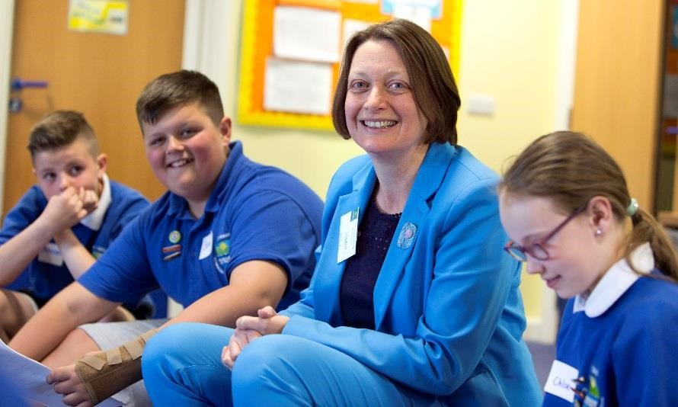
Pam Dull Gweithredu Seiliedig ar Hawliau Plant?
Eisiau gweld Cymru lle mae pob un plentyn a pherson ifanc â chyfle cyfartal i gyrraedd ei botensial llawn………..
Why a Children’s Rights Approach?
Aspires to a Wales where all children and young people have an equal chance to be the best that they can be………..
Sally Holland
Comisiynydd Plant Cymru
Children’s Commissioner for Wales
Notes:
Focus of Slide - Outline Childrens Rights approach
Context - Before going on to look at the Five principles of a Children’s Rights approach this is why Sally Holland wants to embed a rights based approach
----------------------------------------------------------------------------
Ffocws y Sleid – Amlinellu dull gweithredu seiliedig ar Hawliau Plant
Cyd-destun - Cyn mynd ymlaen i edrych ar 5 egwyddor dull gweithredu seiliedig ar Hawliau Plant, dyma pam mae Sally Holland eisiau ymgorffori dull gweithredu seiliedig ar hawliau

Slide 4
Beth yw Dull Gweithredu Seiliedig ar Hawliau Plant?
Fframwaith ar gyfer gweithio gyda phlant sydd wedi’i wreiddio yng Nghonfensiwn y CU ar Hawliau’r Plentyn
Mae Dull Gweithredu Seiliedig ar Hawliau Plant yn ymwneud â gosod CCUHP wrth wraidd cynllunio a darparu gwasanaeth, ac integreiddio hawliau plant ym mhob agwedd ar wneud penderfyniadau, polisïau ac ymarfer
What is a Children’s Rights Approach?
A Children’s Rights Approach is a framework for working with children grounded in the UN Convention on the Rights of the Child
A Children’s Rights Approach is about placing the UNCRC at the Core of planning and service delivery , and integrating children’s rights into every aspect of decision making , policy and practice
Notes:
Focus of Slide – What is a Childrens Rights Approach
Context - The aim of The Right Way training and publication (https://www.childcomwales.org.uk/wp-content/uploads/2017/04/The-Right-Way.pdf) is to help professionals who work with and for children and young people in Wales to embed a Children’s Rights Approach in a practical and meaningful way.
-----------------------------------------------------------------------------------
Ffocws y Sleid – Beth yw Dull Gweithredu seiliedig ar Hawliau Plant
Cyd-destun - Nod hyfforddiant a chyhoeddiad Y Ffordd Gywir (https://www.childcomwales.org.uk/wp-content/uploads/2017/04/Y-Ffordd-Gywir.pdf) yw helpu pobl broffesiynol sy’n gweithio gyda phlant a phobl ifanc yng Nghymru ac ar eu rhan i ymgorffori Dull Gweithredu seiliedig ar Hawliau Plant mewn ffordd ymarferol ac ystyrlon.

Slide 5
Activity: Discussion
Each small group takes a card from the symbols card pack – using articles 3, 12, 14, 15, 19, 24, 27,28,29, 31, 36, 42.
Discuss: What could you do to make this right a reality for children or young people in your setting?
Brief feedback
Gweithgaredd: Trafodaeth
Mae pob grŵp bach yn cymryd cerdyn o’r pecyn o gardiau symbolau – gan ddefnyddio erthyglau 3, 12, 14, 15, 19, 24, 27, 28, 29, 31, 36, 42.
Trafodaeth: Beth gallwch chi ei wneud i wireddu’r hawl hon i blant a phobl ifanc yn eich lleoliad chi?
Adborth cryno
Notes:
Focus of Slide – Activity to explore UNCRC
Context - Before looking at the five principles of the Right Way we will do a practical activity to explore how rights link to your chosen profession/courses you study. It might be worth looking at the convention before you start, and changing some of the Articles suggested in the slide to suit your audience e.g. Social services may add 20, 21, 23, 25, 26.
Activity - Ask participants to work in small groups and hand out a symbols card; these can be downloaded here - https://www.childcomwales.org.uk/uncrc-childrens-rights/uncrc-symbols-resource/
When groups feedback point out that Rights as shown in session one are embedded in policy frameworks in Wales and as professionals we have a duty to ensure children and young people are aware of and access their rights, from the activity that has just been completed it should make it more evident that most work people currently do does support children to access their rights, this needs to be realised.
-----------------------------------------------------------------------
Ffocws y Sleid – Gweithgaredd archwilio CCUHP
Cyd-destun - Cyn mynd ymlaen i edrych ar 5 egwyddor y Ffordd Gywir, byddwn ni’n gwneud gweithgaredd ymarferol i archwilio’r cysylltiad rhwng hawliau a’ch gwaith yn y dyfodol/cwrs presennol. Gallai fod yn werth edrych ar y confensiwn cyn dechrau a newid rhai o’r Erthyglau a awgrymwyd i’w defnyddio yn y drafodaeth ar gyfer erthyglau sydd wedi’u targedu’n fwy, yn dibynnu ar eich cynulleidfa e.e. gallai Gwasanaethau Cymdeithasol ychwanegu 20, 21, 23, 25, 26.
Gweithgaredd – Gofyn i’r cyfranogwyr weithio mewn grwpiau bach a dosbarthu cerdyn symbolau – mae’r rhain ar gael i’w lawrlwytho yma (neu fyddwn ni’n anfon pecyn at unrhyw un sy’n gofyn) - https://www.complantcymru.org.uk/ccuhp-hawliau-plant/adnodd-symbolau-ccuhp/
Pan fydd grwpiau’n rhoi adborth, tynnwch sylw at y ffaith fod Hawliau, fel y dangoswyd yn sesiwn 1, yn rhan o fframweithiau polisi yng Nghymru, ac fel gweithwyr proffesiynol, mae dyletswydd arnon ni i sicrhau bod plant a phobl ifanc yn ymwybodol o’u hawliau ac yn cael mynediad iddyn nhw, dylai’r gweithgaredd sydd newydd gael ei gwblhau ddangos yn fwy amlwg bod y rhan fwyaf o waith mae pobl yn ei wneud ar hyn o bryd yn cefnogi plant i gael mynediad i’w hawliau, mae angen gwireddu hynny.

Slide 6
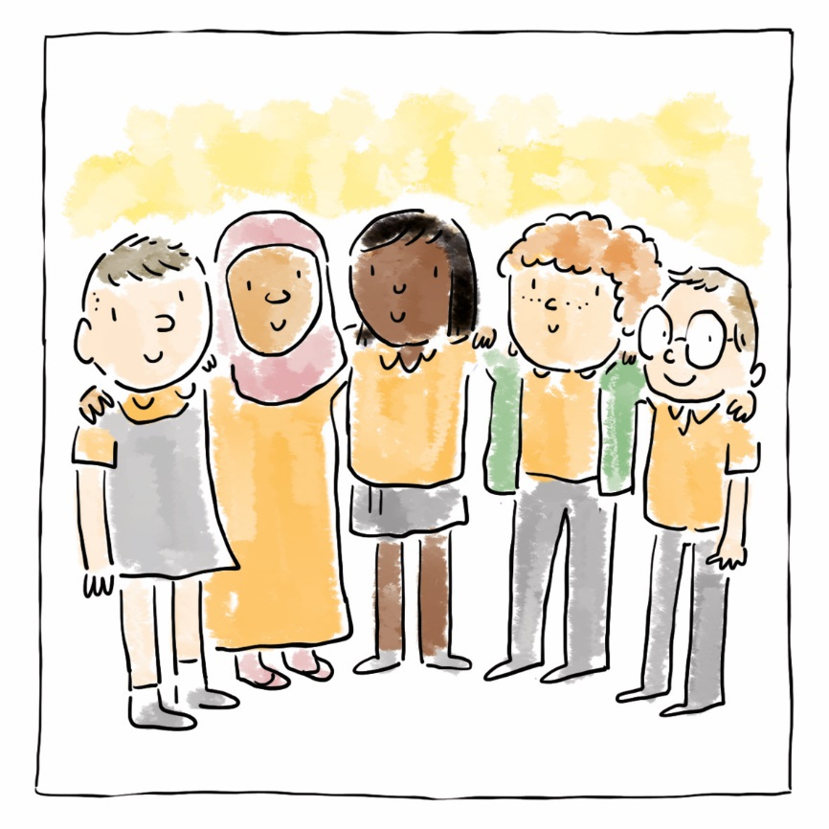
Ymgorffori CCUHP
Cydraddoldeb a pheidio â chamwahaniaethu
Grymuso plant
Cyfranogiad
Atebolrwydd
Embedding the UNCRC
Equality and non-discrimination
Empowering Children
Participation
Accountability
Notes:
Focus of Slide – Outline five principles of Childrens Rights Approach
Context - These five principles place the UNCRC at the core of planning and service delivery and integrate children’s rights into every aspect of decision- making, policy and practice.
The next few slides will explain these in a little more detail, we will then go onto look at some case studies under each of the principles.
--------------------------------------------------------------------------------
Ffocws y Sleid – Amlinellu pum egwyddor dull gweithredu seiliedig ar Hawliau Plant
Cyd-destun Mae’r pum egwyddor yn gwneud CCUHP yn greiddiol i gynllunio a darparu gwasanaethau, ac integreiddio hawliau plant ym mhob agwedd ar wneud penderfyniadau, polisi ac ymarfer.
Bydd y sleidiau nesaf yn esbonio rhagor o fanylion am y rhain, ac yna byddwn ni’n mynd ymlaen i edrych ar rai astudiaethau achos o dan bob un o’r egwyddorion.

Slide 7
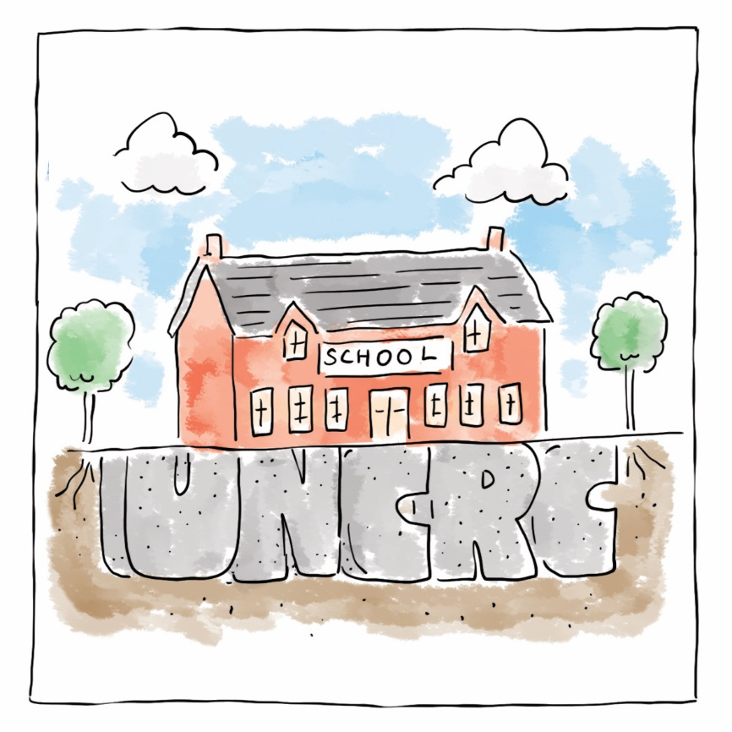
Ymgorffori'r Confensiwn (CCUHP)
| Embedding the UNCRC
Notes:
Focus of Slide – Embedding the UNCRC
Context - The First Principle Embedding the UNCRC means Children’s Rights should be at the core of planning and service delivery. The UNCRC needs to be integrated into every aspect of decision-making through procedures and actions. At its most basic this requires acknowledgement of the UNCRC as a framework for services impacting on children.
----------------------------------------------------------------------------
Ffocws y Sleid – Ymgorffori CCUHP
Cyd-destun Ystyr yr Egwyddor Gyntaf sy’n ymgorffori CCUHP yw y dylai Hawliau Plant fod yn greiddiol i gynllunio a chyflawni gwasanaeth. Mae angen integreiddio CCUHP ym mhob agwedd ar wneud penderfyniadau trwy weithdrefnau a chamau gweithredu. Ar y lefel fwyaf sylfaenol, mae hynny’n gofyn bod CCUHP yn cael ei gydnabod fel fframwaith ar gyfer gwasanaethau sy’n cael effaith ar blant.

Slide 8
Cydraddoldeb a Pheidio â Chamwahaniaethu
| Equality and Non-Discrimination
Notes:
Focus of Slide – Equality and Non-discrimination
Context - The Second principle – Equality and Non- Discrimination – is about ensuring that every child has an equal opportunity to make the most of their talents and develop to their fullest potential, and that no child has to endure poor life chances because of discrimination.
-----------------------------------------------------------------
Ffocws y Sleid – Cydraddoldeb a Pheidio â Chamwahaniaethu
Cyd-destun - Ystyr yr ail egwyddor – Cydraddoldeb a Pheidio â Chamwahaniaethu – yw sicrhau bod pob plentyn yn cael cyfle cyfartal i fanteisio’n llawn ar eu doniau a datblygu hyd eithaf eu potensial, ac nad oes rhaid i unrhyw blentyn oddef cyfleoedd gwael mewn bywyd oherwydd camwahaniaethu.

Slide 9
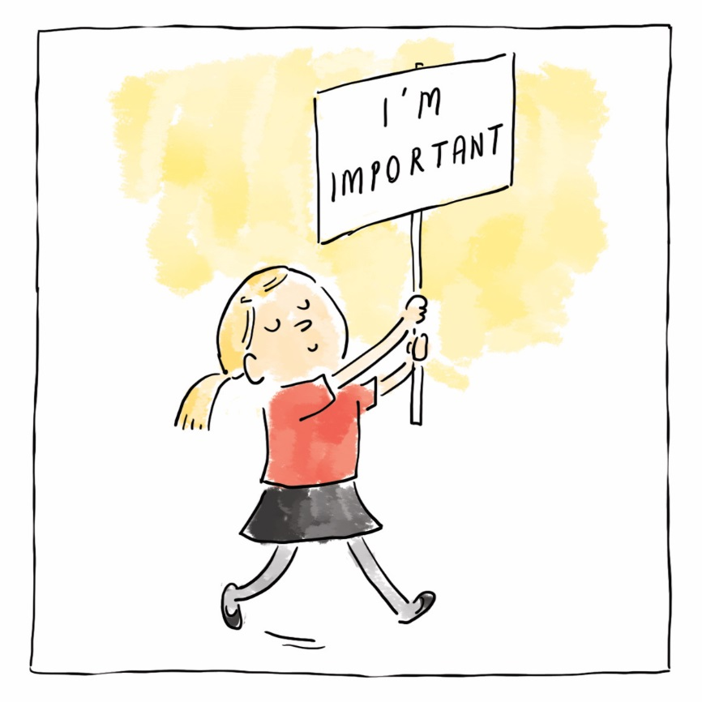
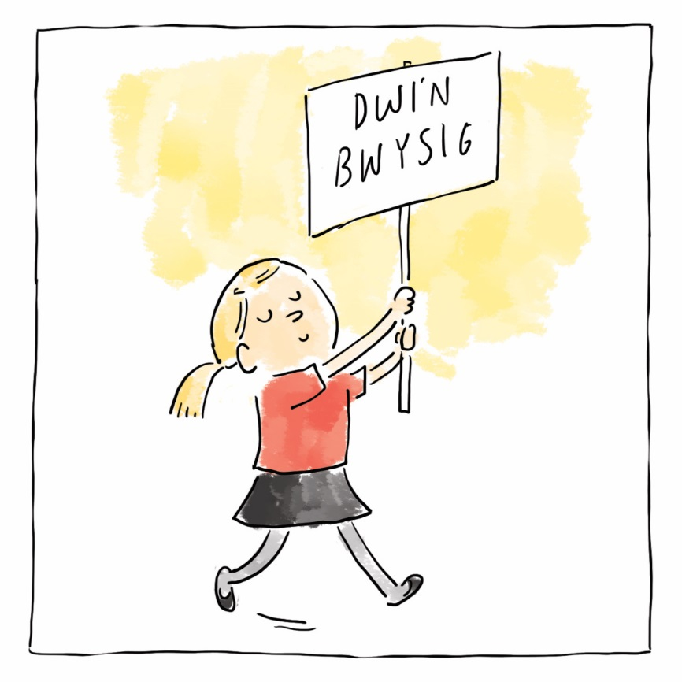
Grymuso Plant | Empowering Children
Notes:
Focus of Slide - Empowering Children
Context - The Third principle – Empowering Children and young people means enhancing their capabilities as individuals so they are better able to take advantage of their rights, and to engage with, influence and hold accountable the people and organisations that affect their lives.
Children’s Rights should be seen as entitlements; they are not optional.
----------------------------------------------------------------------
Ffocws y Sleid – Grymuso Plant
Cyd-destun – Ystyr y drydedd egwyddor – Grymuso plant a phobl ifanc yw gwella’u galluoedd fel unigolion er mwyn iddyn nhw fod mewn sefyllfa well i fanteisio ar eu hawliau, ac ymgysylltu â’r bobl a’r sefydliadau sy’n effeithio ar eu bywydau, dylanwadu arnynt a’u galw i gyfrif.
Dylai Hawliau Plant gael eu gweld fel pethau y dylid eu derbyn; nid rhywbeth dewisol mohonyn nhw.

Slide 10
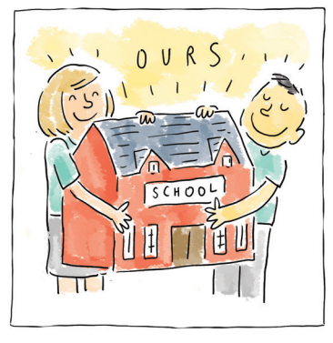
Cyfranogiad | Participation
Notes:
Focus of Slide - Participation
Context The fourth principle is Participation – this means listening to children and young people and taking their views meaningfully into account. All children and young people should be supported to freely express their opinion; they should be both heard and listened to.
------------------------------------------------------
Ffocws y Sleid – Cyfranogiad
Cyd-destun Y bedwaredd egwyddor yw Cyfranogiad – ystyr hynny yw gwrando ar blant a phobl ifanc a rhoi sylw i’w barn mewn ffordd ystyrlon. Dylai pob plentyn a pherson ifanc gael eu cefnogi i fynegi barn yn rhydd; dylen nhw gael eu clywed a chael gwrandawiad.

Slide 11
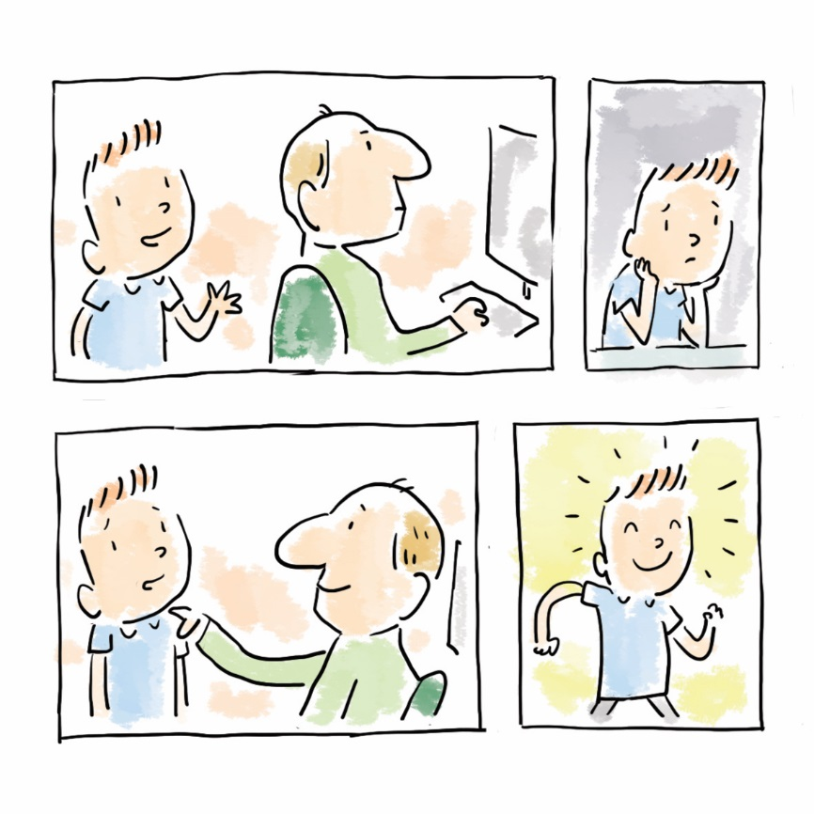
Atebolrwydd | Accountability
Notes:
Focus of Slide – Accountability
Context - The fifth and last principle is Accountability – Authorities should be accountable to children for decisions and actions which affect their lives. Children should be provided with information and given access to procedures which enable them to question and challenge decision makers.
-----------------------------------------------------------------
Ffocws y Sleid – Atebolrwydd
Cyd-destun – Y pumed egwyddor, yr un olaf, yw Atebolrwydd – Dylai Awdurdodau fod yn atebol i blant am benderfyniadau a chamau gweithredu sy’n effeithio ar eu bywydau. Dylai plant gael gwybodaeth a mynediad i weithdrefnau sy’n eu galluogi i gwestiynu a herio llunwyr penderfyniadau.

Slide 12
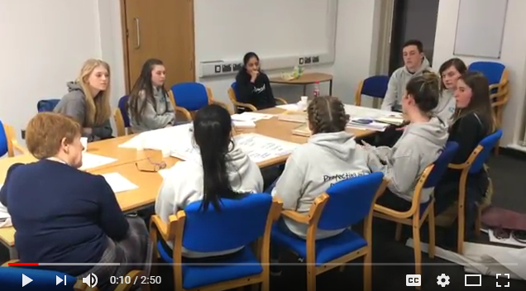
Hawliau ar Waith
Astudiaeth Achos – ABM Youth
Rights in Practice
Case Study – ABM Youth
Notes:
Focus of Slide – examples of the Rights way in practice
Context – these two clips show Rights embedded in different settings
Activity – Videos
---------------------------------------------------------
Ffocws y Sleid – enghreifftiau o Hawliau ar waith
Cyd-destun – mae’r ddau glip yma’n dangos Hawliau yn cael eu hymgorffori mewn gwahanol leoliadau
Gweithgaredd - Fideos

Slide 13
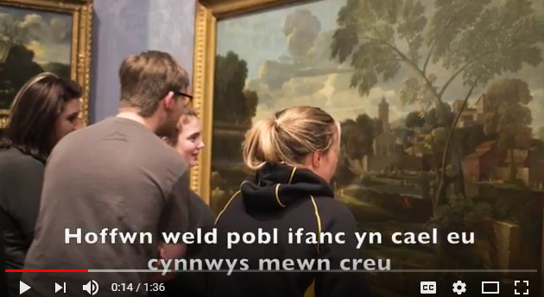
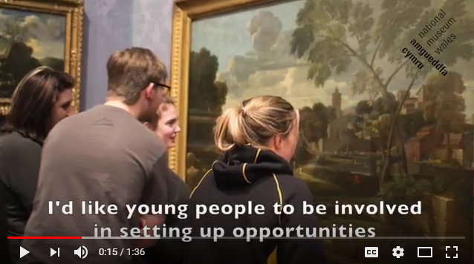
Hawliau ar Waith
Astudiaeth Achos – Amgueddfa Cymru
Rights in Practice
Case Study – Museum Wales

Slide 14
Astudiaethau achos
Case studies
Defnyddio sampl o astudiaethau achos o’r Ffordd Gywir ar gyfer cynlluniau i Wireddu Hawliau.
Rhannu’r cyfranogwyr yn grwpiau a rhoi astudiaethau achos sy’n ymwneud ag un o’r egwyddorion i bob un o’r grwpiau, a gofyn iddyn nhw ystyried sut gall yr enghreifftiau hyn gael eu defnyddio i ddylanwadu ar eich ymarfer eich hun.
Adborth gan y grwpiau ynghylch pob egwyddor.
Unigolion yn creu dewislen ar gyfer newid.
Use a sample of case studies from the Right Way to make plans to Make Rights a Reality.
Split into groups and supply each group with case studies around one of the principles and ask them to consider how you can use these examples to influence your own practice.
Feedback from groups around each principle
Individuals create a menu for change
Notes:
Focus of Slide – Case studies
Context- Split into groups and supply each group with case studies around one of the principles and ask them to consider how they can use these examples to influence their practice using a Menu for Change.
Case studies - https://www.childcomwales.org.uk/wp-content/uploads/2018/06/TRW-case-studies-bilingual-1.docx
Menu for change - https://www.childcomwales.org.uk/wp-content/uploads/2018/06/Menu-The-Right-Way_headed-1.docx
----------------------------------------------------------------------
Ffocws y Sleid – Astudiaethau achos
Cyd-destun – Rhannu’r cyfranogwyr yn grwpiau a rhoi astudiaethau achos sy’n ymwneud ag un o’r egwyddorion i bob un o’r grwpiau a gofyn iddyn nhw ystyried sut gallan nhw ddefnyddio’r enghreifftiau hyn i ddylanwadu ar eu hymarfer drwy ddefnyddio Dewislen ar gyfer Newid.
Astudiaethau Achos - https://www.childcomwales.org.uk/wp-content/uploads/2018/06/TRW-case-studies-bilingual-1.docx
Dewislen ar gyfer Newid - https://www.childcomwales.org.uk/wp-content/uploads/2018/06/Dewislen-y-Ffordd-Gywir_headed.docx

Slide 15
The Right Way – A Children’s Rights Approach for Wales
Y Ffordd Gywir – Dull Gweithredu seiliedig ar Hawliau Plant yng Nghymru
Notes:
Focus of Slide – Signposting to publication
Context - For further information and more in depth ideas you can download your own copy of “The Right Way” from our website
-------------------------------------------------------------
Ffocws y Sleid – Cyfeirio ymlaen at y cyhoeddiad
Cyd-destun – I gael rhagor o wybodaeth a syniadau dyfnach gallwch chi lawrlwytho eich copi eich hun o “Y Ffordd Gywir” o’n gwefan

Slide 16
Article 19
I have the right to be protected from all forms of violence, abuse, neglect and bad treatment by the people who look after me.
Llysgenhadon Cymunedol
Community Ambassadors
Notes:
Focus of Slide – Ambassador schemes
Context - The Children’s Commissioner has three schemes that support young people to become empowered and take part in expressing their views to feed into the work of the office.
The school schemes are for ALL schools in Wales and offer a free scheme for teachers and pupils to embed a rights based approach
The Community Ambassador scheme is targeted at special interest groups across Wales mostly in youth settings.
----------------------------------------------------------------------------------------
Ffocws y Sleid – Cynlluniau Llysgenhadon
Cyd-destun Mae gan y Comisiynydd Plant dri chynllun sy’n cefnogi pobl ifanc i gael eu grymuso a bod yn rhan o fynegi eu barn er mwyn bwydo gwaith y swyddfa.
Mae’r cynlluniau ysgol ar gyfer HOLL ysgolion Cymru ac yn cynnig cynllun di-dâl er mwyn i athrawon a disgyblion ymgorffori dull gweithredu seiliedig ar hawliau
Mae’r cynllun Llysgenhadon Cymunedol yn targedu grwpiau diddordeb arbennig ledled Cymru,yn bennaf mewn lleoliadau ieuenctid.

Slide 17
Atgoffa am y Nodau
Sesiwn 1 – dysgu am CCUHP a rôl y Comisiynydd Plant
Sesiwn 2 – dysgu am Y Ffordd Gywir ac ystyried sut gallwch chi sicrhau eich bod yn cefnogi plant a phobl ifanc i gael mynediad i CCUHP
Reminder of Aims
Session 1 – learn about the UNCRC and role of the Children’s Commissioner
Session 2 – Learn about The Right Way and consider how you can ensure you support children and young people to access the UNCRC
Notes:
Focus of Slide – Revisit Aims
Context – checking with participants what they have learnt and how they can ensure they support young people in their work to access the UNCRC
---------------------------------------------------------------------
Ffocws y Sleid – Edrych eto ar y Nodau
Cyd-destun – gwirio gyda’r cyfranogwyr beth maen nhw wedi’i ddysgu a sut gallan nhw sicrhau eu bod yn cefnogi pobl ifanc yn eu gwaith i gael mynediad i CCUHP

Slide 18
Manylion Cyswllt | Contact Details
Trydar | Twitter @childcomwales/@complantcymru
Awr Hawliau/ Rights Hour Dydd Gwener /Friday 12- 1
Ffôn | Phone 01792 765600
Ebost | Email post@childcomwales.org.uk | post@complantcymru.org.uk
Facebook https://www.facebook.com/childcomwales/
Gwefan | Website www.childcomwales.org.uk| www.complantcymru.org.uk
Notes:
Focus of Slide – Contact details for Childrens Commissioner for Wales
Context For further information about our work and our contacts details please look at our website
------------------------------------------------------------------------------------------
Ffocws y Sleid – Manylion cyswllt ar gyfer Comisiynydd Plant Cymru
Cyd-destun I gael rhagor o wybodaeth am ein gwaith a’n manylion cyswllt, edrychwch ar ein gwefan

