Slide 1
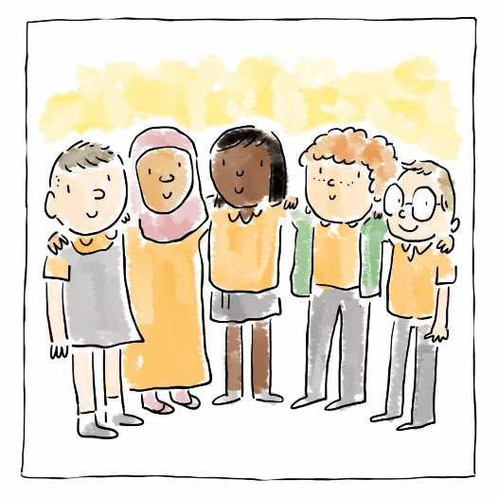
  Hawliau Plant
  Comisiynydd Plant Cymru
  Children’s Rights
  Children’s Commissioner for Wales

Slide 2
Nodau’r Sesiwn
Cyflwyniad i Gonfensiwn y Cenhedloedd Unedig ar Hawliau’r Plentyn (CCUHP)
Amlinellu rôl Comisiynydd Plant Cymru
Aims of the Session
Introduction to the United Nations Convention on the Rights of the Child (UNCRC)
Outline role of the Children’s Commissioner for Wales
Notes:
This session will give participants an introduction to children’s rights and the work of the Children’s Commissioner for Wales.
We’ve also created two additional resources to help participants explore how children’s rights can be implemented in any work involving children and young people, which are on our website.
----------------------------------------------------------------------------------------------
Bydd y sesiwn hon yn rhoi cyflwyniad i hawliau plant a gwaith Comisiynydd Plant Cymru i’r cyfranogwyr.
Rydyn ni hefyd wedi creu dau adnodd ychwanegol i helpu’r cyfranogwyr i archwilio sut gall hawliau plant gael eu gweithredu mewn unrhyw waith sy’n ymwneud â phlant a phobl ifanc; maen nhw ar ein gwefan.

Slide 3
HUMAN RIGHTS
AND CHILDREN’S RIGHTS
HAWLIAU DYNOL
A HAWLIAU PLANT
Notes:
To set Children’s Rights in context it is first worth looking at Human Rights. We are all born with Human Rights.
-------------------------------------------------------------------------------------------
I roi Hawliau Plant yn eu cyd-destun, mae’n werth edrych ar Hawliau Dynol yn gyntaf. Rydyn ni i gyd yn cael ein geni â Hawliau Dynol.

Slide 4
Beth yw hawl?
Hawliau Dynol yw’r pethau sylfaenol y mae arnom ni eu hangen i oroesi ac i gyflawni ein potensial. Mae Hawliau Dynol yn:
Gynhenid
Mae Hawliau Dynol yn gynhenid. Maen nhw gennych chi oherwydd eich bod wedi cael eich geni’n fod dynol.
What is a right?
Human Rights are the basic things we need to in order to survive and to fulfil our potential. Human Rights are:
Inherent
Human Rights are inherent. You have them because you are born a human.
Notes:
It is important to understand these underlying principles that Human Rights are Inherent, Universal, Indivisible, Inalienable, and Unconditional.
-----------------------------------------------------------------------------------------
Mae’n bwysig deall yr egwyddorion gwaelodol hyn, sef bod Hawliau Dynol yn Gynhenid, yn Gyffredinol, yn Anwahanadwy, yn Anaralladwy, ac yn Ddiamod.

Slide 5
Cyffredinol
Mae hawliau’n gyffredinol; maen nhw’n berthnasol i bawb, ym mhob man, bob amser.
Anwahanadwy (dim modd eu gwahanu)
Does dim un hawl sy’n fwy neu’n llai pwysig nag un arall, ac mae ein holl hawliau’n gysylltiedig â’i gilydd.
Universal
Rights are universal; they apply to everyone, everywhere, all the time.
Indivisible (Can’t be separated)
No right is more or less important than another and they are all interlinked.

Slide 6
Anaralladwy
All hawliau ddim cael eu gwerthu na’u rhoi i ffwrdd, ac all neb fynd â nhw oddi arnoch chi.
Diamod
Mae hawliau gan bobl yn awtomatig; does dim angen cyflawni unrhyw weithred i’w cael.
Inalienable
Rights can’t be sold or given away, and nobody can take them from you.
Unconditional
People have rights automatically; no action needs to be performed in order to get them.

Slide 7
Gweithgaredd 1:
Corff o Hawliau
Mewn grwpiau bach, tynnwch lun siâp corff ar ddarn mawr o bapur – A3. Os yw hyn yn cynrychioli plentyn neu berson ifanc sy’n tyfu i fyny yng Nghymru heddiw, trafodwch beth allai fod ei angen arnyn nhw i dyfu i fyny’n hapus, yn iach ac yn ddiogel. Rhowch y pethau rydych chi’n meddwl amdanynt fel anghenion y tu mewn i’r corff, a phethau maen nhw eisiau y tu allan. (gan ddefnyddio nodiadau gludiog neu binnau ysgrifennu).
Rhowch adborth cryno
Activity 1:
Body of Rights
In small groups, draw the shape of a body on a piece of large paper - A3. If this is a child or young person growing up in Wales today have a discussion about what they may want to grow up happy, healthy and safe. Place what you think are someone’s needs in the middle of the body and wants on the outside. (using post-its or pens).
Briefly feedback
Notes:
To explore your own understanding of Children’s Rights we are going to do an activity called Body of Rights. You will need access to A3/large paper and a pen.
Start by drawing the outline of a body on the paper.
In small groups talk about things that children aged 0-18 would like to grow up happy, healthy and safe.
If you identify this as a need then place the post-it/write it inside the body
If you identify this as a want then place the post-it/write it on the outside of the body
-----------------------------------------------------------------------------------------------
I archwilio eich dealltwriaeth eich hun o Hawliau Plant rydyn ni’n mynd i wneud gweithgaredd o’r enw Corff o Hawliau. Bydd arnoch chi angen darn mawr/A3 o bapur a phin ysgrifennu.
I ddechrau, gwnewch amlinelliad o gorff ar y papur.
Mewn grwpiau bach, trafodwch y pethau y byddai plant 0-18 oed yn hoffi eu cael er mwyn tyfu i fyny’n hapus, yn iach ac yn ddiogel yng Nghymru heddiw.
Rhowch y pethau rydych chi’n meddwl amdanynt fel anghenion y tu mewn i’r corff, a phethau maen nhw eisiau y tu allan.

Slide 8
Mae gennym ni Hawliau Dynol, pam mae angen Hawliau Plant?
Mae plant yn fwy agored i gael eu cam-drin a’u hecsbloetio
Yn dibynnu ar eu hoed, mae plant yn ddibynnol ar oedolion yn llwyr neu i raddau helaeth – nid yw eu lles pennaf bob amser yn cael ei ystyried
Mae plant yn wynebu llu o derfynau oed cyfreithiol pryd y bernir eu bod nhw’n gallu gwneud penderfyniadau drostynt eu hunain
Mae plant yn aml heb lais
We have Human Rights, why do we need Children’s Rights?
Children are more vulnerable to abuse and exploitation
Dependent on age, children are entirely or mostly dependent on adults – best interests not always considered
Children face an array of legal minimum ages at which they are considered capable of making decisions for themselves
Children are often voiceless
Notes:
It is clear from the Body of Rights activity that children need a variety of things to grow up happy, healthy and safe. Some of their needs are different to adults’ needs because they are particularly vulnerable. Therefore, children have their own set of rights.
There is a difference between wants and needs – needs are rights and things we are entitled to.
These rights are outlined in the UNCRC - The United Nations Convention on the Rights of the Child.
-------------------------------------------------------------------------------------------
Mae’n amlwg o’r gweithgaredd Corff o hawliau bod angen amrywiaeth o bethau ar blant i dyfu i fyny’n hapus, yn iach ac yn ddiogel. Mae rhai o’u hanghenion yn wahanol i anghenion oedolion oherwydd eu bod yn arbennig o agored i niwed. Felly, mae gan blant eu set eu hunain o hawliau.
Mae yna wahaniaeth rhwng pethau rydyn ni eisiau a phethau mae angen arnom – pethau mae angen arnom yw pethau mae gennym hawl i gael.
Amlinellir yr hawliau hyn yn CCUHP – Confensiwn y Cenhedloedd Unedig ar Hawliau’r Plentyn.

Slide 9
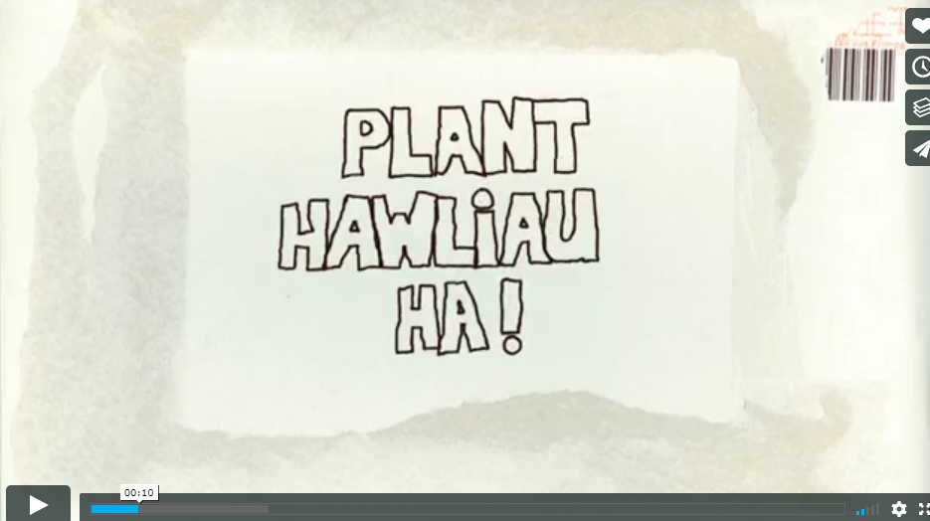
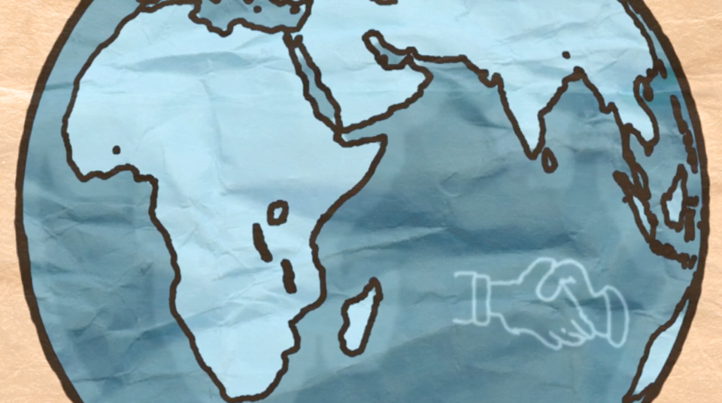
Fideo - Hawliau Plant? Ha!
Video - Children’s Wrongs
Notes:
The Welsh Government have produced many training materials to support adults who work with young people to learn about their rights, and material for children to explore their rights.
This clip is called ‘Children’s Wrongs’, and is from their website. You can find more bilingual resources online.
Following the clip there will be a short quiz, some of the answers may be in the clip!
------------------------------------------------------------------------------
Mae Llywodraeth Cymru wedi cynhyrchu llawer o ddeunyddiau hyfforddi i gefnogi oedolion sy’n gweithio gyda phobl ifanc i ddysgu am eu hawliau, a deunydd er mwyn i blant archwilio eu hawliau.
Yr enw ar y clip yma yw ‘Hawliau Plant? Ha!’, ac mae’n dod o’u gwefan. Mae rhagor o adnoddau dwyieithog ar gael ar-lein.
Bydd cwis cyflym yn dilyn y clip fideo, efallai bydd rhai o’r atebion yn y clip fideo!

Slide 10

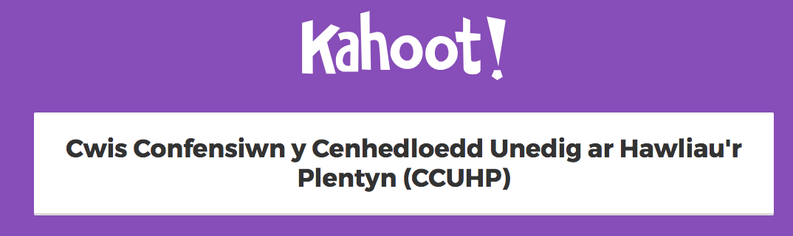
Notes:
This quiz will help introduce the UNCRC and the Children’s Commissioner for Wales to participants.
To take part in this interactive version, click the image to follow the link. All participants must have access to a mobile device with an internet connection to take part.
If that isn’t possible, we have uploaded the questions so you can do the quiz using a pen and paper –
https://www.childcomwales.org.uk/wp-content/uploads/2018/06/UNCRC-Quiz-English.pdf
-----------------------------------------------------------------------------------------
Bydd y cwis yma’n helpu i gyflwyno CCUHP a Chomisiynydd Plant Cymru i’r cyfranogwyr.
I gymryd rhan yn y fersiwn ryngweithiol yma, cliciwch ar y ddelwedd i ddilyn y ddolen. Rhaid bod gan bob cyfranogwr fynediad at ddyfais symudol sydd â chysylltiad â’r rhyngrwyd i gymryd rhan.
Os nad yw hynny’n bosib, rydyn ni wedi cynnwys y cwestiynau yma fel gallwch wneud y cwis ar bapur –
https://www.childcomwales.org.uk/wp-content/uploads/2018/06/Cwis-Confensiwn-y-Cenhedloedd-Unedig-ar-Hawliau-cwis-kahoot-cymraeg.pdf

Slide 11
CCUHP – Confensiwn y Cenhedloedd Unedig ar Hawliau’r Plentyn. Cytundeb rhyngwladol yw hwn sy’n amddiffyn hawliau dynol pobl o dan 18 oed.
Mae’n rhestru’r hawliau sydd gan bob plentyn a pherson ifanc, ym mhobman yn y byd.
Cafodd ei fabwysiadu gan y CU yn 1989, cafodd ei gadarnhau gan y Deyrnas Unedig yn 1991, a daeth i rym yn 1992.
UNCRC - United Nations Convention on the Rights of the Child is an international agreement that protects the human rights of those under the age of 18
It lists the rights that all children and young people, everywhere in the world have
It was adopted by the UN in 1989, the UK ratified it in 1991 and it came into force in 1992.
Notes:
These slides outline a little more about the UNCRC – it covers the age and global dimension of the UNCRC.
It is worth noting that it is the most signed up to piece of UN legislation and offers the worlds “Greatest promise to Children”.
When UN adopted it on November 20th 1989 this became recognised as Universal Children’s Day and it often celebrated across Wales and the globe.
------------------------------------------------------------------------------------
Mae’r sleidiau hyn yn cynnwys rhagor o wybodaeth am CCUHP – mae’n sôn am oed a dimensiwn byd-eang CCUHP.
Mae’n werth nodi mai dyma’r enghraifft o ddeddfwriaeth y CU y mae’r nifer mwyaf wedi ymrwymo iddo a’i bod yn cynnig yr ‘Addewid mwyaf i Blant’ yn y byd.
Pan gafodd ei fabwysiadu gan y CU ar 20 Tachwedd 1989 dewiswyd y dyddiad hwnnw’n Ddiwrnod Byd-eang y Plant, ac mae’n aml yn cael ei ddathlu yng Nghymru ac ar draws y byd.

Slide 12
Mae 54 o ‘erthyglau’ neu hawliau yn y Confensiwn
Mae Erthyglau 1 – 42 yn amlinellu hawliau penodol plant
Mae Erthyglau 43 – 54 yn amlinellu’r rhwymedigaethau sydd ar Bartïon Gwladol ac eraill sydd ‘o dan ddyletswydd’
There are 54 ‘articles’ or rights in the Convention
Articles 1 – 42 outline the rights specific to children
Articles 43 – 54 outline the obligations of State Parties and other ‘duty-bearers’
Notes:
There are 54 articles in the convention, though most children and young people will think it is 42.
On posters and information for children you will see Articles 0-42 s rights for children, as 43-54 are more the logistical side of what Governments have to do to ensure children access those rights.
---------------------------------------------------------------
Mae 54 o erthyglau yn y confensiwn, er y bydd y rhan fwyaf o blant a phobl ifanc yn meddwl am ffigur o 42.
Ar bosteri a gwybodaeth i blant, byddwch chi’n gweld amlinelliad o Erthyglau 0-42, gan fod 43-54 yn ymwneud yn fwy ag agwedd logistaidd yr hyn mae’n rhaid i Lywodraethau ei wneud i sicrhau bod plant yn cael mynediad i’r hawliau hynny.

Slide 13
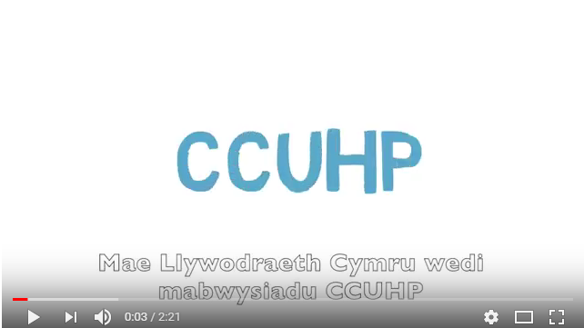

Fideo - Rhoi ‘Sylw Dyledus’ i’r Confensiwn
Video – Having ‘Due Regard’ to the Convention

Slide 14
Beth amdana i?
Ar y cyd â’r Llywodraeth,mae dyletswydd ar bawb sy’n gofalu am blant a phobl ifanc o dan CCUHP. Mae hynny’n golygu bod cyfrifoldeb arnyn nhw i gynnal hawliau plant.
What about me?
Along with the Government, all people who care for children and young people are duty bearers under the UNCRC. That means they have a responsibility to uphold children’s rights.
Notes:
To access their needs, children have to rely on adults. Adults who make decisions that affect children are all responsible for making sure that children’s rights are upheld and respected. These are duties under the UNCRC. We as adults who care about and care for children are therefore “Duty Bearers” with a responsibility to ensure children get their rights.
----------------------------------------------------------------------------
Mae’n rhaid i blant ddibynnu ar oedolion i gael mynediad i’w hanghenion. Mae pob oedolyn sy’n gwneud penderfyniadau sy’n effeithio ar blant yn gyfrifol am sicrhau bod hawliau plant yn cael eu cynnal a’u parchu. Mae’r rhain yn ddyletswyddau o dan CCUHP. Rydym ni’n oedolion sydd â gofal ac yn gofalu am blant, ac felly rydym ni’n ‘Ddeiliaid Dyletswydd’ sydd â chyfrifoldeb i sicrhau bod plant yn cael eu hawliau.

Slide 15
Gweithgaredd 2:
Pa Hawliau allai fod yn bwysig i’ch rôl fel gweithiwr proffesiynol yn y dyfodol?
Gan ddefnyddio poster CCUHP, darllenwch trwy’r erthyglau mewn parau a thrafod pa dair erthygl yw’r rhai pwysicaf i’r rôl rydych am ei chyflawni yn y dyfodol.
Adborth cryno
Activity 2:
What Rights could be important to your role as a professional in the future?
Using a UNCRC poster, read through the articles in pairs and discuss which three articles are most important to the role you aim to have in the future.
Briefly feedback
Notes:
The purpose of this activity is to allow participants an opportunity to explore the range of articles.
Use the poster here - https://www.childcomwales.org.uk/wp-content/uploads/2017/01/6331-CCfW-A2-Rights-Poster-AW-1.pdf
There is no right or wrong articles to choose as All children have ALL articles though sometimes they can conflict with each other and as adults we have to do what is in children’s best interests. (Article 3)
Articles 2, 3, 6 and 12 are often seen as the underpinning articles to the UNCRC.
----------------------------------------------------------------------------
Diben y gweithgaredd hwn yw rhoi cyfle i’r cyfranogwyr archwilio’r amrywiaeth o erthyglau.
Defnyddiwch y poster yma - https://www.childcomwales.org.uk/wp-content/uploads/2017/01/CCfW-A2-Rights-Poster-CYM.pdf
Nid oes erthyglau cywir neu anghywir i’w dewis gan fod POB erthygl yn berthnasol i BOB plentyn, er eu bod weithiau’n gallu gwrthdaro, ac fel oedolion mae’n rhaid i ni wneud beth sydd er lles pennaf y plant. (Erthygl 3)
Mae erthyglau 2, 3, 6 a 12 yn aml yn cael eu hystyried fel erthyglau sylfaenol/egwyddorion tywys i’r CCUHP.

Slide 16
Camu Ymlaen – Pam mae gyda ni Gomisiynydd Plant?
Stepping Out – Why do we have a Children’s Commissioner?
Notes:
This activity is a great way to understand the purpose of the role of Children’s Commissioner.
If you are in a lecture theatre you will need to think about running it from the front with some volunteers to draw out the learning.
Please see separate hand out for this activity and prepare materials in advance –
https://www.childcomwales.org.uk/wp-content/uploads/2018/06/Stepping-out_English1-1-1.docx
---------------------------------------------------------------------------------------------------------------------
Mae’r gweithgaredd yma’n ffordd wych o ddeall diben rôl y Comisiynydd Plant.
Os ydych chi mewn darlithfa bydd angen i chi feddwl am gynnal hyn o’r blaen, gyda rhai gwirfoddolwyr i ddangos y dysgu’n eglur.
Gweler y daflen ar wahân ar gyfer y gweithgaredd yma, a pharatowch ddeunyddiau ymlaen llaw –
https://www.childcomwales.org.uk/wp-content/uploads/2018/06/Camu-Ymlaen_Cymraeg-1.docx

Slide 17
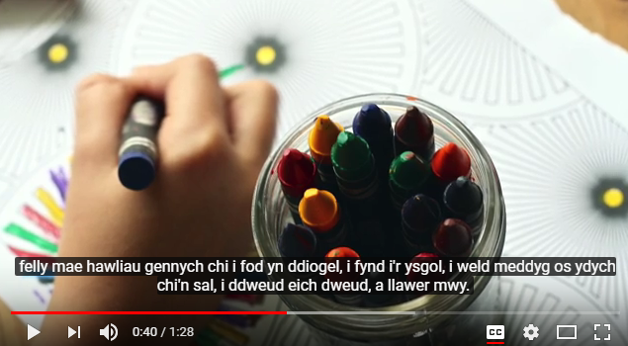
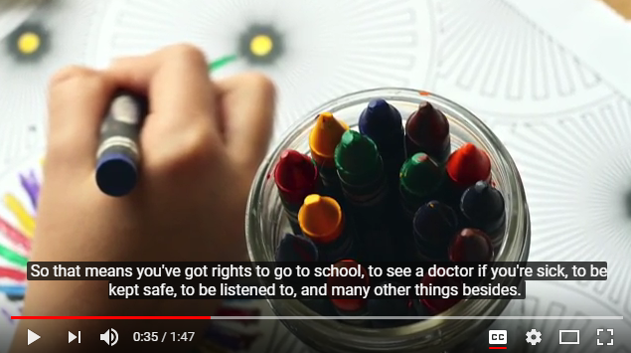
Fideo – Cyflwyniad i Sally a’i gwaith (yn wreiddiol i ysgolion)
Video – Introduction to Sally and her work (originally for schools)
Notes:
This video allows participants to see who Sally Holland is and explains her role as Children’s Commissioner.
Mae’r fideo yma’n gyfle i’r cyfranogwyr weld pwy yw Sally Holland, ac mae’n esbonio’i rôl fel Comisiynydd Plant.

Slide 18
Yn 2001, Cymru oedd y wlad gyntaf yn y Deyrnas Unedig i greu rôl y Comisiynydd Plant.
Roedd Aelodau’r Cynulliad yn sylweddoli bod angen rhywun ar blant a phobl ifanc i godi llais ar eu rhan, a gwneud yn siŵr eu bod nhw’n cael gwrandawiad ac yn cael eu trin yn deg.
Mae cyfres o gyfreithiau yn cynnwys: Deddf Safonau Gofal 2000 a Deddf Comisiynydd Plant Cymru 2001, sy’n esbonio rôl a chyfrifoldebau’r Comisiynydd.
In 2001, Wales was the first country in the UK to create the role of the Children’s Commissioner.
Assembly ministers recognised that children and young people need someone to speak up for them and make sure that they are listened to and treated fairly.
There is a set of laws including:
the Care Standards Act 2000
and the Children’s Commissioner
for Wales Act 2001 which explains
the role and responsibilities of
the Commissioner.
Notes:
Following a number of abuse cases in N.Wales care homes during the 1970’s and 80’s an independent review culminated in the “Waterhouse Report”.
It was identified that children in care needed a National Voice to ensure they were listened to and supported to access their rights, the role of the Commissioner was created in 2001.
----------------------------------------------------------------------------------------------------------------------------------
Yn dilyn nifer o achosion o gam-drin mewn cartrefi gofal yng Ngogledd Cymru yn ystod y 1970au a’r 80au, cafwyd ‘Adroddiad Waterhouse’ yn ddiweddglo ar adolygiad annibynnol.
Nodwyd bod angen Llais Cenedlaethol ar blant mewn gofal i sicrhau eu bod yn cael gwrandawiad ac yn cael eu cefnogi i gael mynediad i’w hawliau, a chrewyd rôl y Comisiynydd yn 2001.

Slide 19
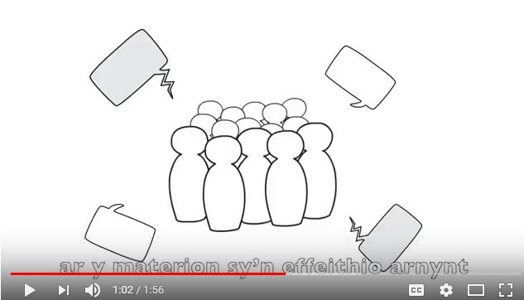
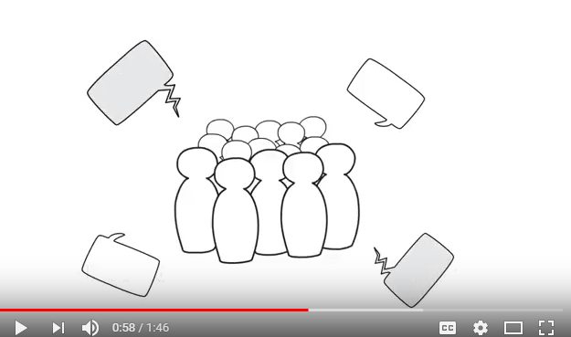
Fideo - Beth yw pwerau’r Comisiynydd?
Video – What are the Commissioner’s powers?
Notes:
This slide outlines the role and remit of the Children’s Commissioner for Wales.
Mae’r sleid yma’n amlinellu rôl a chylch gorchwyl Comisiynydd Plant Cymru.

Slide 20
CEFNOGI plant a phobl ifanc i gael gwybod am hawliau plant
GWRANDO ar blant a phobl ifanc i ddarganfod beth sy’n bwysig iddyn nhw
CYNGHORI plant, pobl ifanc a’r rhai sy’n gofalu amdanyn nhw os ydyn nhw’n teimlo bod ganddyn nhw ddim lle arall i fynd am gefnogaeth
DYLANWADU ar y llywodraeth a chyrff eraill sy’n dweud eu bod nhw’n mynd i wneud gwahaniaeth i fywydau plant, gan wneud yn siŵr eu bod nhw’n cadw eu haddewidion i blant a phobl ifanc
CODI LLAIS dros blant a phobl ifanc yn genedlaethol ar faterion pwysig - bod yn bencampwr i blant Cymru
FIVE FUNCTIONS OF OUR OFFICE
SUPPORT children and young people to find out about children’s rights
LISTEN TO children and young people to find out what is important to them
ADVISE children, young people and those who care for them if they feel that they have nowhere else to go with their problems
INFLUENCE government and other organisations who say that they are going to make a difference to children’s lives, making sure that they keep their promises to children and young people
SPEAK UP for children and young people nationally on important issues – being the children's champion in Wales
PUM SWYDDOGAETH EIN SWYDDFA
Notes:
She SUPPORTS and LISTENS through her participation team who work with groups of children and young people across Wales to teach them about their rights and listen to them to find out what they want the Commissioner to change.
She ADVISES through her Investigation and Advice team.
She INFLUENCES through her policy team to affect government change
She SPEAKS up at all levels to be a voice for children in Wales.
--------------------------------------------------------------------------------------------------------
Mae hi’n CEFNOGI ac yn GWRANDO trwy ei thîm cyfranogiad sy’n gweithio gyda phlant a phobl ifanc ledled Cymru i’w dysgu am eu hawliau ac yn gwrando arnyn nhw er mwyn cael gwybod beth maen nhw eisiau i’r Comisiynydd ei newid.
Mae hi’n CYNGHORI trwy’r tîm Ymchwiliadau a Chyngor.
Mae hi’n DYLANWADU trwy ei thîm polisi i ddylanwadu ar newid yn y llywodraeth
Mae hi’n CODI LLAIS ar bob lefel er mwyn bod yn llais i blant Cymru.

Slide 21
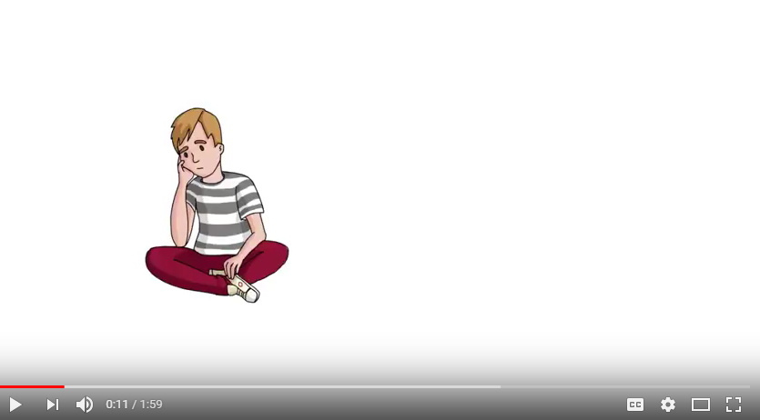
Fideo - Gwasanaeth Ymchwiliadau a Chyngor
Video – Investigations and Advice service
Notes:
Sally’s Investigations and Advice team are there for children and young people and adults who care about them and this video will tell you a little bit more about this service.
--------------------------------------------------------------------------------
Mae tîm Ymchwiliadau a Chyngor Sally yno ar gyfer plant a phobl ifanc a’r oedolion sy’n gofalu amdanyn nhw, a bydd y fideo yma’n sôn rhagor wrthych chi am y gwasanaeth yma.

Slide 22
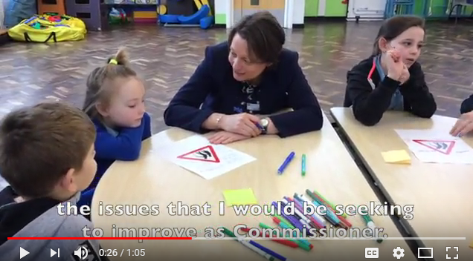
Fideo - Sut mae’r Comisiynydd yn dewis ei gwaith? (Recordiwyd yn 2018)
Video – How does the Commissioner set her work? (Recorded in 2018)
Notes:
When Sally Holland started her post in April 2015 she undertook a large scale survey “What next/Beth Nesa”.
The role of Commissioner is a 7 year post and Sally wanted to find out from children, young people and those that care for them and about them what they thought she should prioritise in her term.
The video shows how the Commissioner sets her work.
----------------------------------------------------------------------------------------------------------
Pan gychwynnodd Sally Holland yn ei swydd ym mis Ebrill 2015, cynhaliodd arolwg ar raddfa fawr, sef “Beth Nesa”.
Mae rôl y Comisiynydd yn swydd 7 mlynedd, ac roedd Sally eisiau cael gwybod gan blant, pobl ifanc a’r rhai sy’n gofalu ac sydd â gofal amdanyn nhw beth roedden nhw’n meddwl dylai hi flaenoriaethu yn ystod ei chyfnod yn y swydd.
Mae’r fideo yn dangos sut mae’r Comisiynydd yn cynllunio’i gwaith.

Slide 23
DIWEDD SESIWN 1
Erbyn hyn dylai fod gan y cyfranogwyr ddealltwriaeth o’r canlynol:
CCUHP
Rôl CPC
Yn y sesiwn nesaf byddwn ni’n edrych ar hawliau ar waith.
END OF SESSION 1
Participants should now have an understanding of:
UNCRC
Role of CCfW
In the next session we will explore rights in practice.
Notes:
This first session has covered an introduction to the UNCRC and the role of the CCfW in the next session we will look at her documents The Right Way or The Right Way to Education to explore how we can put rights into reality in our daily lives. Meanwhile, if you want more information please visit the website www.childcomwales.org.uk
-----------------------------------------------------------------------------------------------------------
Mae’r sesiwn gyntaf hon wedi rhoi cyflwyniad i CCUHP a rôl CPC. Yn y sesiwn nesaf byddwn ni’n edrych ar ei dogfennau Y Ffordd Gywir neu’r Ffordd Gywir i Addysg, er mwyn archwilio sut gallwn ni wireddu hawliau yn ein bywydau pob dydd. Yn y cyfamser, i gael rhagor o wybodaeth ewch i’r wefan www.complantcymru.org.uk

