Slide 1
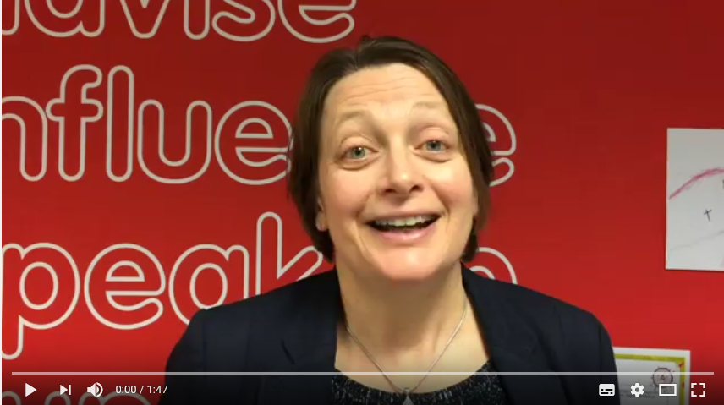
Student Ambassadors
Children’s Commissioner for Wales
Sally Holland
Notes:
Sally Holland is the Children’s Commissioner for Wales. She is the third children’s commissioner in Wales and has held the post since 2015. CLICK ON THE VIDEO and play the video to hear Sally explain her role.

Slide 2
It’s Sally’s job to:
Listen to what you have to say
Speak up about things that are important to you
Tell you about your rights
Help to make sure you get your rights
Talk to you if there is a problem
Notes:
Sally has five important jobs. Sally’s Student Ambassadors in Wales help her in this work throughout Wales!

Slide 3
Student Ambassadors help Sally by:
Raising awareness about rights
Informing people about the role of the Commissioner
Completing rights missions to inform Sally about young people’s experiences and opinions
Notes:
This is how the Student Ambassadors help Sally. All Student Ambassadors in Wales have these three jobs. Young people doing the Community Challenge for their key stage 4 Welsh Baccalaureate are also helping Sally by training other pupils about rights.

Slide 4
What are children’s and young people’s rights?
Notes:
We’re going to do a short activity to get thinking about rights.

Slide 5
What’s being experienced?
Notes:
Ask the audience to answer the question on the slide. What are these young people experiencing?
[You can write up their suggestions on a flip chart or board if you like]

Slide 6
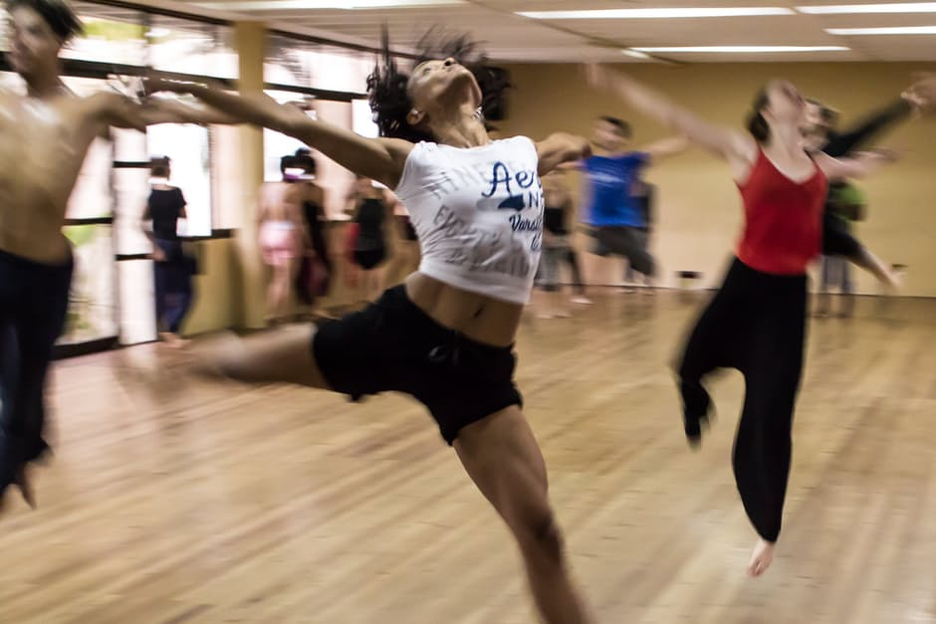
What’s being experienced?
Notes:
Repeat the activity

Slide 7
What’s being experienced?
Notes:
Repeat the activity

Slide 8
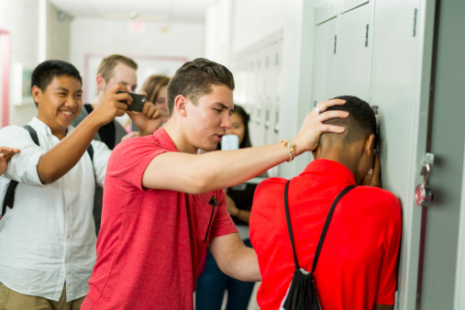
What is being taken away?
Notes:
Ask the audience to answer the question on the slide. What has been taken away from children and young people here?
[You can write up their suggestions on a flip chart or board if you like]

Slide 9
What is being taken away?
Notes:
Repeat the activity.

Slide 10
What is being taken away?
Notes:
Repeat the activity

Slide 11
Children’s Rights
These are the things every child and young person should experience to be happy, healthy and safe.
No child or young person should have these things taken away from them.
Notes:
We’ve discussed some of the things young people experienced in Wales and around the world. We’ve also looked at some of the things that are taken away from young people in Wales and around the world. Children’s rights are the things that all children should experience to be happy, healthy and safe. No child or young person should have these things taken away from them.

Slide 12
Notes:
This video shows how the United Nations and the different countries of the world developed the list of things that all children and young people need to be happy, healthy and safe. This is called the Convention on the Rights of the Child. CLICK ON THE PICTURE TO PLAY:
[Hyperlinked to http://www.uncrcletsgetitright.co.uk/index.php/training-materials/videos]

Slide 13
Getting Involved
You can support young peoples’ rights in Wales by helping your Student Ambassadors complete termly rights missions!
Notes:
In Wales you can help make sure that all children and young people experience their rights by getting involved with the Children’s Commissioner for Wales.
The simplest way to do this is to support your Student Ambassadors – find out who they are and how you can help them in their jobs.
[This is a good opportunity to inform your school the names of your Ambassadors and any current events / missions that you need help with]

Slide 14
Investigations and Advice
If you think you or a young person you know is being treated unfairly text us for free
80800*
*start your text message with com
Notes:
Sally can also help you if you think you are being treated unfairly. You can call on behalf of yourself or another young person and Sally and her team will investigate the situation to see if they can help. Any adult that is worried about a child can also call us on the same number.

Slide 15
Notes:
Sally can also help you if you think you are being treated unfairly.
CLICK ON THE VIDEO and it will explain how Sally’s office does this: https://youtu.be/GtBF5DgTajo
You can call Sally’s office if you are worried you are not getting your rights.
Any adult that is worried about a child can also call Sally’s office on the same number.

Slide 16
01792 765600
Children’s Commissioner for Wales
Oystermouth House
Phoenix Way
Llansamlet
Swansea, SA7 9FS
@childcomwales
Investigations and Advice Line
0808 8011000
01792 765600
Comisiynydd Plant Cymru
Ty Ystumllwynarth
Ffordd Ffenics
Llansamlet
Abertawe, SA7 9FS
@complantcymru
Llinell Cymorth a Chyngor
0808 8011000
Notes:
You can also contact the Children’s Commissioner in any of these ways.

Slide 17
For more UNCRC information and resources you can also visit Welsh Government website www.uncrcletsgetitright.co.uk/index.php/right
Let us know if you’ve shared this presentation by tweeting @childcomwales and using the hashtag #RightsHour

